Slide 1
New Age Materials

Slide 2
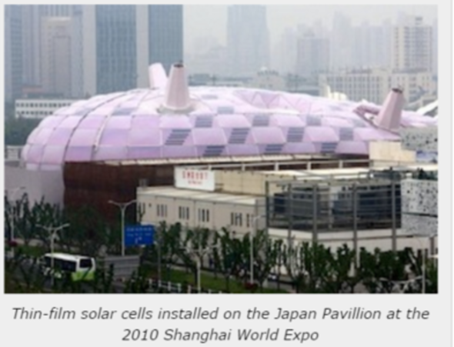
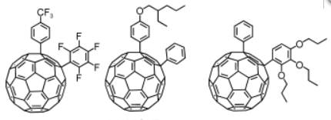
Bucky balls
Carbon fullerenes for superior efficiency in photovoltaic cells
Light, strong and cheap.
More efficient than silicon.
Can be moulded to fit building roof or caravan roof

Slide 3
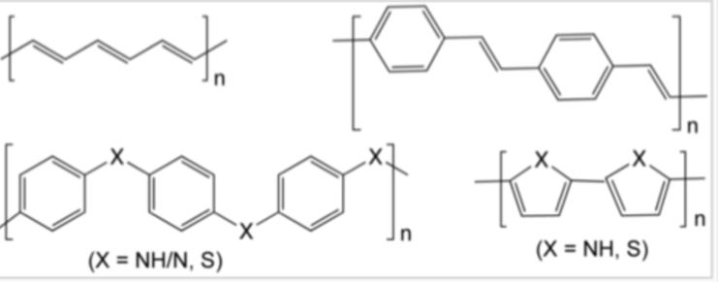
Conductive polymers
Example: polymer from acetylene
Don’t have to rely on heavy metals in electrical uses.
Used in light weight batteries

Slide 4
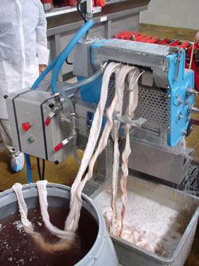
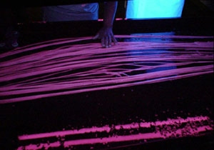
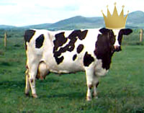
Gut tennis strings – from cow’s intestines
Superior elasticity to modern plastics

Slide 5
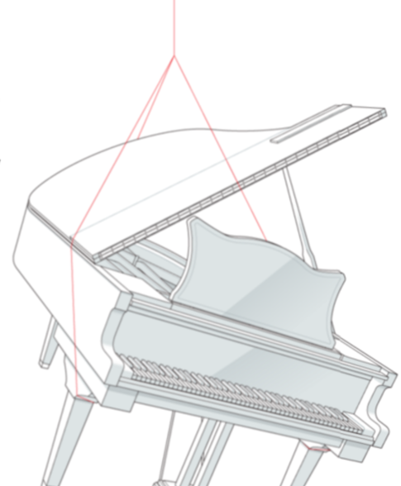
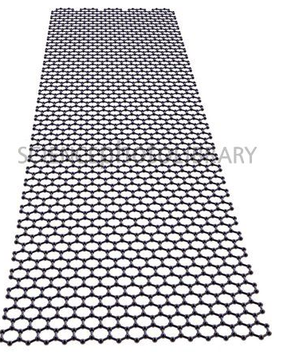
Graphene
Single layer of graphite ( carbon)
Extreme, lightweight strength and electrical conductivity.
One thin thread can support a piano

Slide 6
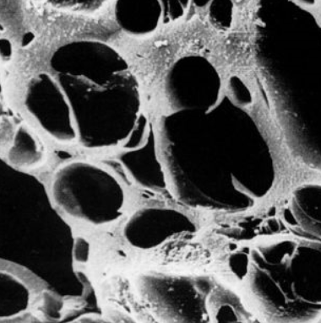
Activated charcoal
Charcoal expanded during heating with a gas to make it very porous
Absorb odours, absorb impurities from water, brown sugar or drug overdoses.
Reinforces rubber

Slide 7
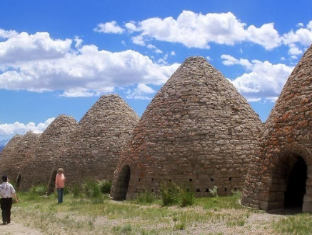
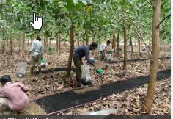
Biochar
Charcoal produced by burning organic matter in the absence of oxygen
Ovens used in the Middle Ages to smoulder organic products to produce biochar
Removes carbon dioxide from the air, acts as a fertilizer.

Slide 8
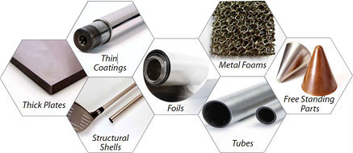
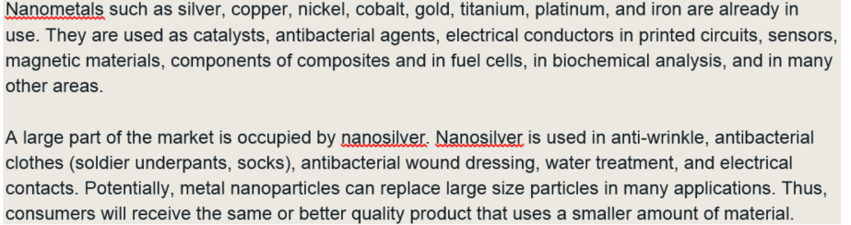
Nanometals
Superior properties than normal metals. Stronger, specialist applications.

Slide 9
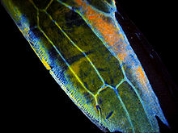
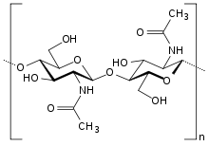
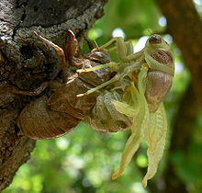
Chitin
Polymer of glucose, found in the shells and wings of beetles and crabs
Above: Close up of wing of a sap-beetle
Below: cicada emerging from chitin cocoon
Very strong natural material

