Slide 1
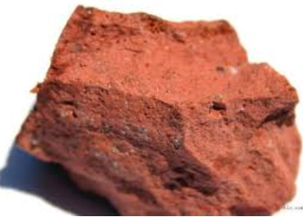
Alcoa Portland
Red bauxite rock – high concentration of aluminium

Slide 2
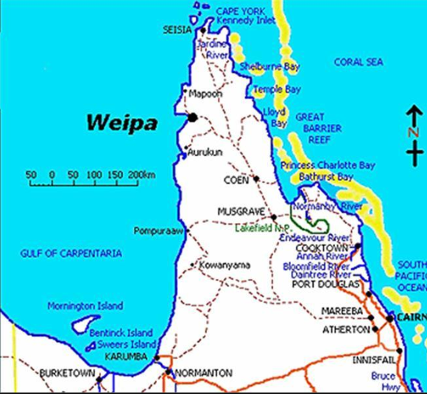
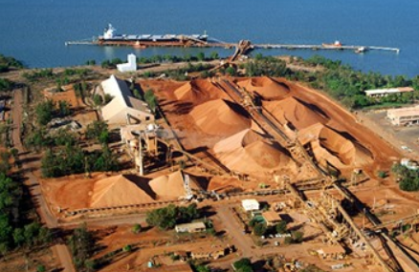
Mined in Weipa and taken by boat to Gladstone

Slide 3
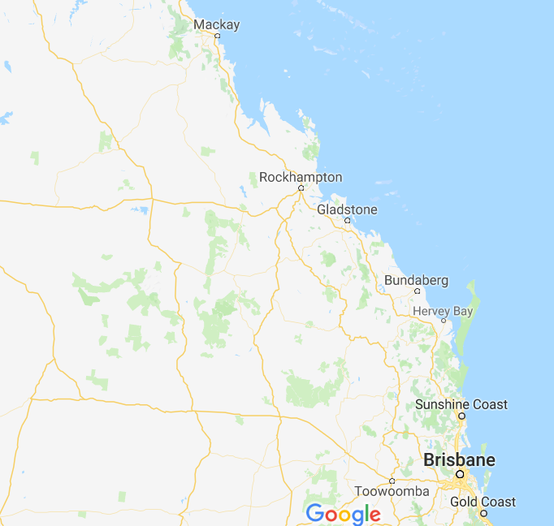
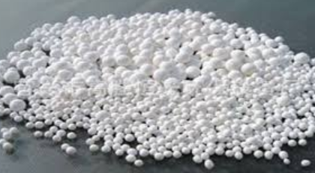
Gladstone:
port
good labour force
Concentrated to mainly alumina - Al₂O₃

Slide 4
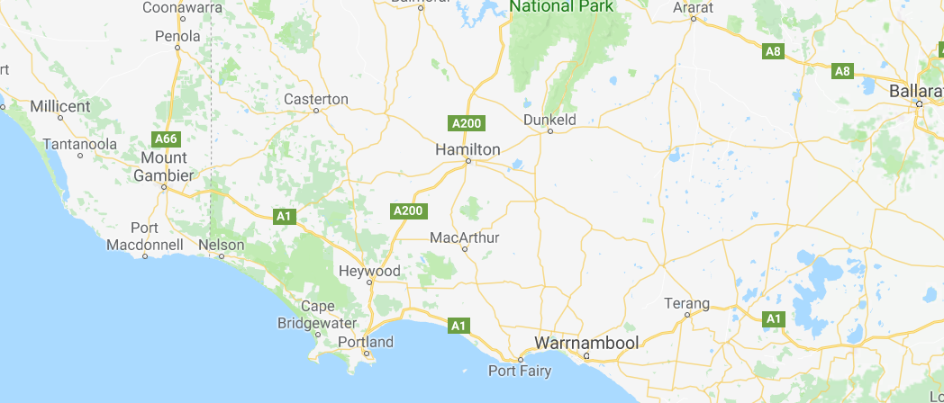
Back on a boat and taken to Portland

Slide 5
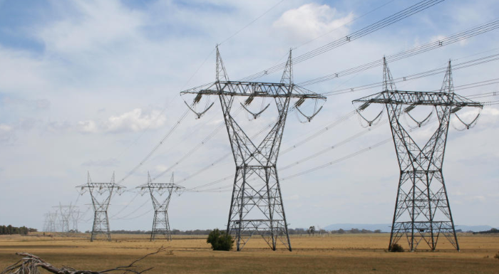
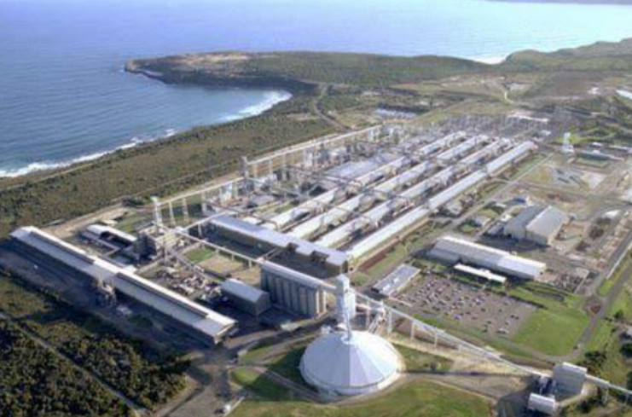
Electrolysis process required the establishment of a BIG power line across Victoria

Slide 6
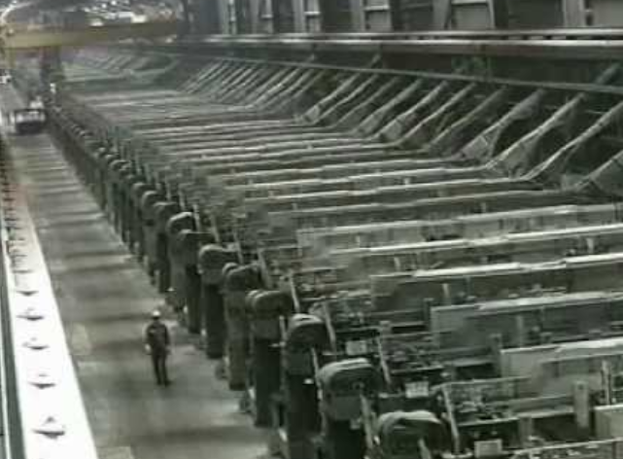
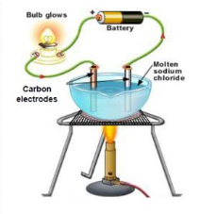
In the lab, a molten solution might be in a crucible – in this plant the molten solution takes up a mammoth warehouse

Slide 7
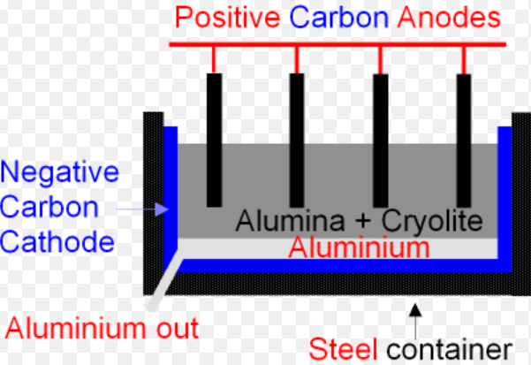
Al³⁺(l) + 3e⁻ → Al(l)
2O²⁻(l) + C(s) → CO₂(g) + 4e⁻

Slide 8
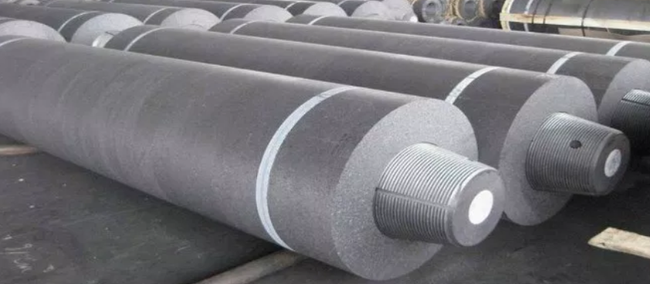
Carbon electrodes!

Slide 9
