Slide 1
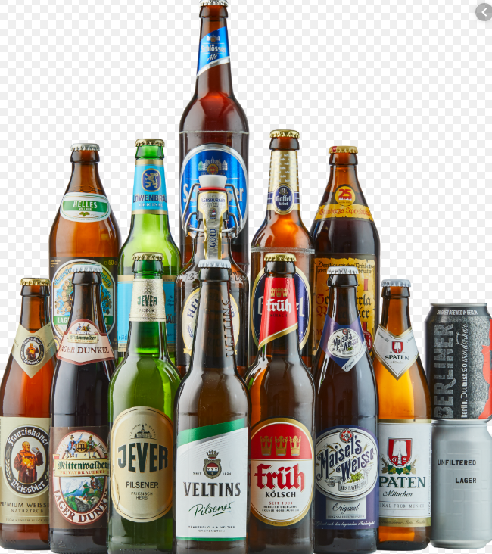
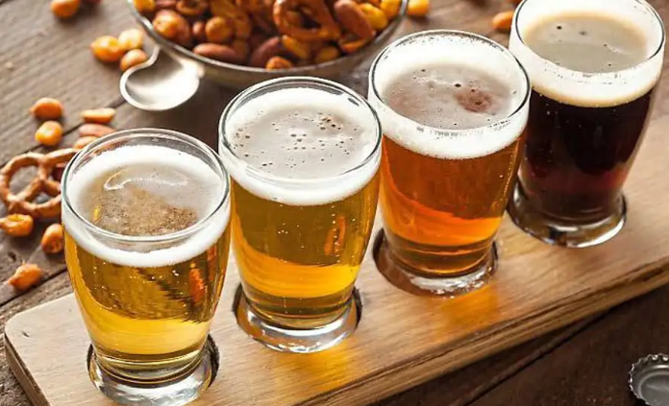
Beer
ethanol produced from fermentation of malt.

Slide 2
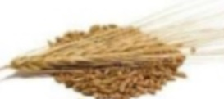
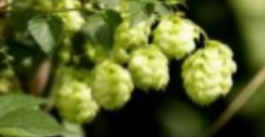
Raw materials
barley
hops
yeast
sugar
barley
hops

Slide 3
Brewing - start to finish

Slide 4
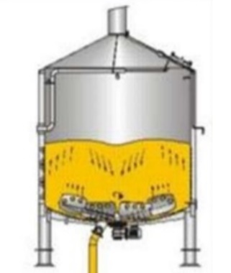
Milling and mashing:
Malt is crushed to help water absorption.
Enzymes (amylase) act to convert starch to sugars.
Husks removed to leave wort.
(The barley is crushed and soaked to produce sugars)

Slide 5
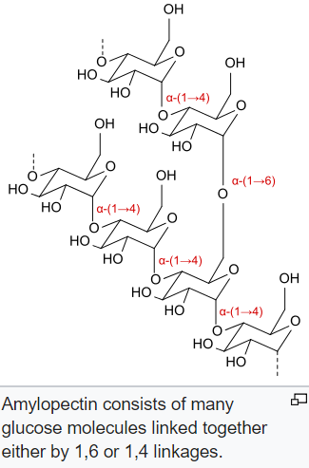
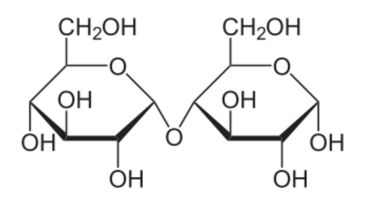
Amylopectin (starch)is a polysaccharide formed from glucose. Maltase can break the starch down to maltose disaccharide. The dissacharide will eventually be converted to ethanol.

Slide 6
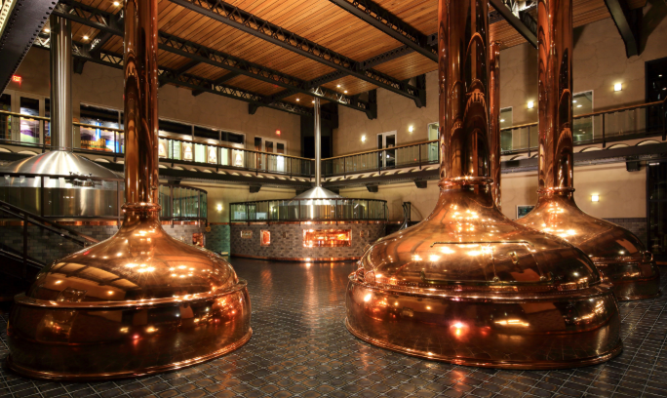
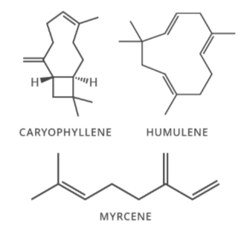
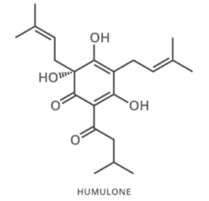
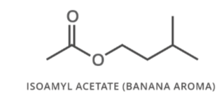
The mash is boiled with the flowers of the hops. The hops add
flavours (esters)
alpha acids and
essential oils.
ester
essential oil
Alpha acid (bitter)

Slide 7
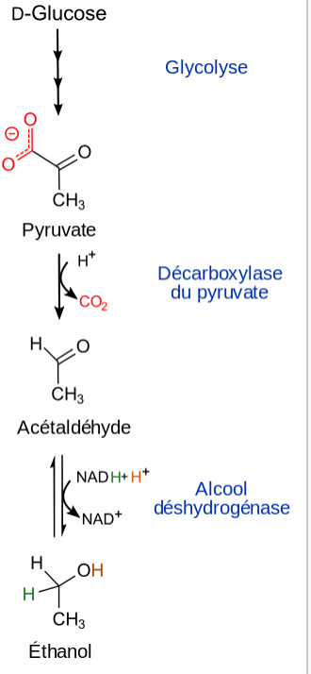
Fermentation
The wort is then cooled for fermentation. A simplified fermentation reaction is
yeast
C₆H₁₂O₆(aq) → 2C₂H₅OH(aq) + 2CO₂(g)
glucose ethanol carbon dioxide
The carbon dioxide produced provides the carbonation in beer when the pressure is released.
The beer manufacturer chooses different strategies to mature, age and sometimes filter the beer that has been formed.
Yeast is a catalyst.

Slide 8
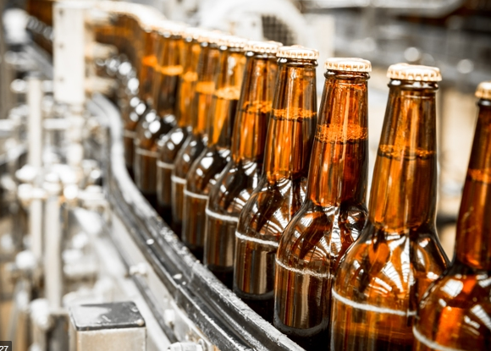

Slide 9
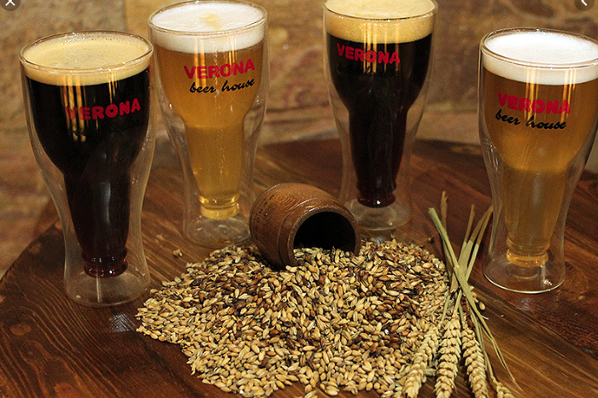

Slide 10
