Slide 1
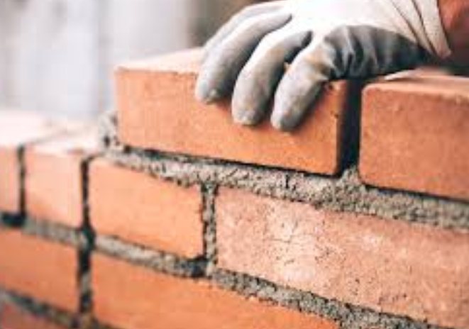
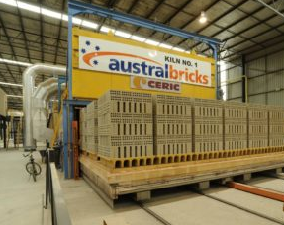
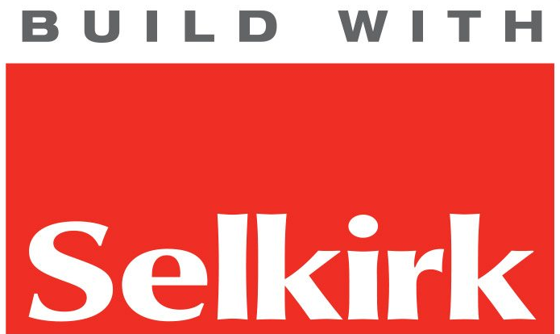
Bricks
Austral: Wollert
(north of Melbourne)
Selkirk: Ballarat

Slide 2
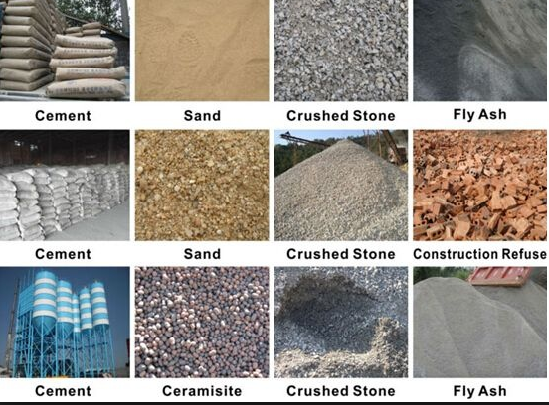
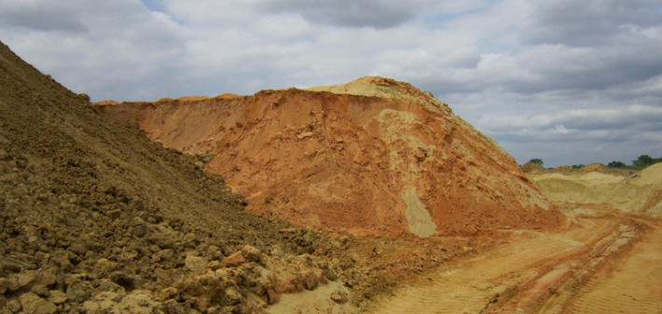
Raw materials
Sand, clay and crushed stone.

Slide 3
Raw materials
Typical composition:
sand (silica) 50 – 60%
clay (alumina) 20 - 30%
lime (CaO) 2- 5%
iron oxide 5%
magnesia < 1%
Typical formulas of sand -
Ca3SiO5 or CaO.SiO2
Typical formula of clay -
Ca3Al2O6

Slide 4
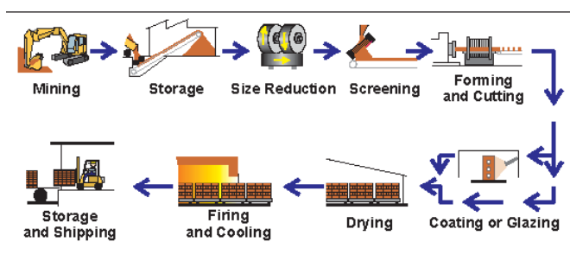
Brick making process

Slide 5
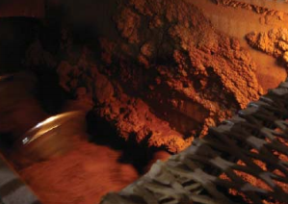
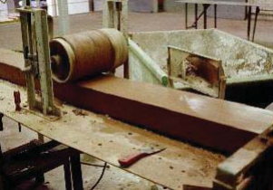
Raw materials crushed and made into a slurry in water.
Slurry is extruded as a rectangular column. This column will next be cut into individual bricks.

Slide 6
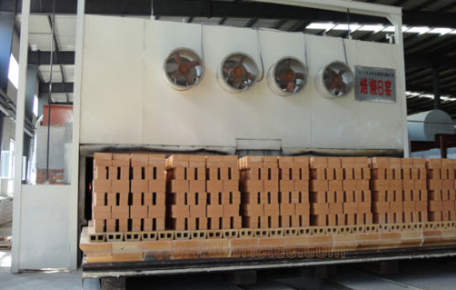
Bricks about to enter an oven to be ‘fired’.

Slide 7
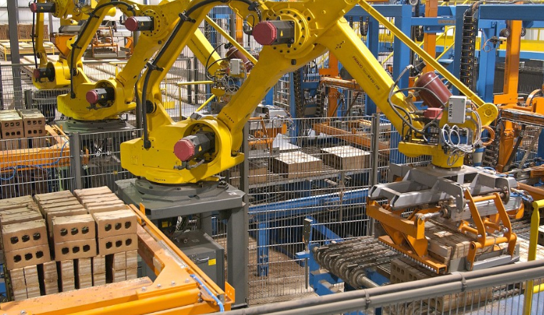
Very automated process.

Slide 8
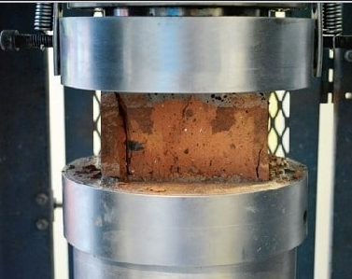
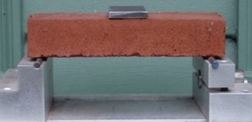
Quality control testing
Stress test
Compression test
Other tests:
hardness, colour, water absorption and efflorescence.

Slide 9
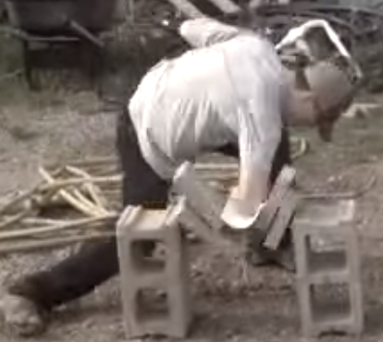
Some people like to conduct their own tests!

