Slide 1
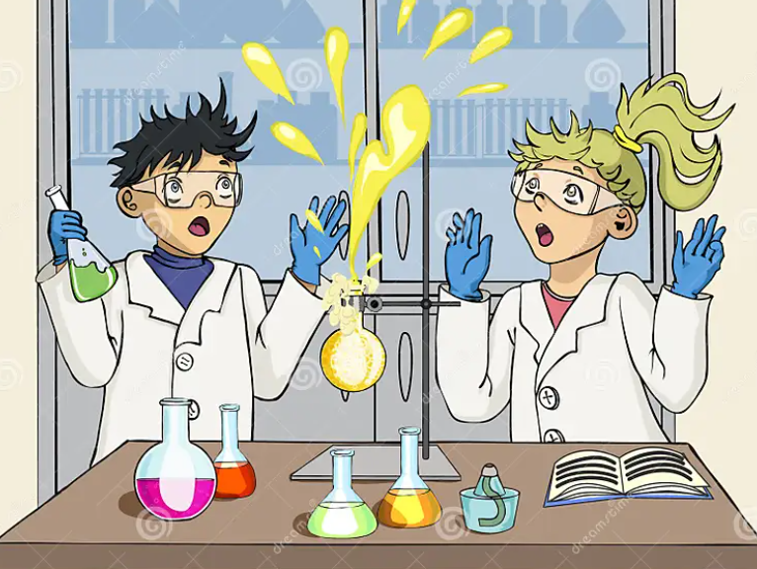
Errors and uncertainty
POShea

Slide 3
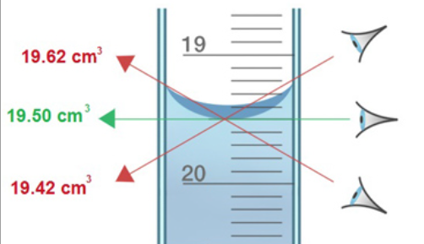
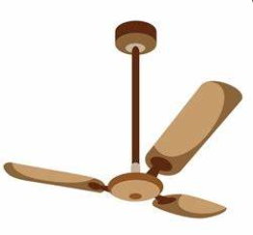
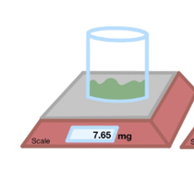
Random errors:
caused by factors that randomly affect measurements. Random errors lead to inconsistent measurements.
Observational – how you read your instruments or scales eg. holding a measuring cylinder up to read the scale.
Environmental: changes around experimental equipment eg. air conditioner turning off and on

Slide 4
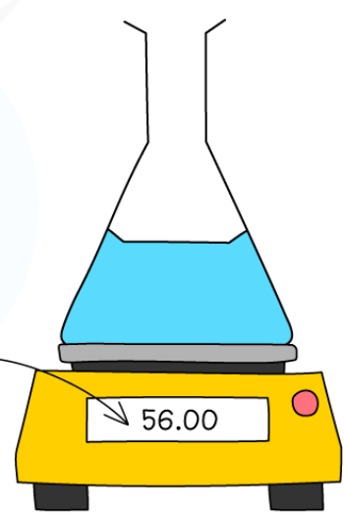
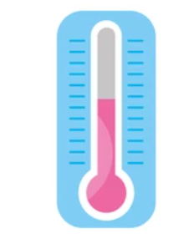
Systematic errors:
errors that occur in the same direction each time
Bubble in thermometer.
Balance not calibrated
Liquid evaporating from beaker

Slide 5
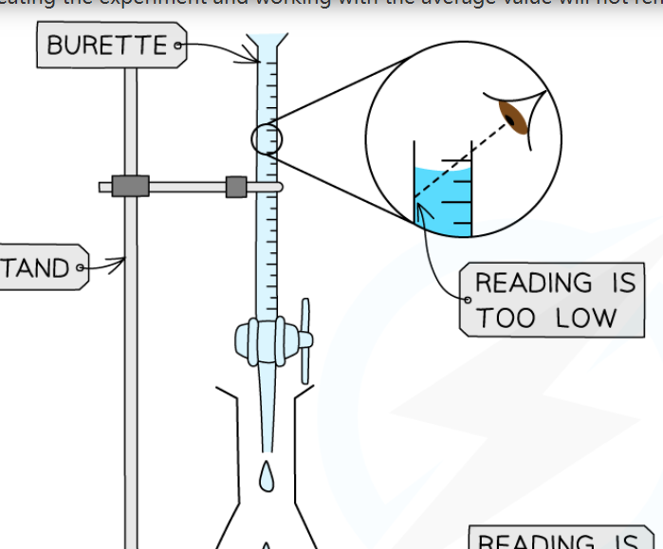
Systematic or random?
Reading from the same incorrect height each time is systematic but
Reading from varying heights is random – running multiple trials reduces the impact of random errors

Slide 6
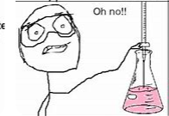
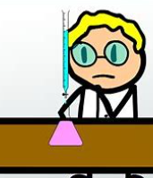
Accuracy and precision.
Precision – how consistent the results obtained are
Accurate – how close to a known value the results are
I got 1.22 M
I got 1.19 M
0.86 M
I got 1.21 M
These student results are precise but not accurate

Slide 7
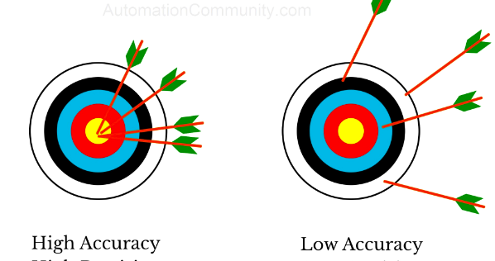

Slide 8
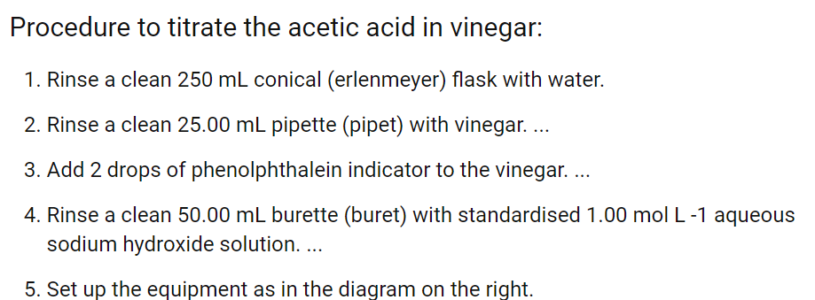
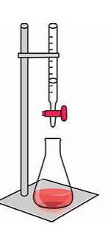
Repeatability
How close are my results each time I conduct this experiment?
Same person, same equipment, same procedure – how close are our results?
Are we confident about the result obtained?

Slide 9
Reproducibility
Can different experimenters get the same result following the same procedure using their equipment (different burette etc)?
Might be different location or different supplies of reagent
- ensures the validity of findings
0.83 M
0.84 M
0.83 M

Slide 10
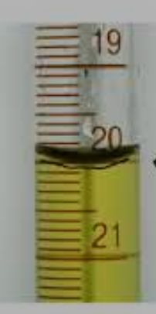
Resolution
Reading the scale of your equipment (ammeter, ruler, burette etc to judge the measured value.
The smallest change in the quantity that causes a noticeable change in the value indicated.
VCAA interpretation is: if the measurement scale on a 50 mL burette is at 0.1 mL intervals, the resolution of the burette is said to be 0.1 mL. In a titration, the user must estimate the volume between the two marked intervals on the burette so that the value reported will be to two decimal places. For example, measurement readings of 10.50 mL or 10.55 mL are possible, but a measurement reading of 10.53 mL cannot be claimed. The meniscus of the liquid will either be on the burette line marking, in which case the reading would be 10.50, or it will lie between 10.50 and 10.60, in which case it is measured as 10.55 mL.

Slide 11
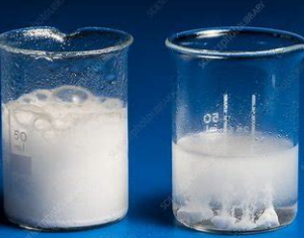
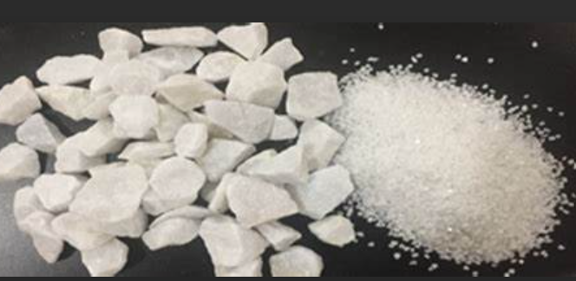
Validity
Does your experiment investigate what it claims to?
Design needs to be appropriate.
Implementation needs to follow stated procedure
Rate of reaction: Investigating impact of concentration on rate. Experiment is invalid if different concentrations use different sized particles.

