Slide 1
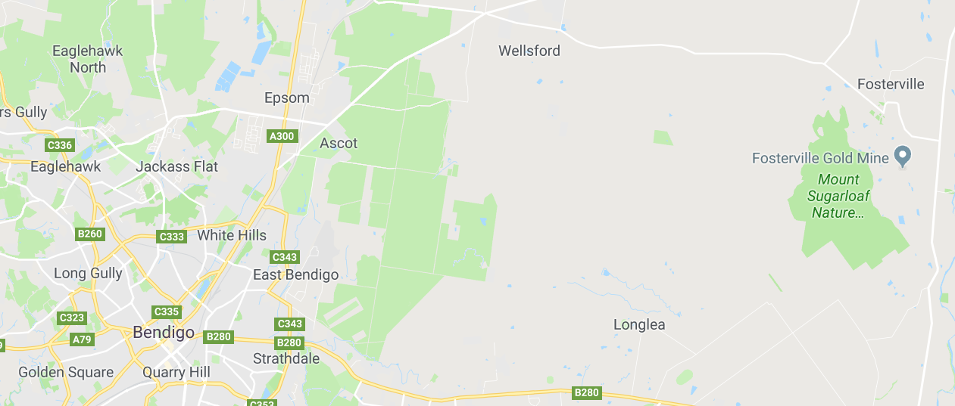
GOLD
There is a gold boom in Central Victoria, Fosterville east of Bendigo being the heart of the boom.

Slide 2
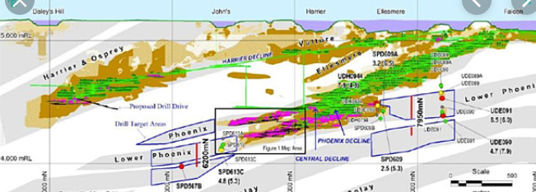
Gold is mined from seams, probably lava flows millions of years earlier.

Slide 3
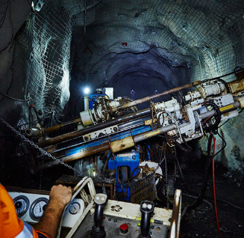
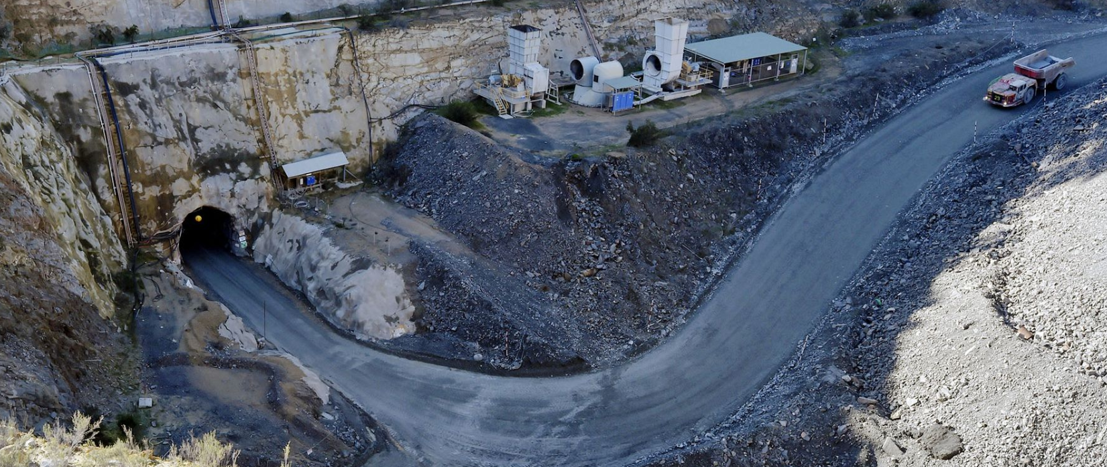
Some of Victoria’s mines extend over a kilometre below the surface.
The rock is drilled and carried to the surface for processing.

Slide 4
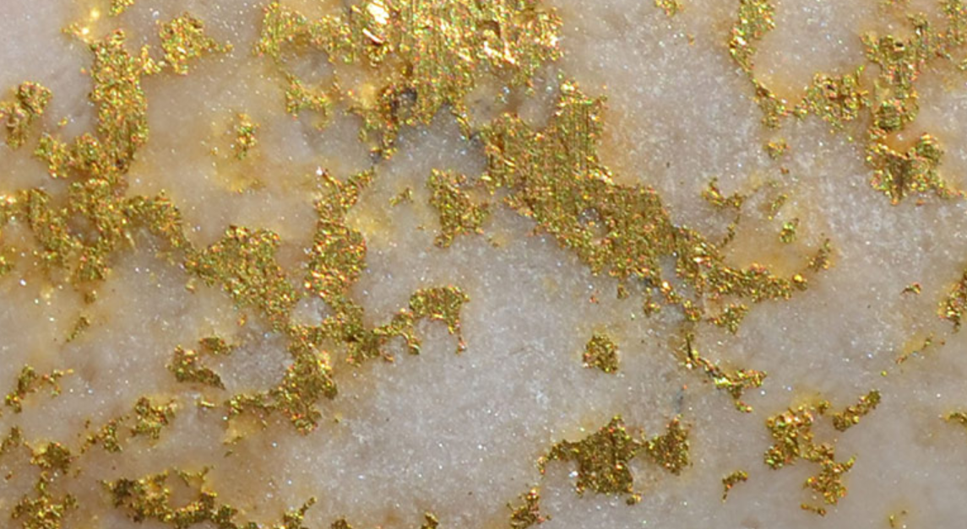
Obvious gold particles in white quartz.
Ore processing is in two phases – first the large particles of gold are separated, secondly the small particles are collected using chemical processes.

Slide 5
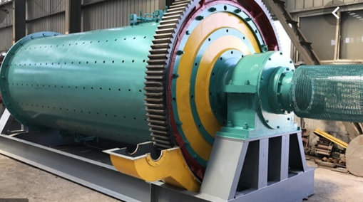
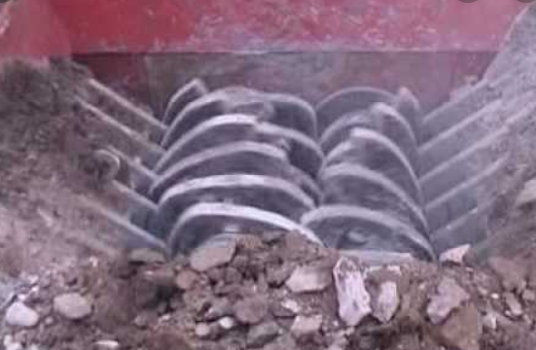
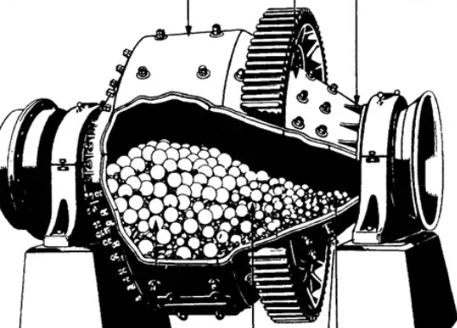
Ball mill: The ore is added to a cylinder containing steel balls. It is rotated at high speed and the balls break the ore particles.
The ore is crushed. It is easier to extract the gold if some of the other rock has been removed.
Crusher

Slide 6
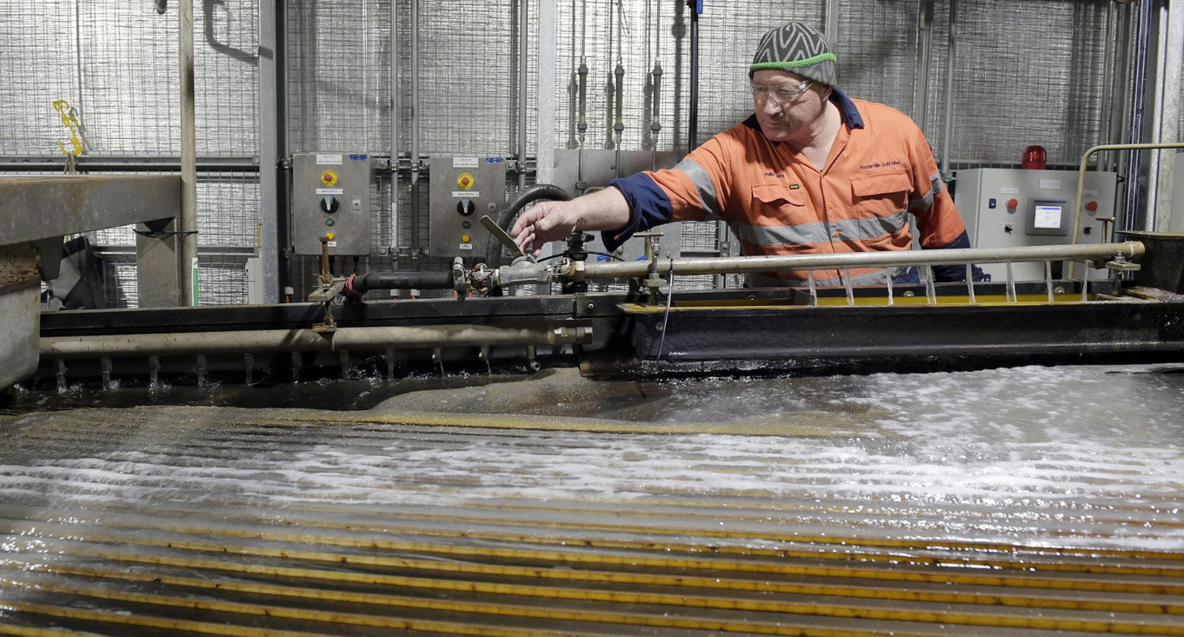
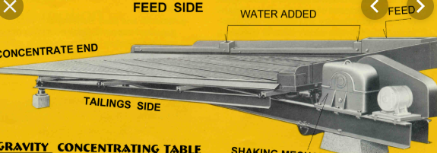
Gravity shaking tables
The density of gold is 19.3 g cm-3.
This is far denser than normal rock. The ore is washed over the shaking table and the heavy gold particles collect in the grooves.

Slide 7
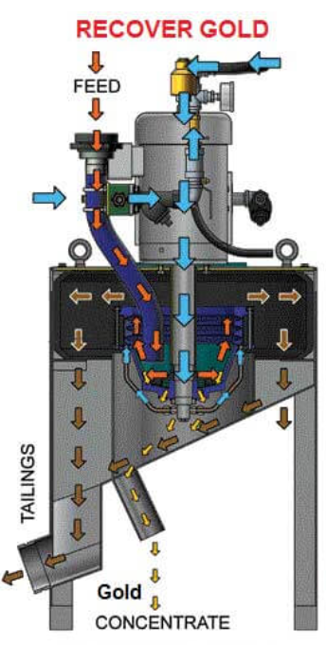
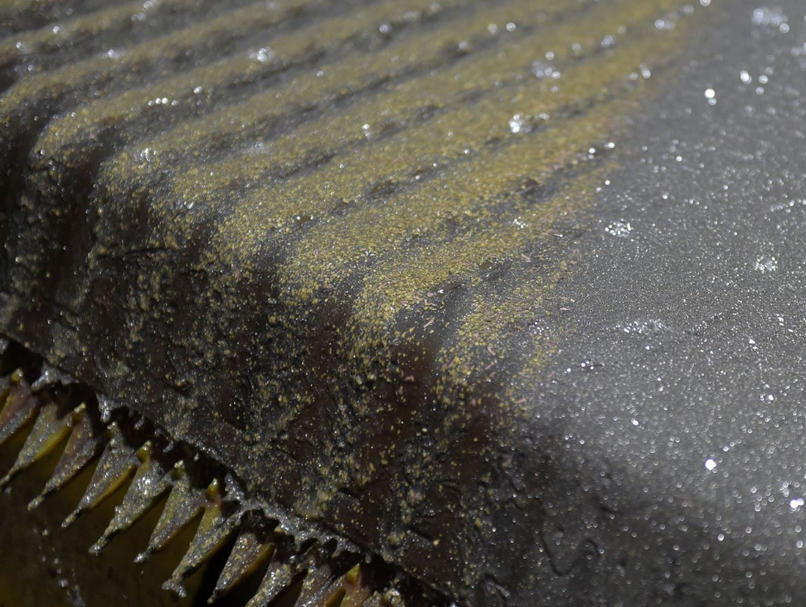
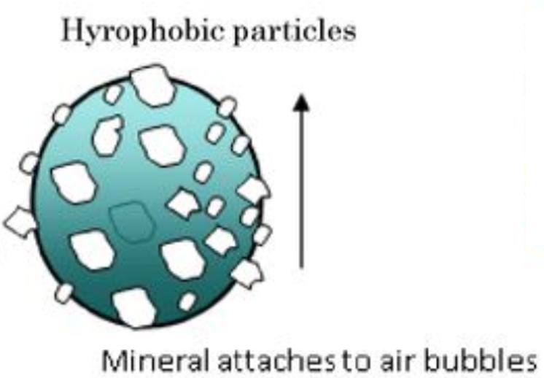
FLOTATION
Air is pumped into the slurry. Gold particles attach to the air bubbles and are lifted out of the mix. Surfactants are added to make gold hydrophobic.
Gold particles flowing over the top of the tank.

Slide 8
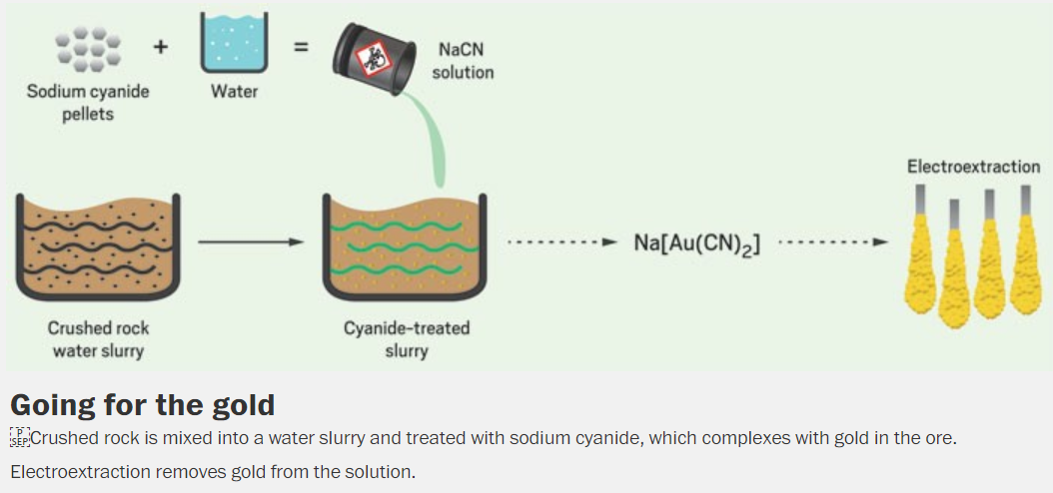
Cyanidation
Simplistically, gold is converted to gold ions that form a complex with cyanide ions. The complex is separated by adsorption on activated charcoal. Zinc is added to precipitate gold.

Slide 9
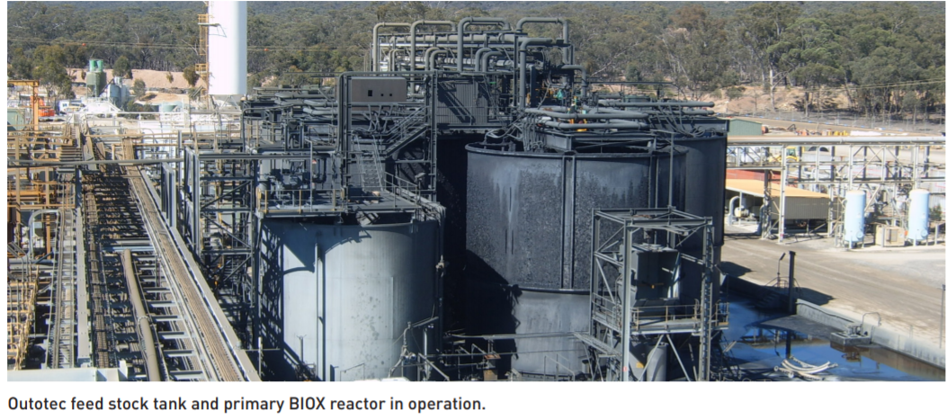
BIOX (Biological oxidation)
Fosterville uses a BIOX program where bacteria oxidise low solubility sulfide ores to high solubility sulfate ions. The efficiency of the cyanidation is improved this way

Slide 10
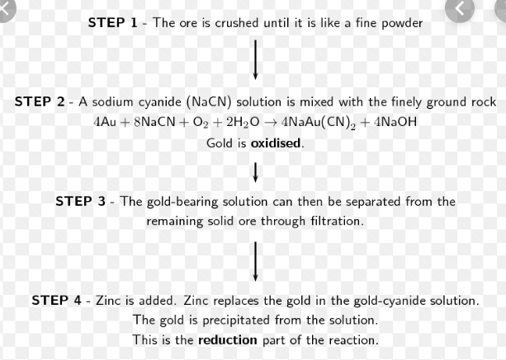
Cyanide complex:

Slide 11
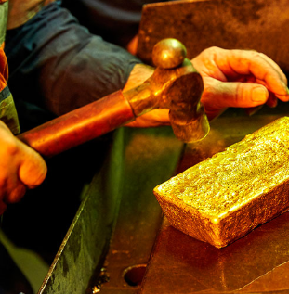
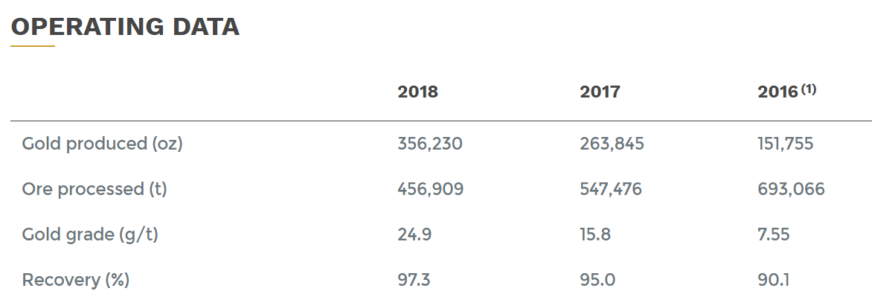
Gold bullion!
The table below shows the increasing yields at Fosterville

