Slide 1
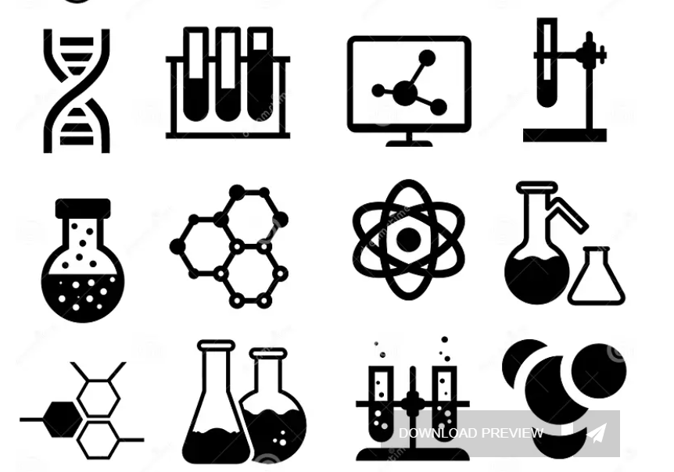
Green Chemistry

Slide 2
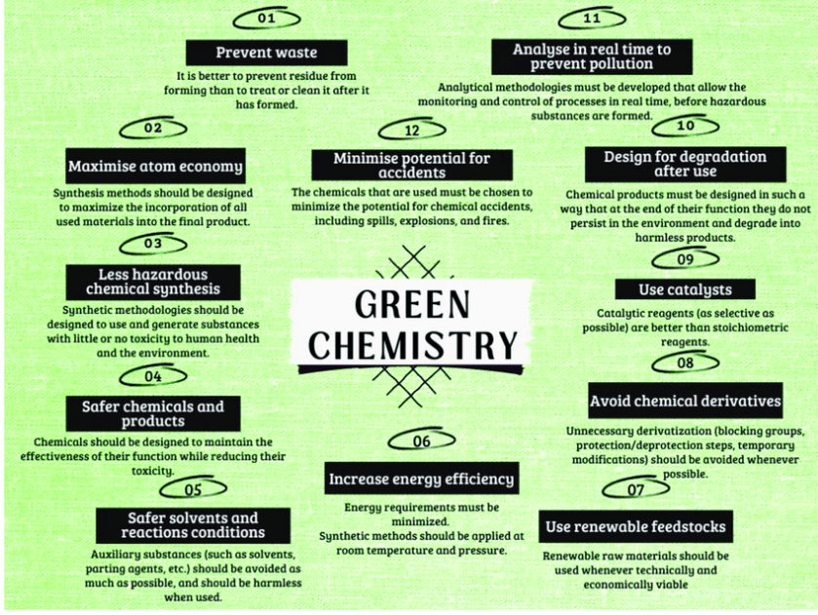

Slide 3
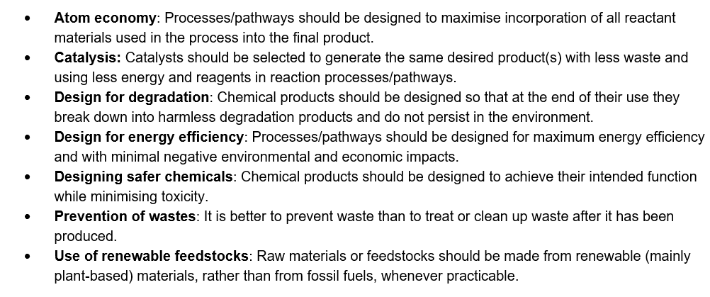
VCAA listed

Slide 4

Designing safer chemicals
Ex. Dry cleaning industry
Was once carbon tetrachloride but ..

Slide 5
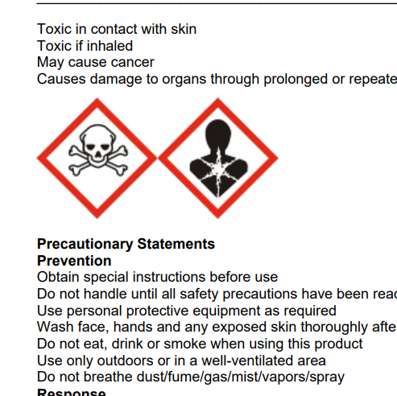
This was not good for Krista’s life expectancy!

Slide 6
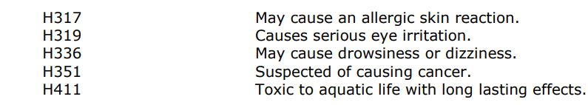
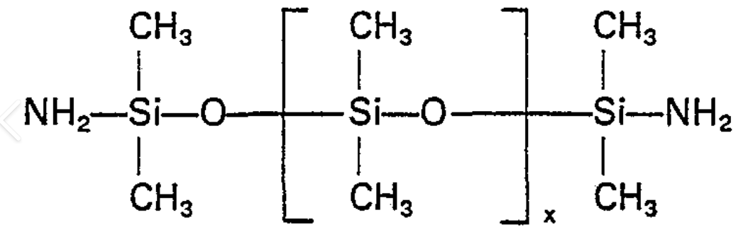
Replaced firstly with ‘perc’ – tetrachloroethene
but still of concern
but now with a much safer product – siloxane.
Extremely gentle.
So gentle, in fact, that it’s been used for decades as a base ingredient in many personal care products you drip into your eyes and rub into your skin on a daily basis. Such as shampoos, antiperspirants, deodorants and moisturizing creams. Even lipsticks.

Slide 7
Catalyst- less energy and waste to make the same product
Example: Manufacture of ethene – the most used organic chemical in the world. This is a very tricky reversible reaction – at low temperatures very low conversion occurs (endothermic)
Requires very high temperatures to improve conversion but this leads to unwanted side reactions.

Slide 8
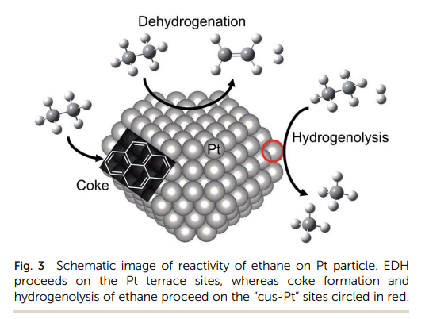
Bring in a platinum catalyst – high surface activity of platinum

Slide 9
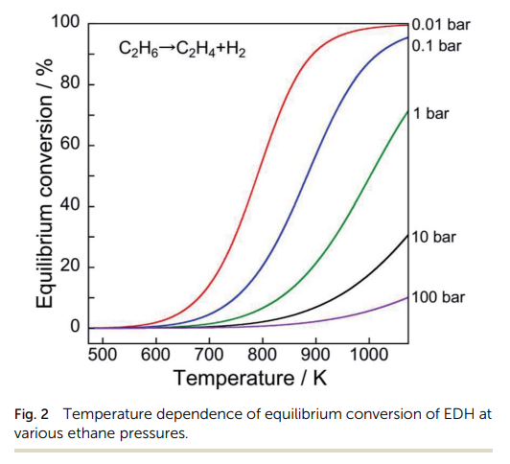
Reaction can now operate at 900 K, rather than 1100, higher % conversion
=> energy saved, less waste

Slide 10
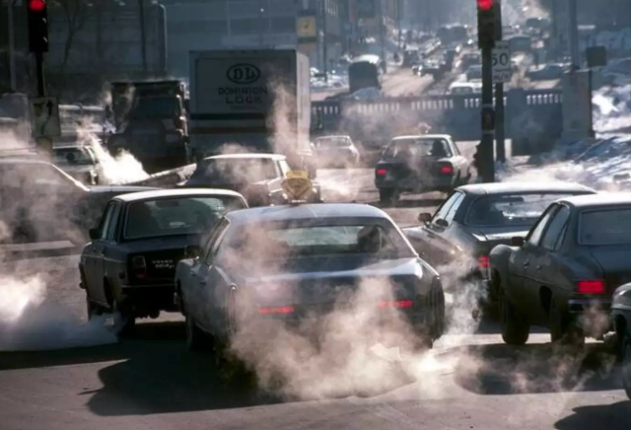
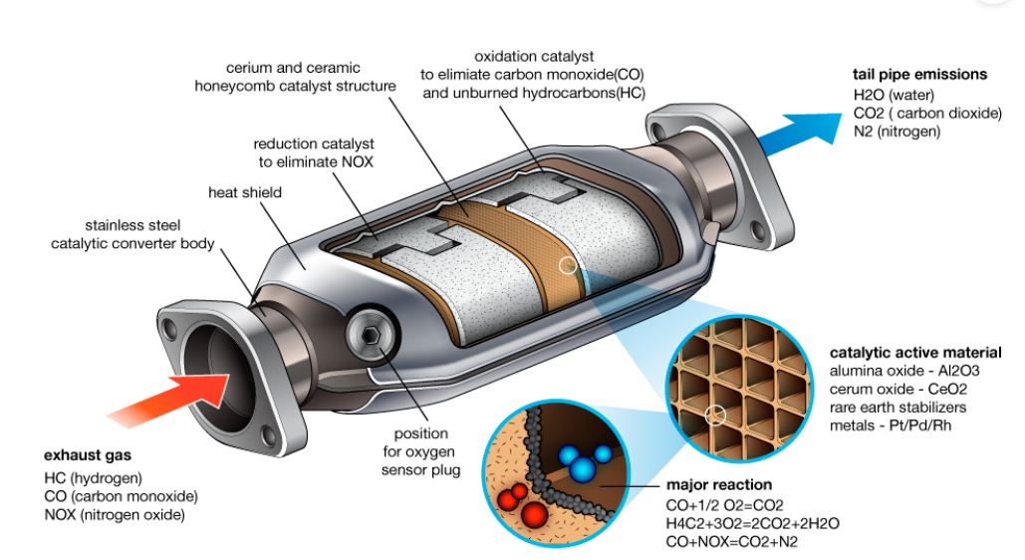
Catalyst added to car exhaust system

Slide 11
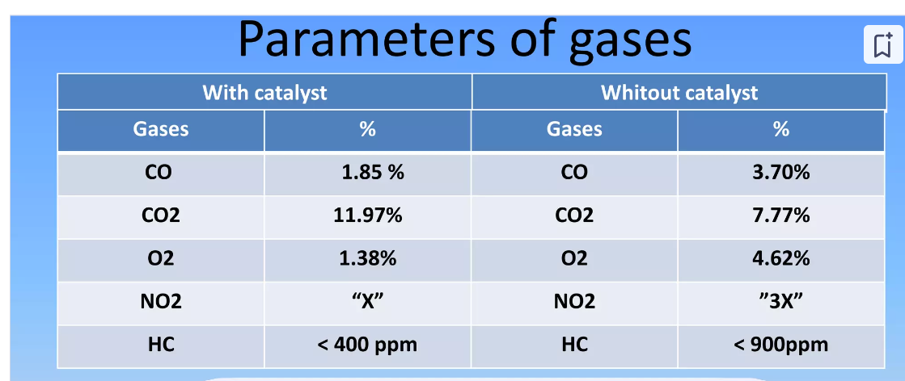
Less toxic emissions

Slide 12
Atom economy – the products need to include as high a percentage of reactant as possible – not wasting chemicals
Example: making ethanol from chloroethane produces KCl – what to do with that?
Atom economy = M(ethanol)x 100/(M(chloroethane) + M(KOH)) = 4600/120.6 = 38%
Making ethanol from addition reaction on ethene uses every reactant atom => 100% atom economy

Slide 13
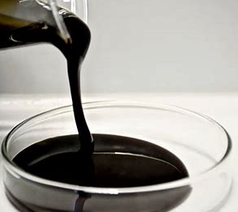

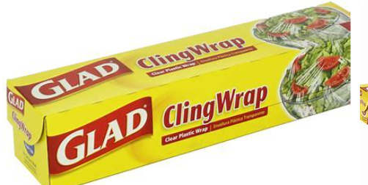

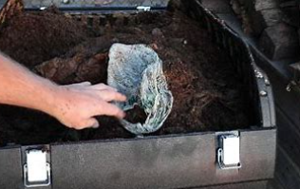
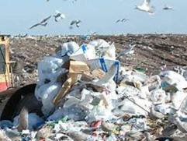
Renewable feedstock
Seaweed vs oil
Compost wrap vs normal
Compost vs landfill

Slide 14
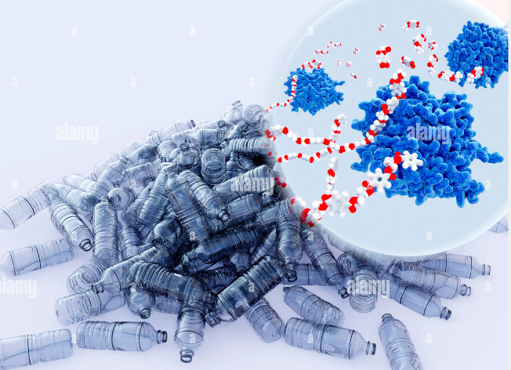
Design for degradation
PET incorporating PETase – will break down

Slide 15
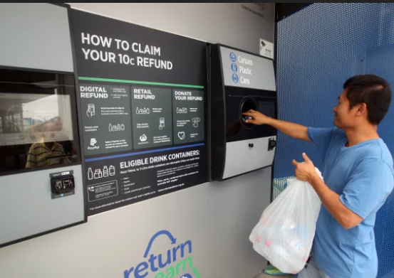
Prevention of waste

Slide 16

Design for energy efficiency

