Slide 1
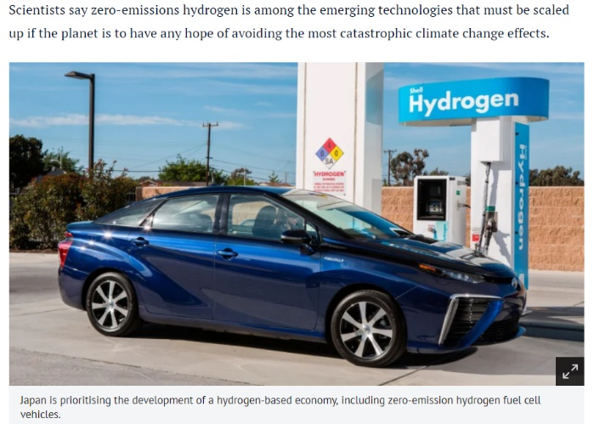
Hydrogen: Fuel
Proposal:
Use hydrogen gas as a fuel. It has a high energy density and the only product when it burns is water.
2H₂(g) + O₂(g) → 2H₂O(l)
ΔH = -282 kJ mol⁻¹
© POShea

Slide 2
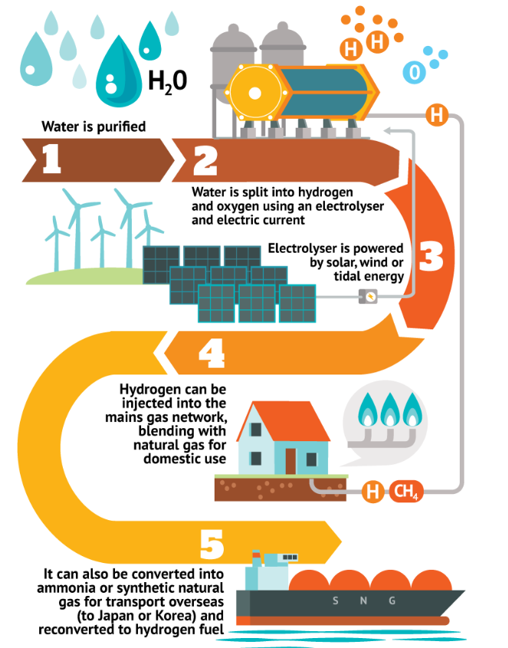
Generate hydrogen
Blend it with natural gas
Use it in vehicles
Export it.

Slide 3
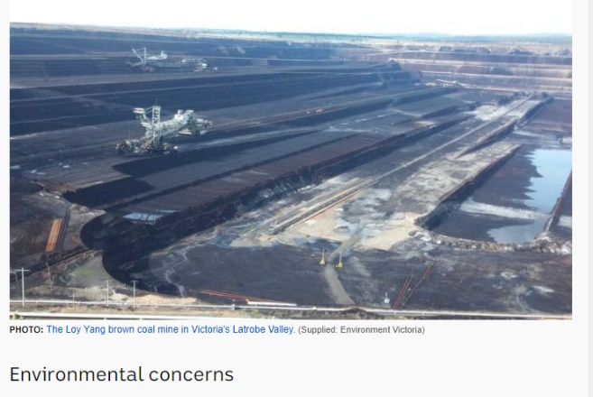
Question:
How to source hydrogen?
Latrobe Valley trial: hydrogen from coal using steam reforming.
CH₄(g) + H₂O(g) → CO(g) + 3H₂(g)
CO(g) + H₂O(l) → CO₂(g) + H₂(g)
Problem: produces CO₂

Slide 4
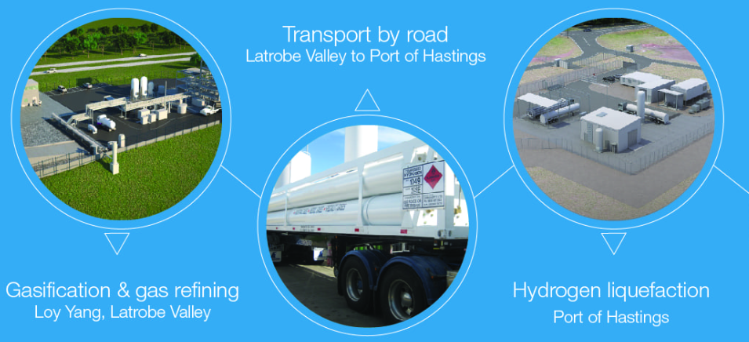
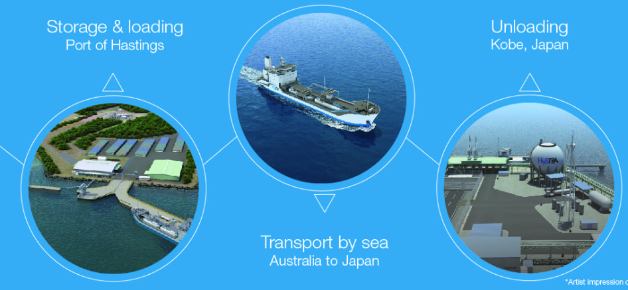

Slide 5
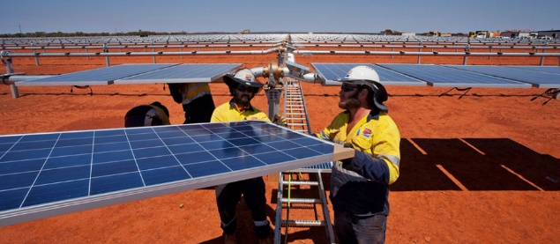
Solar option
WA trial. Electrolysis of water using solar array.
2H₂O(l) → 2H₂(g) + O₂(g) Pollution free
Supply of water and electricity required.

Slide 6
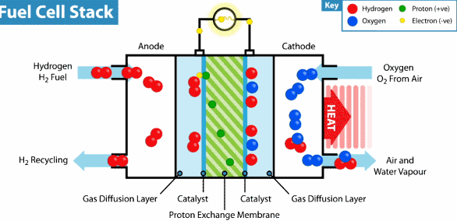
Hydrogen fuel cell:
generating electricity from hydrogen
Expensive: high tech porous electrodes
Anode: 2H₂(g) → 2H⁺(aq) + 2e
Cathode: O₂(g) + 4H⁺(aq) + 4e → 2H₂O(l)
Overall: 2H₂(g) + O₂(g) → 2H₂O(l)

Slide 7
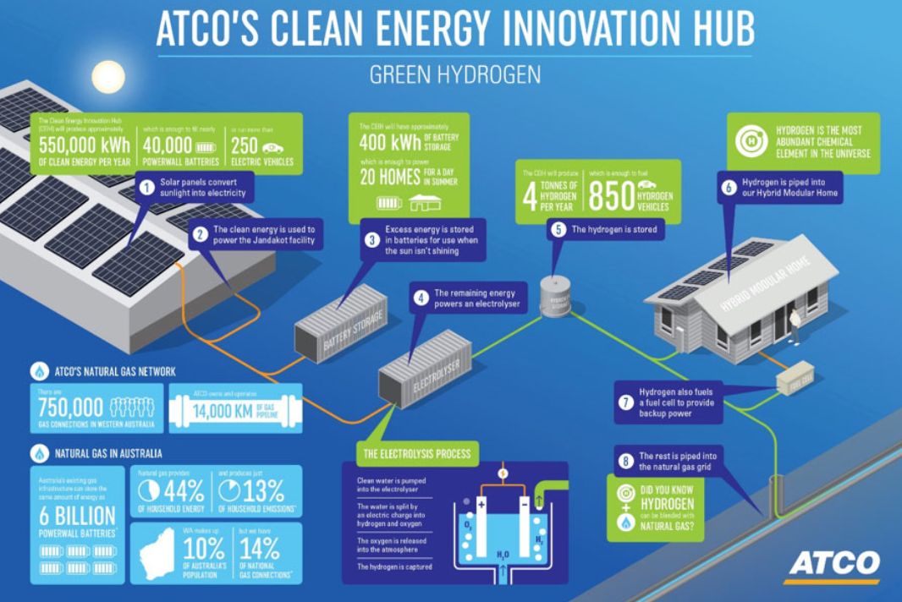
Adelaide trial: water to hydrogen. Hydrogen blended with natural gas to be used in surrounding homes.

Slide 8
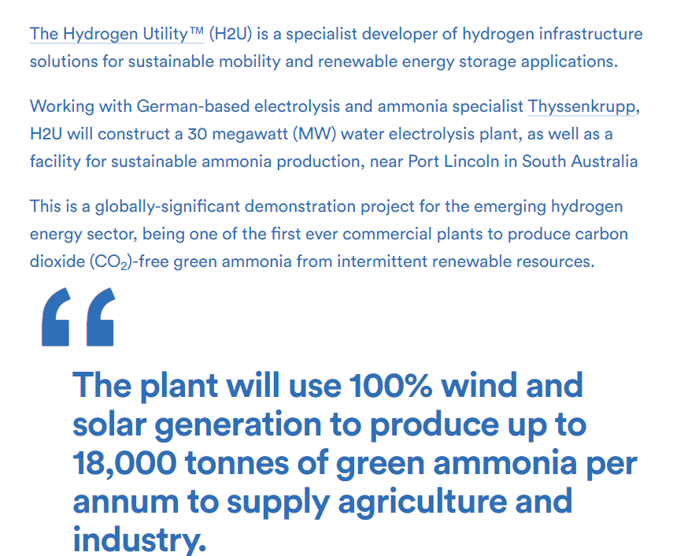
South Australian trial:
convert hydrogen to ammonia for fertiliser or as a safe means of transport.

Slide 9
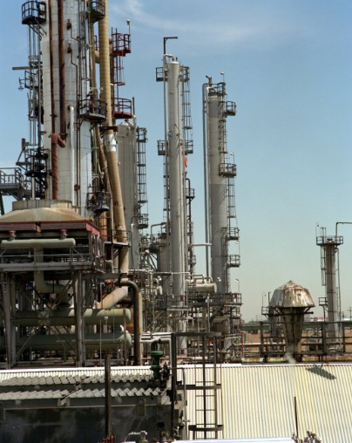
Ammonia production
N2(g) + 3H2(g) ⇌ 2NH3(g)
This is the Haber process.

Slide 10
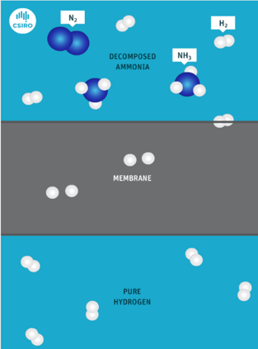
N2(g) + 3H2(g) ⇌ 2NH3(g)
The above reaction is reversed once ammonia has been transported.
CSIRO has invented a membrane to absorb hydrogen gas. As stated by Le Chatelier, removing hydrogen will favour the reverse reaction.

