Slide 1
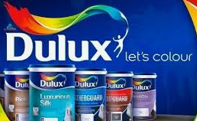
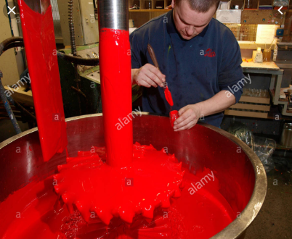
Paint Industry
Dulux: Dandenong Haymes: Ballarat

Slide 2
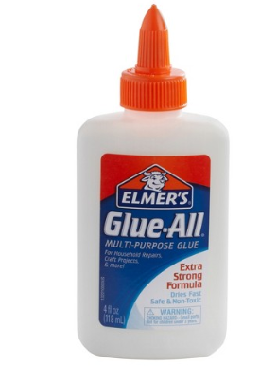
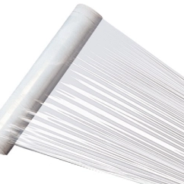
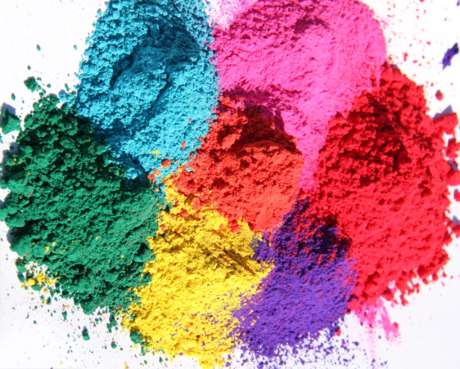
What is paint?
Paint is like a plastic film with added pigments so you cannot see through it and adhesives to make it stick to a surface.

Slide 3
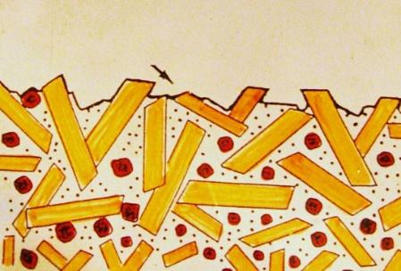
Microscopic view of paint film.
The pigment is embedded in the plastic film. The paint sets as the solvent in it evaporates.

Slide 4
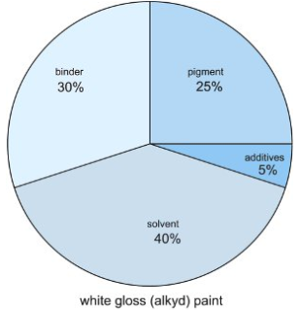
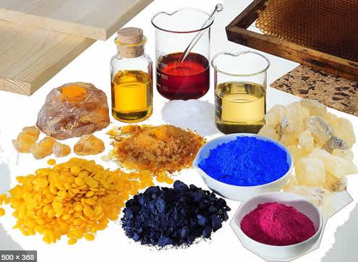
Ingredients
Binder: oil or acrylate polymer
Pigment: colour and body
Solvent: water or oil
Extender: titanium dioxide, talc, etc
Other: surfactant, fungicide, adhesive

Slide 5
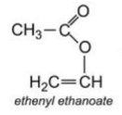
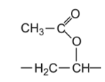
Acrylic paint (common paint!)
Monomer is methyl methacrylate (ethenyl ethanoate).
Note the C = C double bond to allow addition polymerisation.
Polymer is polymethyl methacrylate, also known as Perspex.
This is an emulsion polymer as the polymer is held in a solvent emulsion. As the solvent evaporates the polymer sets with pigment trapped.

Slide 6
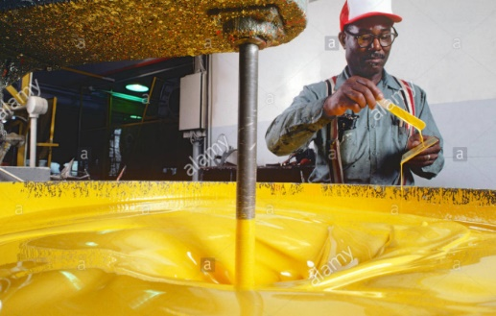
Paints need to be mixed for long periods to disperse the pigments evenly in the viscous liquid.
https://www.youtube.com/watch?v=1xpX7uyxRXo

Slide 7
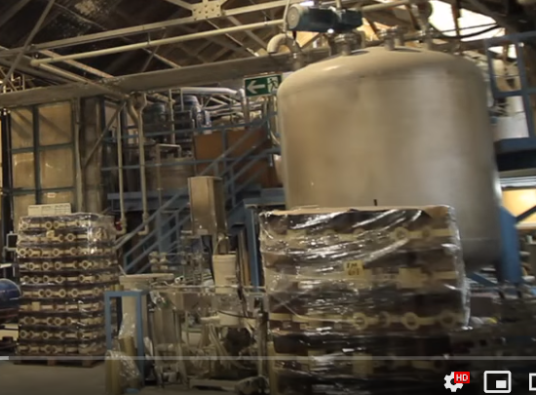
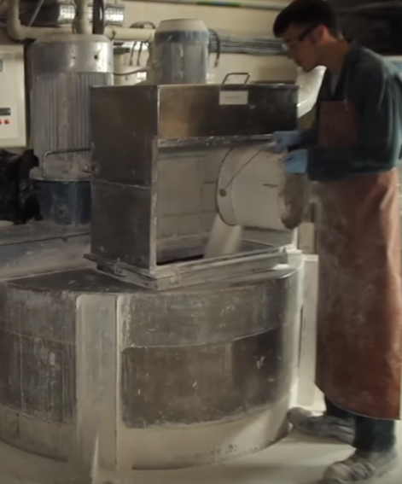
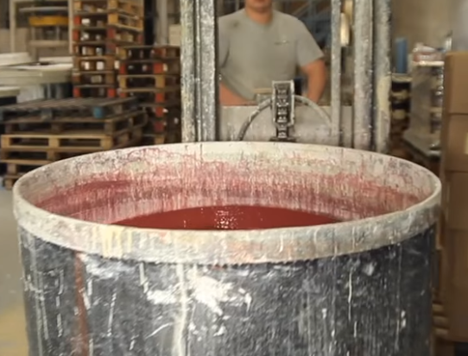
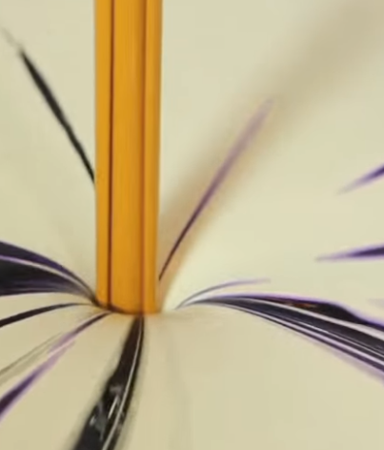
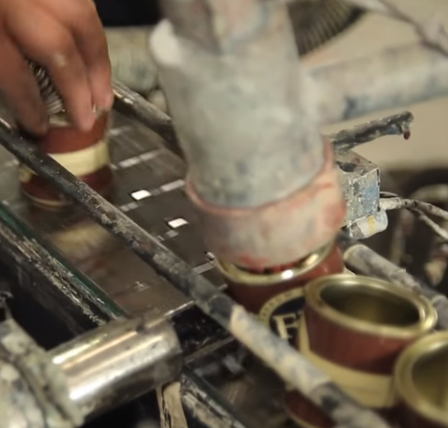
Factory floor: Ingredients measured, mixed, pigments added and product canned.
https://www.youtube.com/watch?v=4VYb_7D9XMA

Slide 8
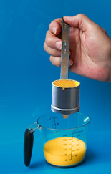
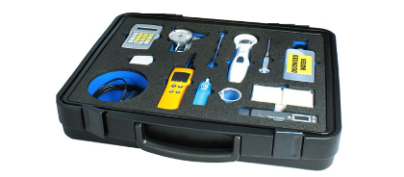
Quality control:
Viscosity testing: A mechanical stirrer measures the resistance to flow.
Testing devices for abrasion resistance and light resistance.

Slide 9
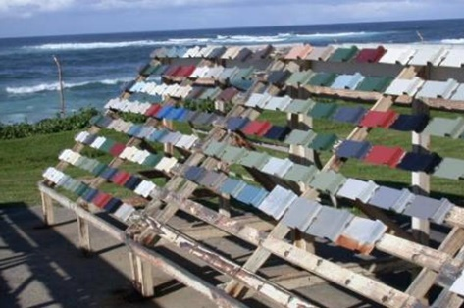
Weather testing. Samples are exposed to severe climate extremes to test their aging properties.

