Slide 1
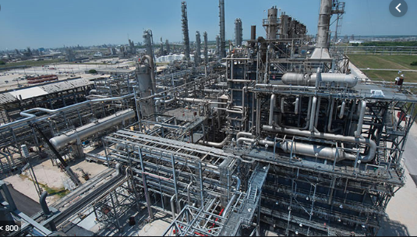
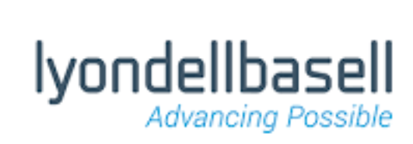
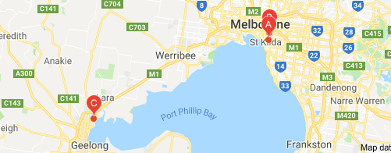
Polypropene
(Polypropylene)
© POShea

Slide 2
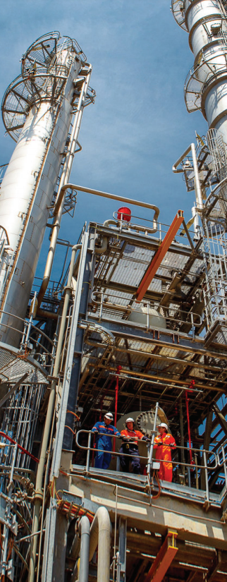
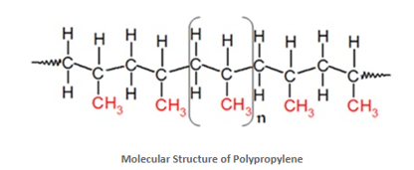
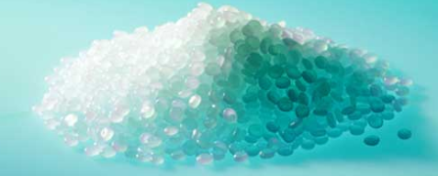
Propene reacts with itself to form polypropene.
Addition polymerisation.
Polymer pellets – ready for moulding.

Slide 3
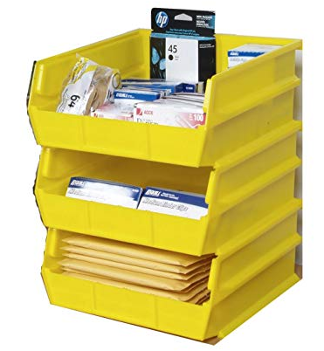
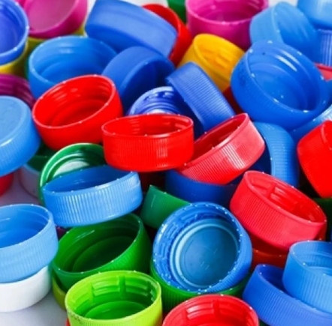
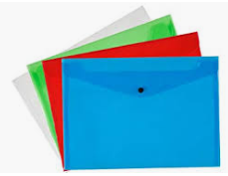
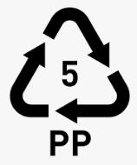
Polypropene items: Cheaper polymer with superior toughness and melting point to polyethene.
Identified as recycle code 5.

Slide 4
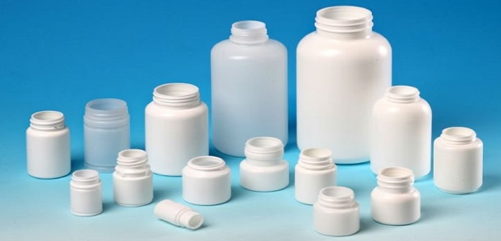
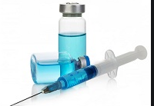
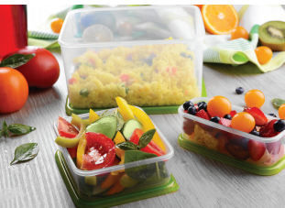
Many medical packaging uses.
Also used for
Carpet and rugs: durable, colourfast fibres
Microwave food containers, plates and kitchen items: oil and bacteria resistance
Luggage: backpacks, suitcases and shopping bags

Slide 5
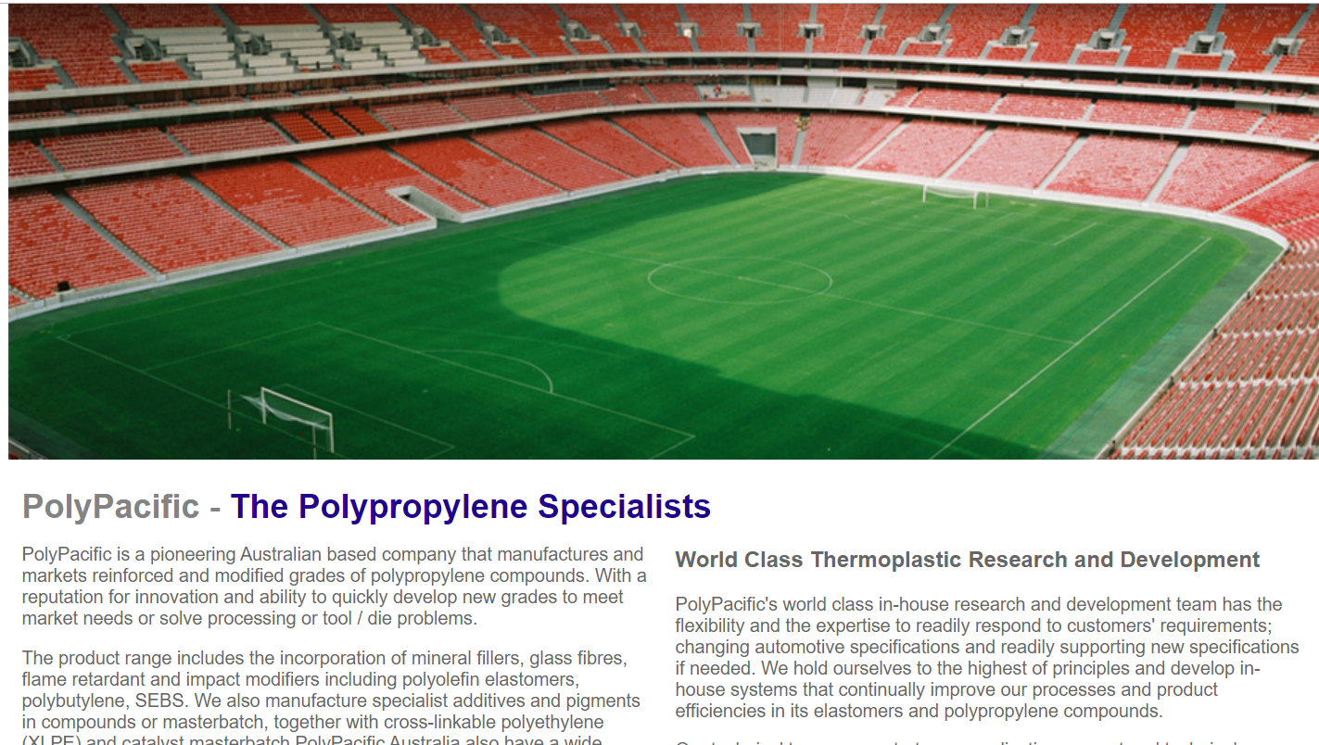
Playing surface and seats both made from polypropene.

Slide 6
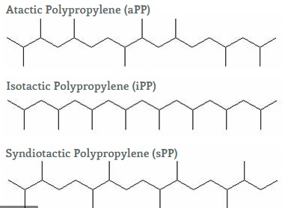
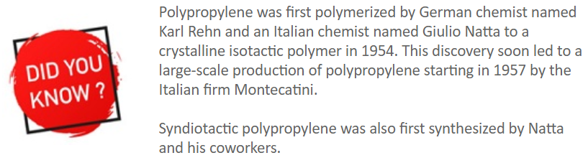
Polypropene variations
The properties will differ depending upon how the methyl side chains orient.

Slide 7
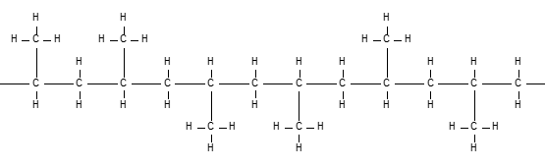
Atactic
Methyl groups are randomly positioned on either side of the chain.

Slide 8
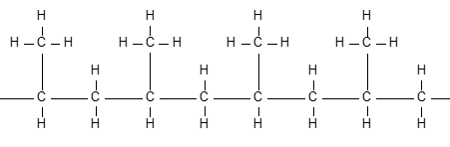
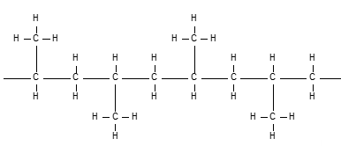
Syndotactic
Methyl groups alternating
Isotactic
Methyl groups all on the same side
Symmetry in a structure allows tight packing of molecules.
Tight packing increases crystallinity , increasing hardness, brittleness and melting point.

Slide 9
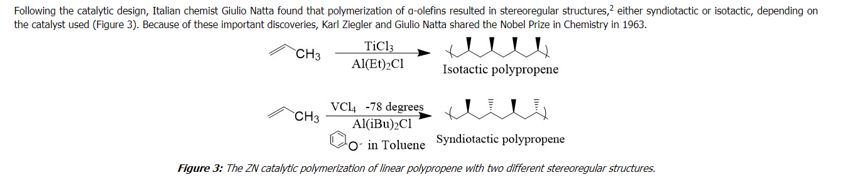
Ziegler-Natta catalysts: allow control of the placement of each monomer.

Slide 10
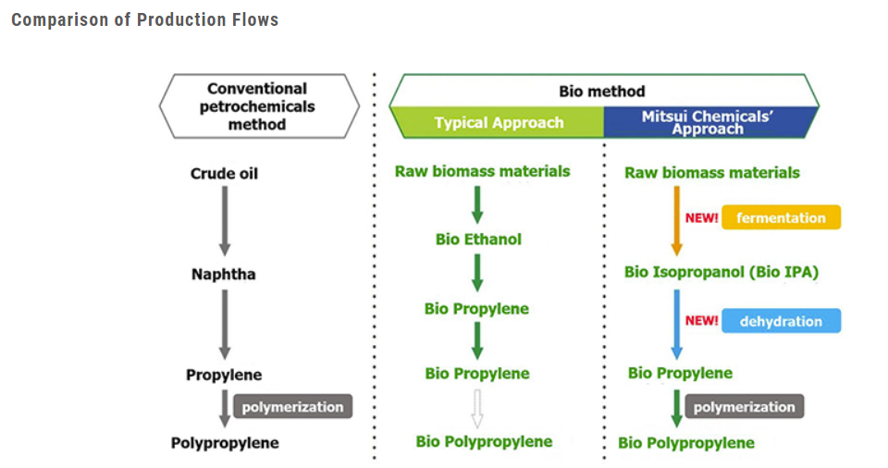
Bio-polypropene.
The monomer can be sourced from bioethanol or biopropan-2-ol.

Slide 11
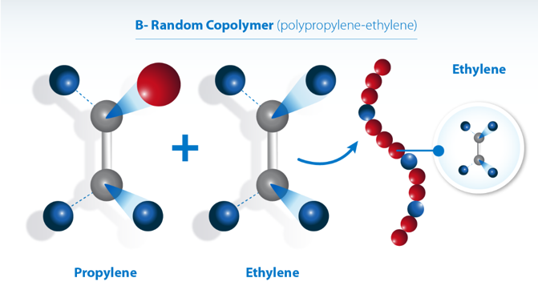
Copolymer with smaller percentages of ethene.
The presence of ethene disrupts the symmetry of the structure.
Copolymer is less crystalline and will be more transparent and have a lower melting point.

Slide 12
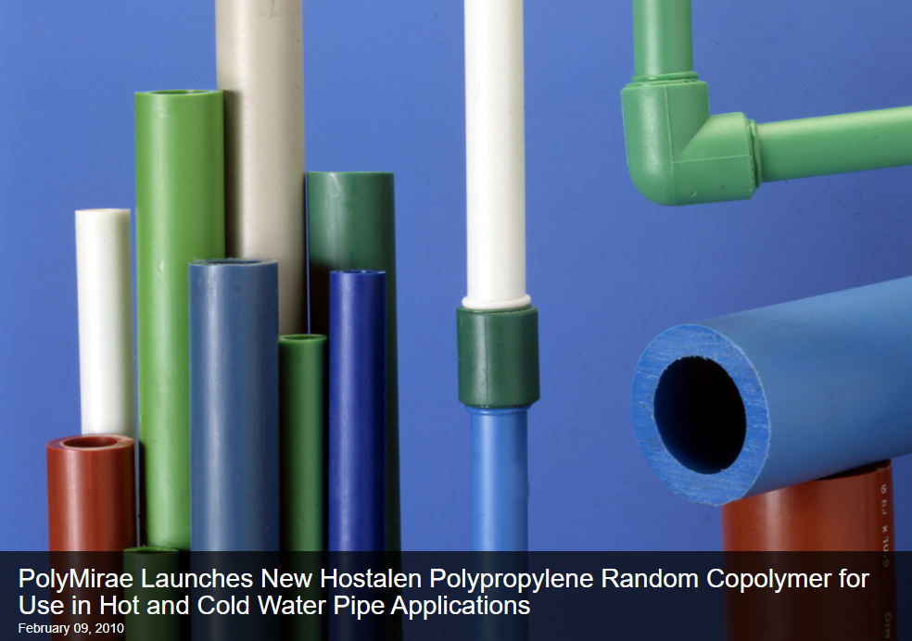
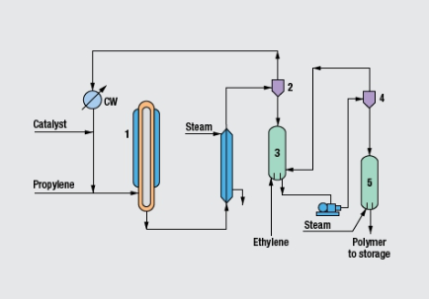

Slide 13
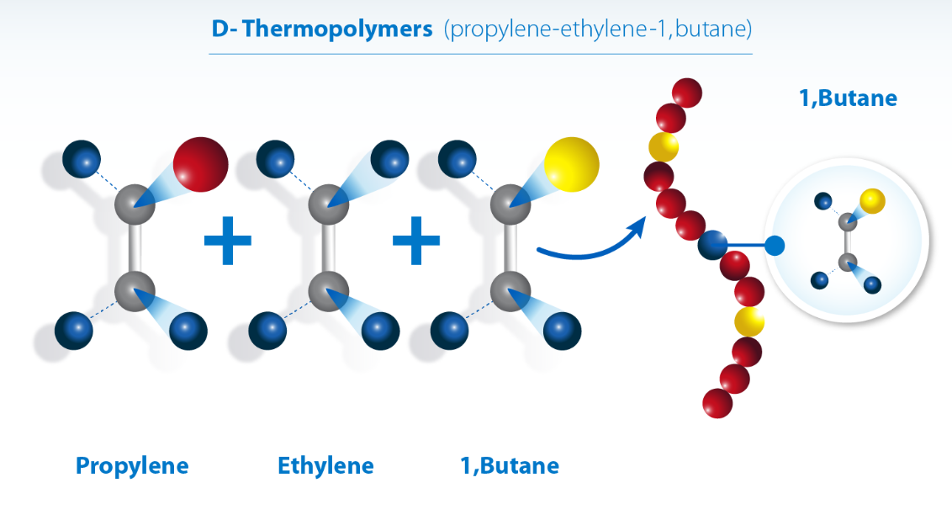
Three monomers – propene, ethene and but-1-ene.
Increased transparency

Slide 14
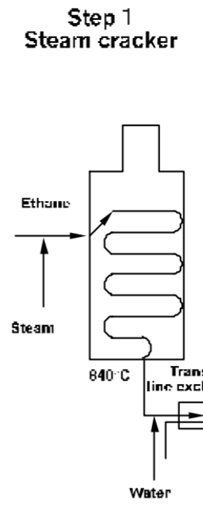
Where does the propene come from?
It is formed as a byproduct when ethane is cracked to ethene at Qenos.
C2H6(g) ⇌C2H4(g) + H2(g)
Cracking is conducted under very harsh conditions, high temperature and very high pressure.
Propene is separated from ethene by fractional distillation.

