Slide 1
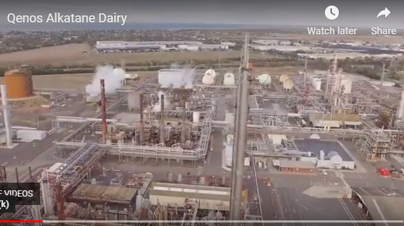
Qenos: Altona
Polyethene manufacture ©POShea

Slide 2
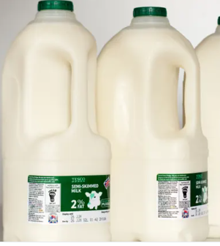
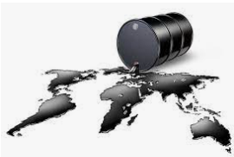
Qenos is a large petrochemical plant in Altona that makes polyethene from ethene using petroleum feedstock.

Slide 3
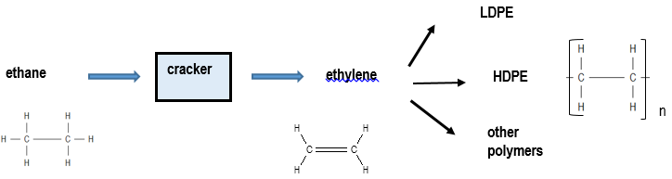
Qenos: ethane feedstock converted to ethene (ethylene).
Ethene is then polymerised to polyethene

Slide 4
Ethane to ethene:
Cracking of an alkane to an alkene
Cracker
C₂H₆(g) ⇌ C₂H₄(g) + H₂(g) endothermic
A difficult reaction – harsh conditions used.
temperatures up to 900⁰C (T goes up, K goes up)
a very short reaction time
low hydrocarbon concentrations (favours forward reaction; 1:2 reactant to product ratio)
rapid cooling of products to prevent their decomposition. (K value higher at low temp)

Slide 5
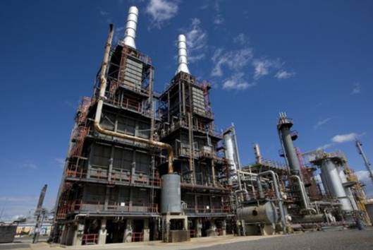
Twin cracking units –
- maintenance on one, the other still runs.

Slide 6
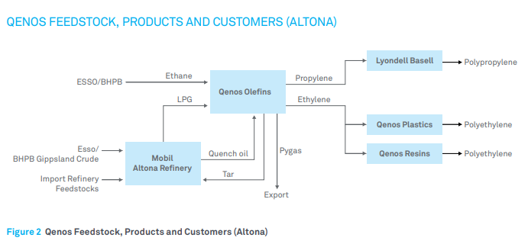
Ethane supply
Ethane is obtained by fractional distillation of gas from the Gippsland gas fields or from overseas crude oil. Pipelines from the refineries supply Qenos

Slide 7
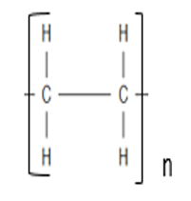
Polymerisation
Ethene
Polyethene
Addition polymerisation

Slide 8
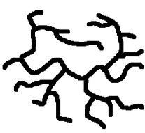
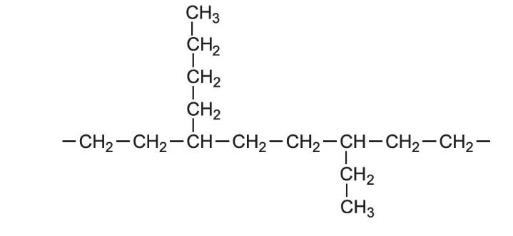
LDPE: low density polyethene
Polymerisation at high pressure and temperature produces an untidy, branched structure. The chains do not pack neatly so it is called low density polyethene.

Slide 9
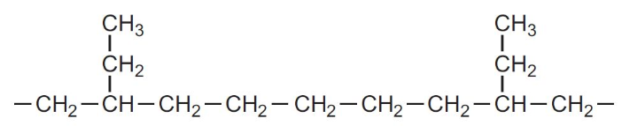
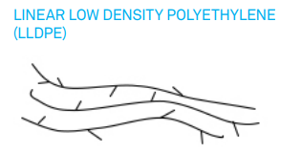
LLDPE: linear low density polyethene
If a high-tech Ziegler-Natta catalyst is used, high pressure and temperature are not needed and the polymer structure is linear.

Slide 10
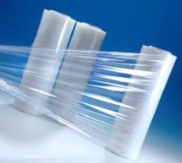
The branches in LLDPE are not caused during polymerisation, they are due to small amounts of but-1-ene monomer being included in the structure. The small branch is the rest of the butene molecule..

Slide 11
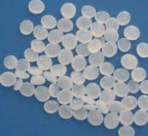
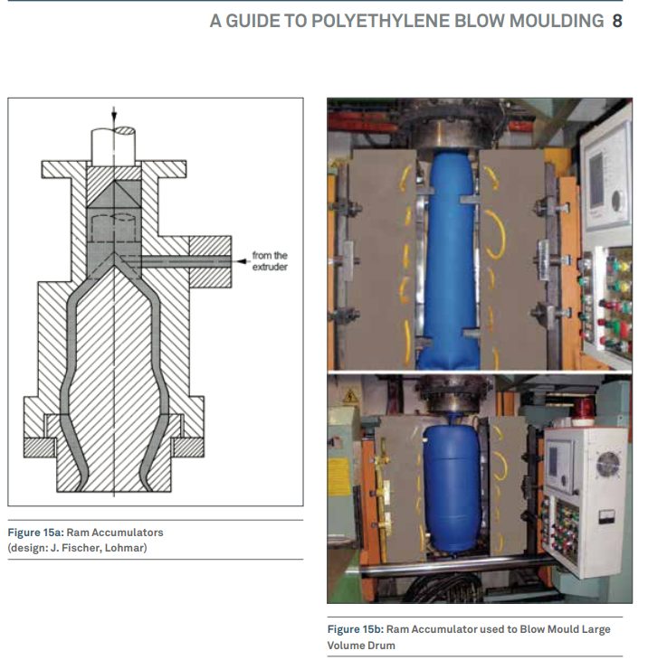
LLDPE is sold as pellets. Manufacturers heat these pellets and add colour to make a range of commercial products.

Slide 12
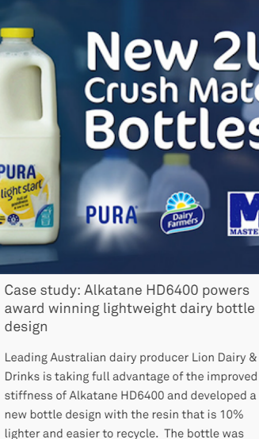
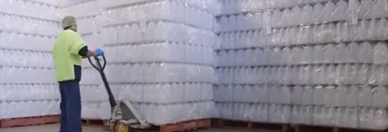
Qenos have named the LLDPE they use for milk containers, Alkatane.
http://www.qenos.com/internet/home.nsf/web/RHAT-9AZ9JC
https://www.newmac.co/portfolio/qenos-transformation-video/

