Slide 1
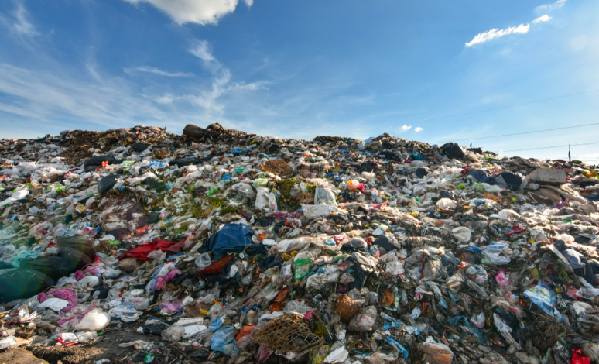
Recycling dilemma? All solved!
Australia has not been trying to sort its recycle. It has been dumping it on Asia. Unfortunately, Asia no longer wants it.

Slide 2
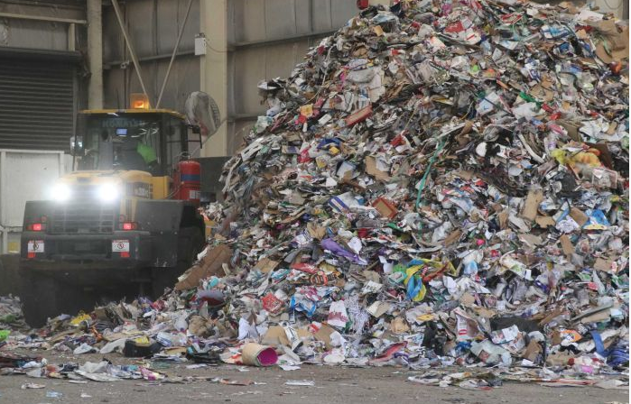
But at the Northern Adelaide Waste Management Authority Resource Recovery Centre (NAWMA), it's a different story.

Slide 3
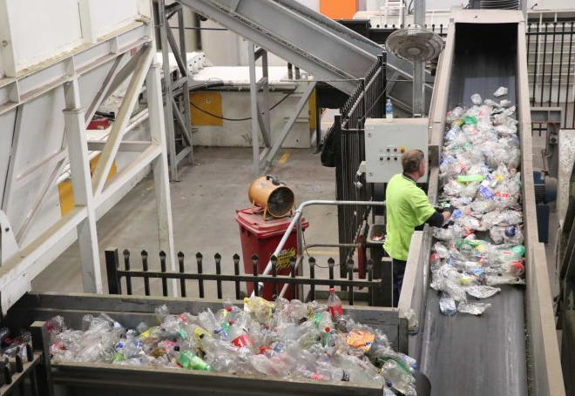
Sorting first to remove paper and glass

Slide 4
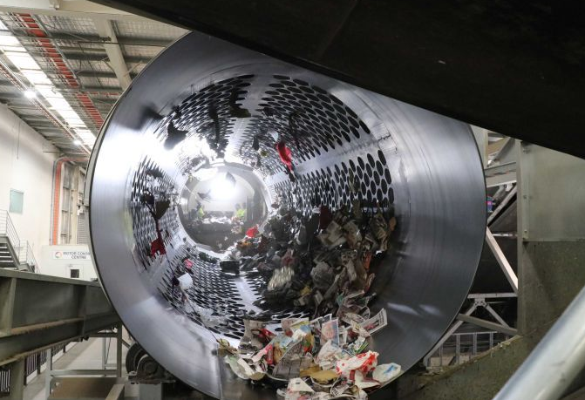
Optical scanners bombard plastics with light and use the reflection to recognise the item as a plastic. This is the breakthrough, that plastics are automatically isolated from other waste!

Slide 5
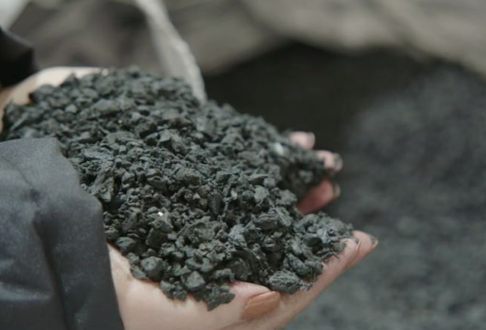
Plastics are then ground and compressed into pellets. Many innovative products can be formed from these pellets.

Slide 6
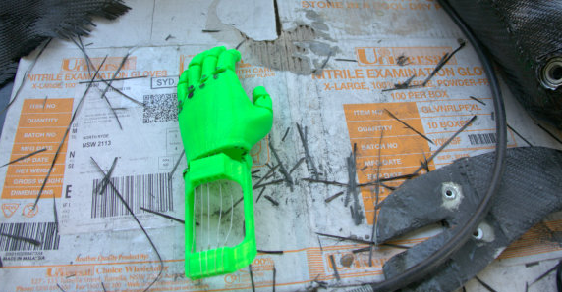
Repurpose for Good – makes a variety of prosthetics from recycled plastic.

Slide 7
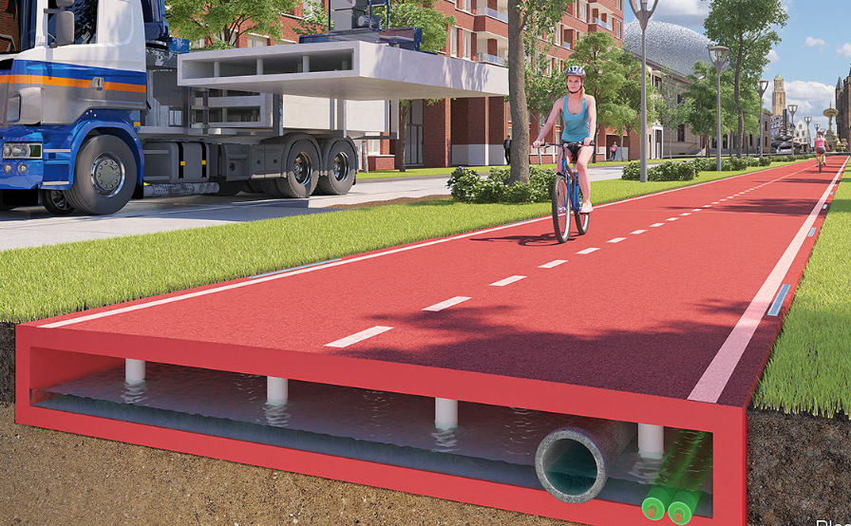
City councils are trialling sections of road and bike path made from recycled plastic.

Slide 8
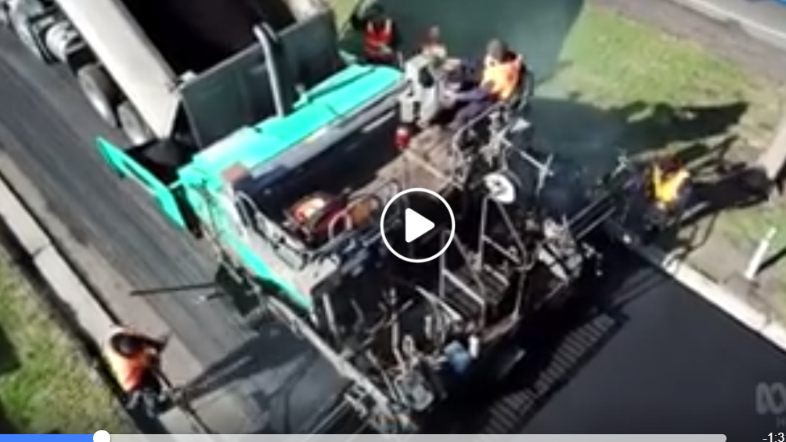

Slide 9
Garden City Plastics – sheds and pots

Slide 10
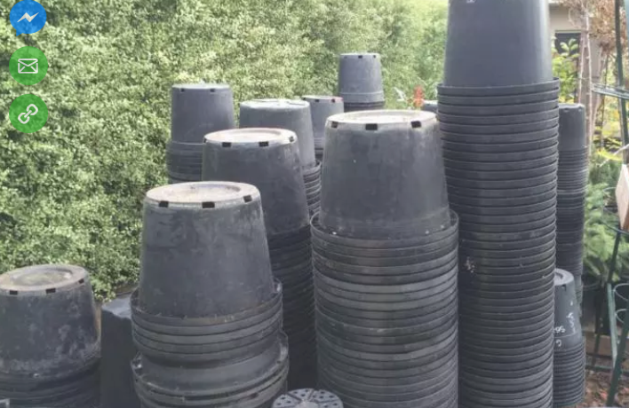
Garden City Plastics – sheds and pots

Slide 11
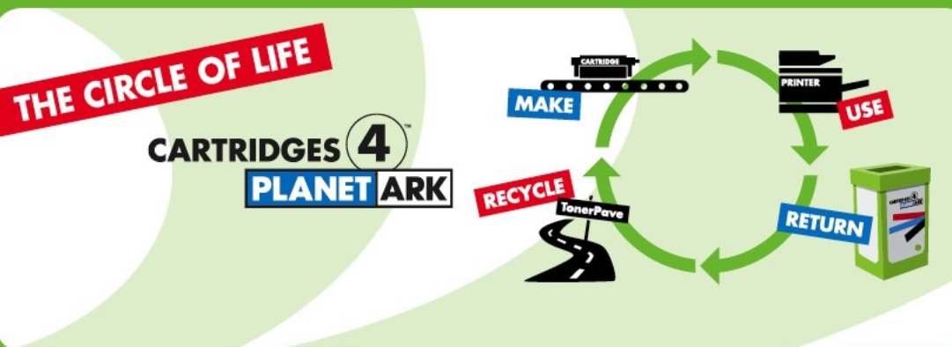
Close the Loop – deals with toner cartridges

