Slide 1
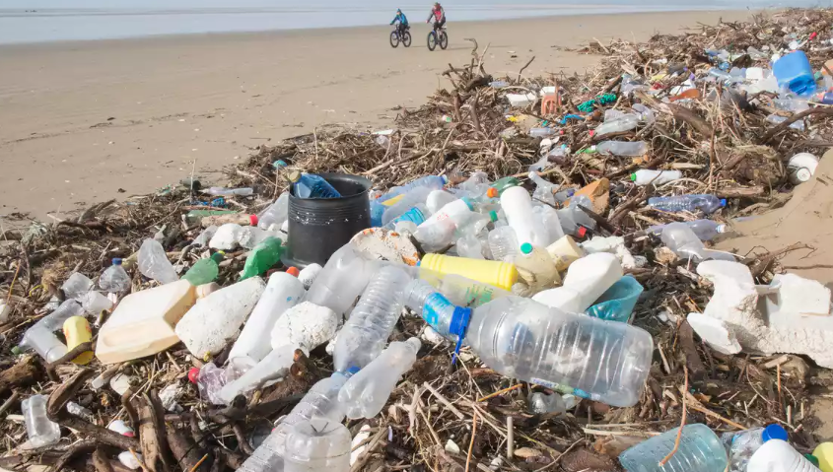
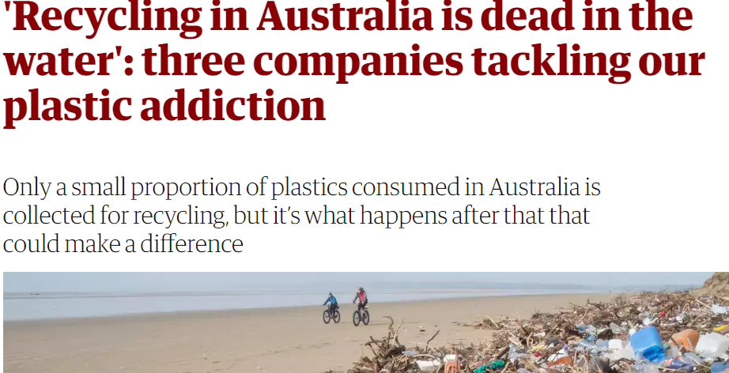
Australian Plastic Recycling
a national disaster and disgrace!

Slide 2
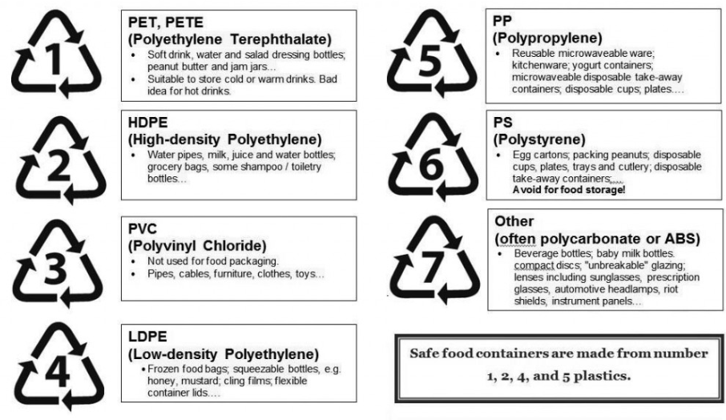
Are you aware of our plastics coding system?

Slide 3
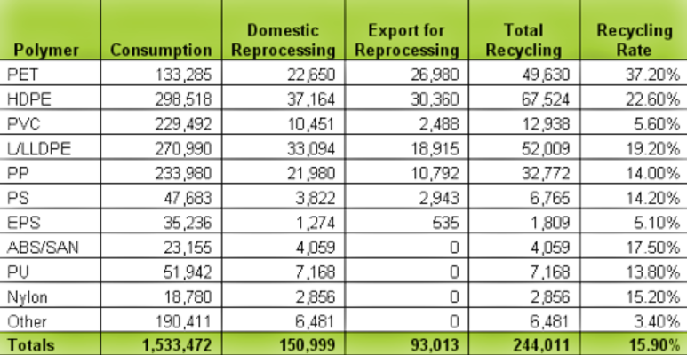
What’s the problem – we have a recycling system?
but
1. We are still only collecting small percentages of most plastics.

Slide 4
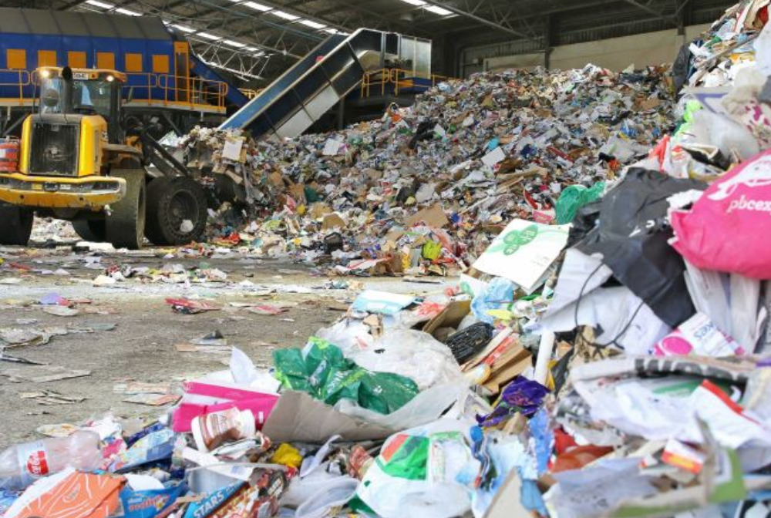
We don’t do much with what we collect anyway!
we sent most to China but China is no longer taking this.

Slide 5
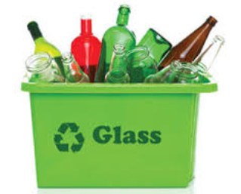
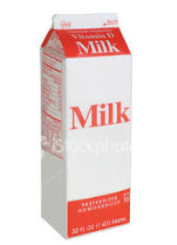
Glass does not come back refilled with the original product – it is ground to a powder to add to cement or it is buried in landfill.
These have an awkward layer of plastic in the cardboard – often just added to landfill.

Slide 6
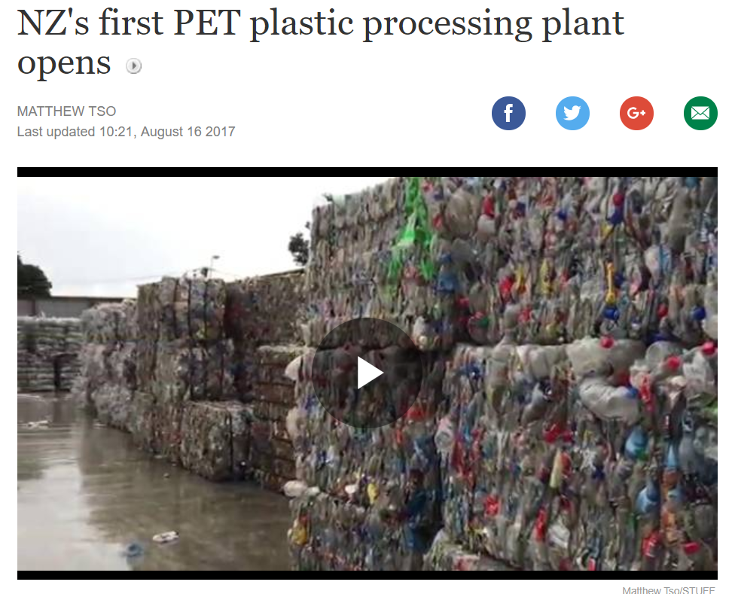
It is possible to build recycling plants – just check NZ

Slide 7
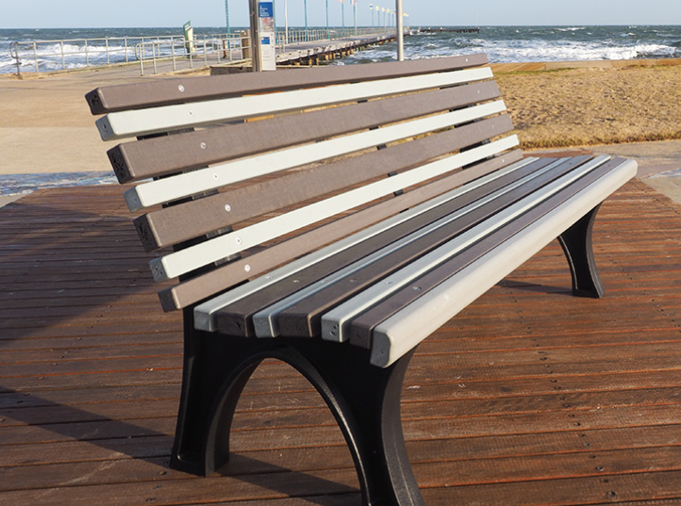
Replas – one of our few recyclers – offers arrange of furniture and outdoor products.

Slide 8
What we could do that rarely even gets a mention.
Follow the South Australian model.

Slide 9
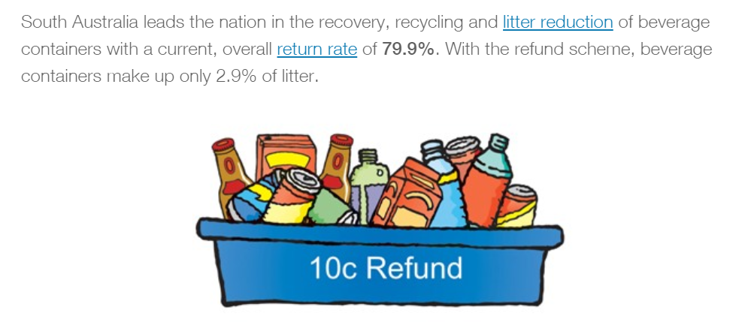

Slide 10
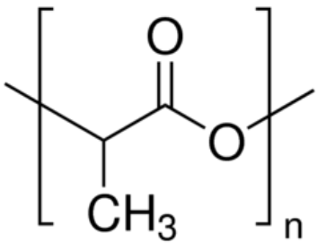
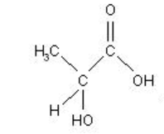
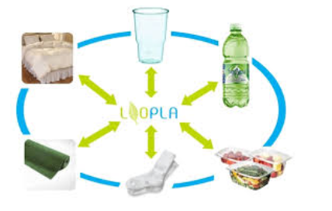
Use degradable plastics – there are several options.
lactic acid → polylactic acid
Polylactic acid – made from dairy waste.
-Dissolves easily in water.

Slide 11
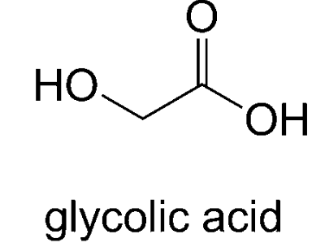
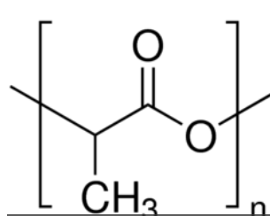
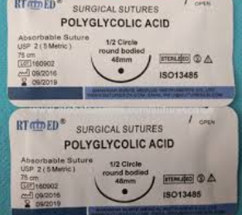
Polyglycolic acid

Slide 12
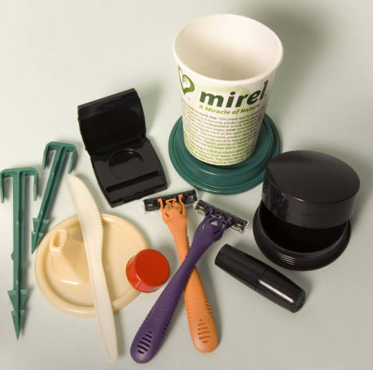
Polyhydroxybutyrate

Slide 13
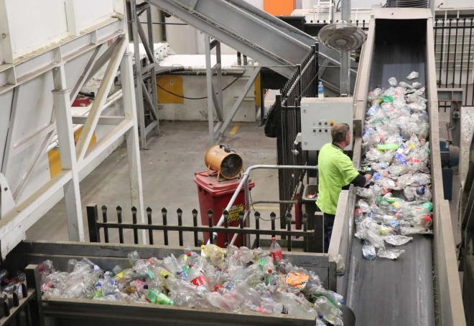
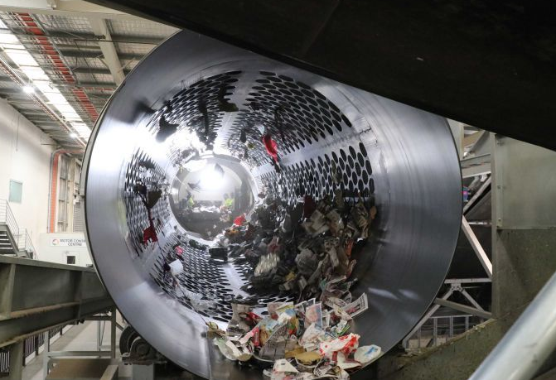
Exciting North Adelaide solution – breakthrough!
They are able to sort waste. First non-plastic is removed, then an optical sorter distinguishes between plastics.

Slide 14
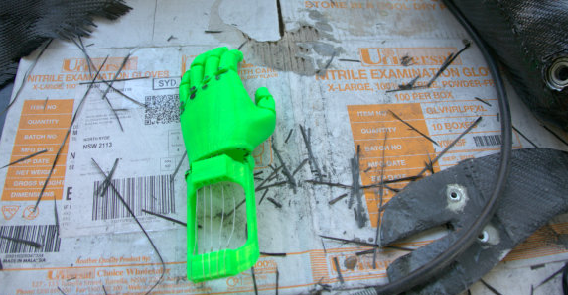
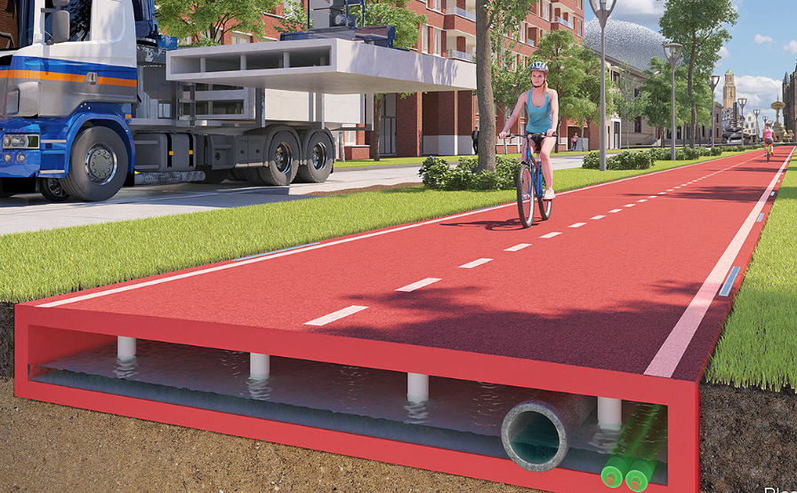
Once plastic is sorted it is easy to remold to make …
sheds, pots, artificial limbs and roads.

