Slide 1
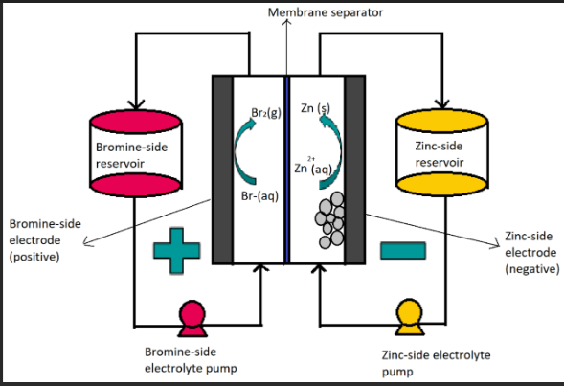
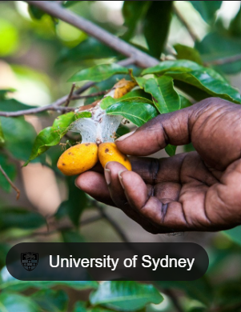
VCE 2024
osheachem.weebly.com

Slide 2
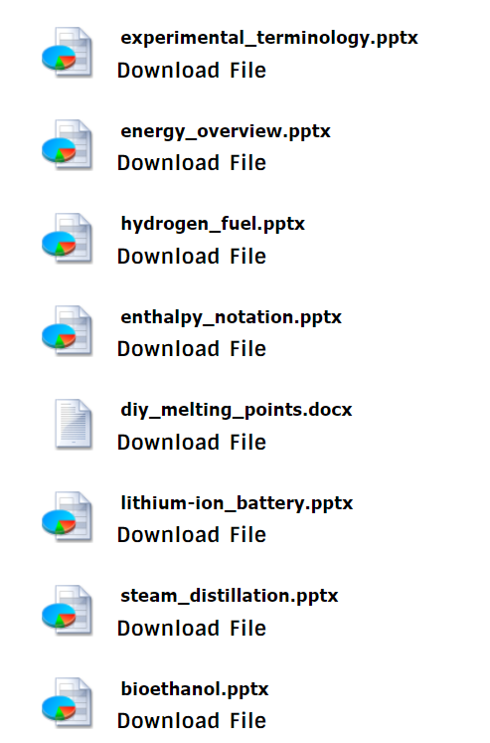
osheachem.weebly.com
SACs, topic tests, exams
Kilbaha

Slide 4
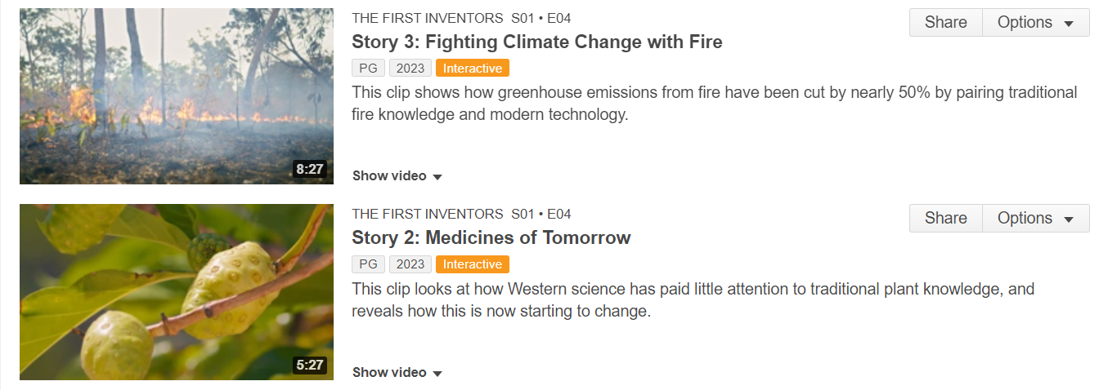
Aunty Fran Bodkin
Prof Gerard Meunch

Slide 5
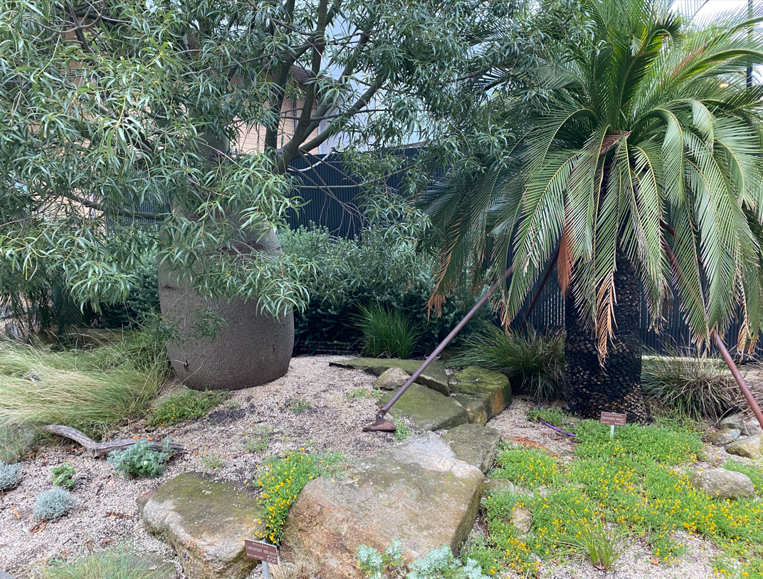
The System Garden

Slide 8
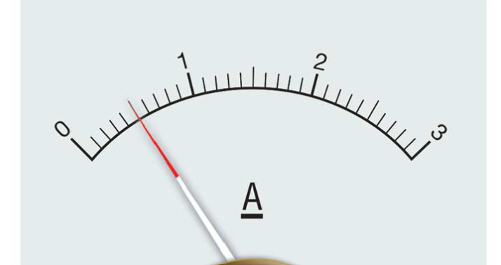
Resolution
Resolution: The smallest change in the quantity being measured that causes a perceptible change in the value indicated on the measuring instrument. For example, if the resolution of a burette is 0.05 mL, then the user must estimate the volume between the two marked intervals on the burette so that the value reported will be to two decimal places. For example, measurement readings of 10.50 mL or 10.55 mL are possible, but a measurement reading of 10.53 mL cannot be claimed. The meniscus of the liquid will either be on the burette line marking, in which case the reading would be 10.50, or it will lie between 10.50 and 10.60, in which case it is measured as 10.55 mL.

Slide 10
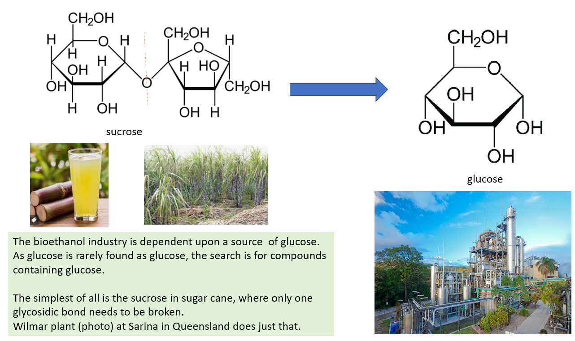
bioethanol

Slide 11
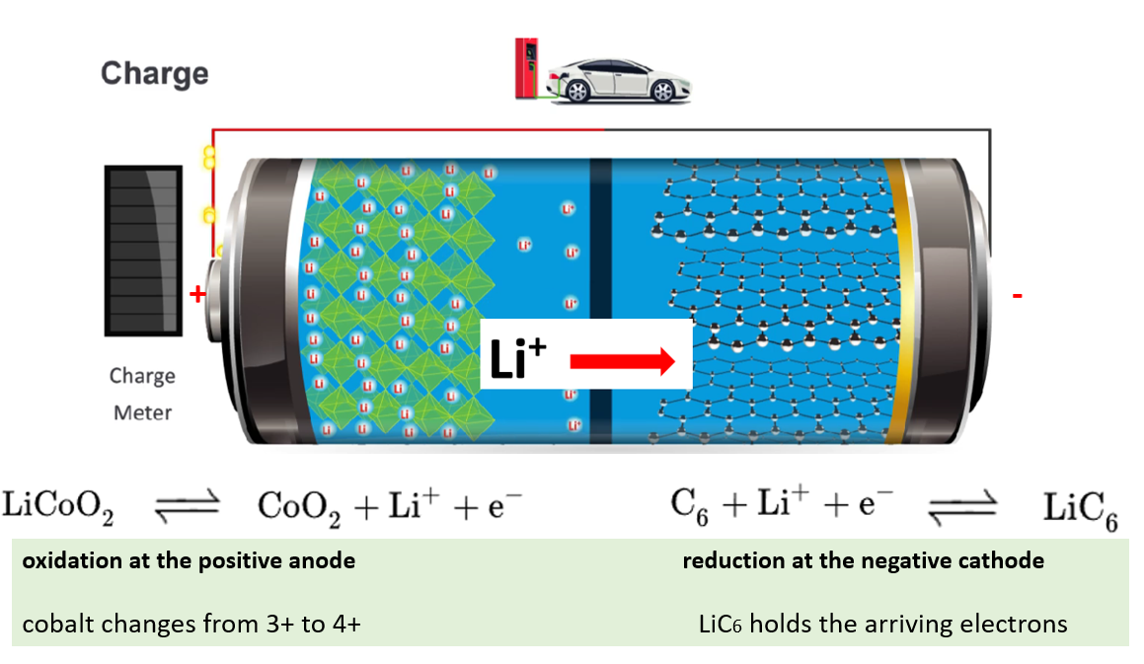

Slide 12
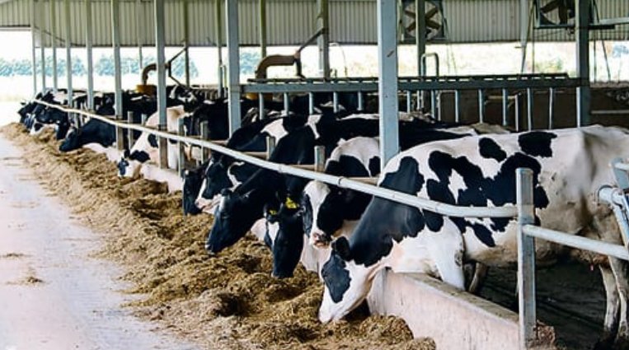
The herd of 300 cows never leave this barn. They sleep, eat and get milked here

Slide 13
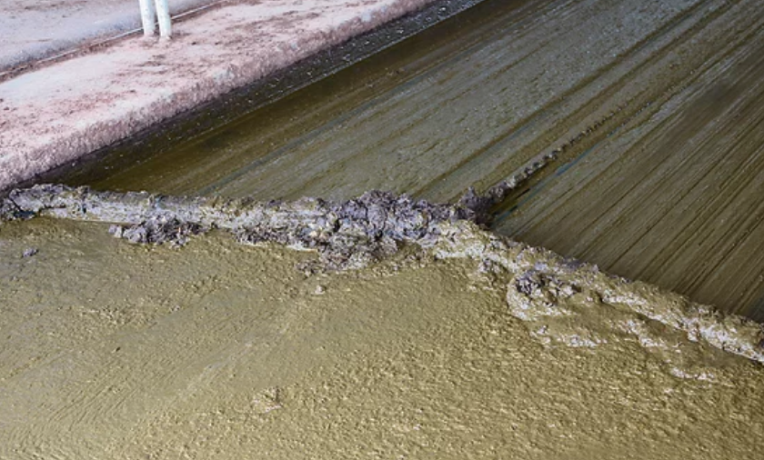
Sewage is automatically scraped to a holding tank. 25000 litres of effluent collected per day.

Slide 14
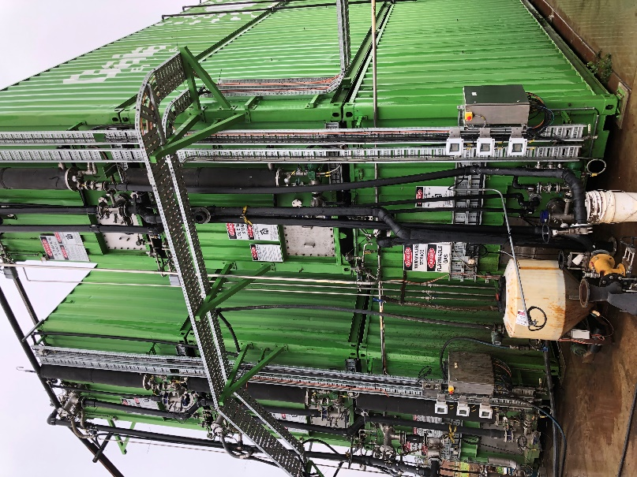
Liquids are pumped into sealed shipping containers. These act as digestors, producing biogas.
Biogas composition
Methane 60 %
CO2 25 %
Water
Hydrogen sulfide

Slide 15
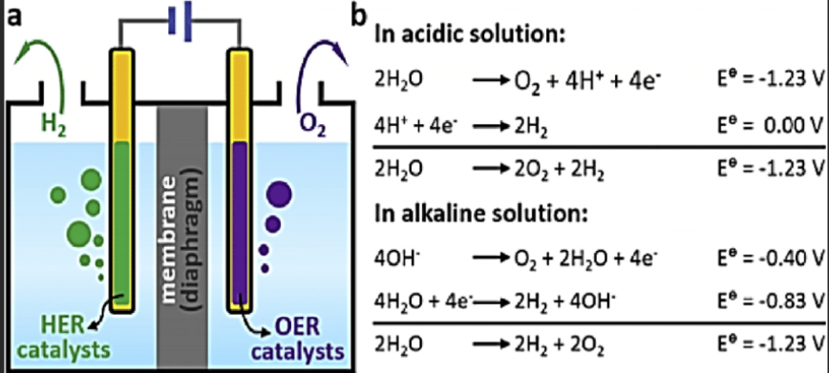
Electrolysis of water
Water with a little NaCl
Electrolysis of acid or base 1.23 V – Hoffmann voltameter

Slide 16
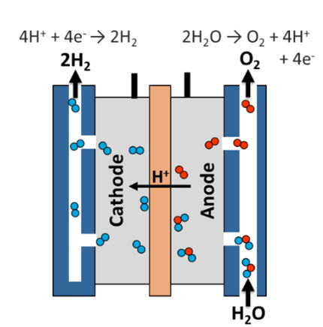
PEM Electrolysis of water 1.23 V

Slide 17
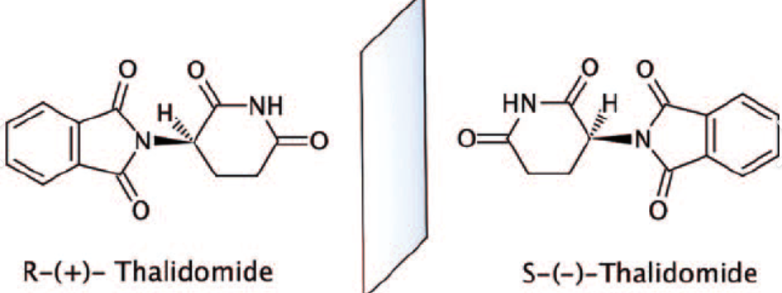
Enantiomers in the body
(S)-enantiomer of thalidomide is teratogenic

Slide 19
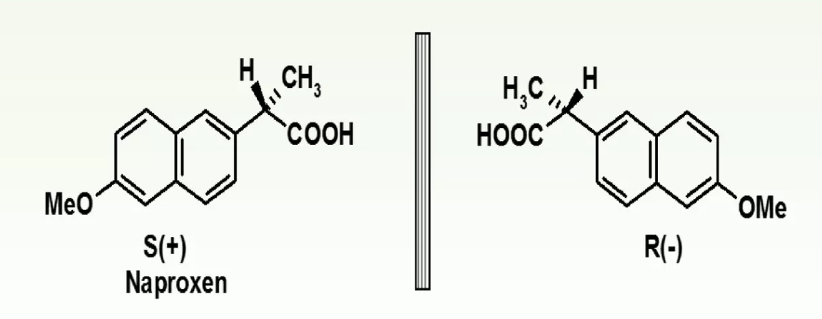

Slide 20
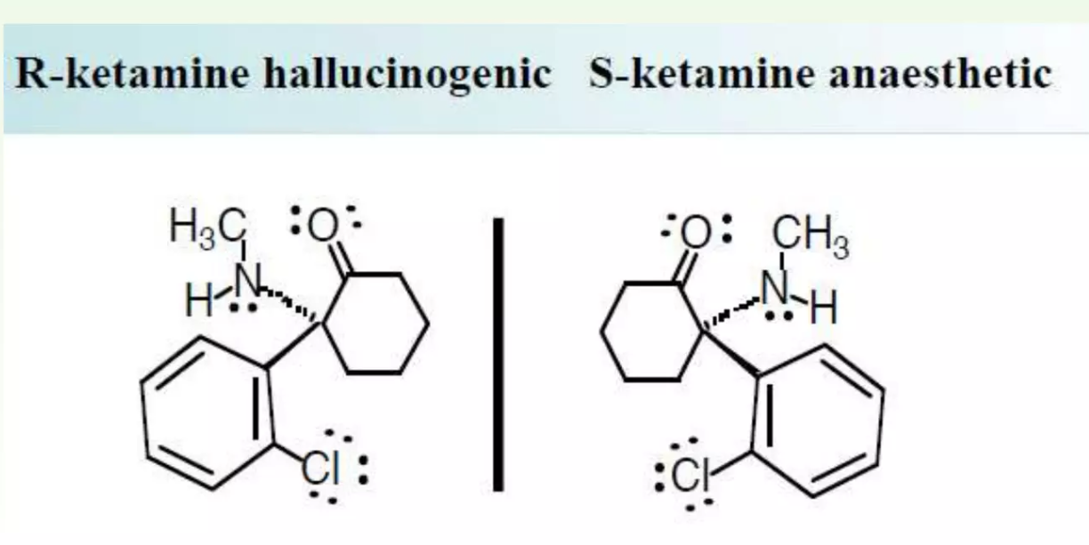

Slide 21
Unit 12 Part 6 Mechanism of Relenza - YouTube
Competitive enzyme inhibitors

Slide 22
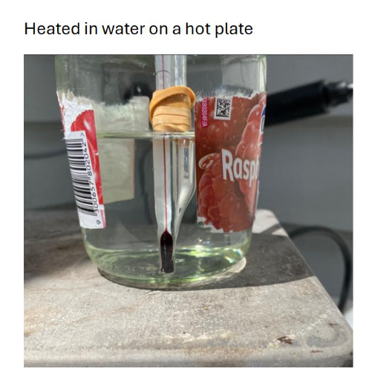

Slide 23
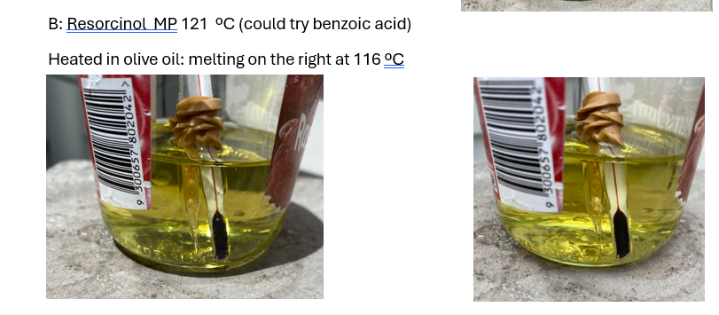

Slide 27
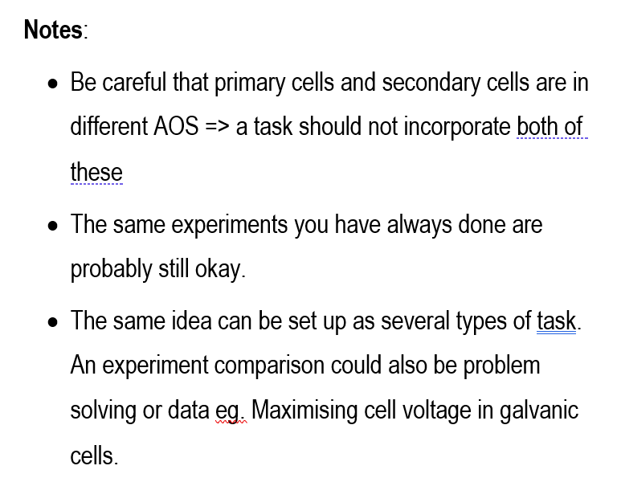

Slide 28
Same theme – different task: Bioethanol
Case Study Ethtec trial plant in the Hunter Valley. Wilmar bioethanol Australia
Problem solving: Finding ideal conditions and sugars for fermentation
Comparison: different fruits, different sugars, % ethanol obtained
Investigation: Ways of determining the rate of fermentation reaction

Slide 29
Wilmar: Yarraville

Slide 31
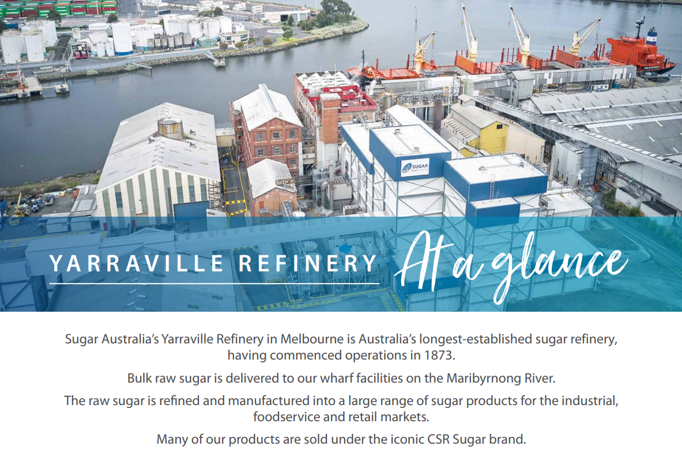

Slide 32
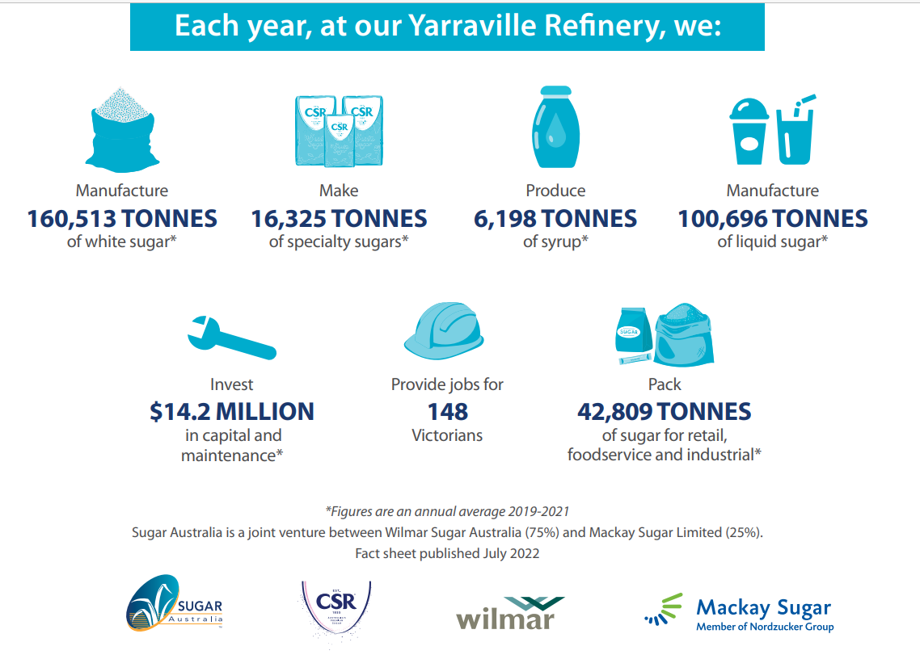

Slide 35
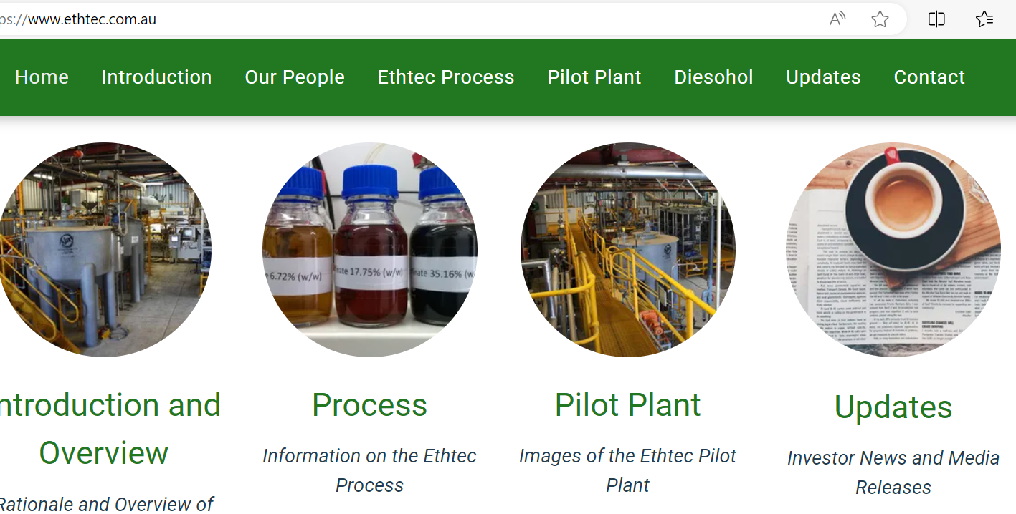

Slide 36
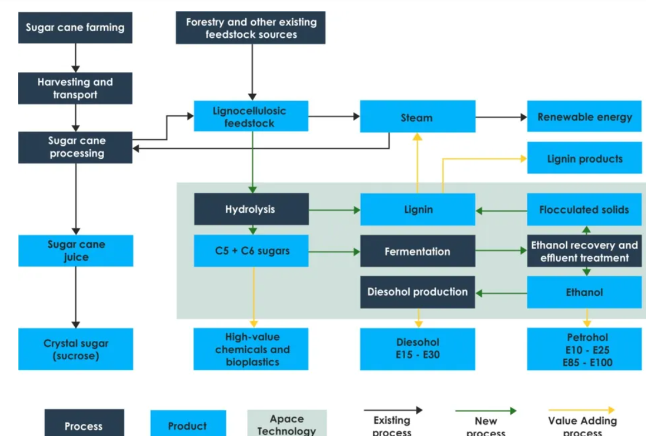

Slide 37
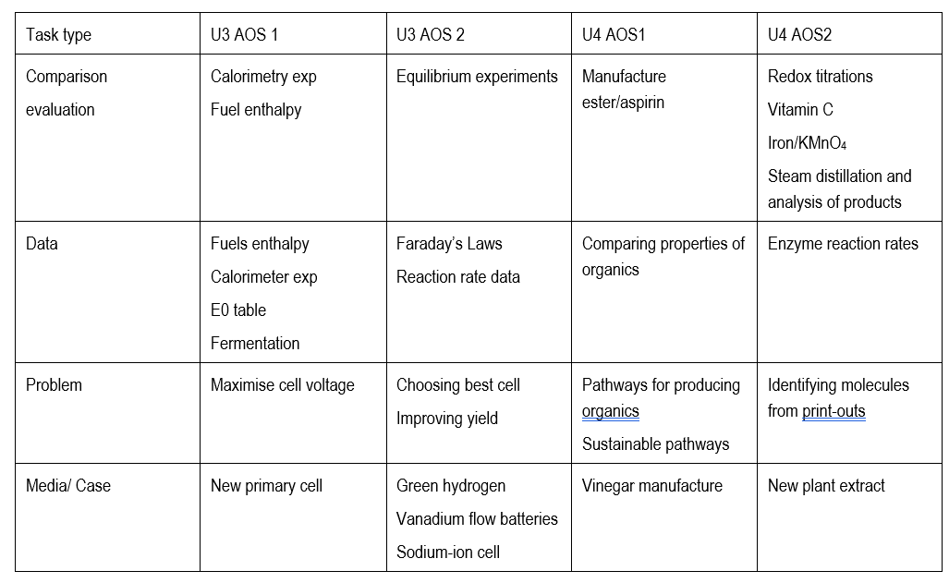

Slide 38
Calorimeter pracs rate data pathways problem pinocembrin case study

Slide 39
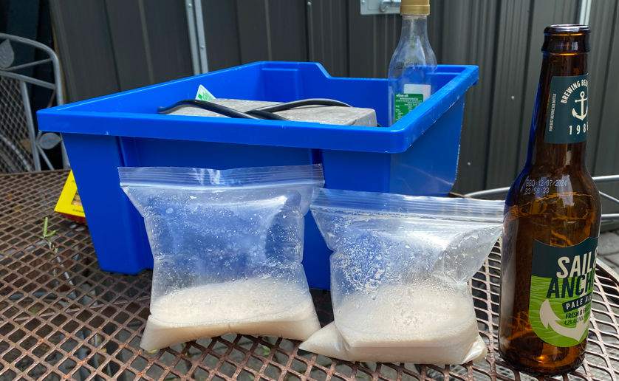

Slide 40
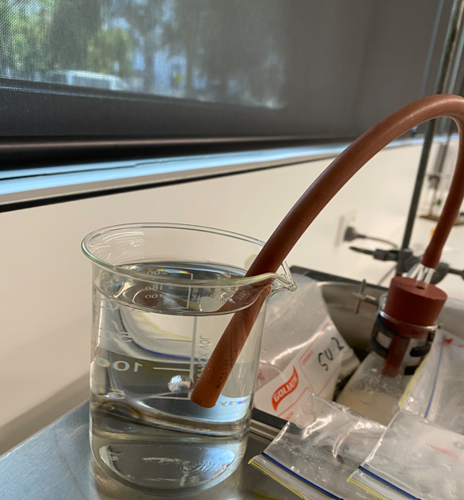
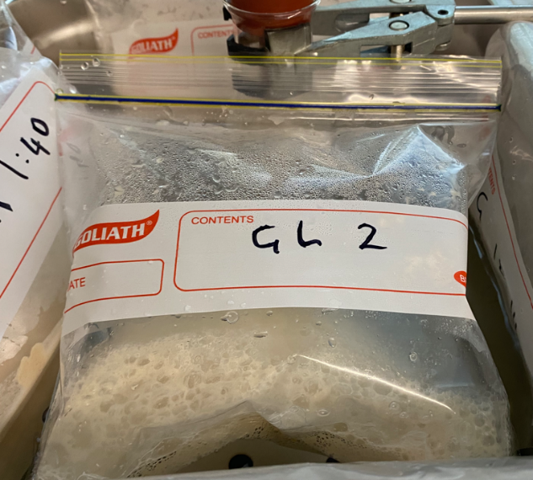
Fermentation of sugars
Rate of bubbles emerging indicates the reaction rate.
Investigate a range of factors
- SAC with Kilbaha

Slide 41
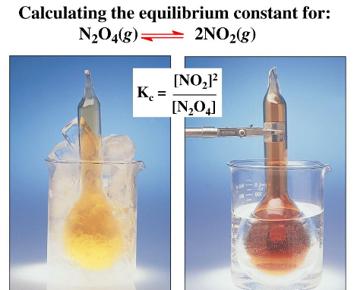
Comparison
Equilibrium constant and temperature: exothermic (CoCl₆) vs endothermic (N₂O₄)
Electrolysis of CuBr2 compared to NaCl
Electrical calibration vs chemical calibration
Enzymes and pH vs enzymes and temperature
Bioethanol and different sugars
Aspirin vs esters

Slide 42
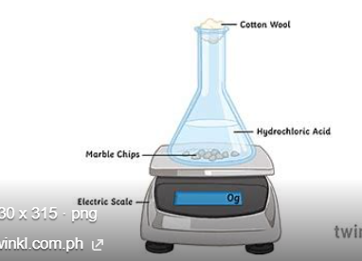
Typical experiments that are obviously still relevant
Calorimetry, burning of food
Biodiesel manufacture
Redox: Electrochemical series
Rate: CaCO3 + HCl HCl + Na2S2O3
Equilibrium cobalt chloride, NO2,
Electrolysis: Faraday’s Laws CuSO4 copper electrodes
Organic: Ester, aspirin
Redox titrations
Enzyme reaction rates

Slide 43
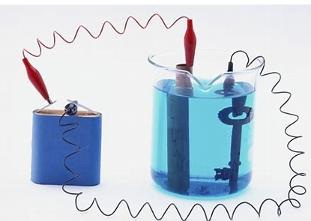
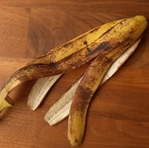
Problem solving
How to improve the efficiency of your calorimeter
Cost of using different fuels to travel 1000 km
Working out how to get good vitamin C redox results –
comparing fruits and vegies
Identifying an unknown molecule
Improving the yield of a reversible reaction eg green ethene
Best battery to use
Slowing the rate of cut fruit deterioration
Improving the voltage of a galvanic cell
Successful electroplating
Measuring viscosity of organic liquids
Successfully tracking an enzyme reaction
Producing quality bioethanol
% purity of oxalic acid or steel wool

Slide 44
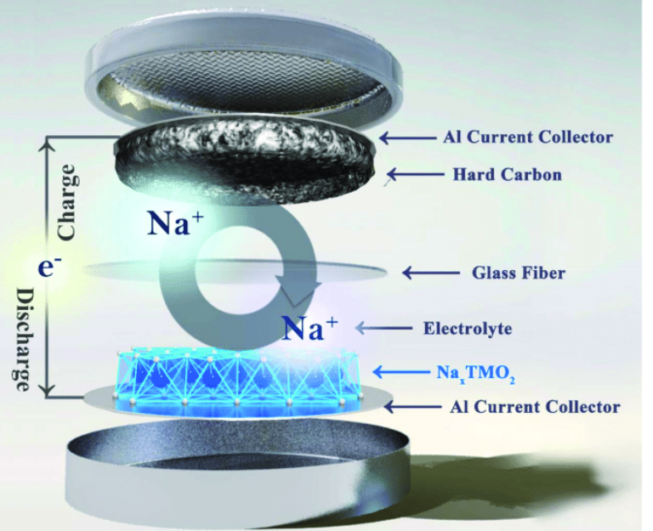
Case Studies/Media Files

Slide 45
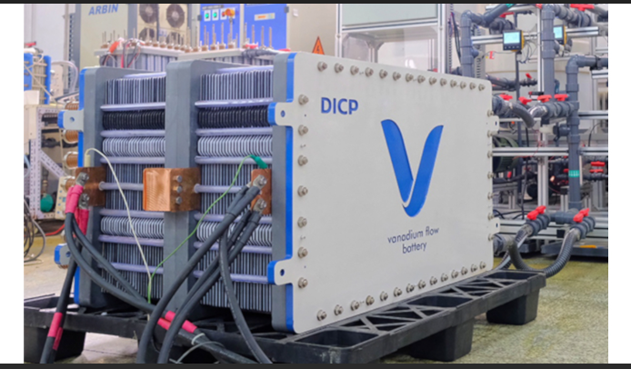

Slide 46
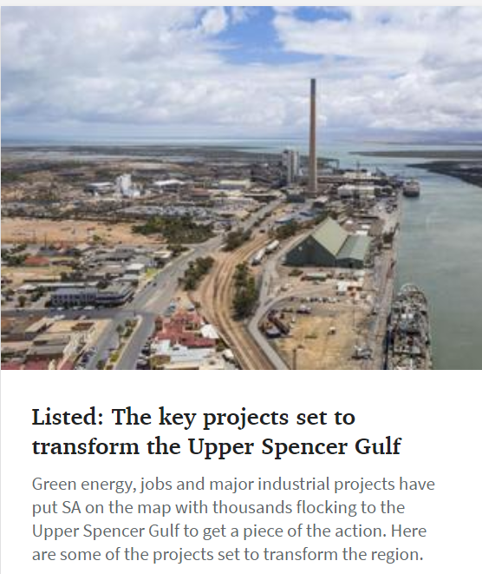
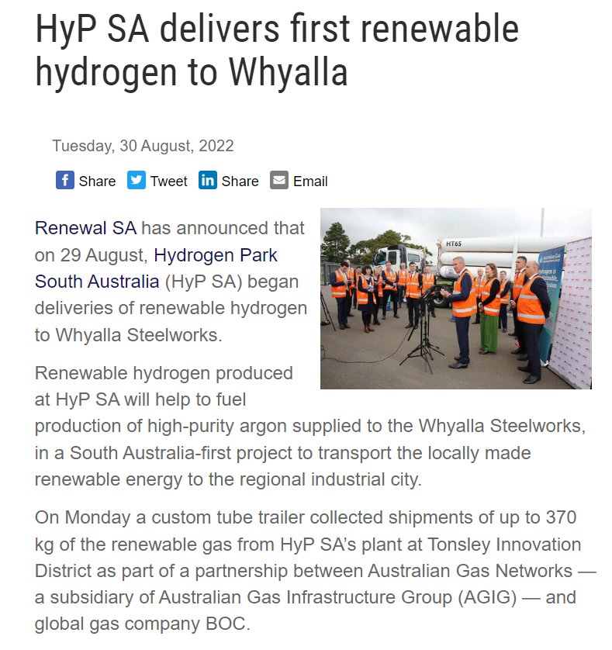
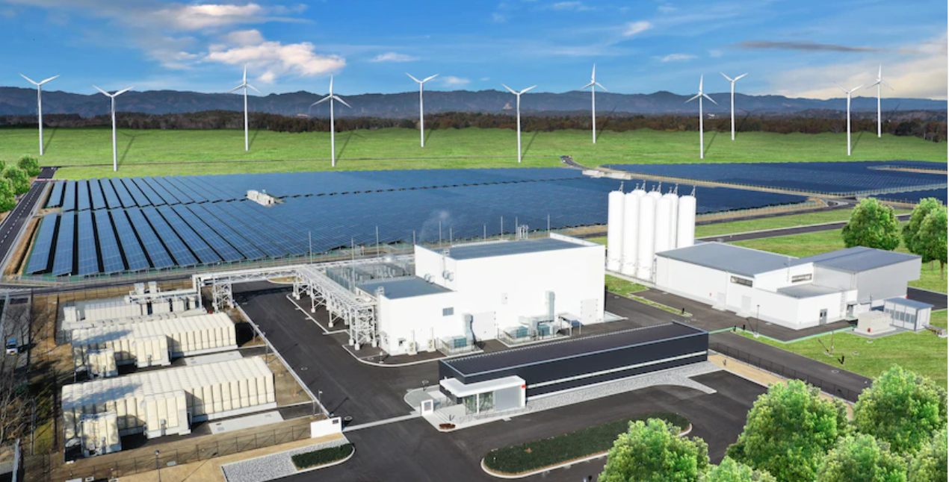
Green hydrogen
-energy source
-sustainability
-electrolyser
- associated industries
-catalysts

Slide 48
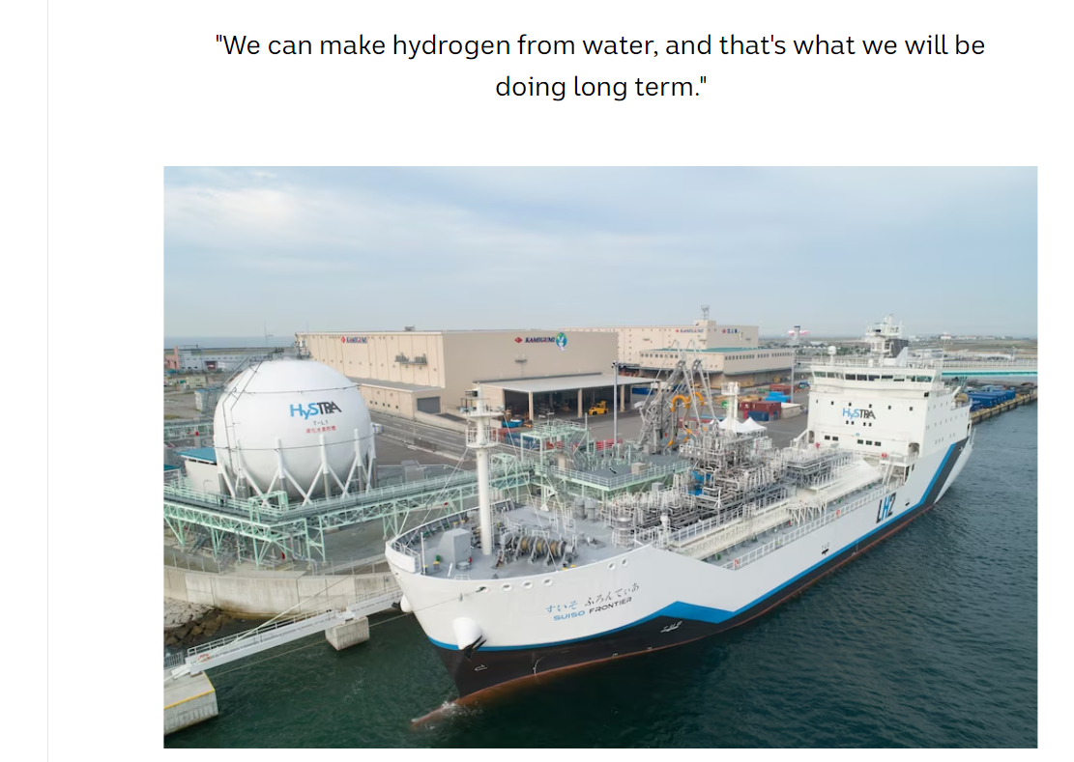

Slide 49
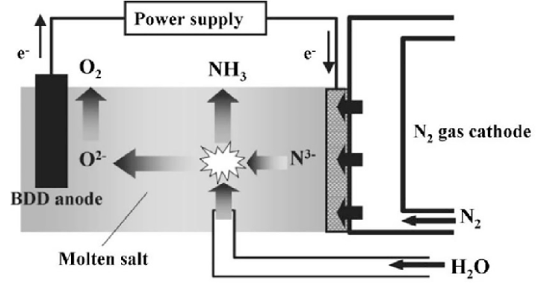
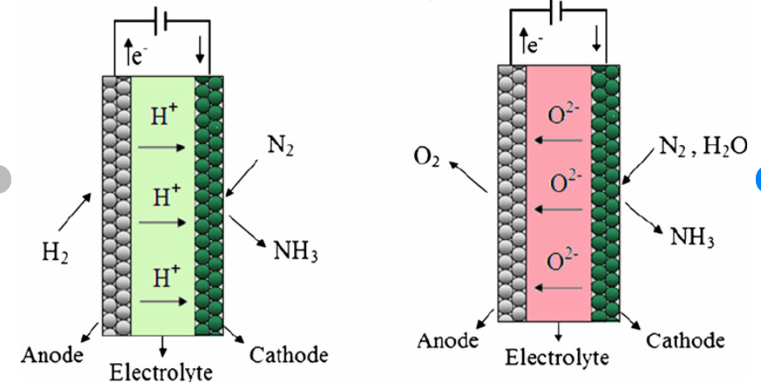
Green ammonia
renewable energy
better catalysts
electrolysis not Haber

Slide 50
What’s in a case study? Questions on
Traditional Haber process
Conditions used for the equilibrium optimisation – why they work
Limitations of this process
Green ammonia – renewable energy used to power the plant
Hydrogen produced in a PEM
Sustainability issues
Electrolytic production

Slide 51
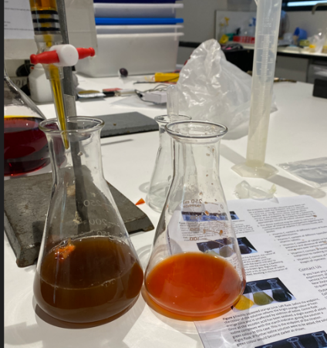
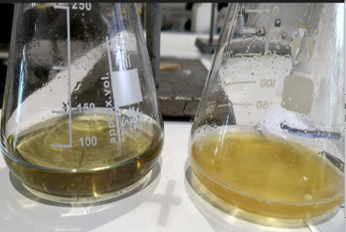
Vitamin C content: orange juice
Capsicum
Kakadu plum
University of Canterbury vitamin C

Slide 52
Case Study: Vitamin C in Kakadu plums
Comparison: Vitamin C in different fruits
Different methods of preparing your sample.
Data: Each group puts their data on the board and you graph it.
Problem solving: How to judge the endpoint? How do commercial juices fare?
Investigation: aspects of the above

Slide 53
Case Study: Galvanic cells. Zinc bromide cell.
Vanadium flow battery
Data: Forming your own electrochemical series.
Comparing the voltage produced against electrode separation, depth
Problem solving: How to maximise the voltage. What commercial battery is the best value?
Investigation

Slide 54
Reaction rates
Comparison of marble chips and temp, then marble chips and concentration. Measure mass or volume
Rhubarb and potassium permanganate
Problem solving: oxalic acid content of different parts of a rhubarb plant
Can you determine oxalic acid content of rhubarb?
Data: Analyse the data and draw graphs rather than compare the experiments.

Slide 55
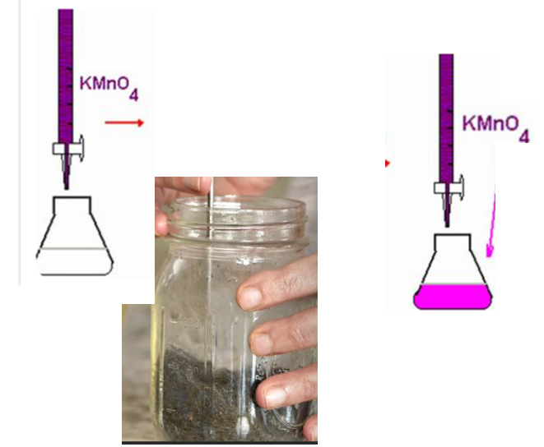
% purity of steel wool
Fe + H₂SO₄
Fe2+ + MnO₄⁻

Slide 56
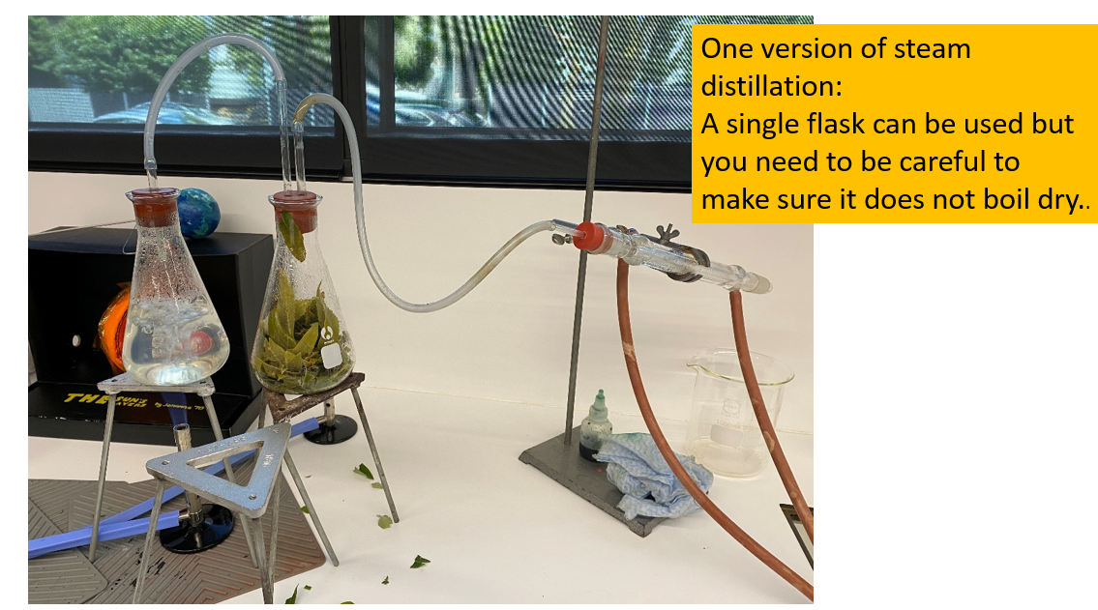

Slide 57
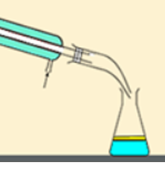
Non-polar components
1,8-cineole anti-microbial
limonene
Polar components
Ascorbic acid antioxidants
Ellagic acid

Slide 58
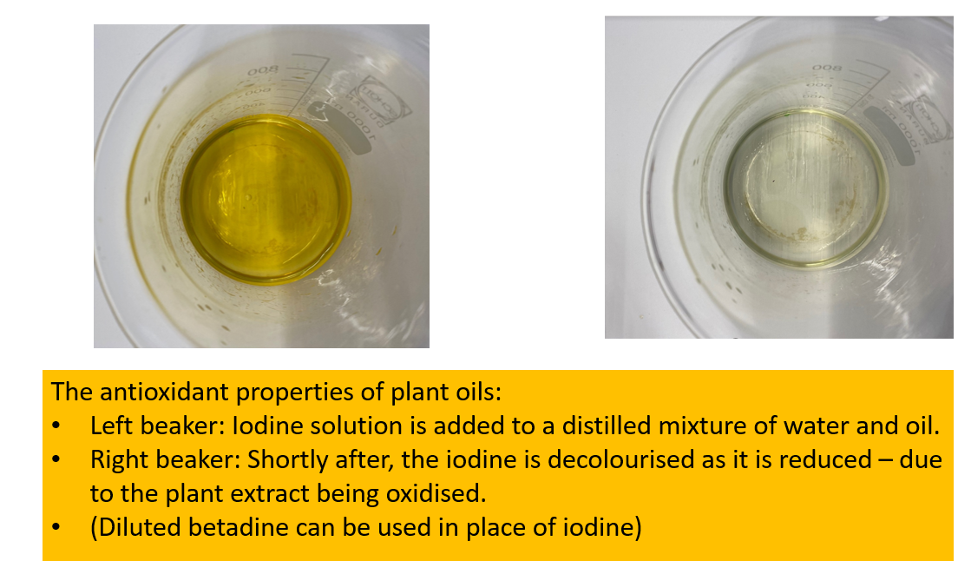

Slide 59
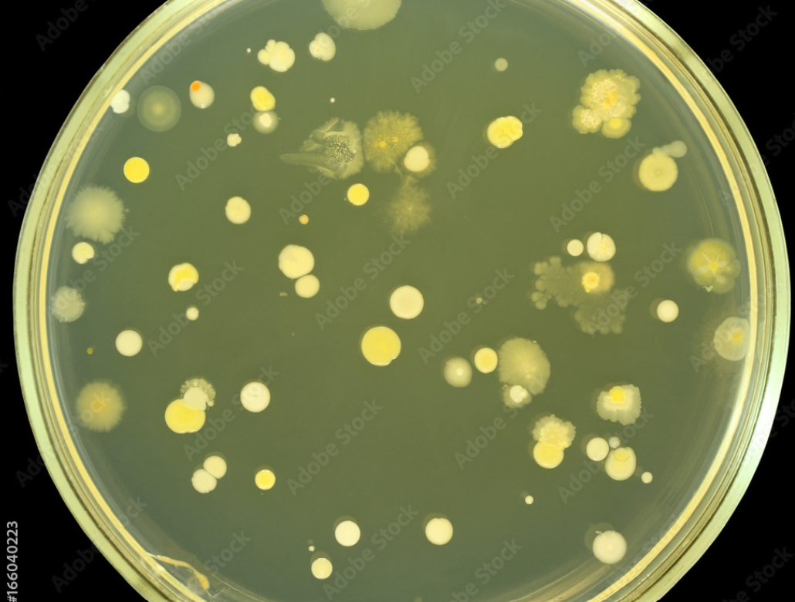
Oil + swab

Slide 60
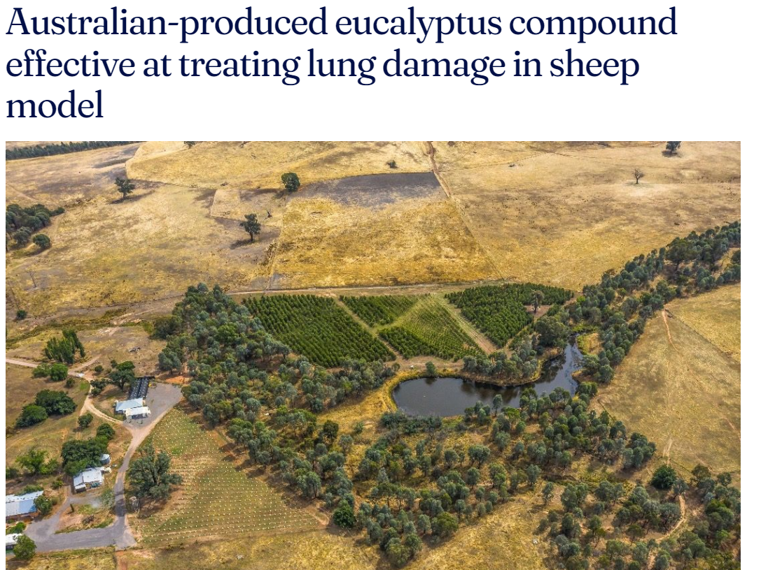
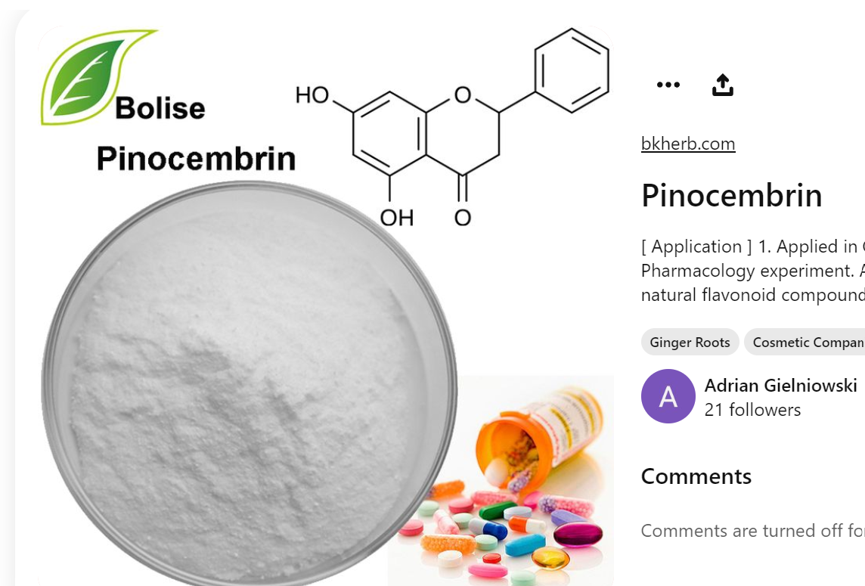

Slide 61
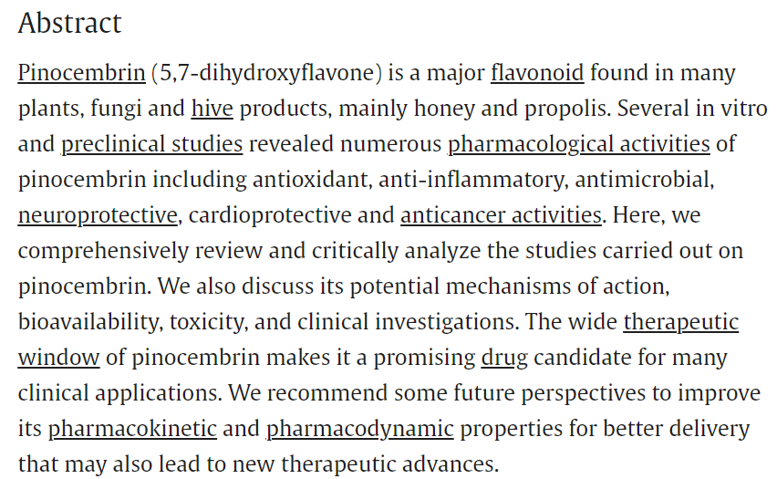
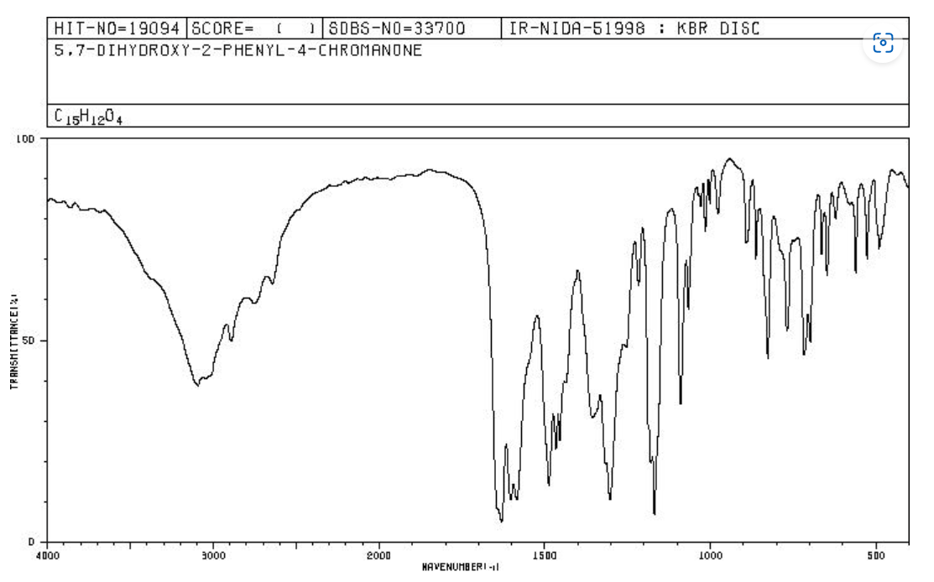
Dr Jason Goodger
School of Biosciences

Slide 62
Eucalyptol
Blue Mallee Gums

Slide 63
Monash pharmaceutical College – Dr Michelle McIntosh
Isolating and testing THC

Slide 64
Cann group Mildura

