Slide 1
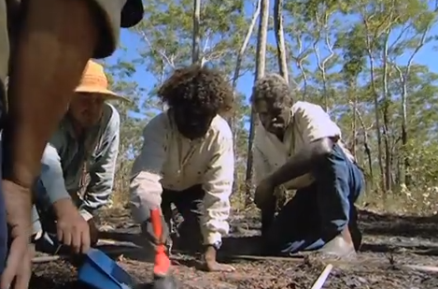
Exploring indigenous science
If you thought indigenous Australians knew very little about chemistry, think again!
Scientists are now starting to realise how chemical processes indigenous Australians have applied over the past centuries.
Indigenous rangers planning fire breaks in Northern Australia.
© POShea

Slide 2
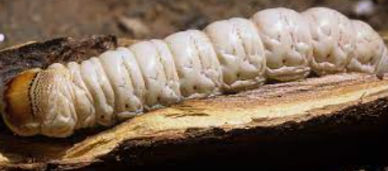
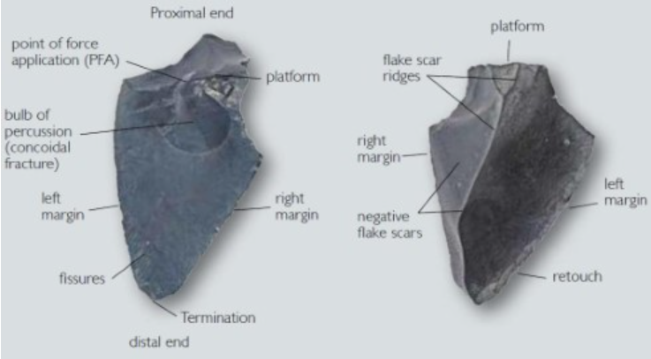
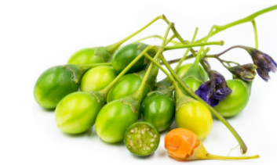
Resources
Plants, animals and soil/rocks
Animals
Witchetty grub – source of minerals, burn ointment
Basalt axes, blades and grinding stones
Kangaroo apples
Vitamins and antioxidants – now cultivated overseas and used to make steroids

Slide 3
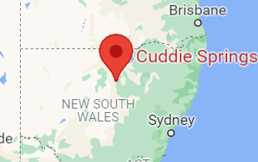
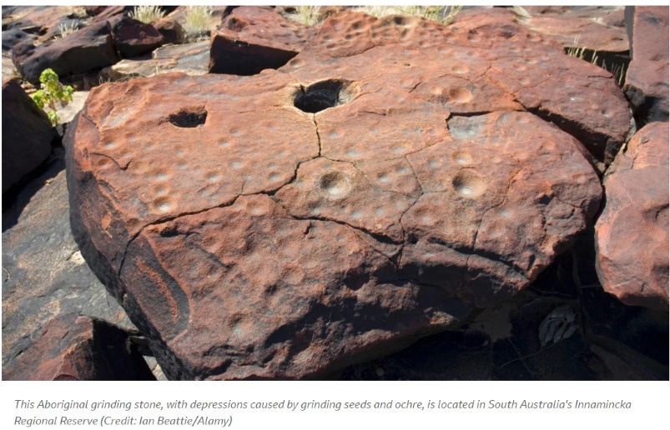
Bread making
30000 years ago: use of flour
Grinding stones

Slide 4
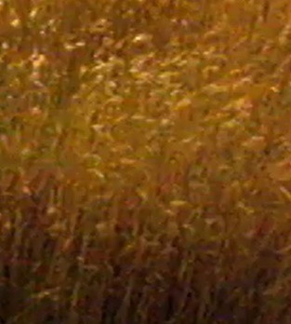
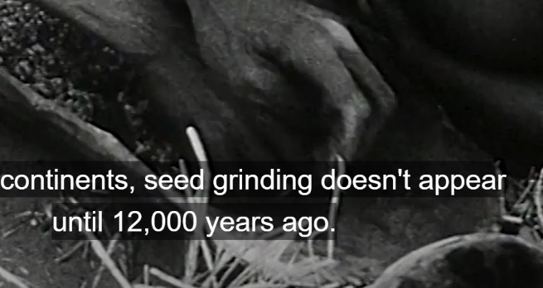
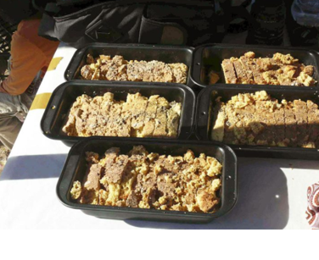
Bread making
30000 years ago
Native grasses
Lake Mungo loaf

Slide 5
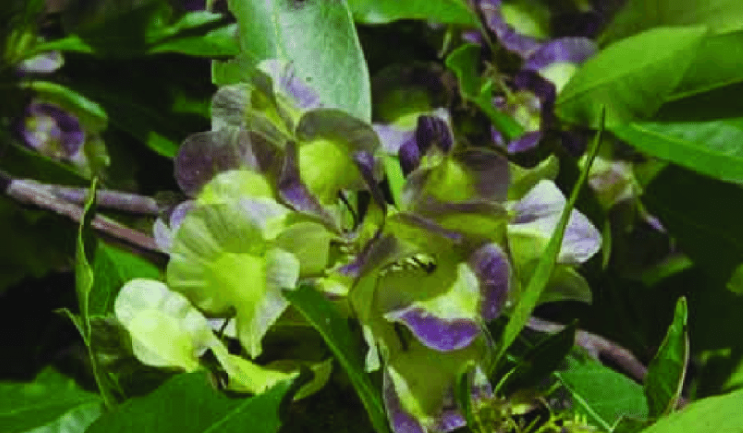
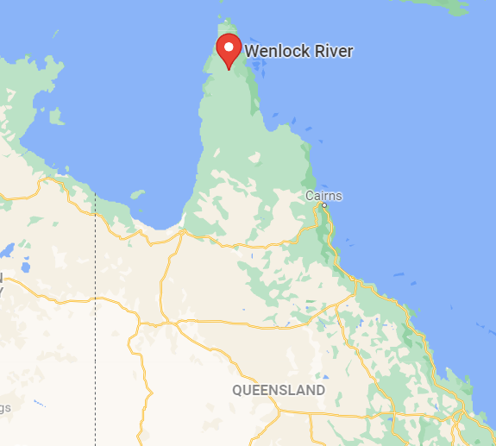
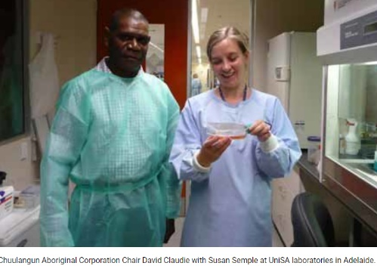
Uncha plant

Slide 6
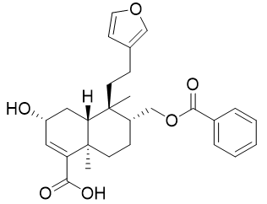
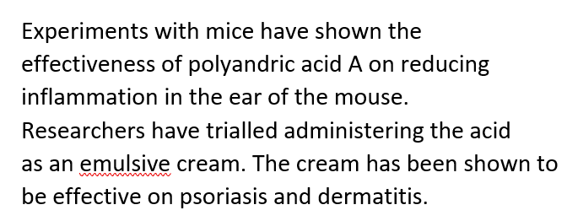
Diterpenoids
Flavenoids

Slide 7
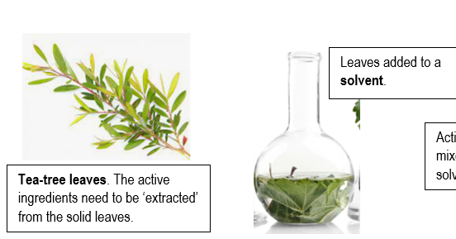
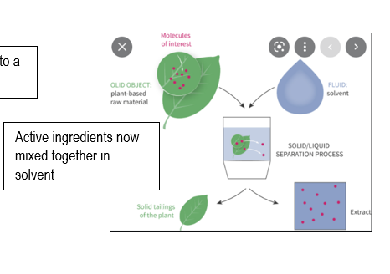
Plant investigation
Extract the liquids

Slide 8
Separate the ingredients
Identify ingredients

Slide 9
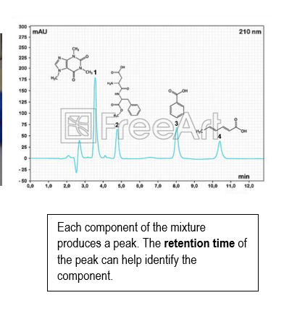

Slide 10
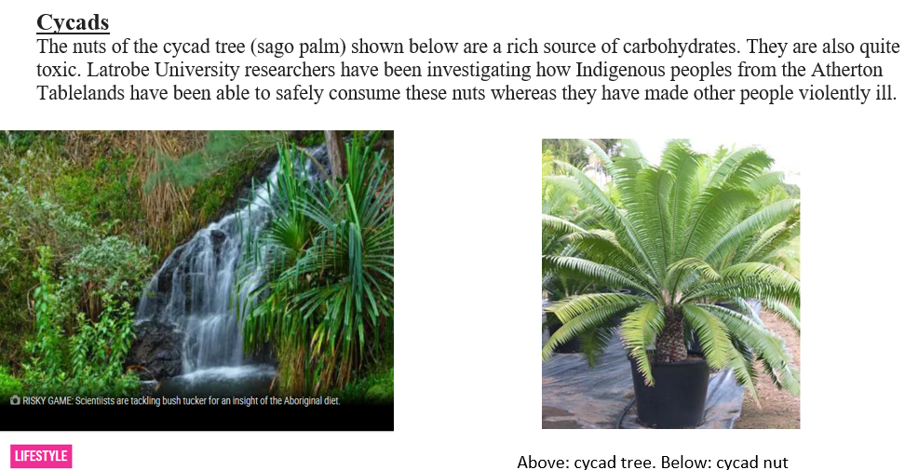

Slide 11
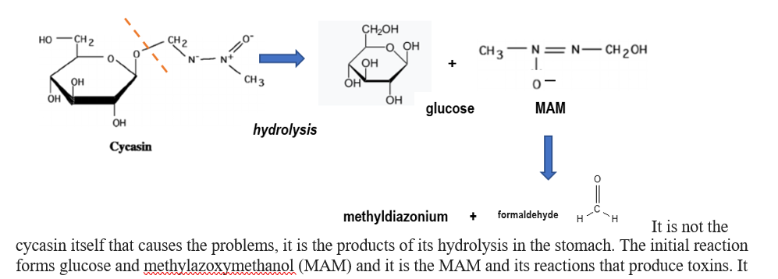
So, how is it that Aboriginal peoples from North Queensland were able to consume these nuts? They hydrolysed the cycasin before consuming it. They ground the nuts to a powder that was placed in a dilly bag and the dillybag left soaking in the creek. The grinding increased the surface area of the starch powder, increasing the rate of hydrolysis. The arm temperatures of North Queensland water supplies also increased the reaction rate. Most of the toxic products are soluble whereas starch is only slightly soluble so the toxins were leached from the starch.

Slide 12
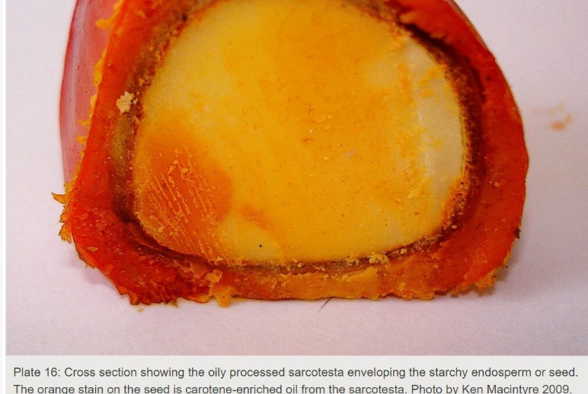
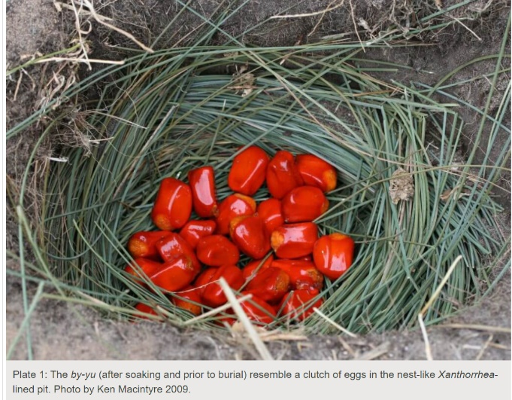
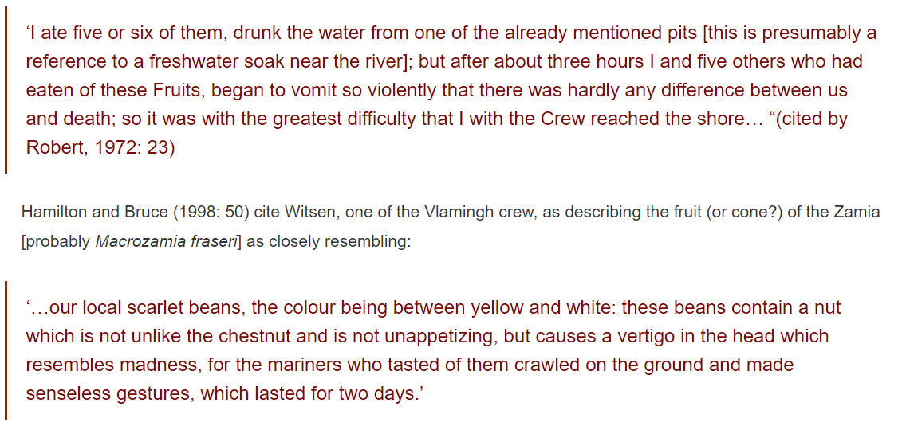
Bayoo fruit: Macrozamia

Slide 13
The native women collect the nuts from the palms [Macrozamia] in the month of March, and having placed them in some shallow pool of water, they leave them to soak for several days. When they have ascertained that the by-yu has been immersed in water for a sufficient time, they dig, in a dry sandy place, holes which they call mor-dak; these holes are about the depth that a person’s arms can reach, and one foot in diameter; they line them with rushes, and fill them up with the nuts, over which they sprinkle a little sand, and then cover the holes nicely over with the tops of the grass-tree; in about a fortnight the pulp which encases the nut becomes quite dry, and it is then fit to eat, but if eaten before that it produces the effects already described. The natives eat this pulp both raw [that is, processed but not roasted] and roasted; in the latter state they taste quite as well as a chestnut.’

Slide 14
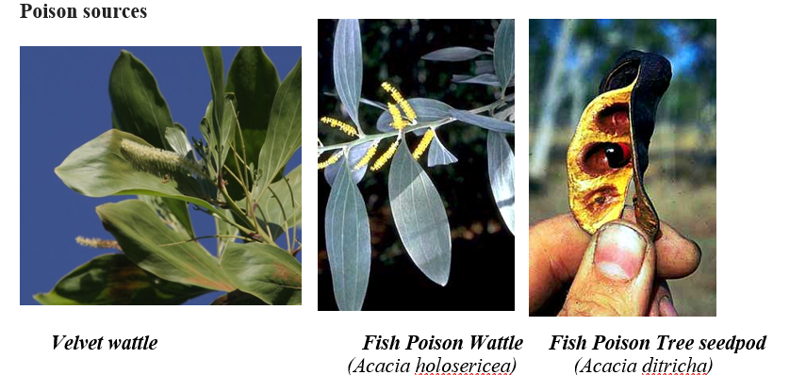
Indigenous fishing poisons

Slide 15
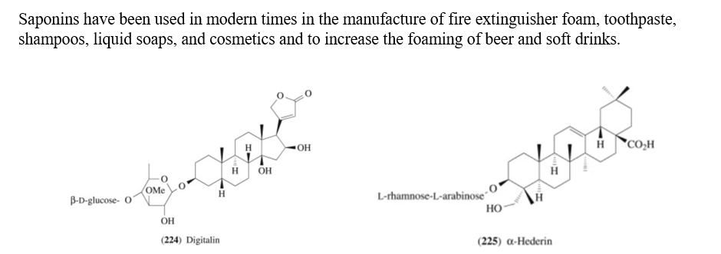
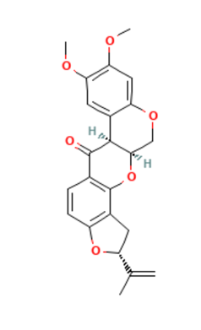
Saponins
Rotenones

Slide 16
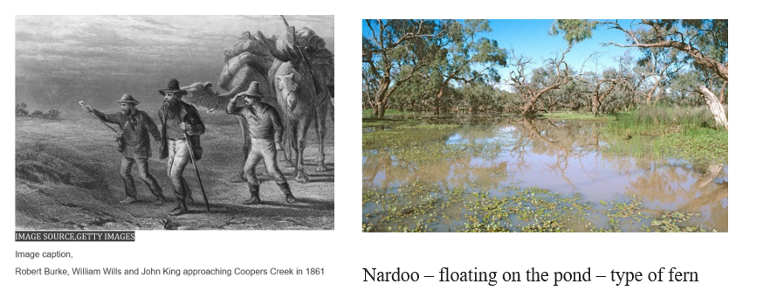
Nardoo

Slide 17
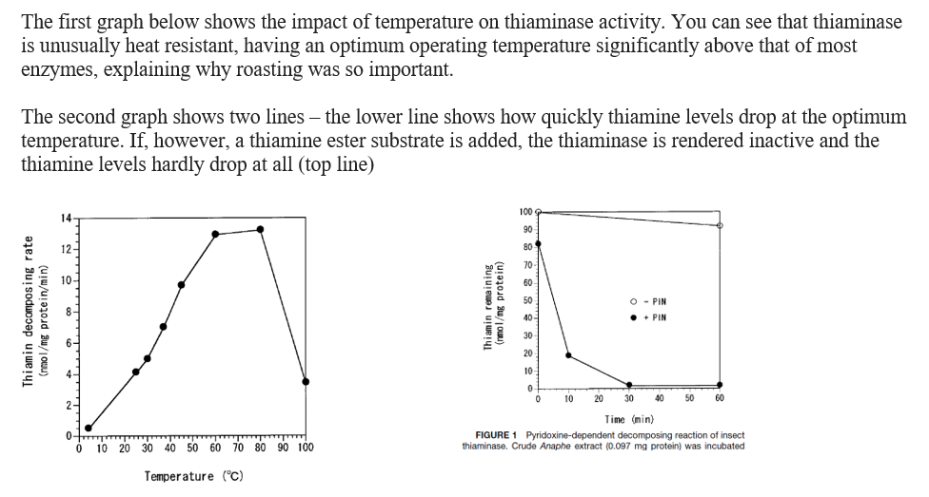

Slide 19
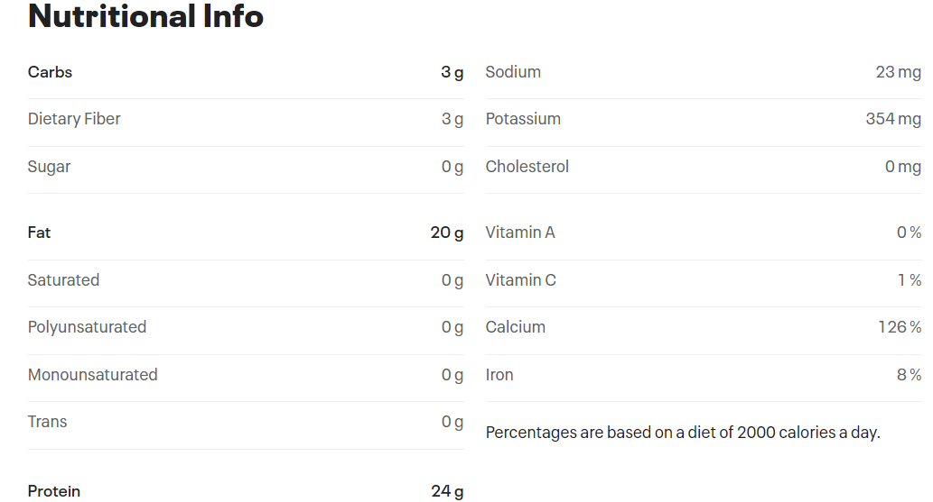

Slide 20
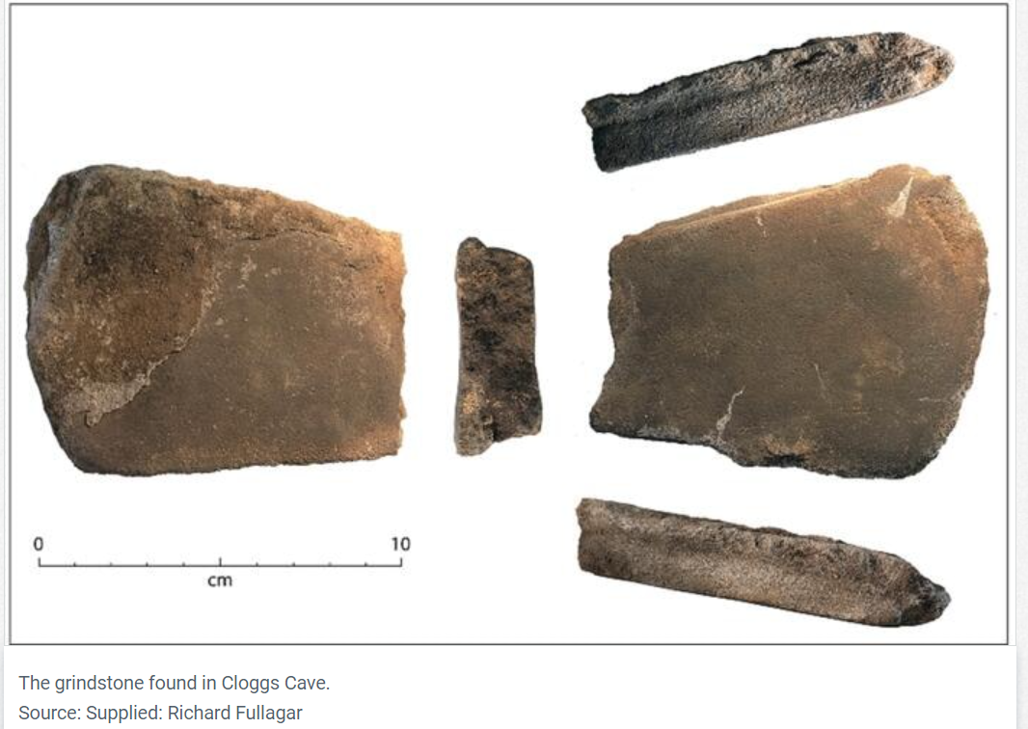

Slide 21
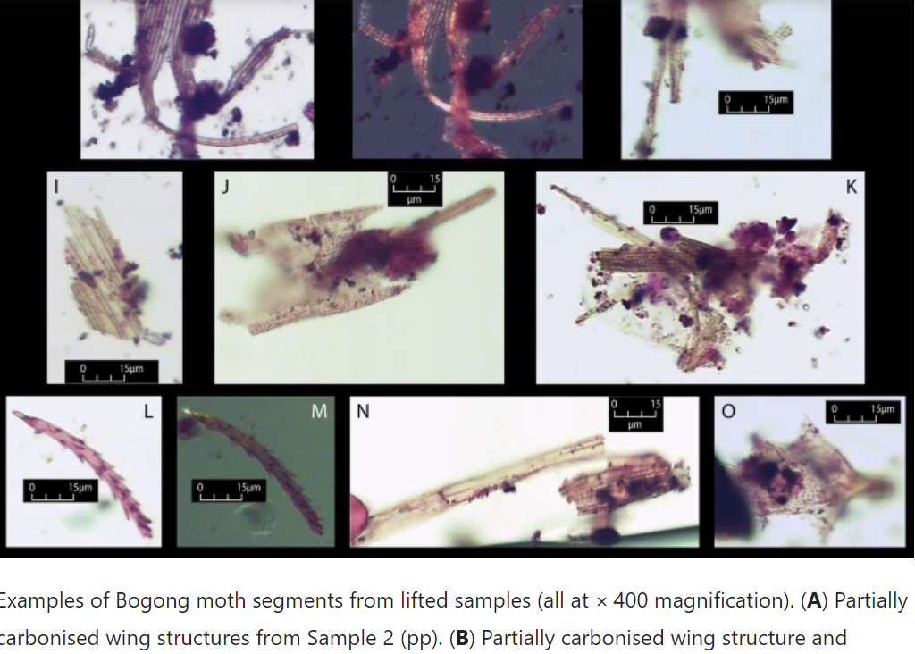

Slide 22
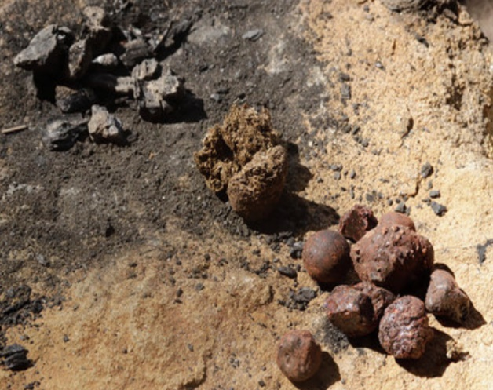

Slide 23
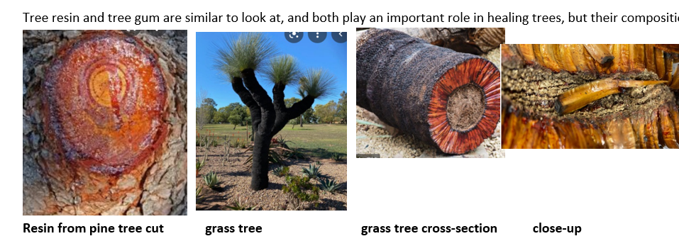

Slide 24
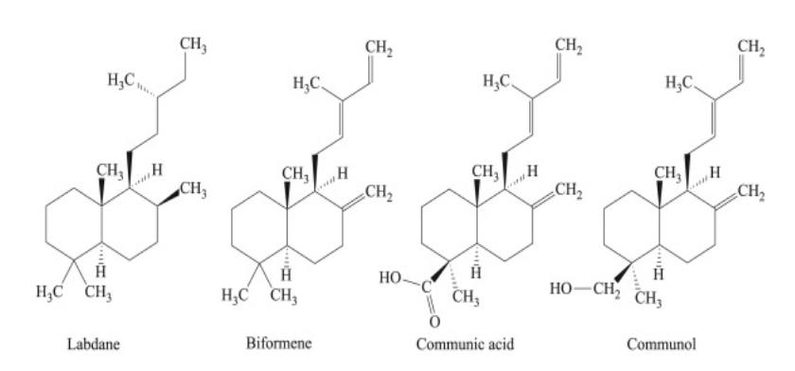

Slide 25
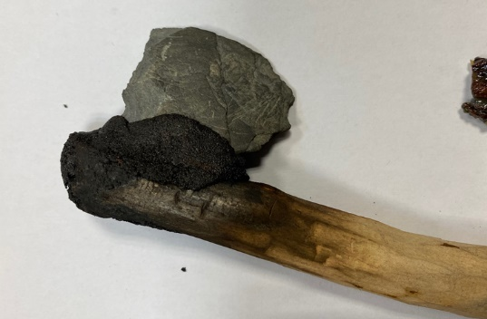

Slide 26
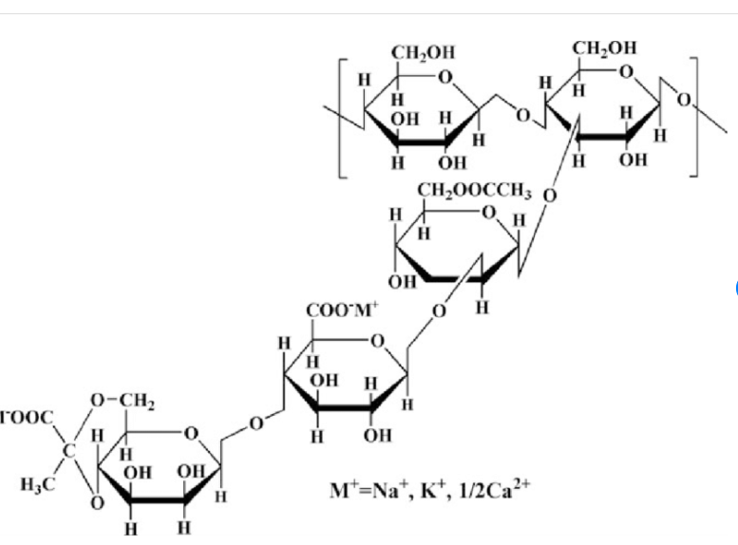
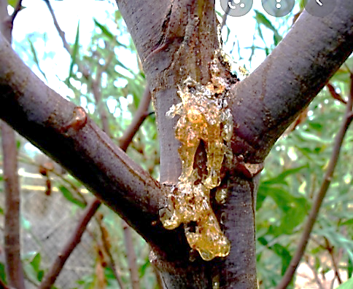

Slide 27
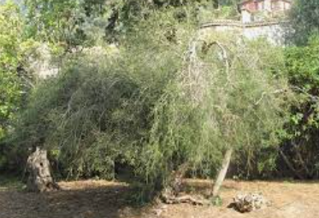
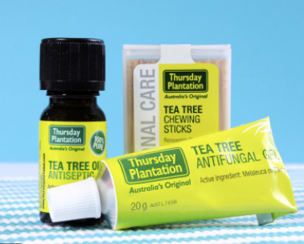

Slide 28
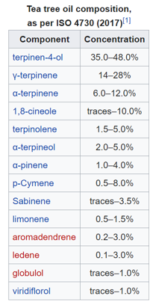
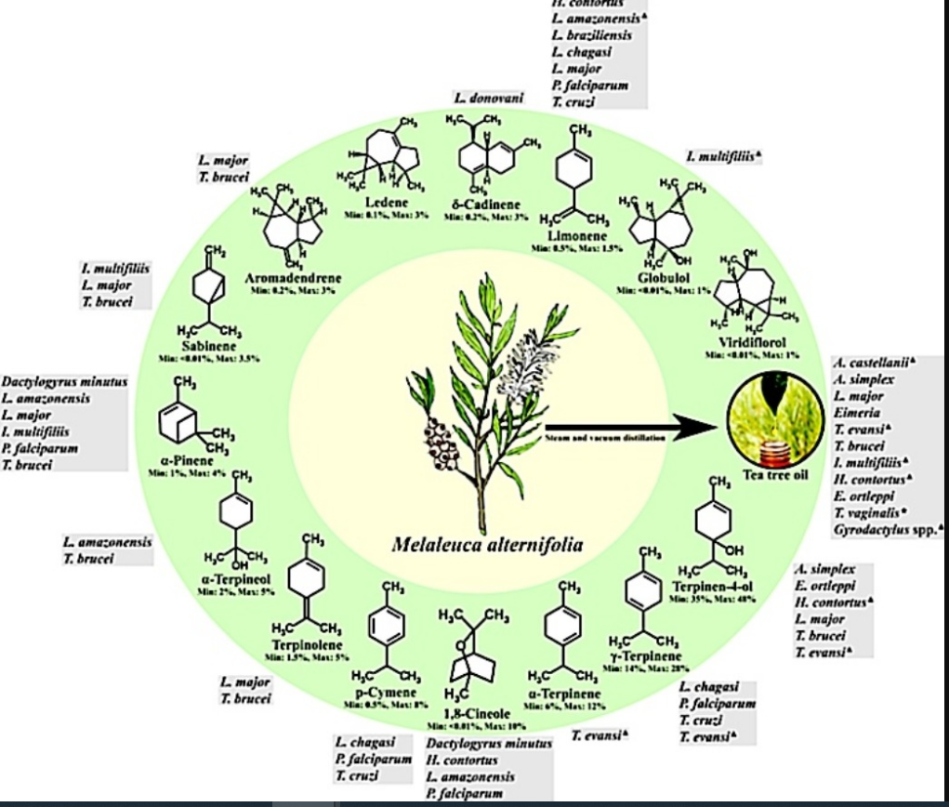

Slide 29
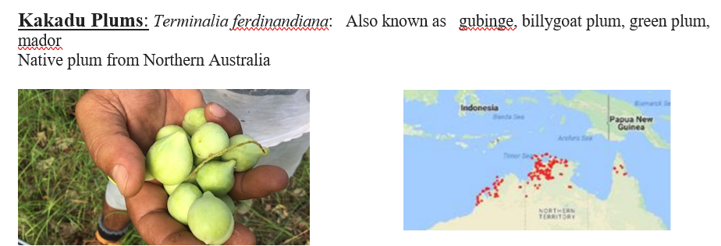

Slide 30
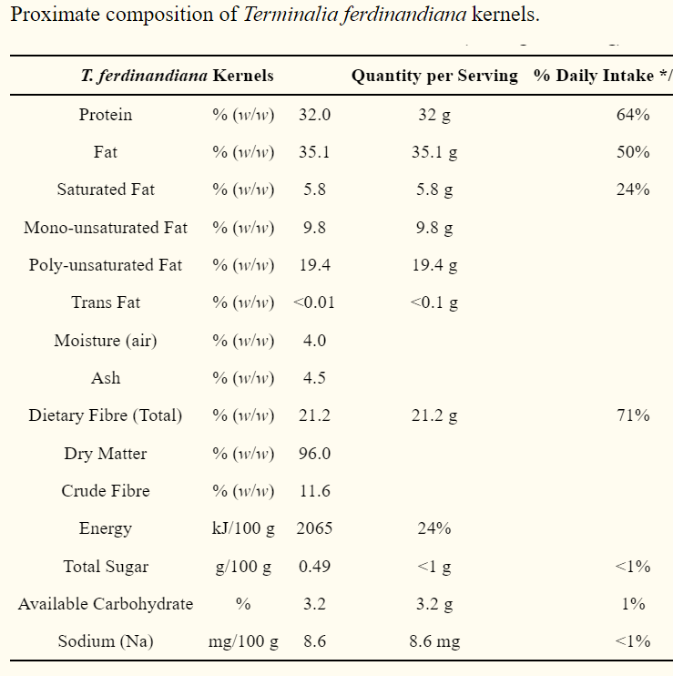

Slide 31
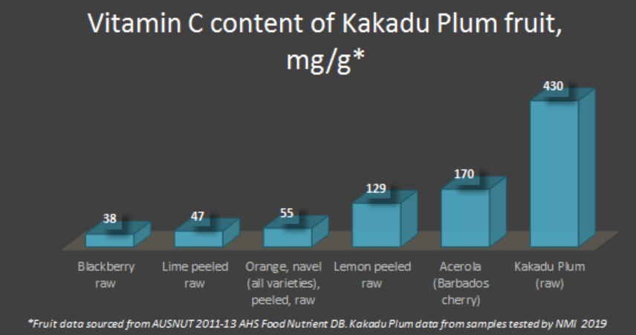
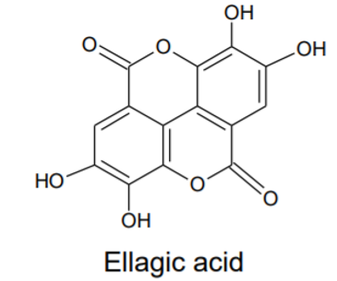
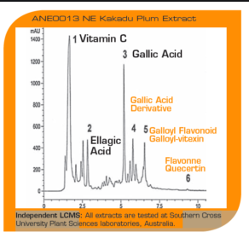

Slide 32
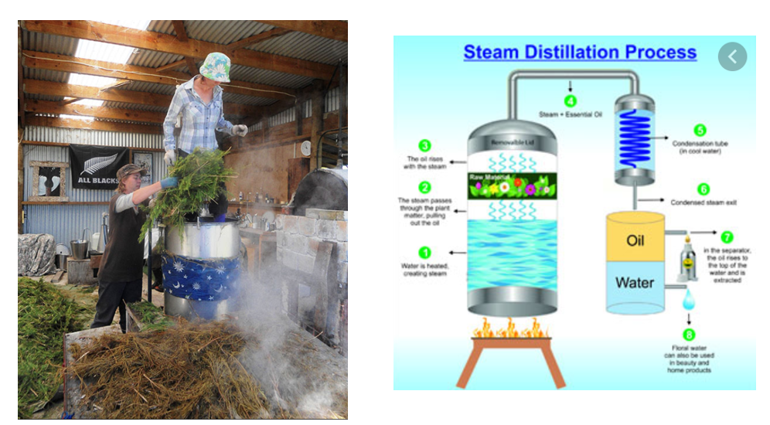

Slide 33
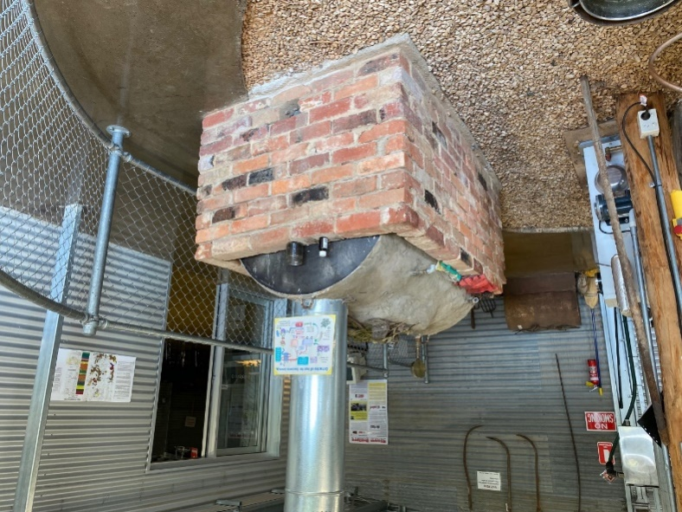

Slide 37
