Slide 1
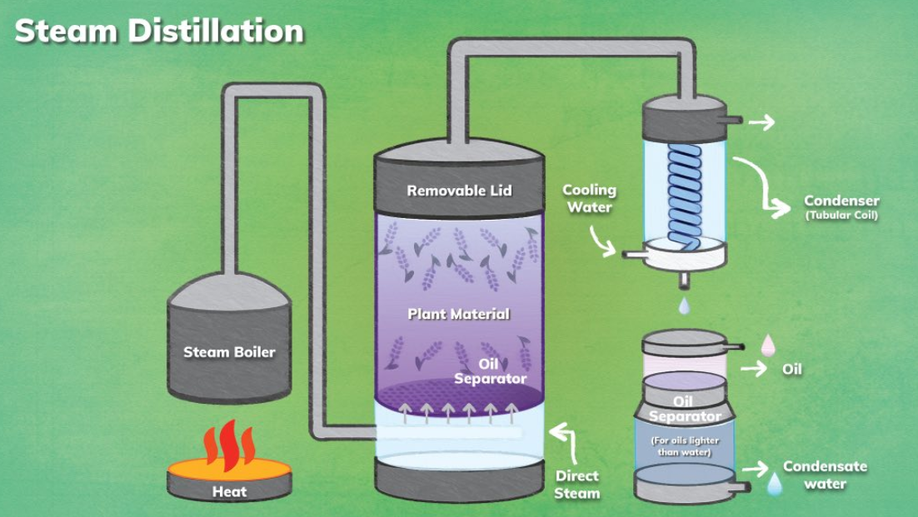
Conducting your own steam distillation of plants.

Slide 2
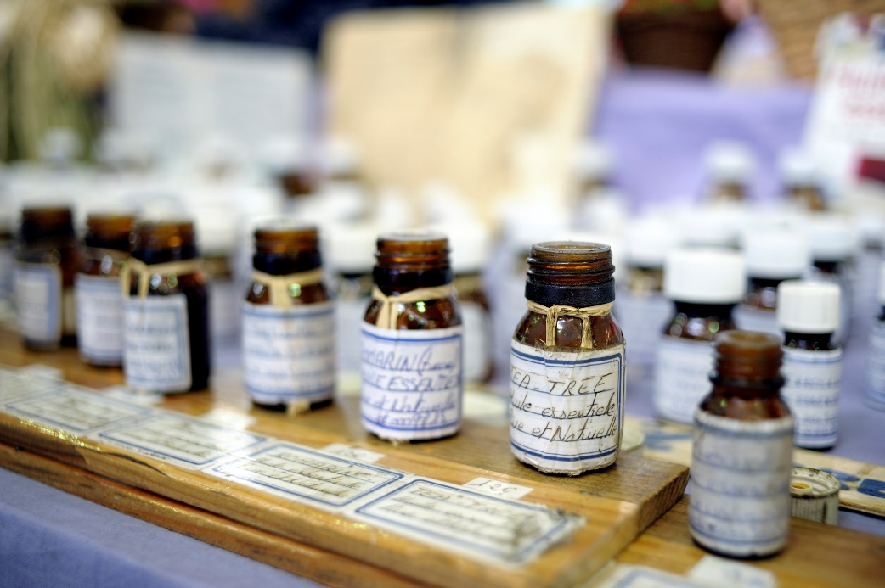
Victoria has a long history of commercial steam distillation, with eucalyptus oil and other aromatice

Slide 3
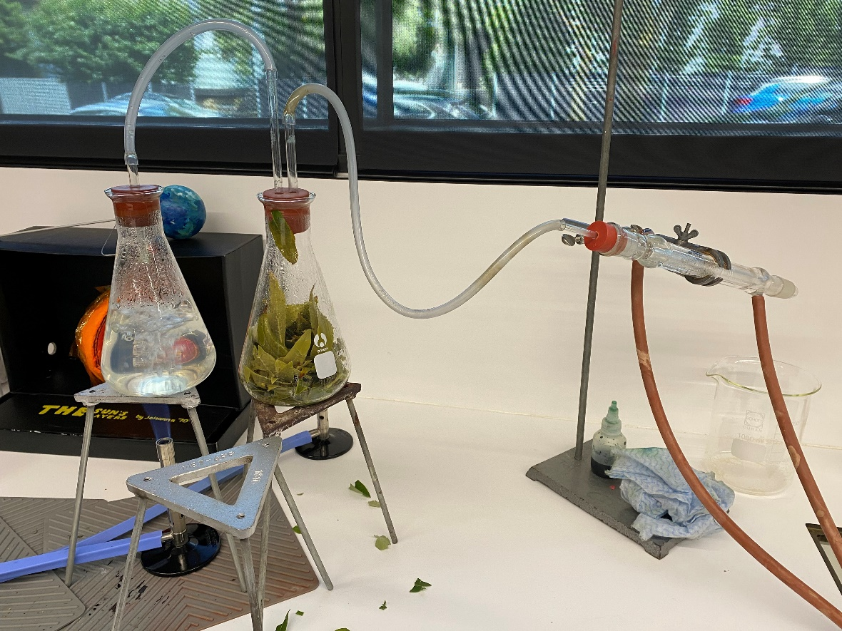
One version of steam distillation:
A single flask can be used but you need to be careful to make sure it does not boil dry..

Slide 4
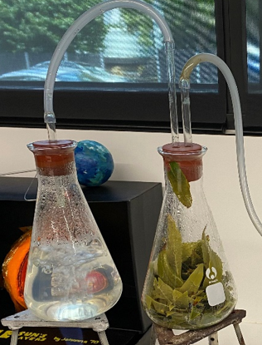
The flask on the left is a steam generator.
The glass tubing in the right flask goes to the bottom of the flask to deliver steam to the base of the flask

Slide 5
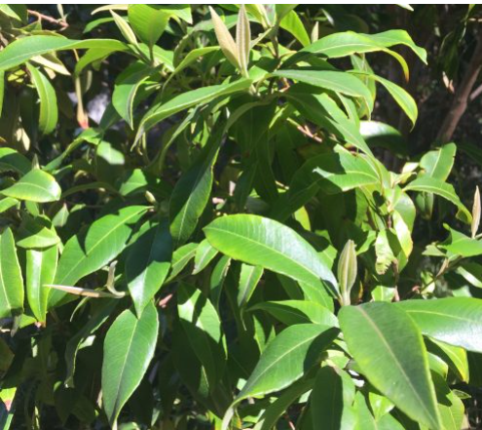
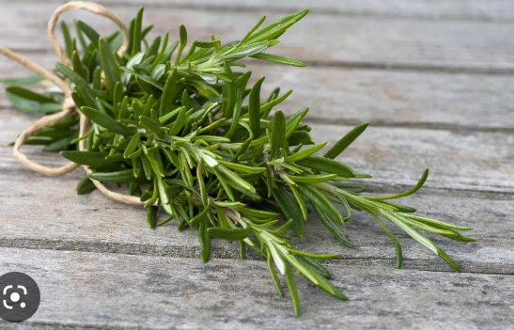
Plants to use:
Rosemary leaves
Lemon myrtle (recommendation of Helen Silvester Casey Tech)
Lavender

Slide 6
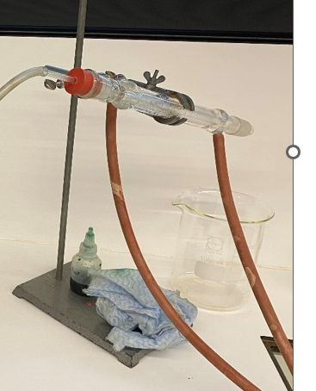
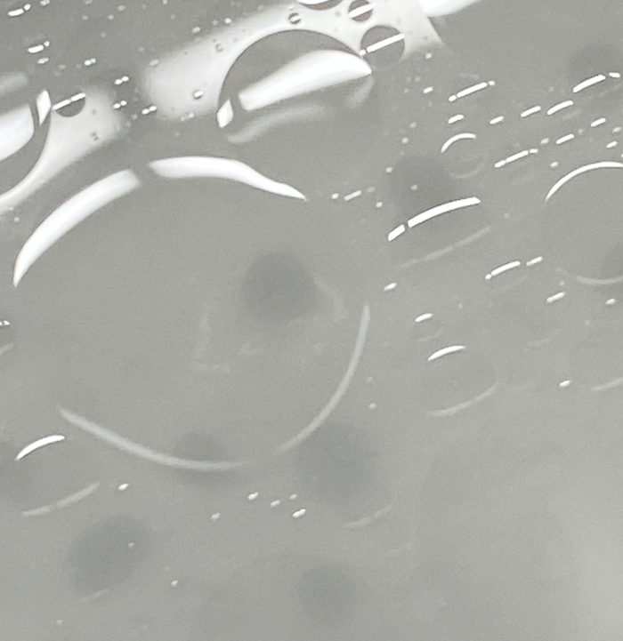
The condenser cools the steam and the oil it carries.
The photo on the right shows a layer of oil forming on the water surface.

Slide 7
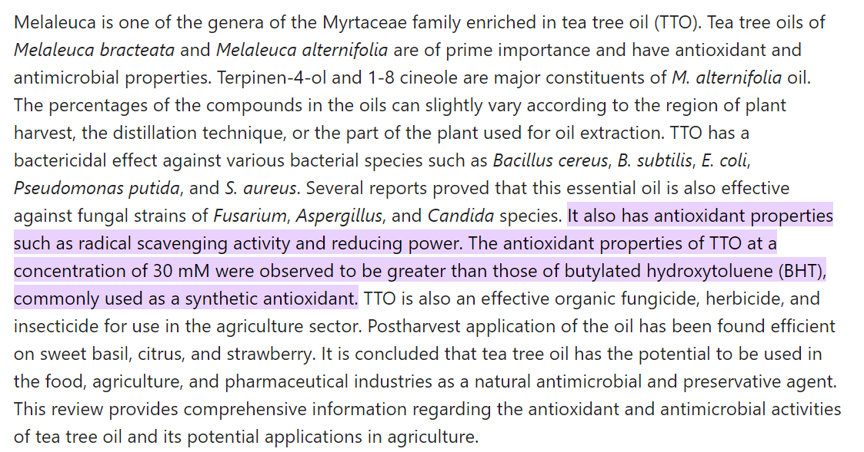

Slide 8
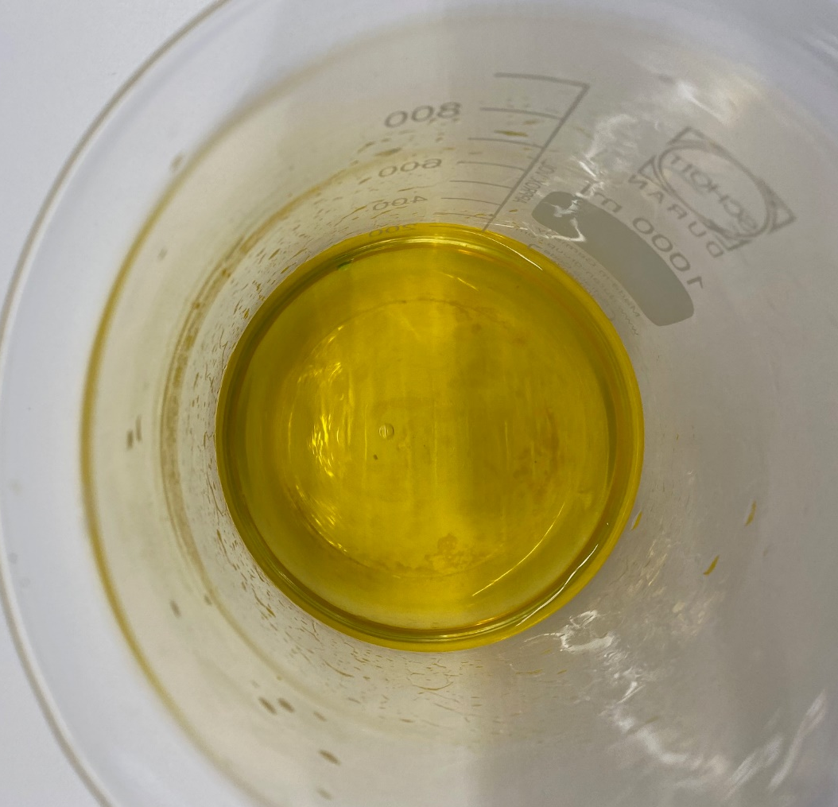
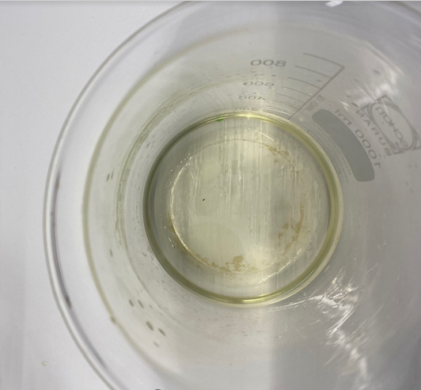
The antioxidant properties of plant oils:
Left beaker: Iodine solution is added to a distilled mixture of water and oil.
Right beaker: Shortly after, the iodine is decolourised as it is reduced – due to the plant extract being oxidised.
(Diluted betadine can be used in place of iodine)

