Slide 1
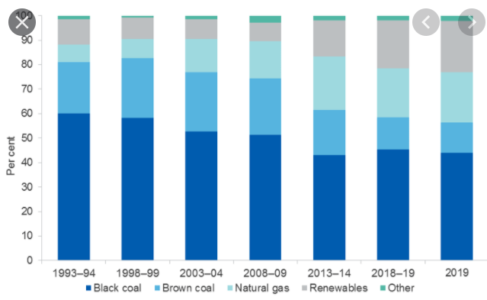
Australian energy data: 2020
Keep in mind: Public attention on energy usage usually focuses solely on electrical energy, where we are making improvements.
This is misleading as we have two other huge areas of consumption-
transport and
Industry heating (example steel production)
In the case of transport we are making less progress.

Slide 3
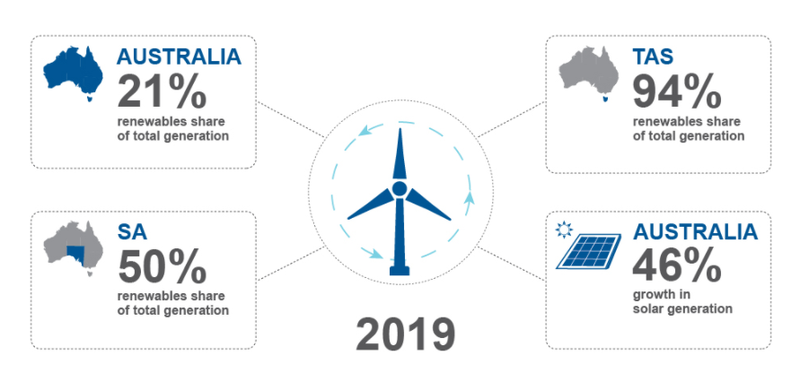
21% renewable means 79 % fossil fuel.
Note the big difference between states with renewable use – Tassie and SA have left Qld/NSW a long way behind

Slide 4
Coal: dig up carbon and burn it to form CO2 – convert the thermal energy to electrical.

Slide 5
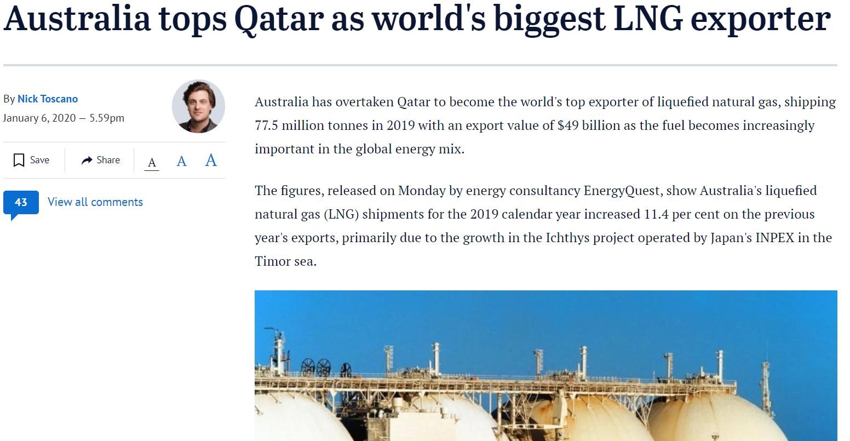
We are good at something! Is it something we want to be good at?
Try this sum. Assume natural gas is all methane and calculate the mass of CO2 that will be formed from combustion of the figure given of 77.5 million tonnes methane.

Slide 6
Energy industry view

Slide 7
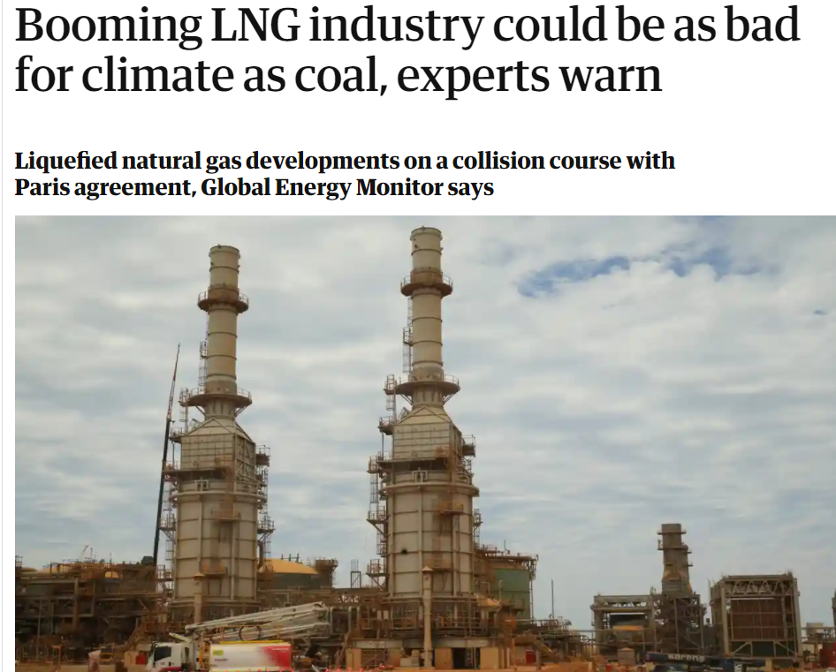
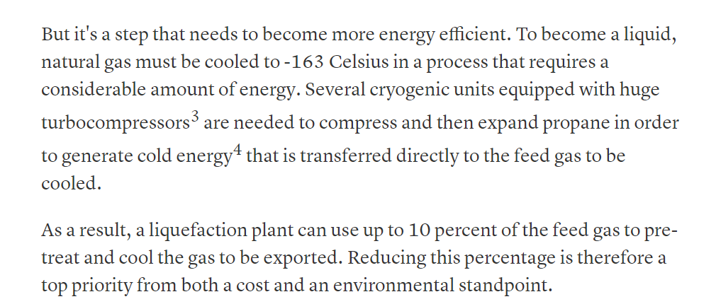
Environmental agency view
Keep in mind – liquifying natural gas is challenging, costly and energy intensive.

Slide 8
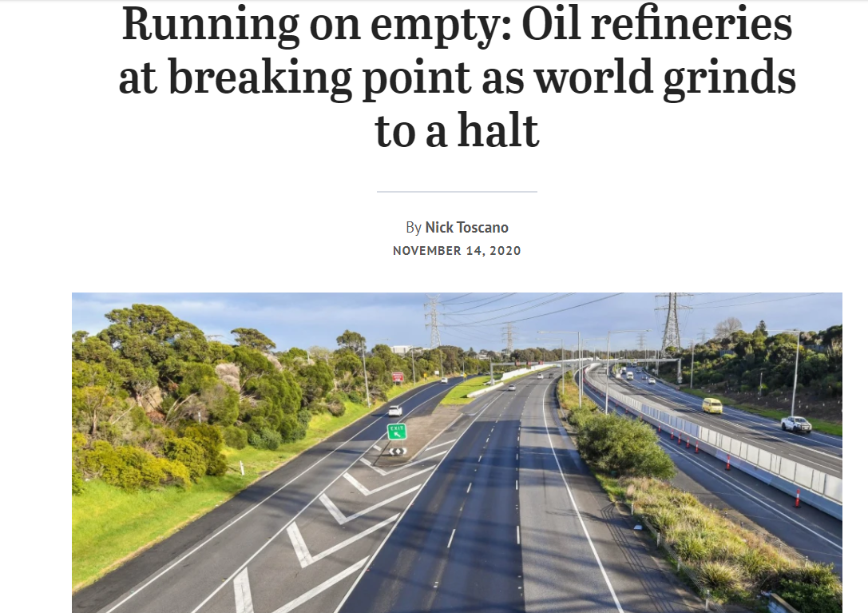
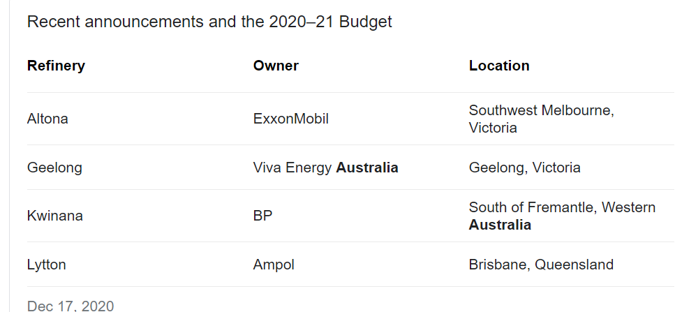
Issue: Australia had over 10 oil fractionating plants – now we are down to 3. In the event of a crisis, we could not manufacture near enough petrol or diesel of our own

Slide 9
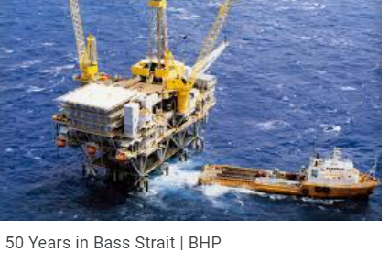
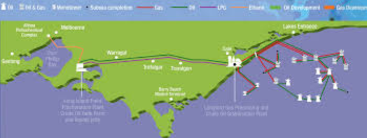
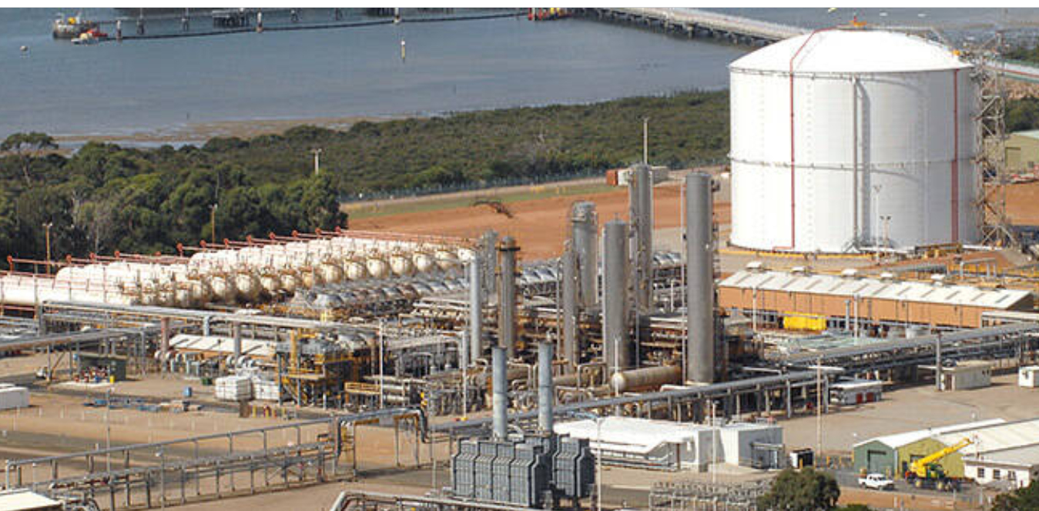
Issue: Australia exports LNG but Victoria has to import from other states, hence gas is costly.
We do have some gas still in Bass Strait. It is
piped to Sale then to
Long Island Point where it is fractionated to propane and ethane. Ethane goes to Altona to make ethene (Exxonmobil) and polyethene. Propene similarly is used to make polypropene (LyondellBasel).

Slide 10
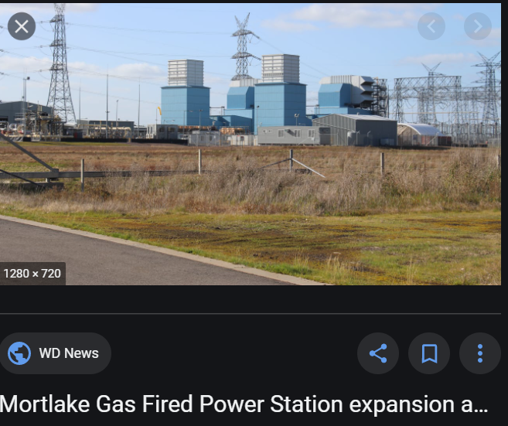
Some gas is also taken from near the Twelve Apostles to Mortlake to produce electricity.

Slide 11
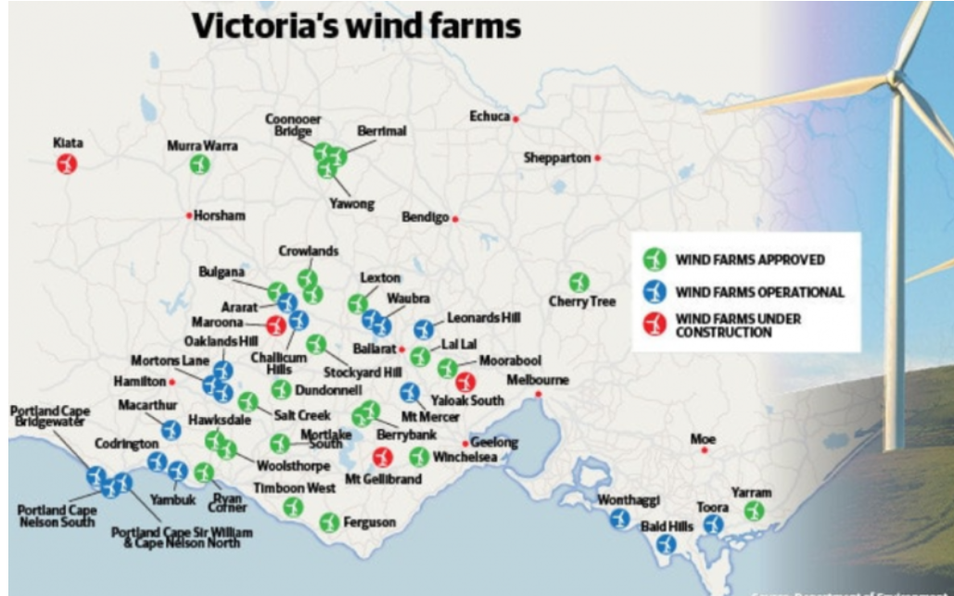
Innovation: Victoria about to pass SA for wind generation.

Slide 12
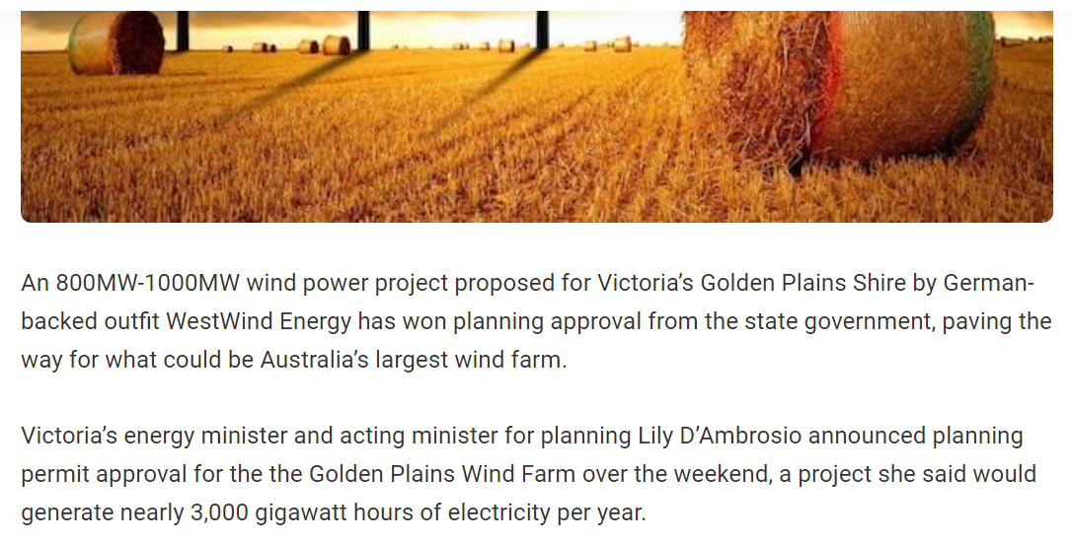
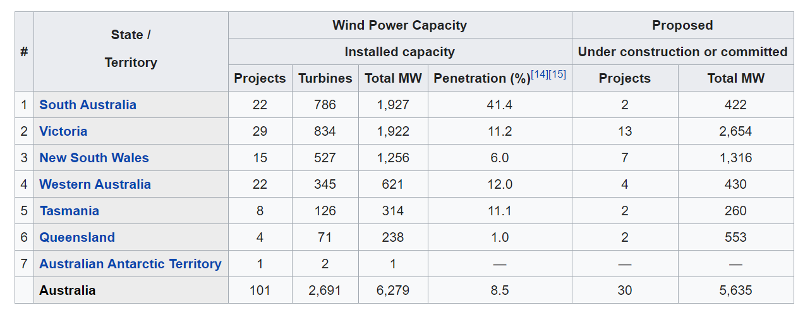

Slide 13
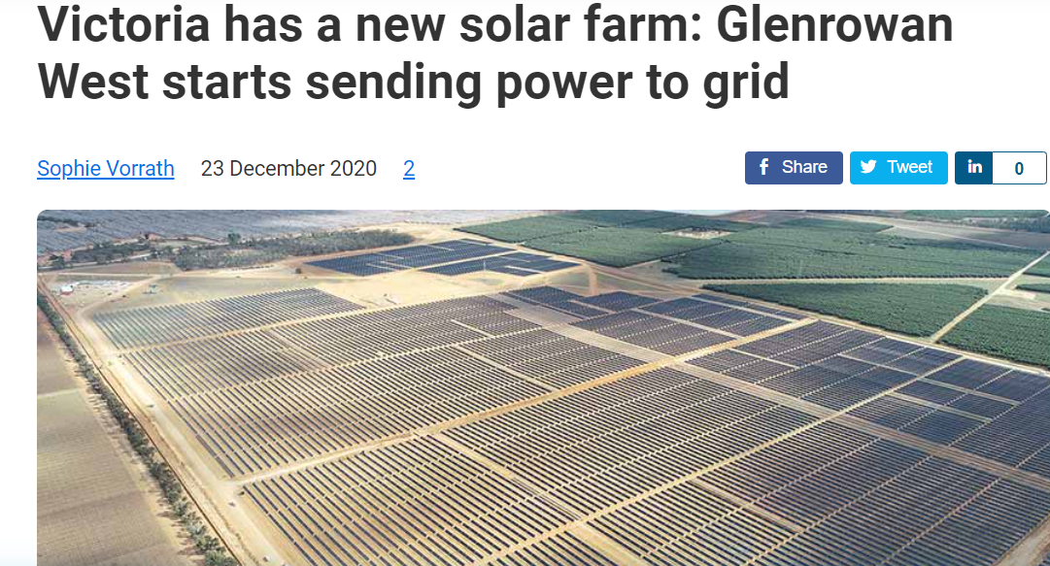
Innovation: Solar farms

Slide 14
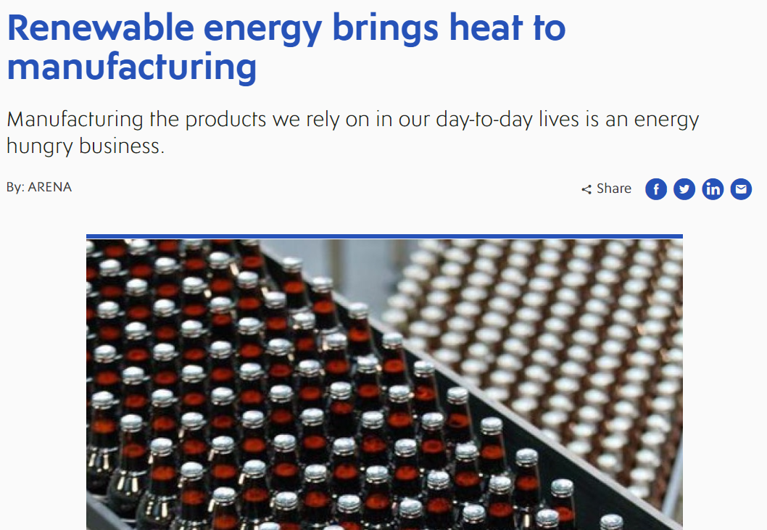
Innovation: Businesses are aiming to be zero net energy users.

Slide 16
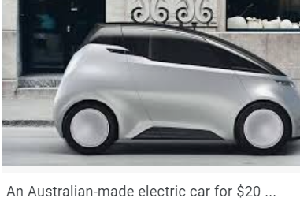
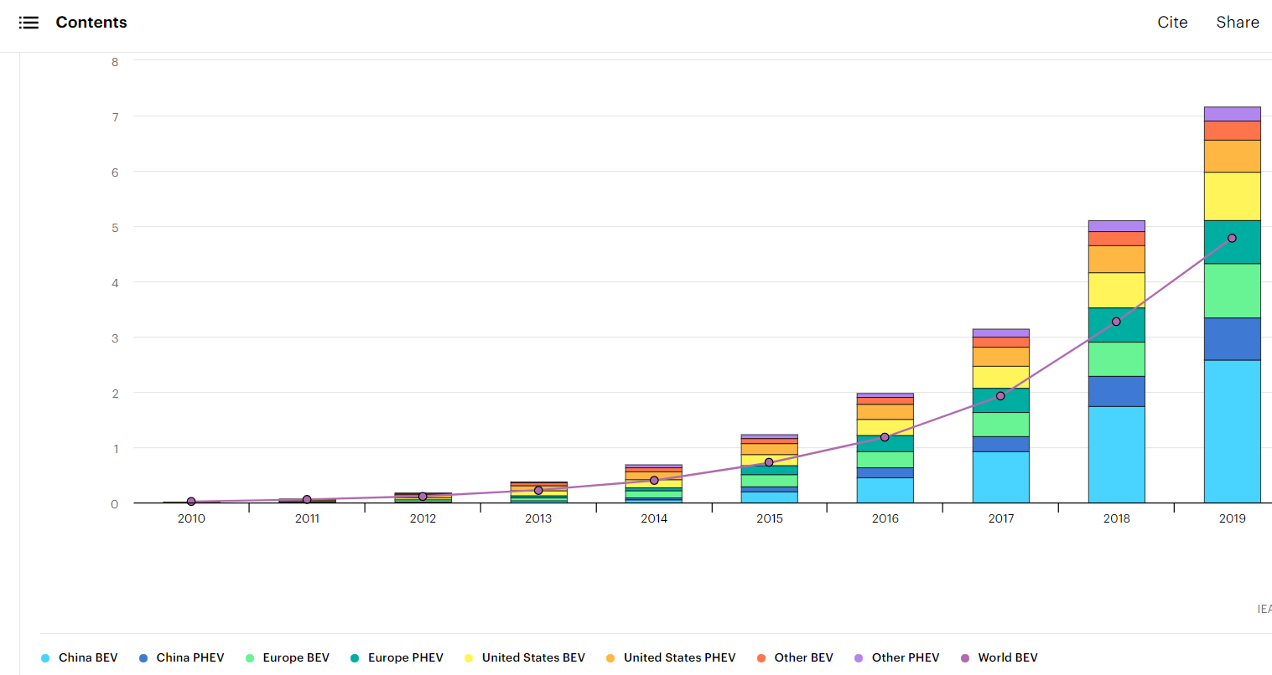
Innovation: Other countries are moving to electric cars at a rapid rate

Slide 17
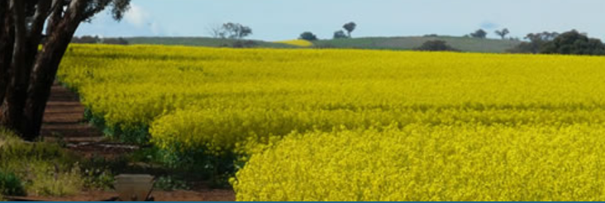
Canola industry: Most of us have seen these yellow crops but did you know 80% of our canola is exported, mainly for biodiesel production in Europe and Asia.

Slide 18
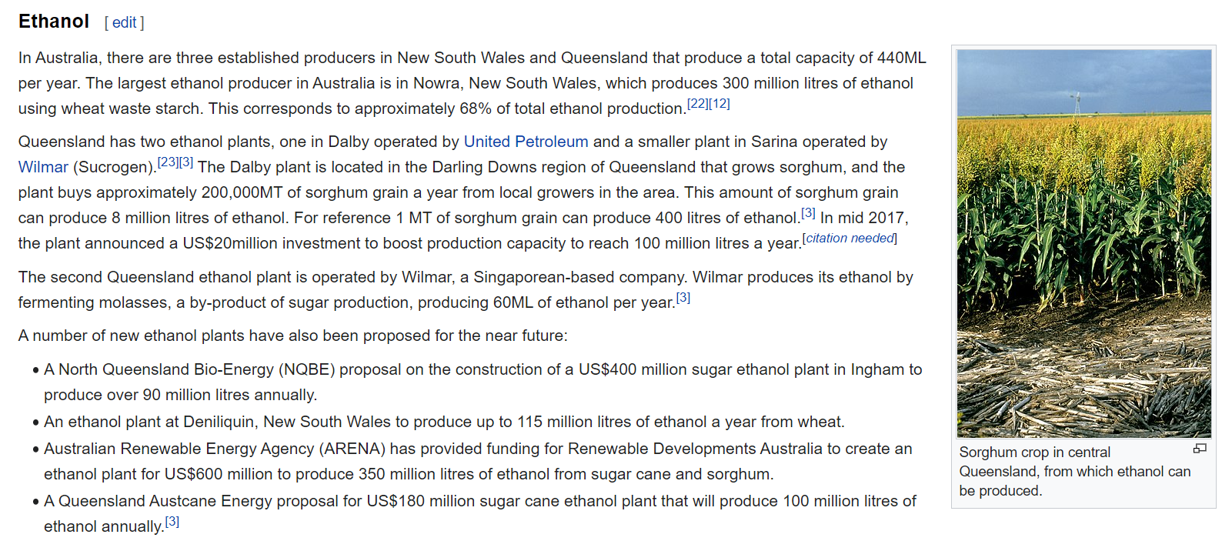
We have 3 operational bioethanol plants, 2 in Qld using sugar waste and one in NSW using wheat waste.

Slide 19
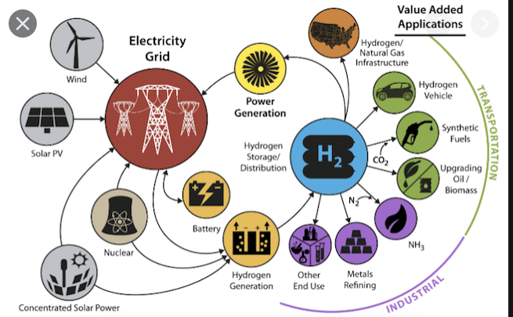
Hydrogen economy – much touted. Can be used for fuel cells in cars or blended with natural gas for your house

Slide 20
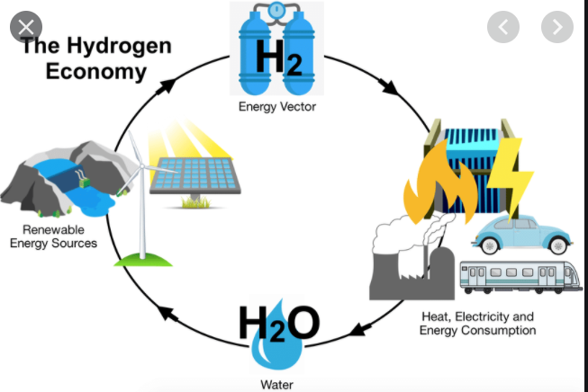
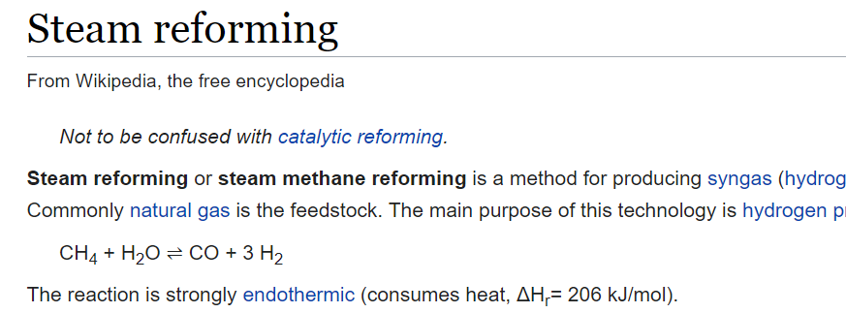
Good or bad? Depends entirely on one thing – whether the hydrogen is produced by electrolysis of water using renewable energy or whether it is formed from coal or natural gas where the process involves CO2.

