Slide 4
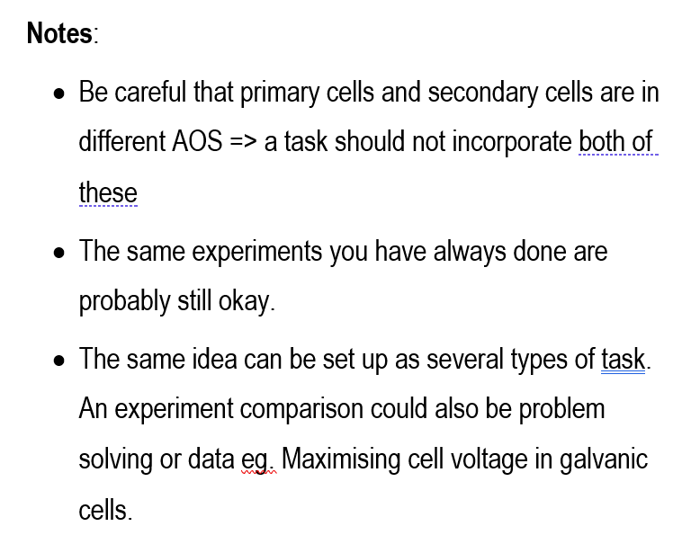

Slide 5
Same theme – different task: Bioethanol
Case Study Ethtec trial plant in the Hunter Valley. Wilmar bioethanol Australia
Problem solving: Finding ideal conditions and sugars for fermentation
Comparison: different fruits, different sugars, % ethanol obtained
Investigation: Ways of determining the rate of fermentation reaction

Slide 6
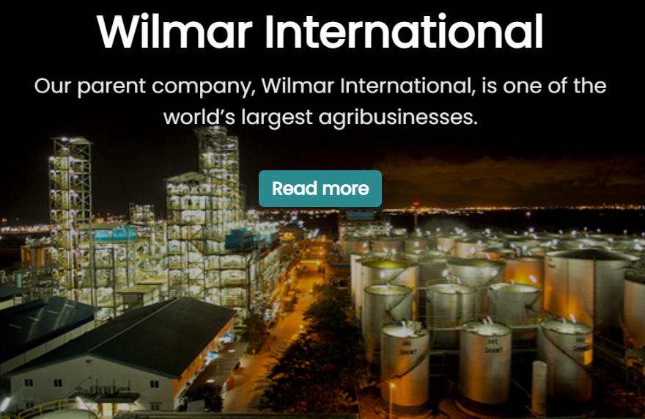
Wilmar: Yarraville

Slide 7
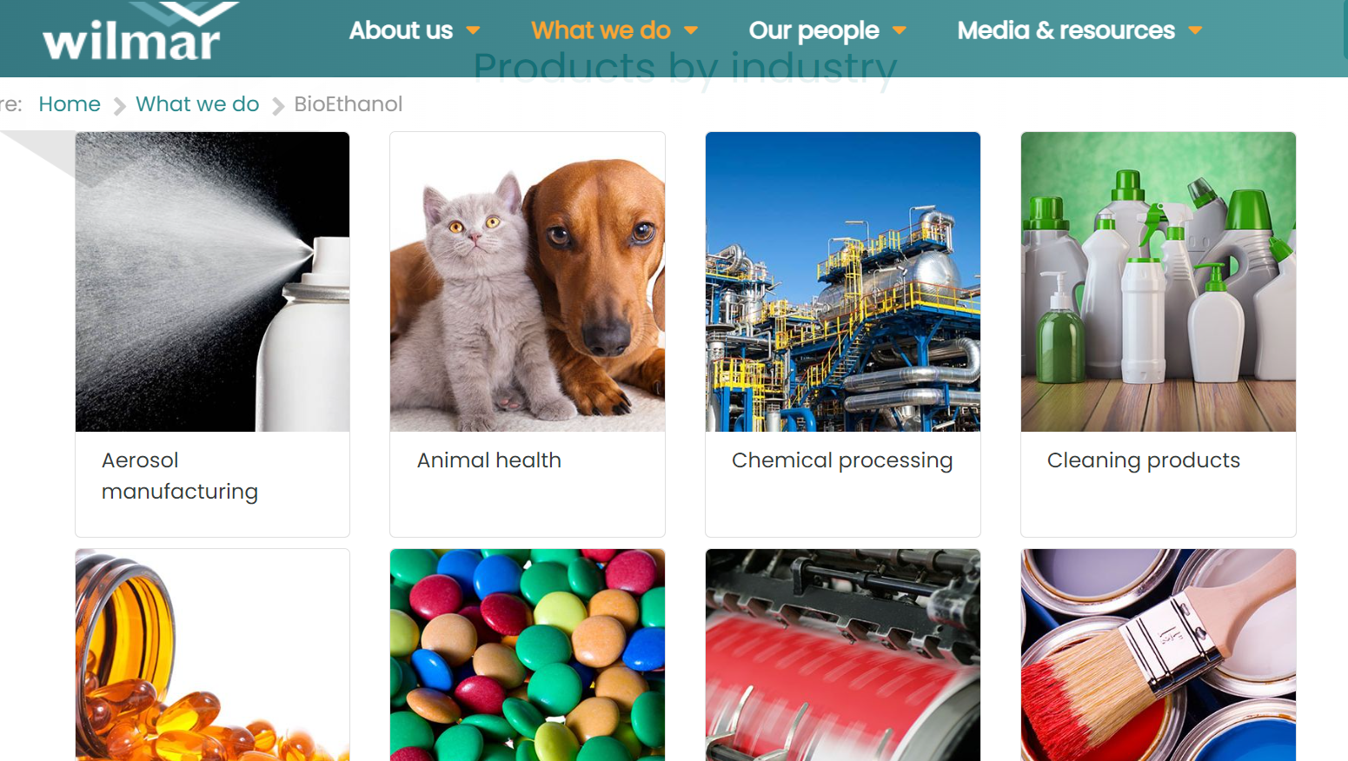

Slide 8
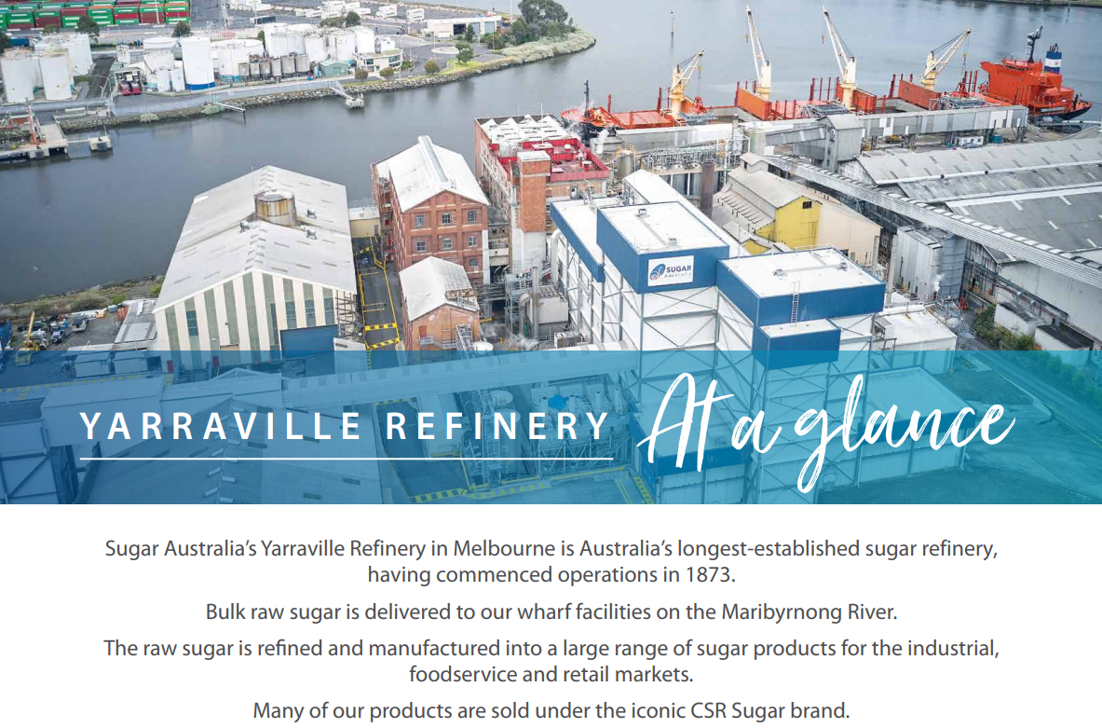

Slide 9
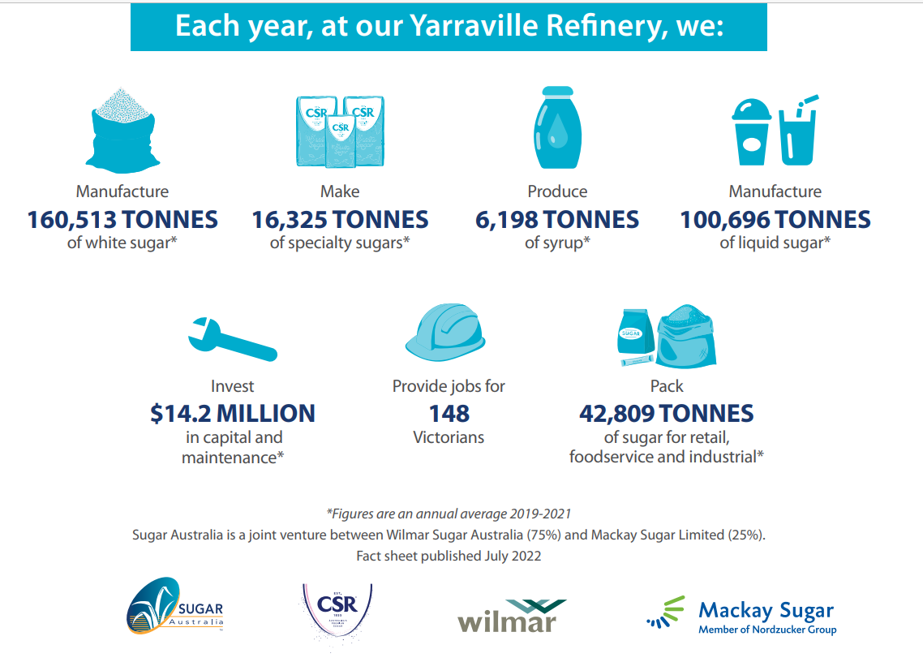

Slide 12
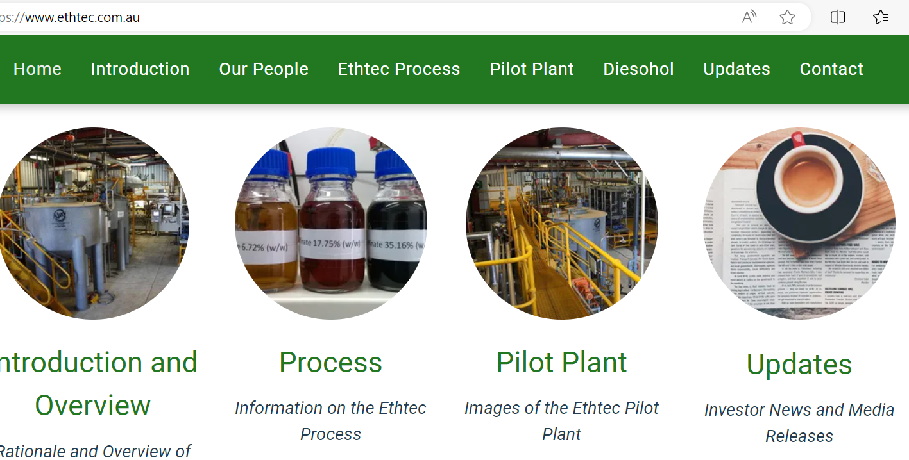

Slide 13
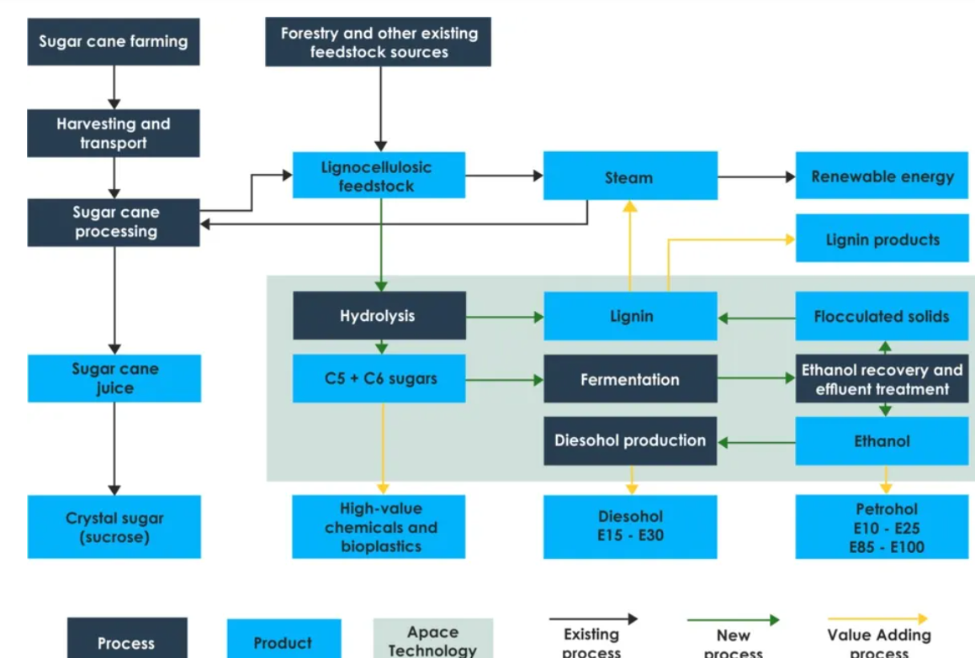

Slide 14
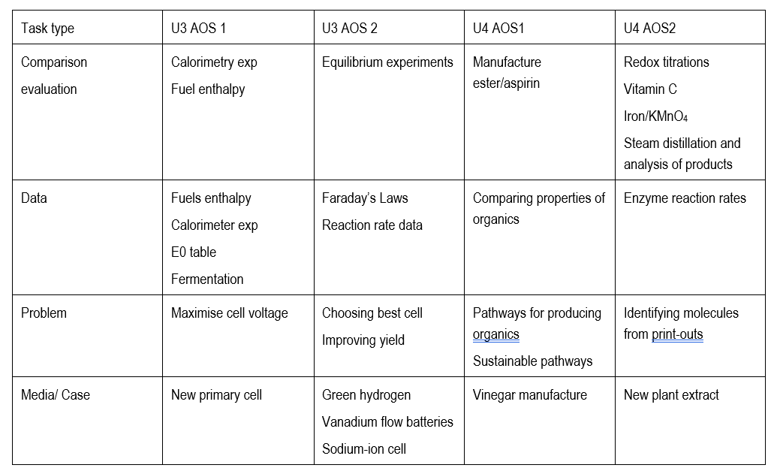

Slide 15
Calorimeter pracs rate data pathways problem pinocembrin case study

Slide 16
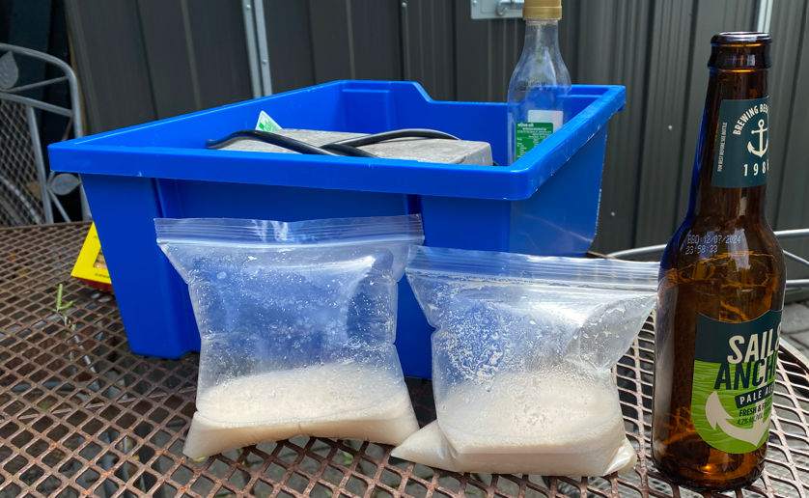

Slide 17
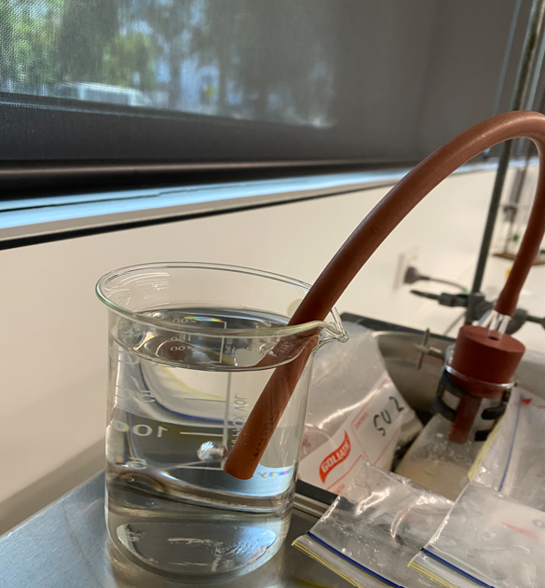
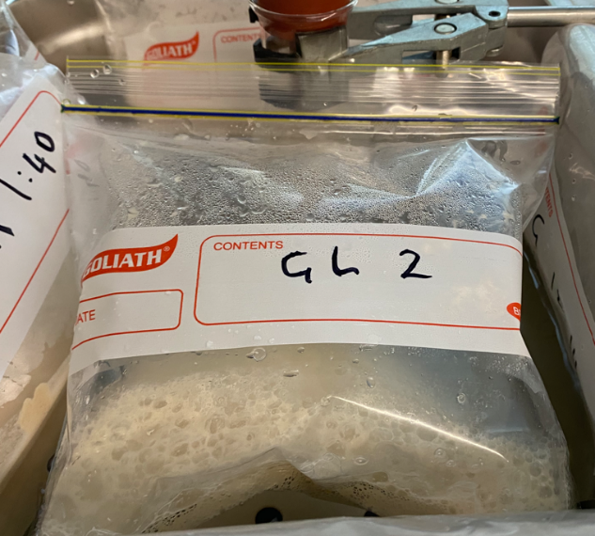
Fermentation of sugars
Rate of bubbles emerging indicates the reaction rate.
Investigate a range of factors
- SAC with Kilbaha

Slide 18
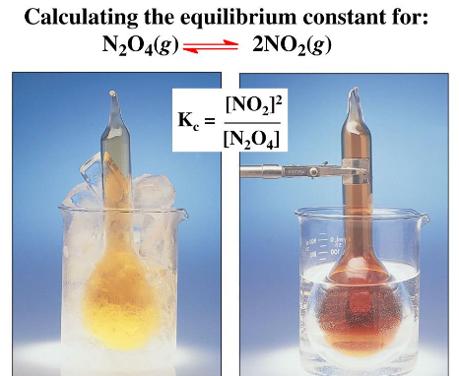
Comparison
Equilibrium constant and temperature: exothermic (CoCl₆) vs endothermic (N₂O₄)
Electrolysis of CuBr2 compared to NaCl
Electrical calibration vs chemical calibration
Enzymes and pH vs enzymes and temperature
Bioethanol and different sugars
Aspirin vs esters

Slide 19
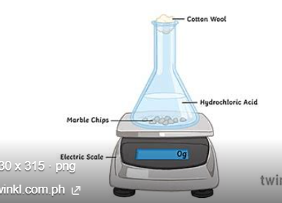
Typical experiments that are obviously still relevant
Calorimetry, burning of food
Biodiesel manufacture
Redox: Electrochemical series
Rate: CaCO3 + HCl HCl + Na2S2O3
Equilibrium cobalt chloride, NO2,
Electrolysis: Faraday’s Laws CuSO4 copper electrodes
Organic: Ester, aspirin
Redox titrations
Enzyme reaction rates

Slide 20
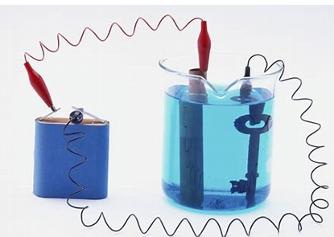
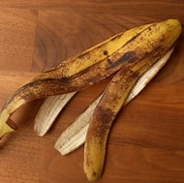
Problem solving
How to improve the efficiency of your calorimeter
Cost of using different fuels to travel 1000 km
Working out how to get good vitamin C redox results –
comparing fruits and vegies
Identifying an unknown molecule
Improving the yield of a reversible reaction eg green ethene
Best battery to use
Slowing the rate of cut fruit deterioration
Improving the voltage of a galvanic cell
Successful electroplating
Measuring viscosity of organic liquids
Successfully tracking an enzyme reaction
Producing quality bioethanol
% purity of oxalic acid or steel wool

Slide 21
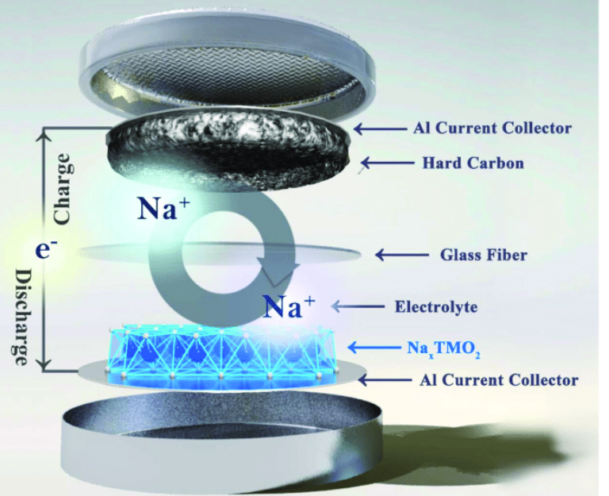
Case Studies/Media Files

Slide 22
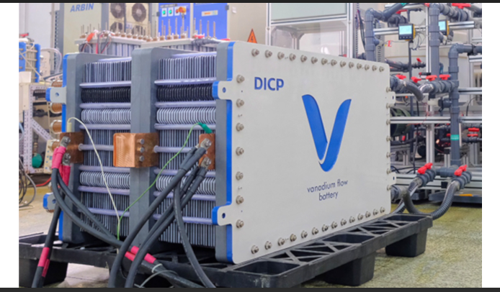

Slide 23
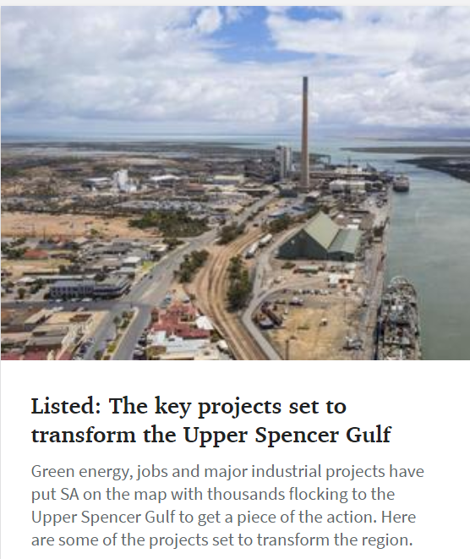
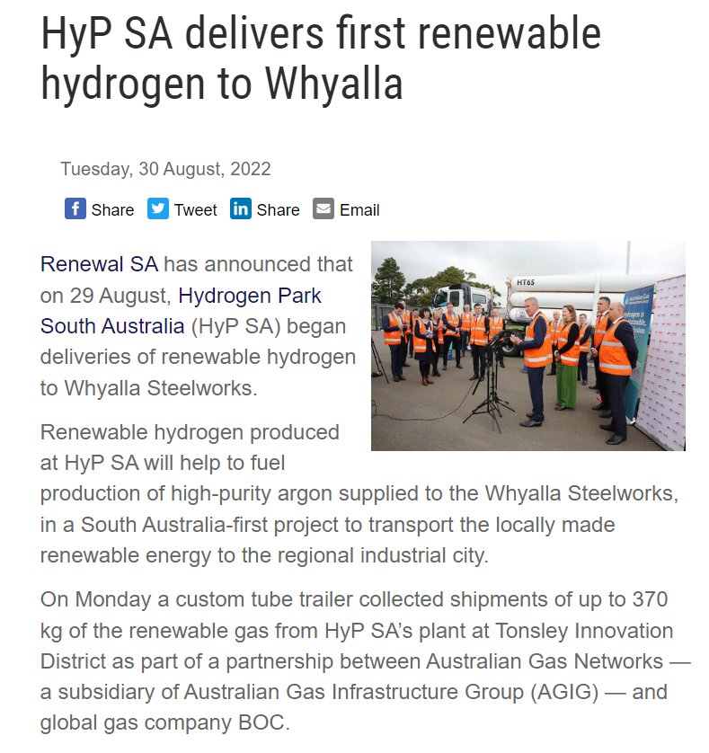
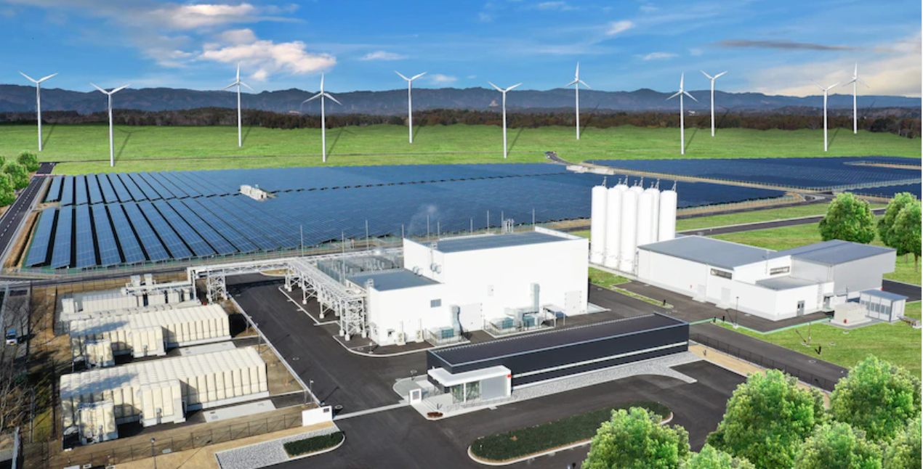
Green hydrogen
-energy source
-sustainability
-electrolyser
- associated industries
-catalysts

Slide 25
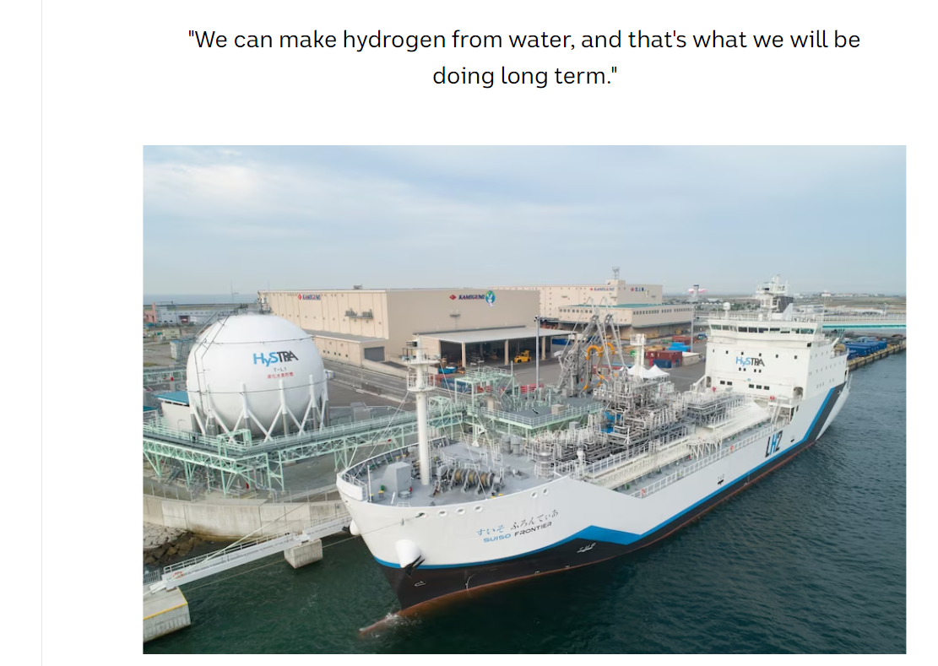

Slide 26
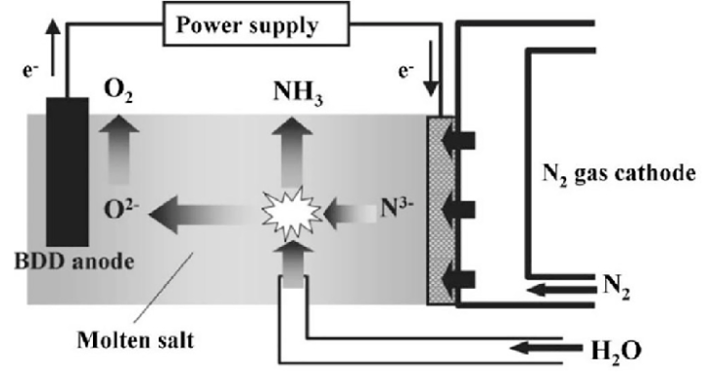
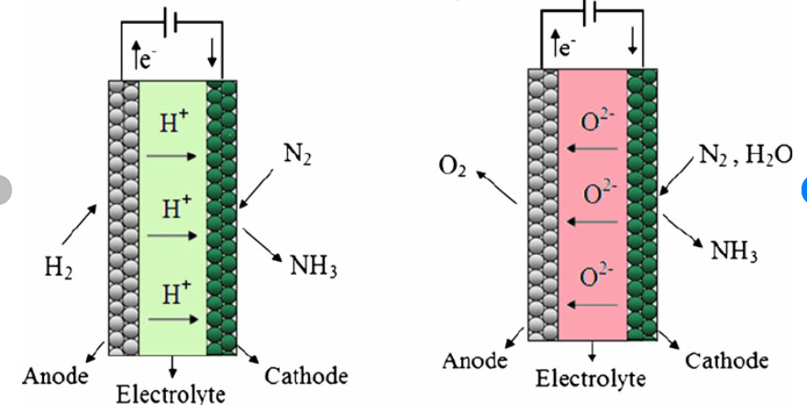
Green ammonia
renewable energy
better catalysts
electrolysis not Haber

Slide 27
What’s in a case study? Questions on
Traditional Haber process
Conditions used for the equilibrium optimisation – why they work
Limitations of this process
Green ammonia – renewable energy used to power the plant
Hydrogen produced in a PEM
Sustainability issues
Electrolytic production

Slide 28
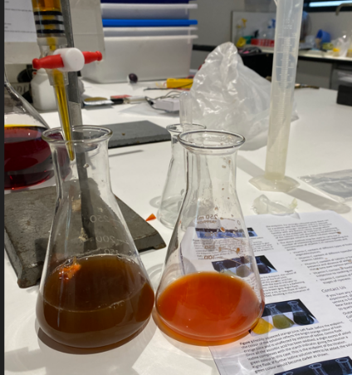
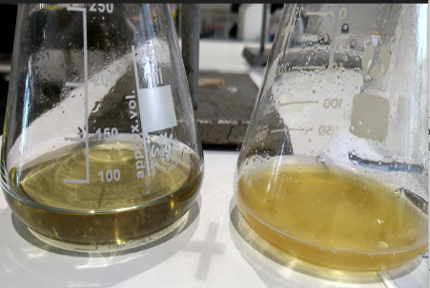
Vitamin C content: orange juice
Capsicum
Kakadu plum
University of Canterbury vitamin C

Slide 29
Case Study: Vitamin C in Kakadu plums
Comparison: Vitamin C in different fruits
Different methods of preparing your sample.
Data: Each group puts their data on the board and you graph it.
Problem solving: How to judge the endpoint? How do commercial juices fare?
Investigation: aspects of the above

Slide 30
Case Study: Galvanic cells. Zinc bromide cell.
Vanadium flow battery
Data: Forming your own electrochemical series.
Comparing the voltage produced against electrode separation, depth
Problem solving: How to maximise the voltage. What commercial battery is the best value?
Investigation

Slide 31
Reaction rates
Comparison of marble chips and temp, then marble chips and concentration. Measure mass or volume
Rhubarb and potassium permanganate
Problem solving: oxalic acid content of different parts of a rhubarb plant
Can you determine oxalic acid content of rhubarb?
Data: Analyse the data and draw graphs rather than compare the experiments.

Slide 32
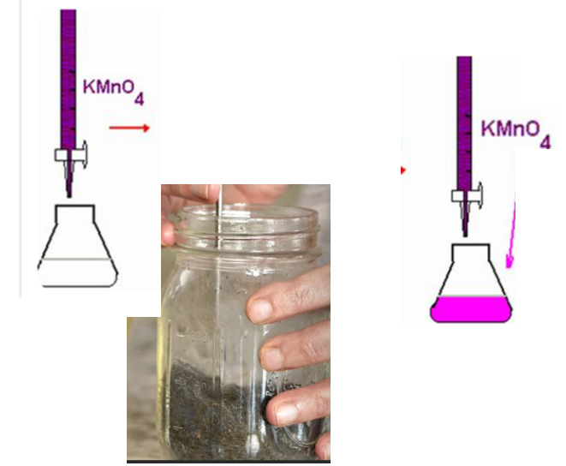
% purity of steel wool
Fe + H₂SO₄
Fe2+ + MnO₄⁻

Slide 33
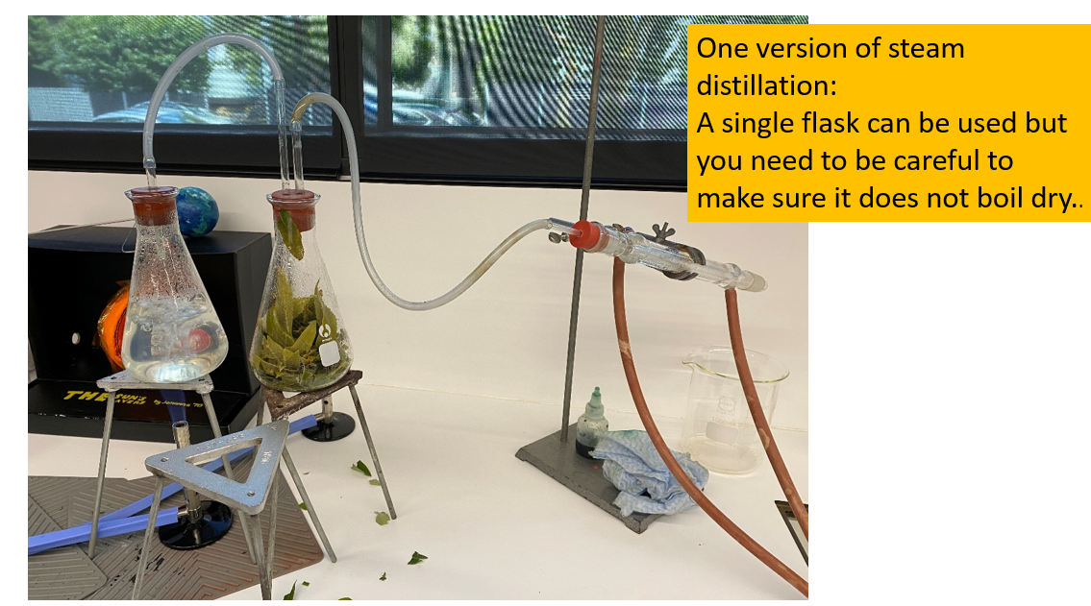

Slide 34
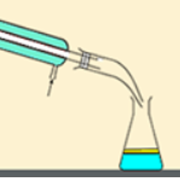
Non-polar components
1,8-cineole anti-microbial
limonene
Polar components
Ascorbic acid antioxidants
Ellagic acid

Slide 35
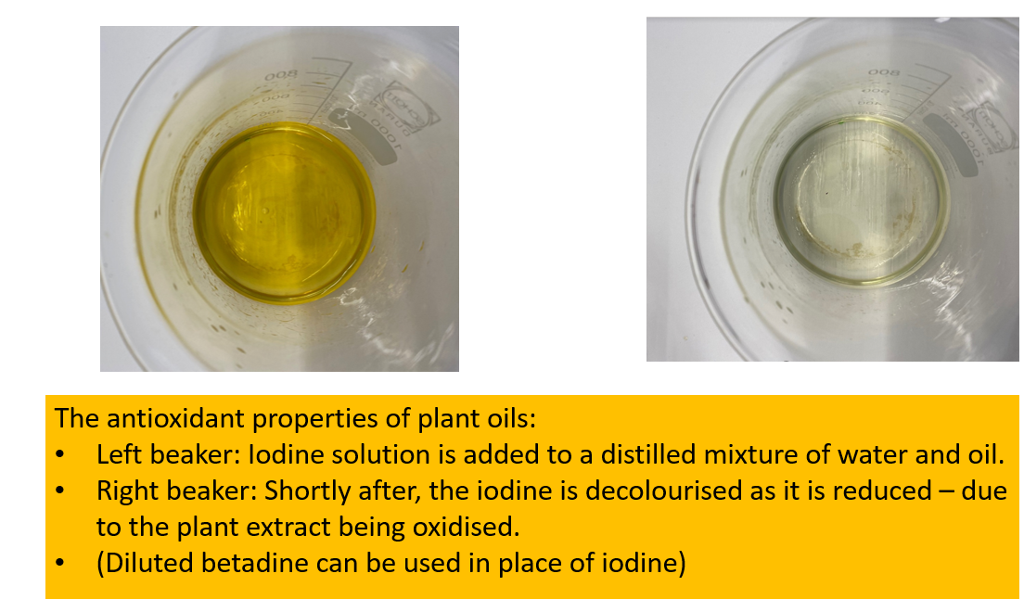

Slide 36
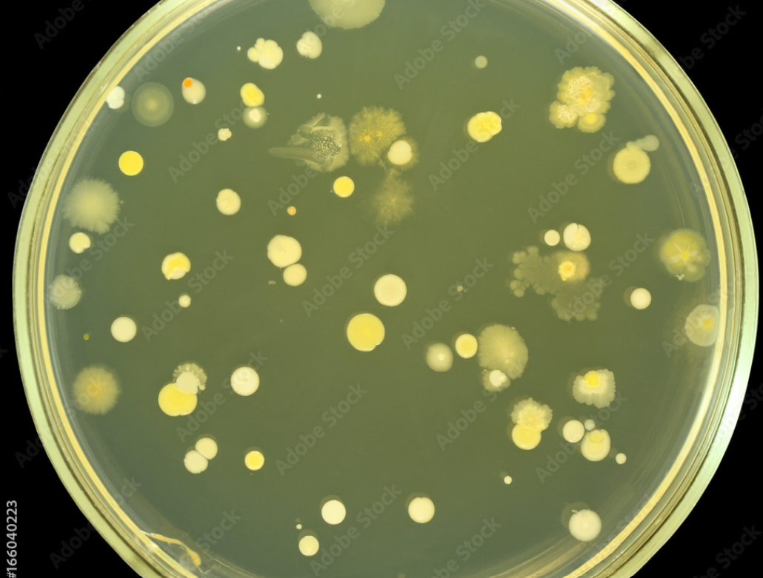
Oil + swab

Slide 37
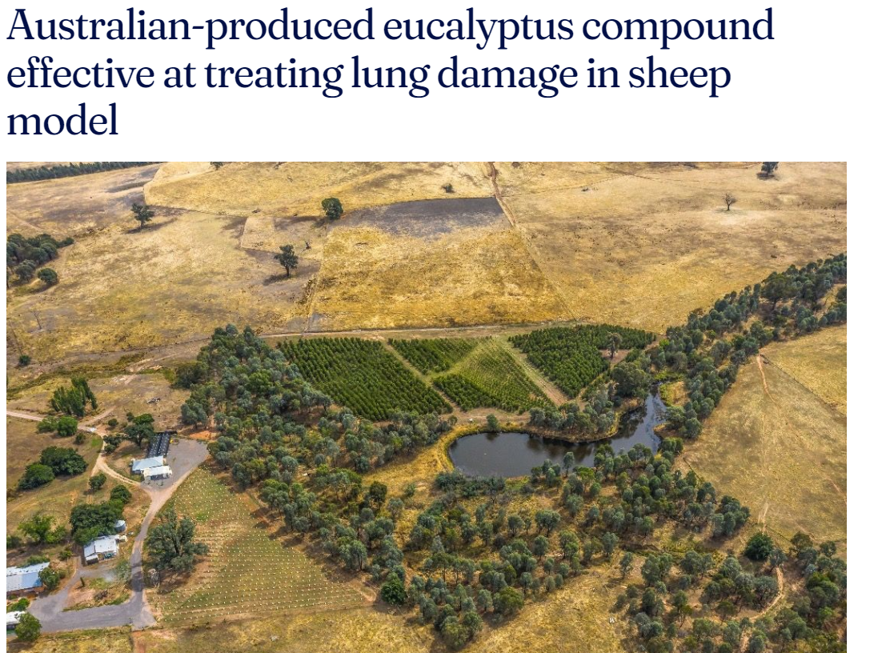
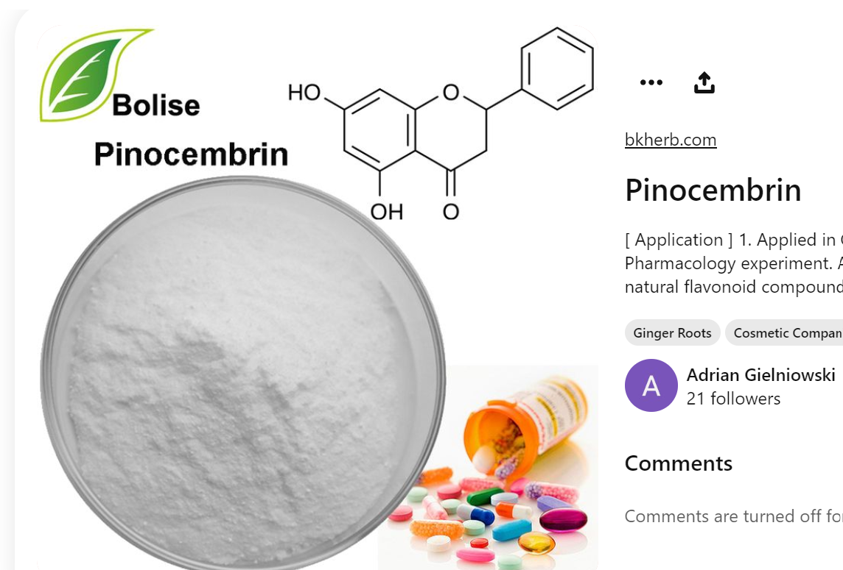

Slide 38
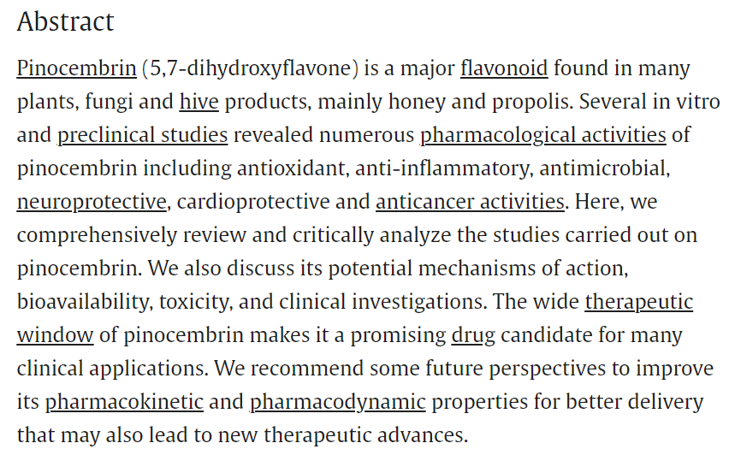
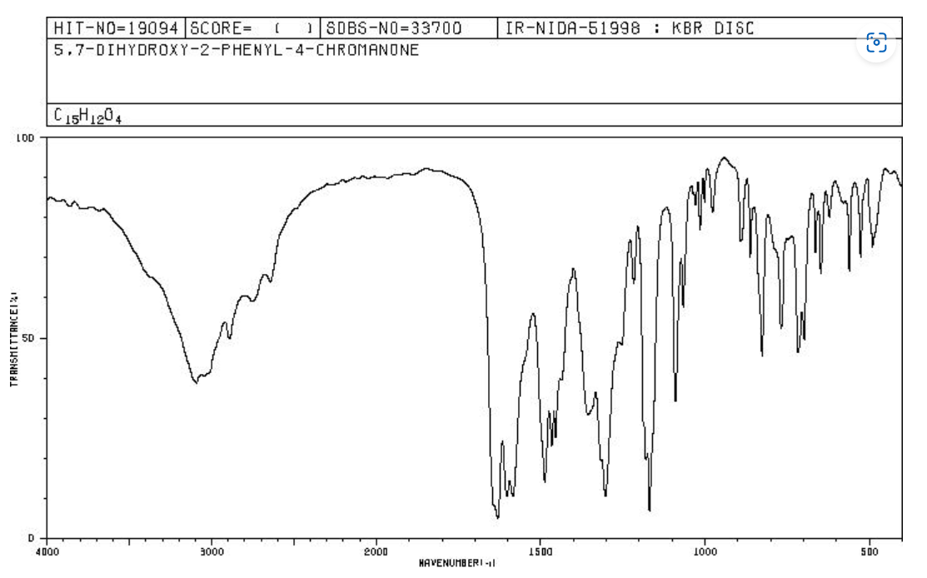
Dr Jason Goodger
School of Biosciences

Slide 39
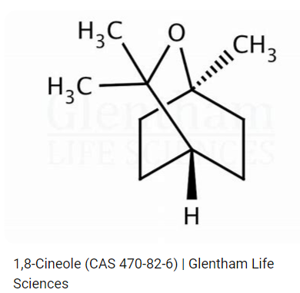
Eucalyptol
Blue Mallee Gums

Slide 40
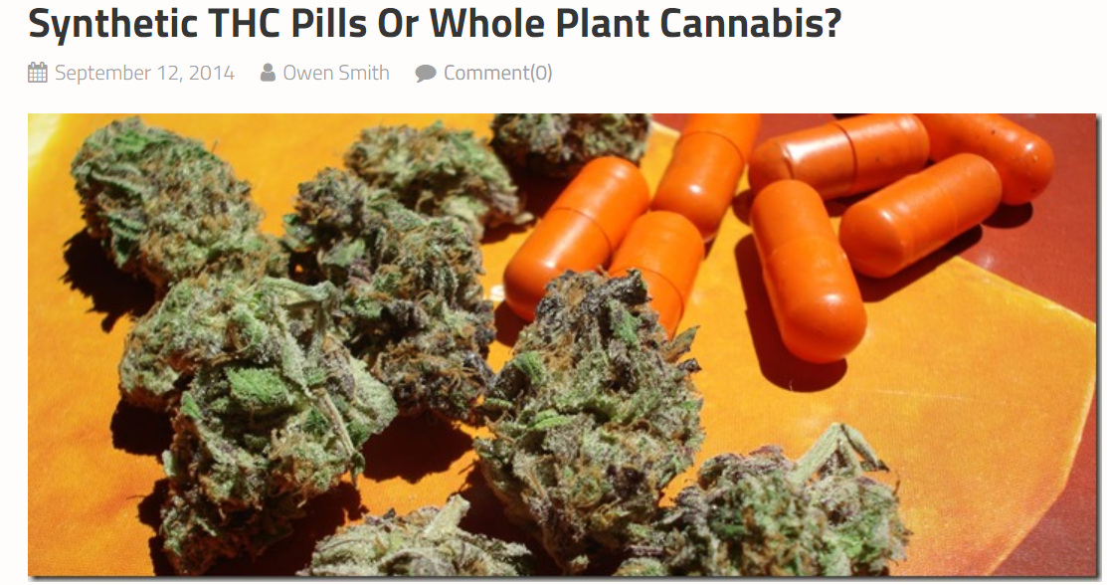
Monash pharmaceutical College – Dr Michelle McIntosh
Isolating and testing THC

Slide 41
Cann group Mildura

