Slide 1

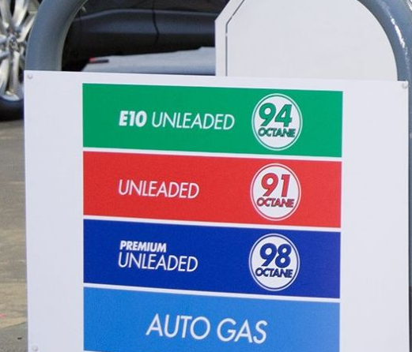
Bioethanol – limiting the impact of petrol

Slide 2
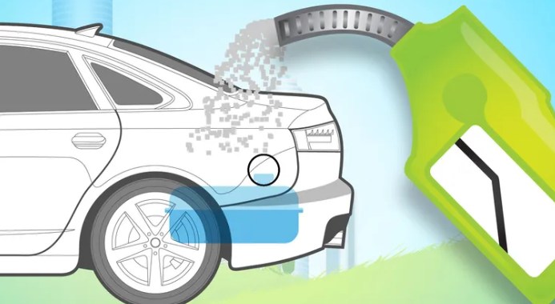
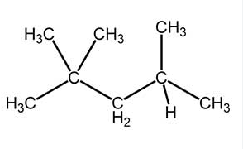
E10: petrol blend
ethanol
10% ethanol
90% petrol
Fossil fuel – scarce
- polluting

Slide 3
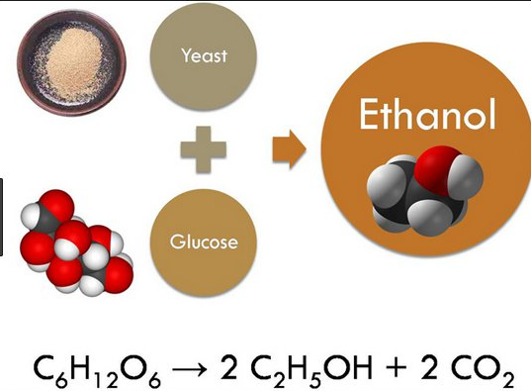
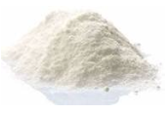
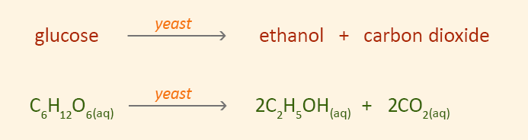
Ethanol is produced by fermentation of glucose.
Yeast acts on a glucose solution to convert the glucose molecule to ethanol and CO2.
Optimum temperature 35 0C.

Slide 4
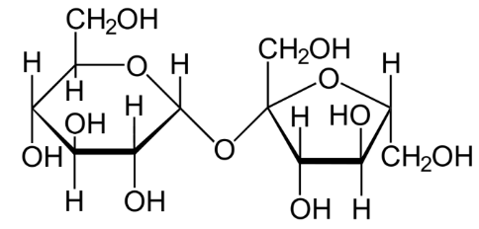
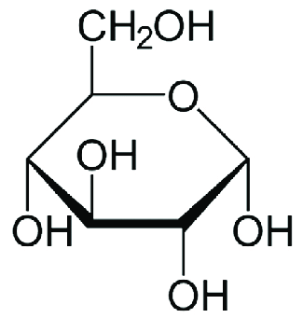
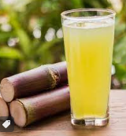
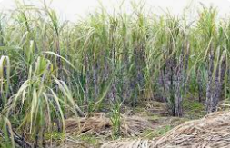
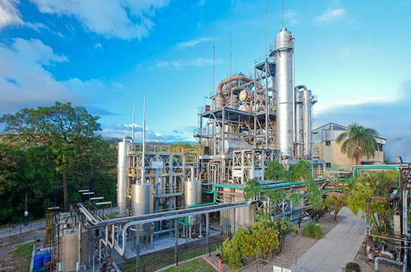
sucrose
glucose
The bioethanol industry is dependent upon a source of glucose. As glucose is rarely found as glucose, the search is for compounds containing glucose.
The simplest of all is the sucrose in sugar cane, where only one glycosidic bond needs to be broken.
Wilmar plant (photo) at Sarina in Queensland does just that.

Slide 5
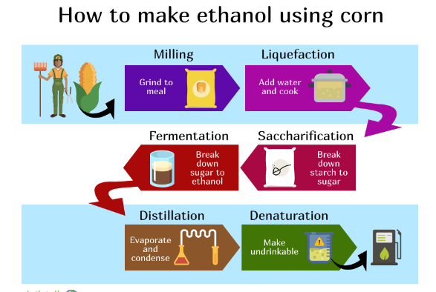
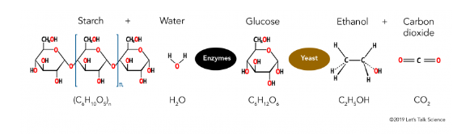
Sucrose is used for eating more than fuel so Brazil and the US use corn.
In this case the larger starch molecules need to broken up – same glycosidic bonds but more of them.

Slide 6
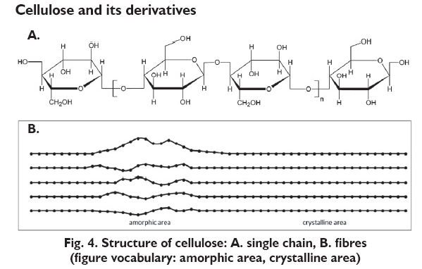
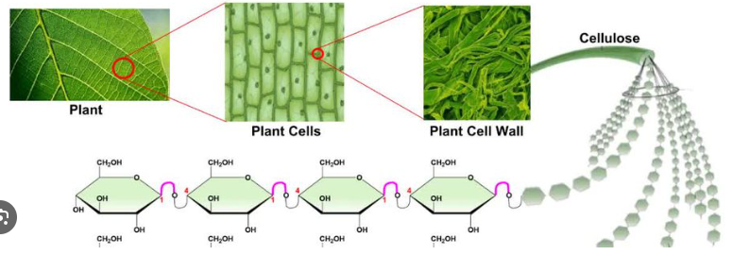
Research is focusing on cellulose as forest waste can be more abundant.
Same glycosidic bonds but the structure of cellulose is more rigid => degree of processing is increased.

Slide 7
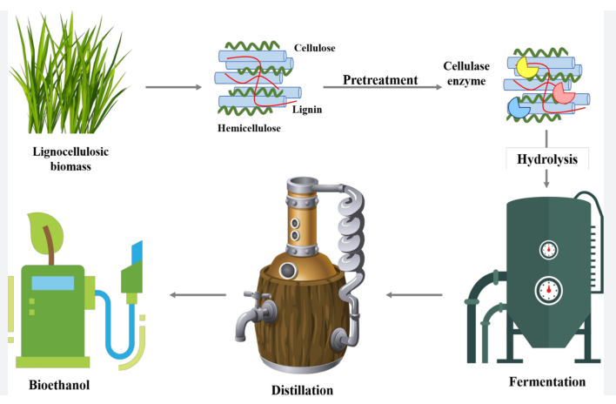
Bioethanol production: raw material is pulped into a solution, the carbohydrates are broken down to glucose, the glucose is fermented, the ethanol distilled and purified.

Slide 8
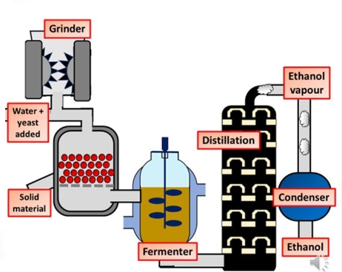
The fermenter produces an ethanol solution, about 11% ethanol (v/v).
This is distilled to purify the ethanol to 98%.
It is later ‘denatured’ to make it unpleasant to drink (CH3SH added)

Slide 9
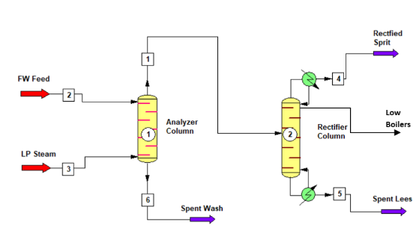
Alcohol solution heated above 78 0C
Ethanol with bp 78 0C comes off the top
Water with bp 100 0C comes off the bottom
First tower removes solids etc, second tower does the separation.

Slide 10
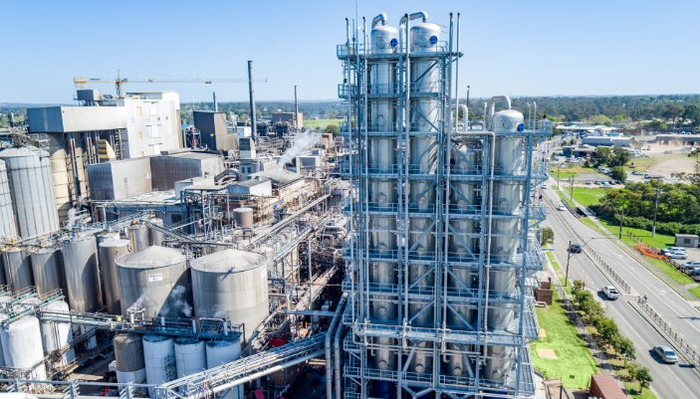
This is the reality of what looks like a simple column – note the car size on the right – Manildra Nowra

Slide 11
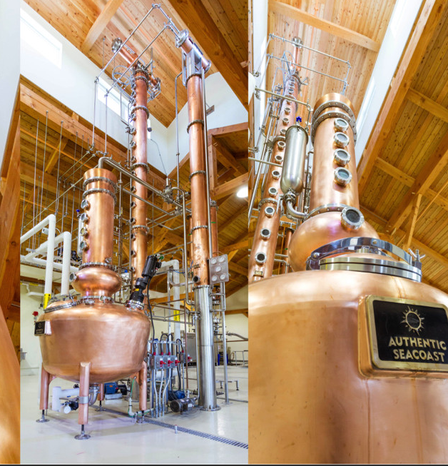
The best way to see functional distillation is to make the effort to visit a distillery.

Slide 12
E10 | Petrol
Lower energy density (46 kJ/g) Can be sourced from waste material Renewable Cleaner combustion Less engine wear | Higher energy density (48 kJ/g) Established distribution system Fossil fuel

Slide 13
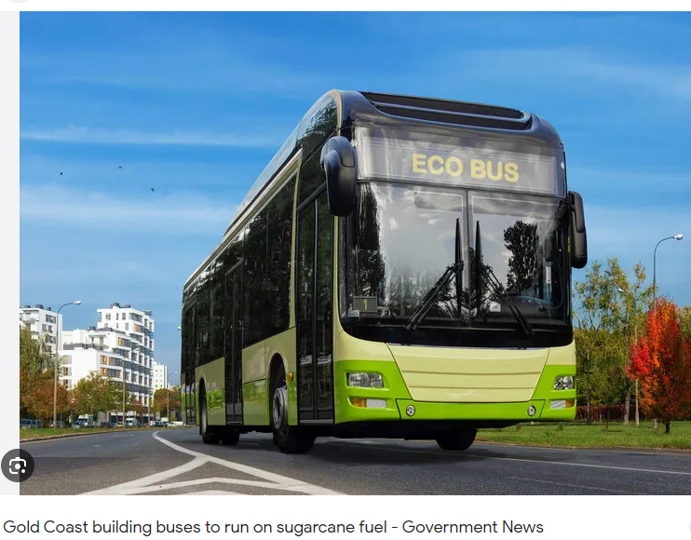
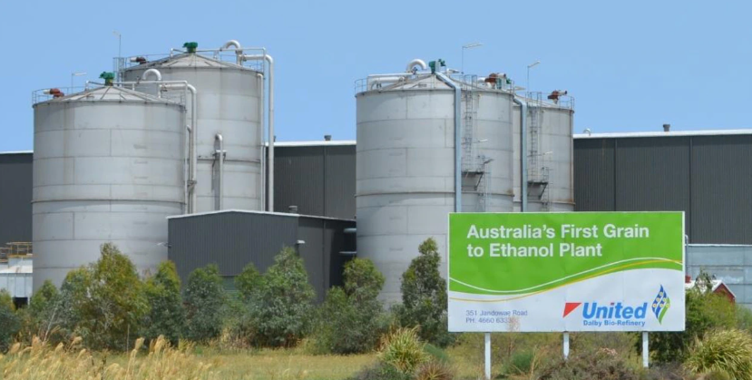
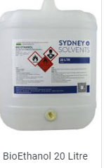
Dalby Qld. Sorghum used as a raw material

