Slide 1
Canola oil (Canada oil)
The yellow flowers have an oily seed that is harvested.
© POShea

Slide 2
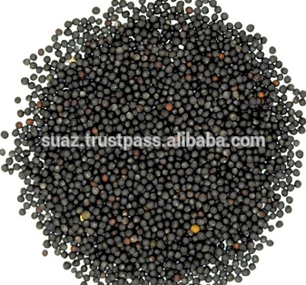
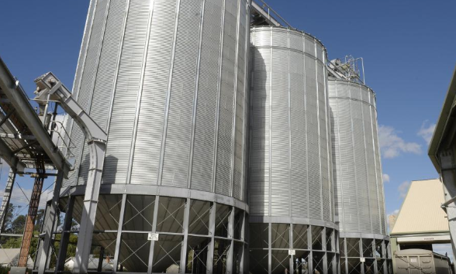
Canola seeds
GrainCorp: Numurkah

Slide 3
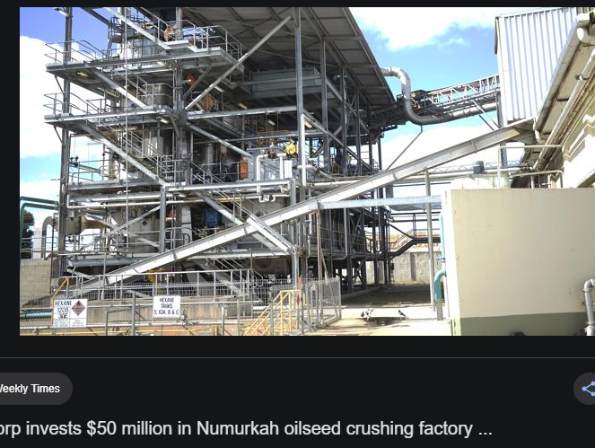
Seed pressing facility

Slide 4
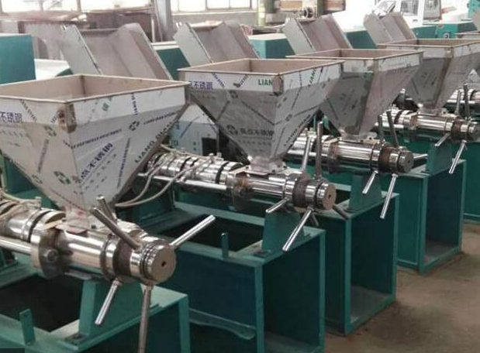
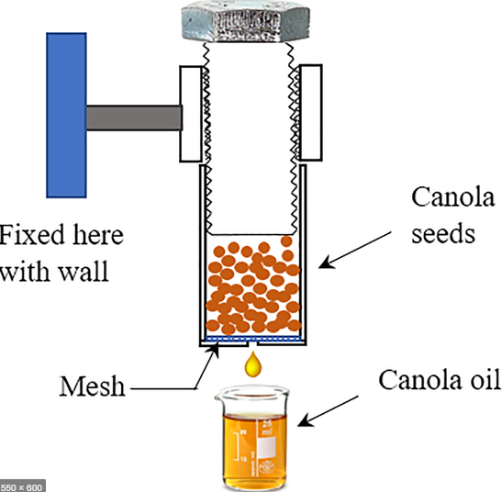

Slide 5
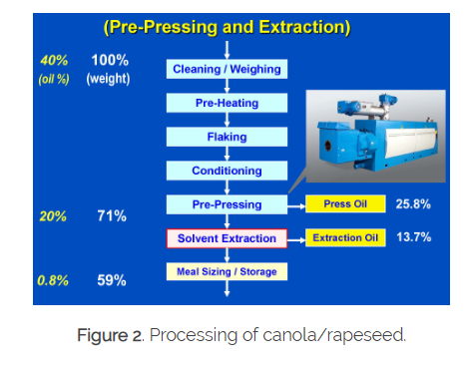
Simplified processing flowchart
Pressing does not extract all oil, therefore the remaining part of the seed is soaked in hexane.
Non-polar hexane dissolves non-polar oil (solvent extraction)
The hexane is boiled off and recycled.
Traces of hexane are not desirable in food.

Slide 6
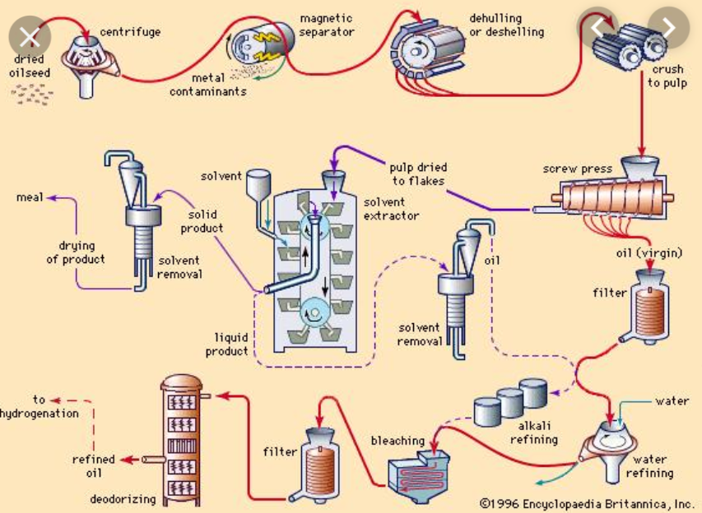

Slide 7
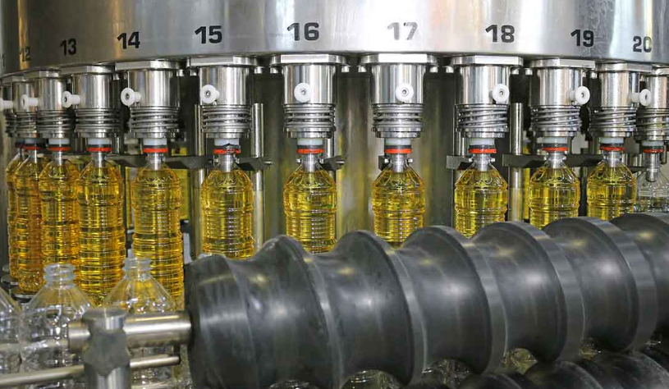
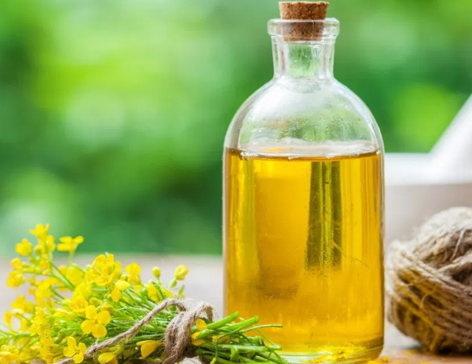
Oil is bleached and deodorised for bottling.

Slide 8
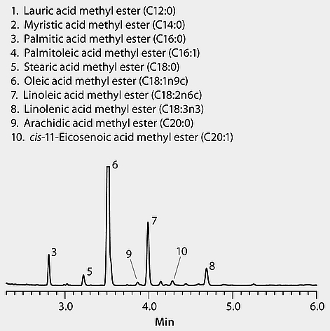
Composition
Canola oil is made from a mixture of fatty acids, oleic acid being the most common.
HPLC chromatogram
The longer the molecule, generally the higher the retention time. A non-polar mobile phase is used as the fatty acids are non-polar.
The area under the oleic acid peak (no 6) is greater than other components as it has the highest concentration.

Slide 9
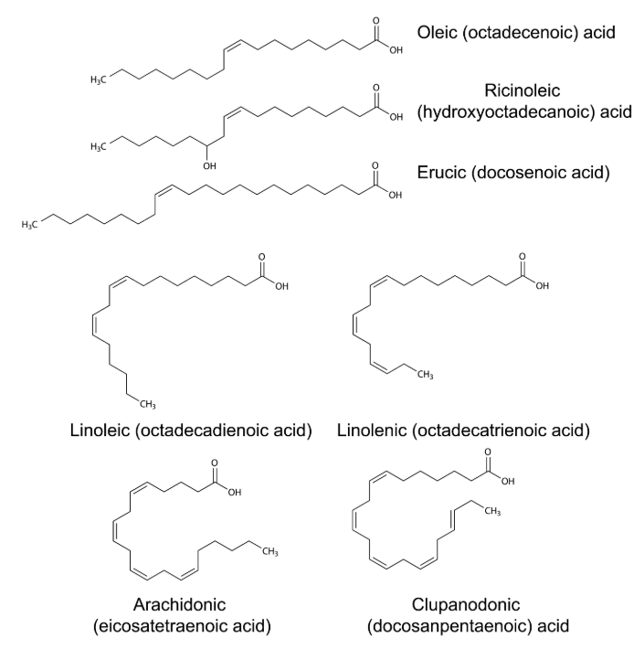
Oleic acid: monounsaturated (C18H34O2)
Erucic acid: concerns with toxity so concentration needs to be low.
Linolenic: essential omega-3 fatty acid (c=c double bond is on third carbon from methyl end)

Slide 10
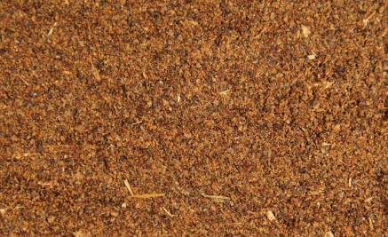
Canola meal
Seed remnants are sold as pig food after oil has been extracted.

Slide 11
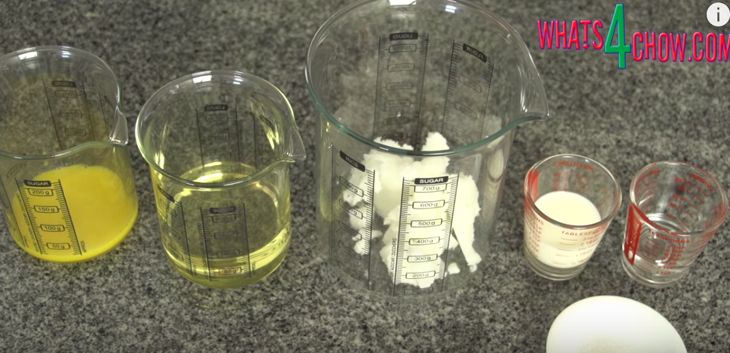
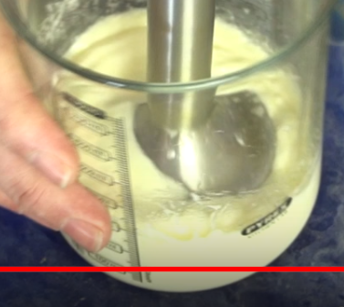
Egg canola vegie oil milk lemon juice salt
Margarine manufacture
Canola oil and vegetable oil are blended with emulsifier, salt, milk and food acid. Yellow dye is added to match the colour of butter.

Slide 12
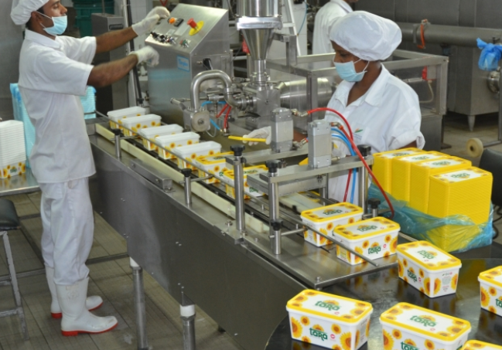
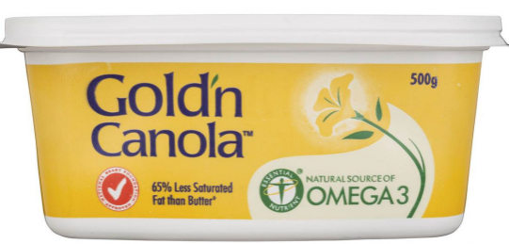
Canola Oil (52%), Water, Vegetable Oils, Salt, Milk Solids, Emulsifiers (322 (From Soy), 471), Preservative (202), Food Acid (270), Colour (160a), Flavour, Vitamins A & D

Slide 13
Canola meal
Good or bad for you?
It is often promoted as healthy as oleic acid is monounsaturated, however
the use of hexane to extract last oil remnants is not desirable and
hydrogenation during margarine manufacture can convert some cis fats to less healthy trans fats

