Slide 1
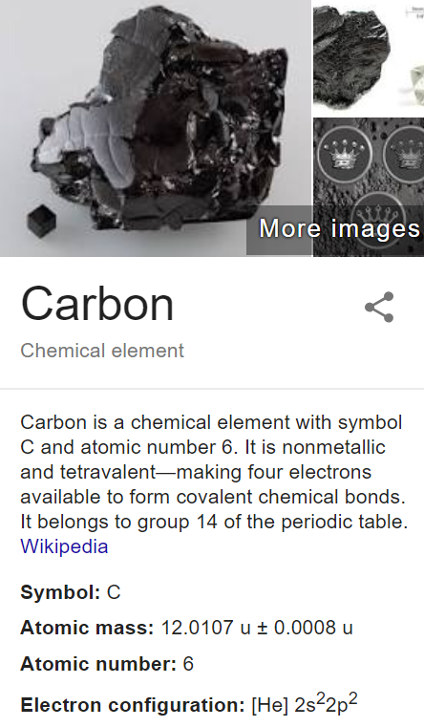
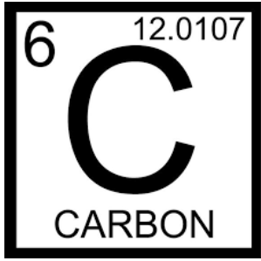
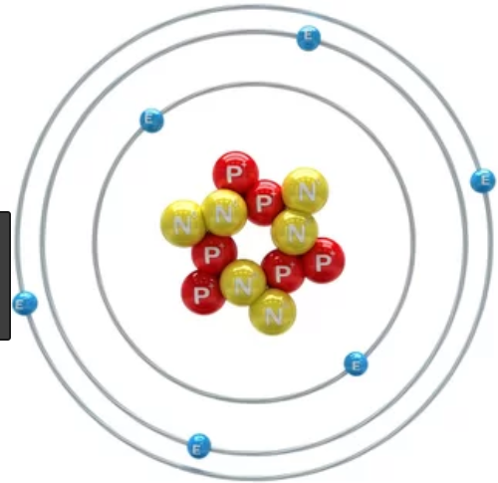
Allotropes of carbon: A remarkable element

Slide 2
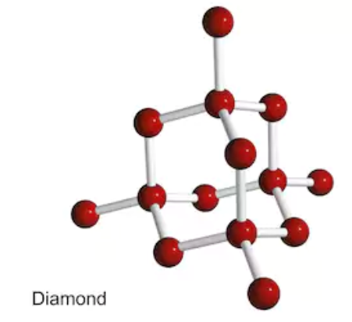
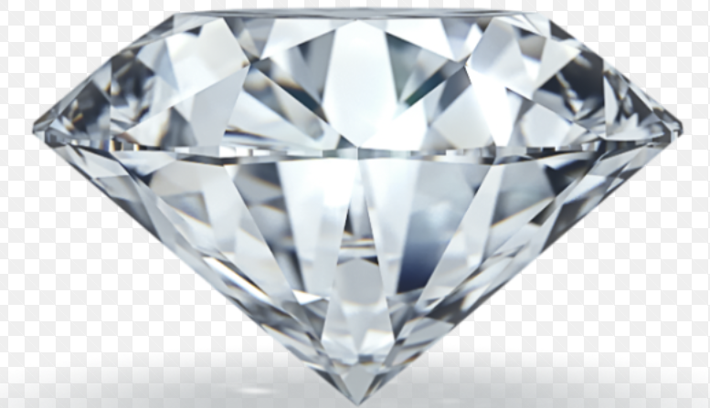
Diamond
3-D structure
Each carbon bonded to 4 other carbons
Hard, rigid, brittle
Sublimes
Good conductor of heat

Slide 3
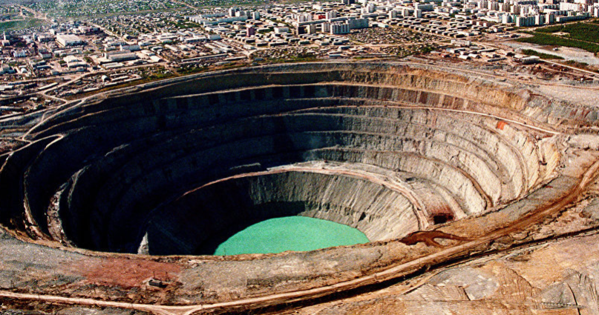
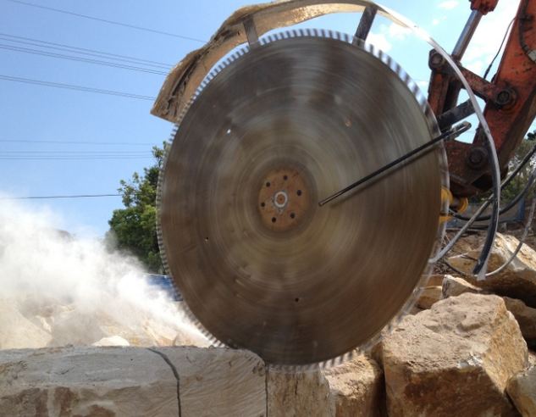
Diamond tipped tools
Natural diamonds: deposits found where carbon has been subjected to severe heat and pressure

Slide 4
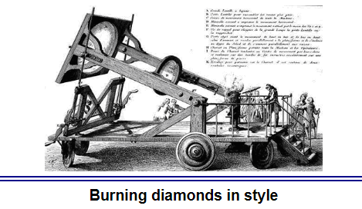
A giant lens set up to focus light on a diamond. Lavoisier did this in 1810 and found the diamond turned to gas. It burnt to form carbon dioxide.

Slide 5
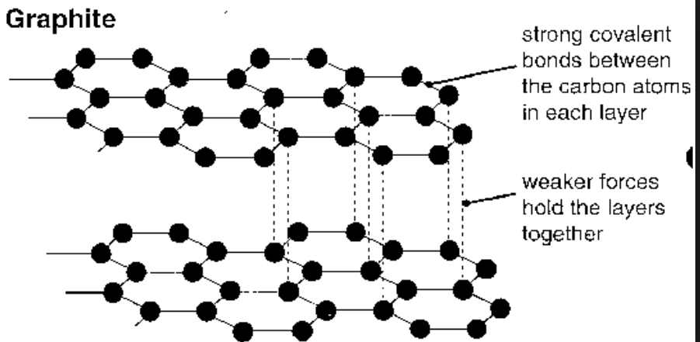
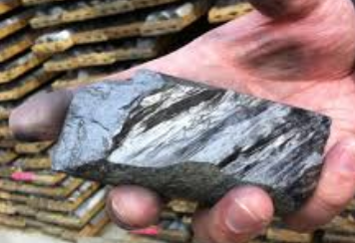
Layer structure. Each carbon bonded to 3 other carbon atoms.
Also sublimes at a high temperature
Conducts electricity – giving it many uses.
Lubricant

Slide 6
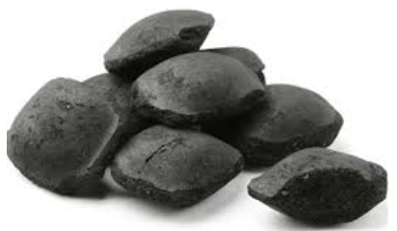
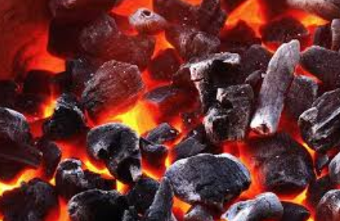
Charcoal. Ground pieces of graphite. Amorphous structure.
Useful as a fuel, reinforcement in rubber.

Slide 7
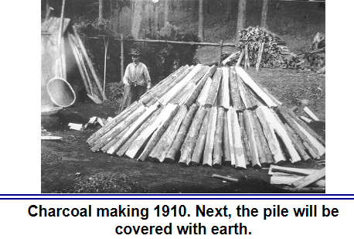
Biochar: Been prepared for centuries to improve soil. Organic material burnt in limited oxygen produces a form of charcoal. (The wood shown above is burnt over a period of weeks)

Slide 8
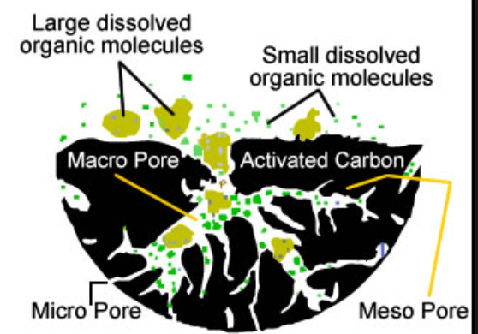
Activated charcoal: charcoal treated with heat and zinc chloride develops minutes pores.
Used to filter water, odours, drug overdoses, convert brown sugar to white

Slide 9
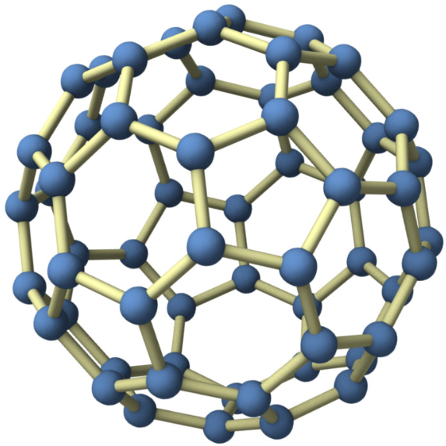
Buckyballs or fullerenes
Many possible combinations
Imparts high strength and conductivity.

Slide 10
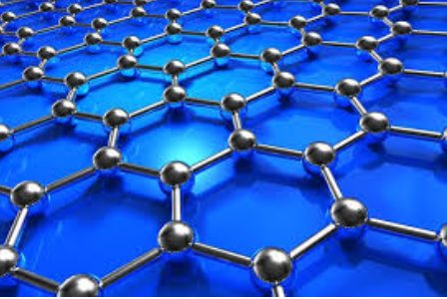
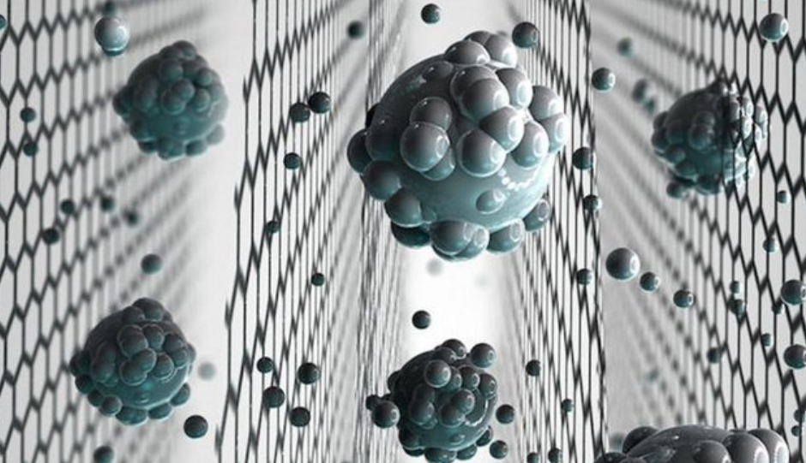
Graphene: graphite stripped down to just a single layer. Very strong with high surface energy
The second slide shows graphene being used to filter water.

Slide 11
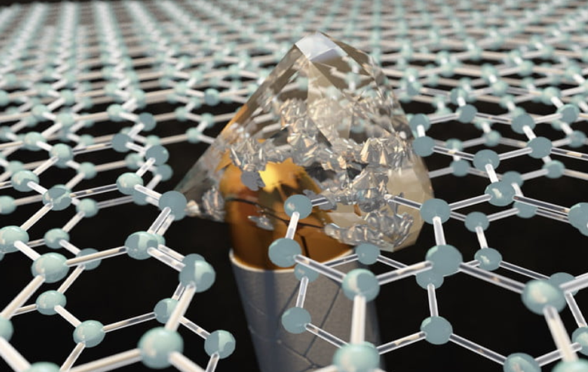
A graphene bullet proof vest.

Slide 12
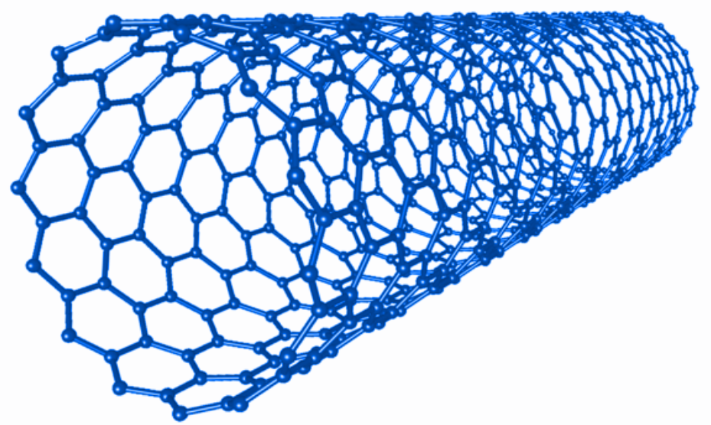
Nanotube: graphene wrapped into a tube.

