Slide 1
Top 10 of Australian chemicals
Top 10 of Australian chemical companies.

Slide 2
Kahoot statistics
Kahoot for homework (Quizziz does this)

Slide 3
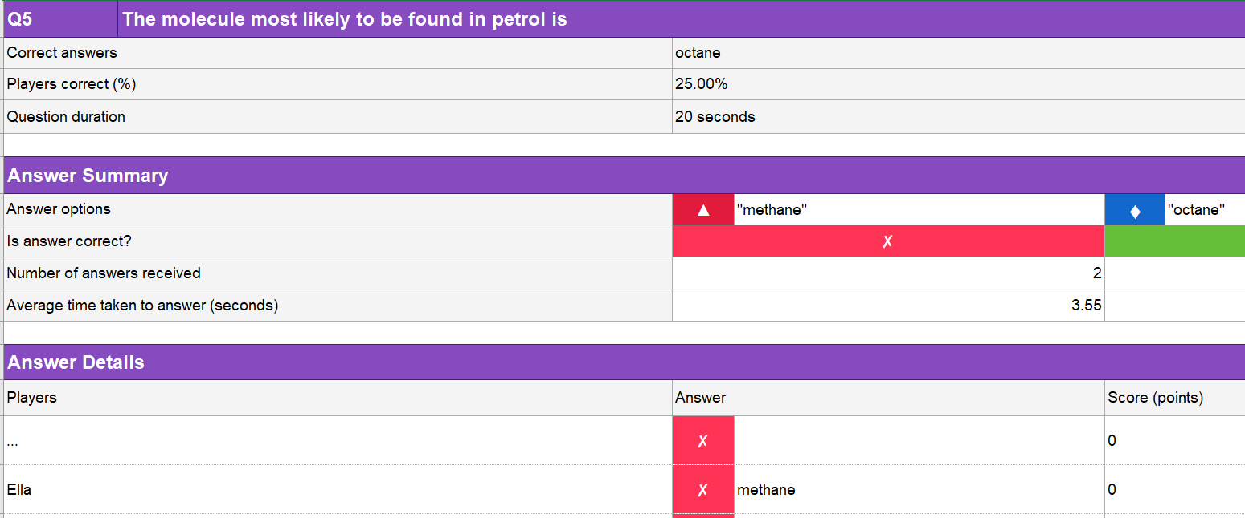

Slide 4
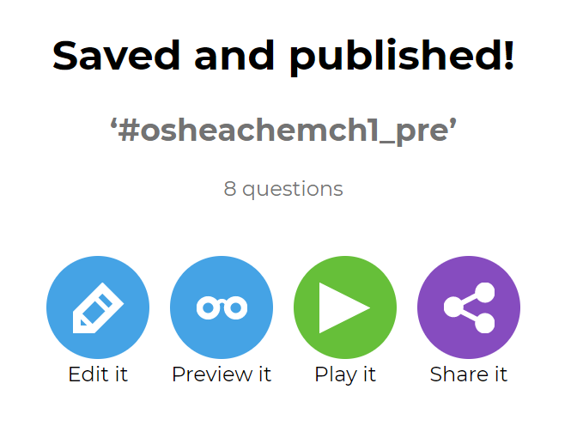

Slide 5
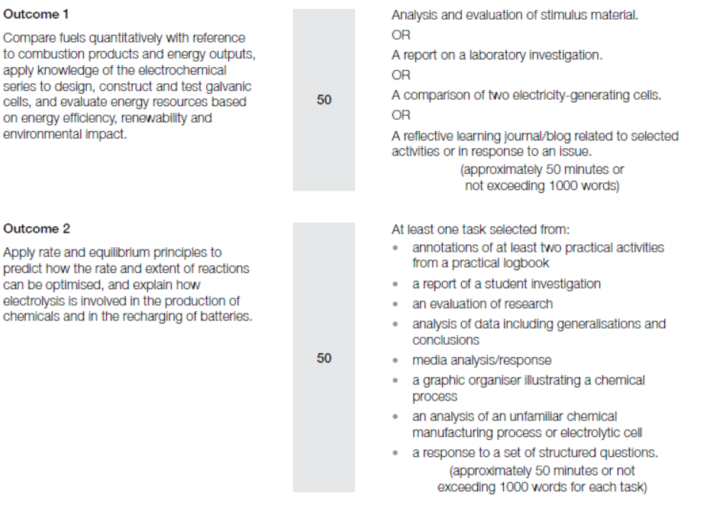

Slide 6
 | Unit 3 | Unit 4
AOS 1: | Report on a laboratory investigation: Combustion of alcohols Experimental procedure ∆H vs molar mass of alcohols 50 marks | Structured questions Ethanol properties and reactions 15 marks Response to structured questions Instrumentation and structure Propanone, propanamine 15 marks
AOS 2: | Report on a student investigation: Reaction rate of iron solutions 25 marks Response to structured questions: Equilibrium graphs 25 marks | Laboratory Investigation Reactions of glucose and other simple sugars 30 marks
Poster | Reactivity of metals and relationship to electrochemical series 30 marks

Slide 10
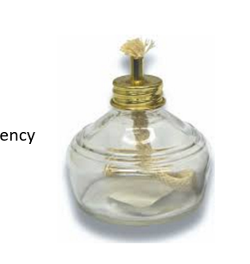
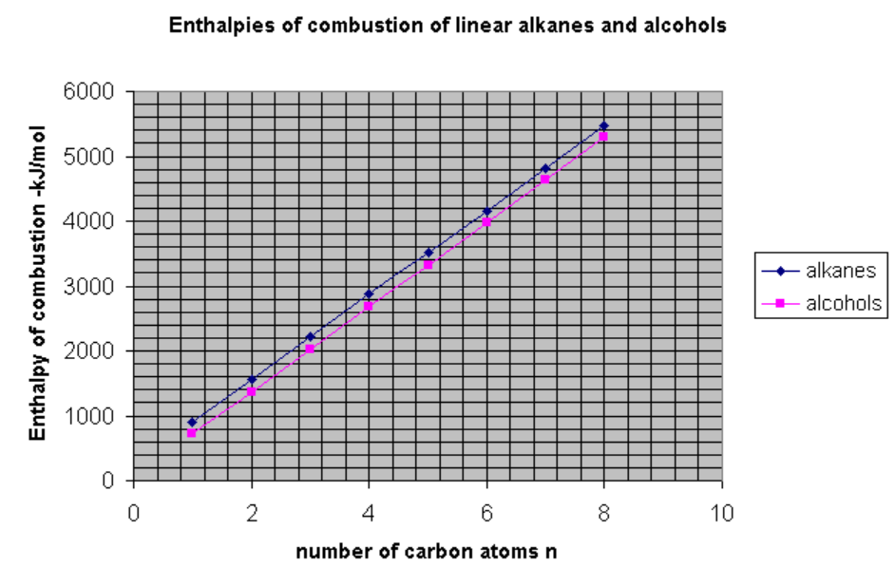
Graph likely to have a gradient close to 0.
C-H bonds stronger than C- O bonds

Slide 11
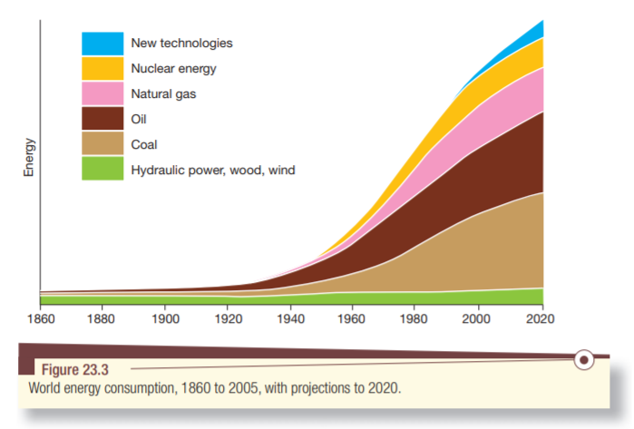

Slide 12
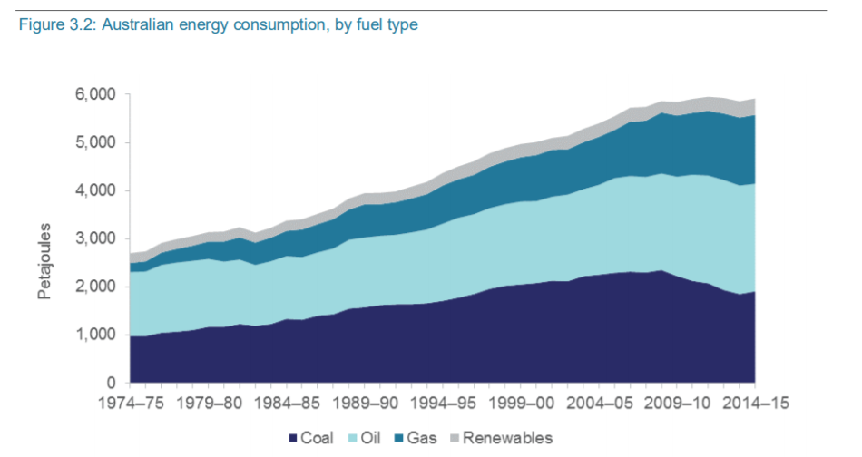

Slide 13
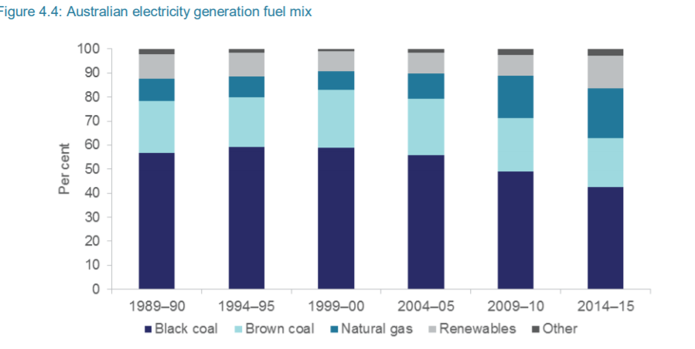

Slide 14
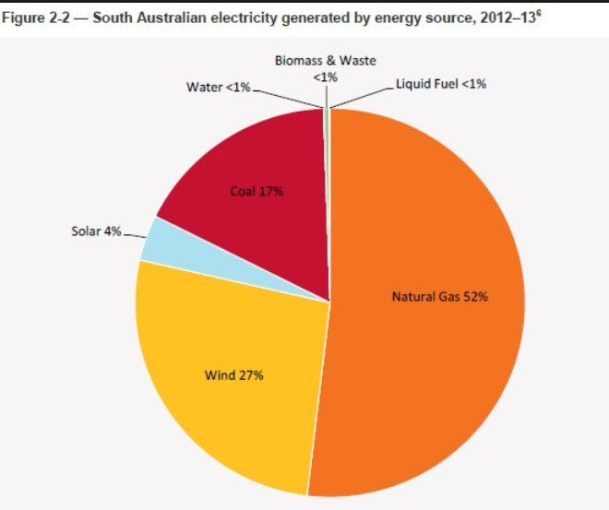

Slide 15
Tasmania

Slide 16
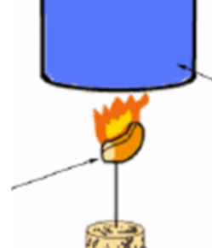
Burning
Half an almond held vertical
Savoy cracker
Water cracker held vertical
Wooden dowel
No coal

Slide 17
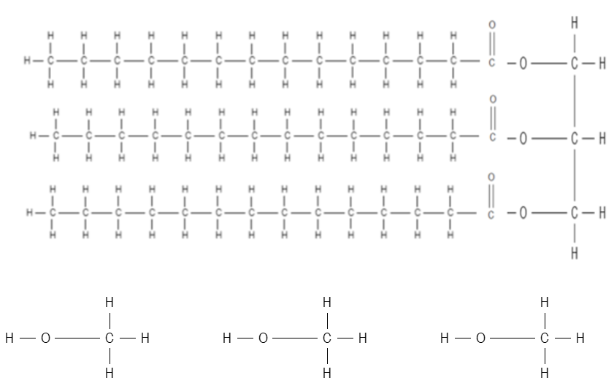

Slide 19
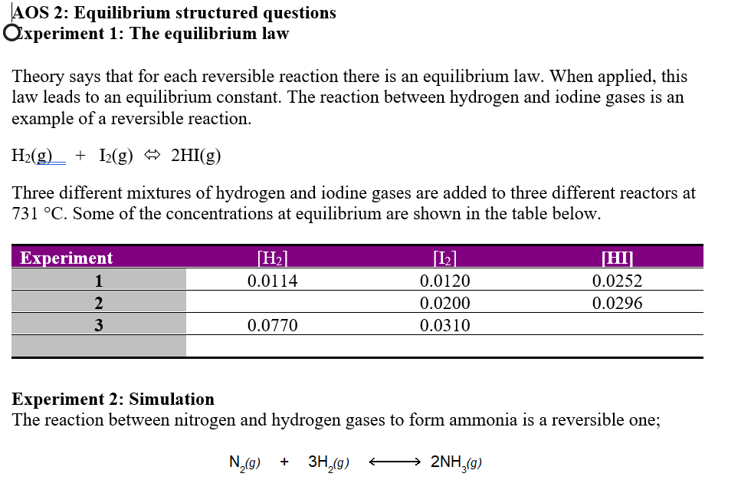

Slide 22
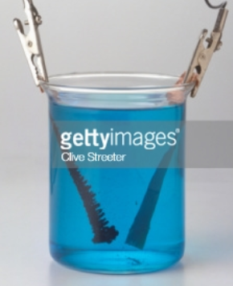
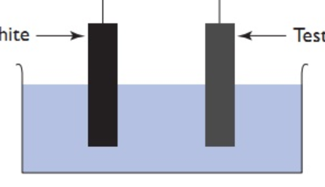
Same size beaker
Same depth
Same separation
AC current best
Electrodes held in retort
Not this!

Slide 23
Q = [Ox]
[Red]

Slide 24
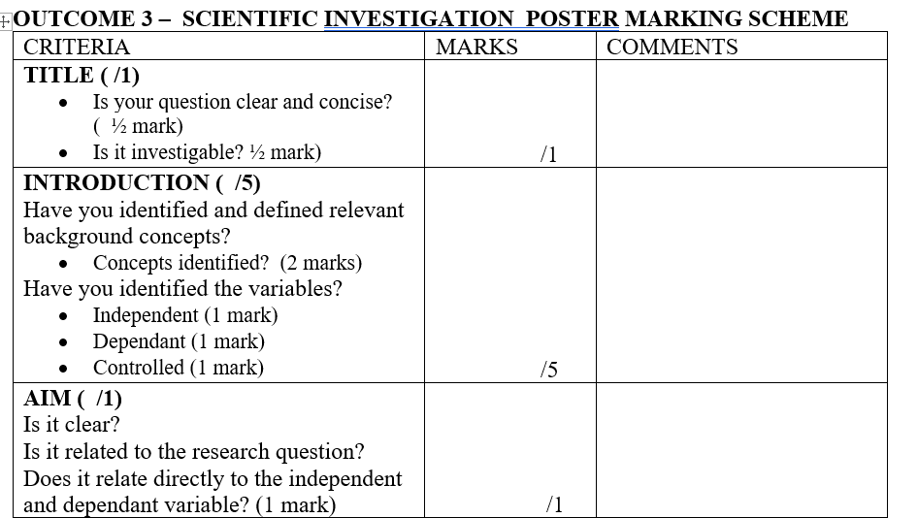

Slide 25
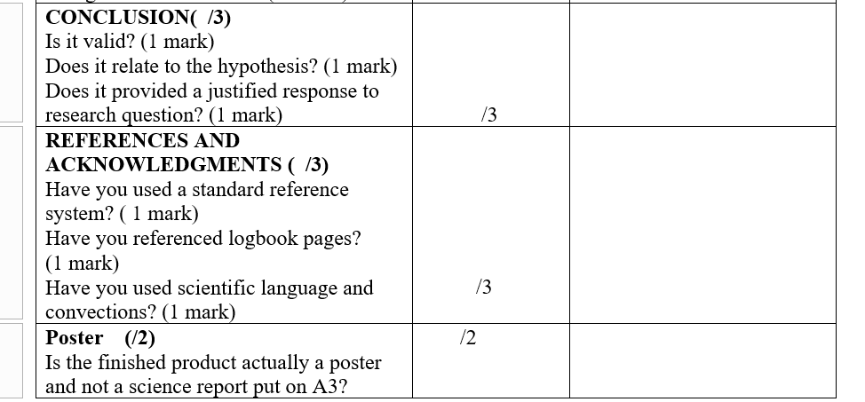

Slide 26
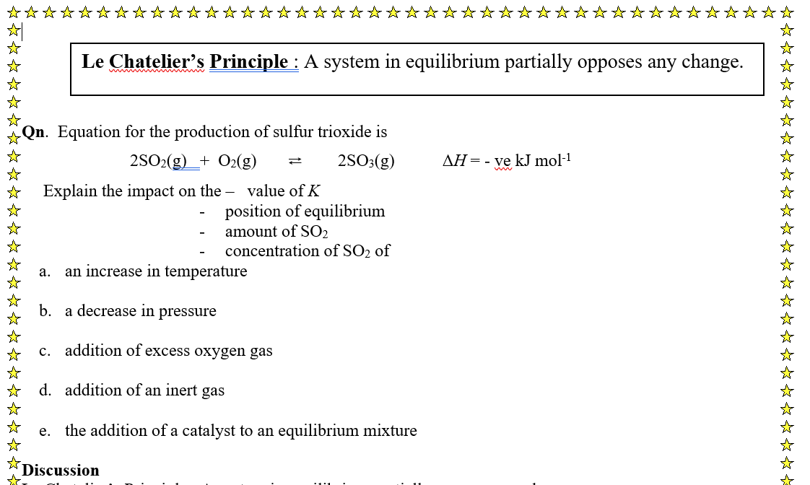

Slide 27
ASR
Monsanto
BASF
Hoersch
Olympic tyres
Dunlop
Nicholas aspirin
Conveyor belts
Oil refinery
Top 10 of Australian chemicals
Top 10 of Australian chemical companies.

Slide 28
Qenos
Orica
Mining
Cheese and butter
wine and beer
Tea-tree oil
Pathology

Slide 30
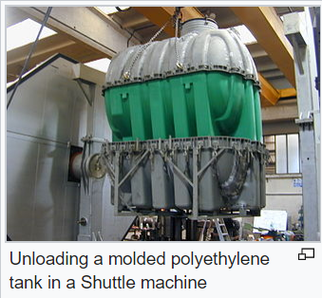

Slide 31
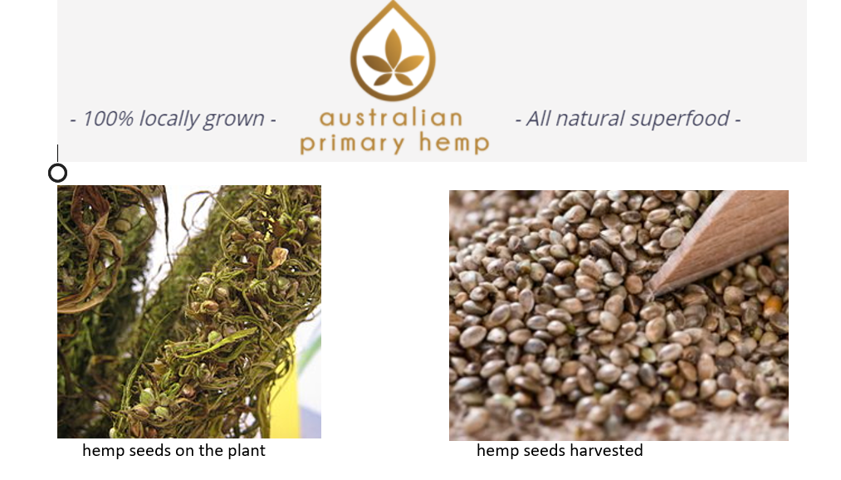

Slide 32
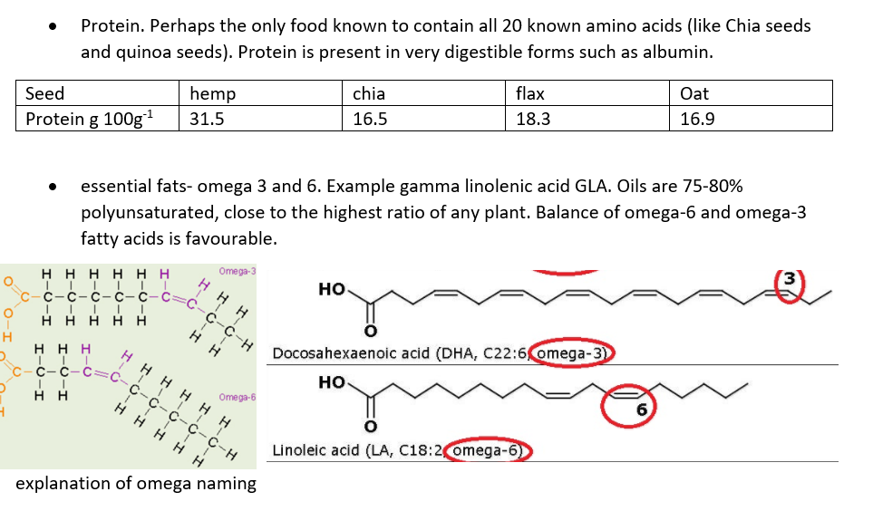

Slide 33
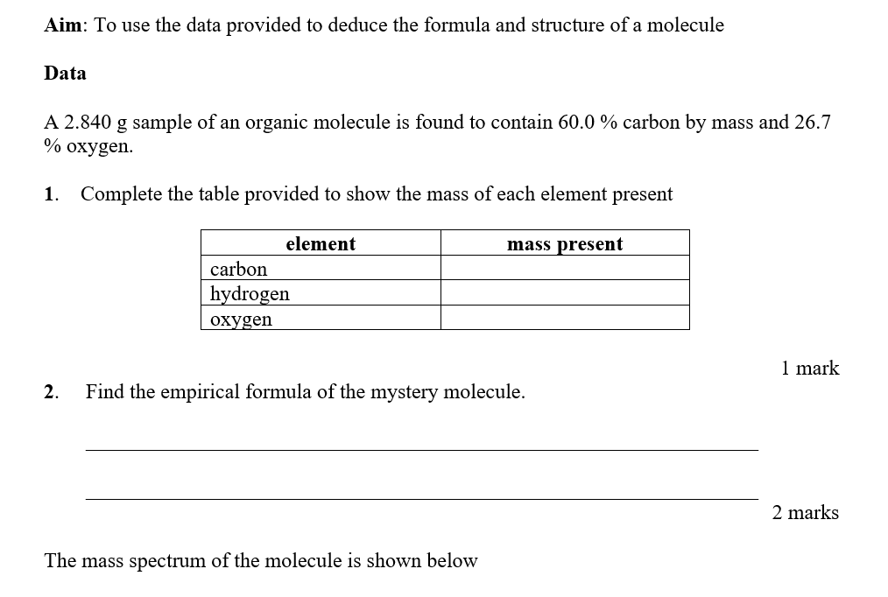

Slide 34
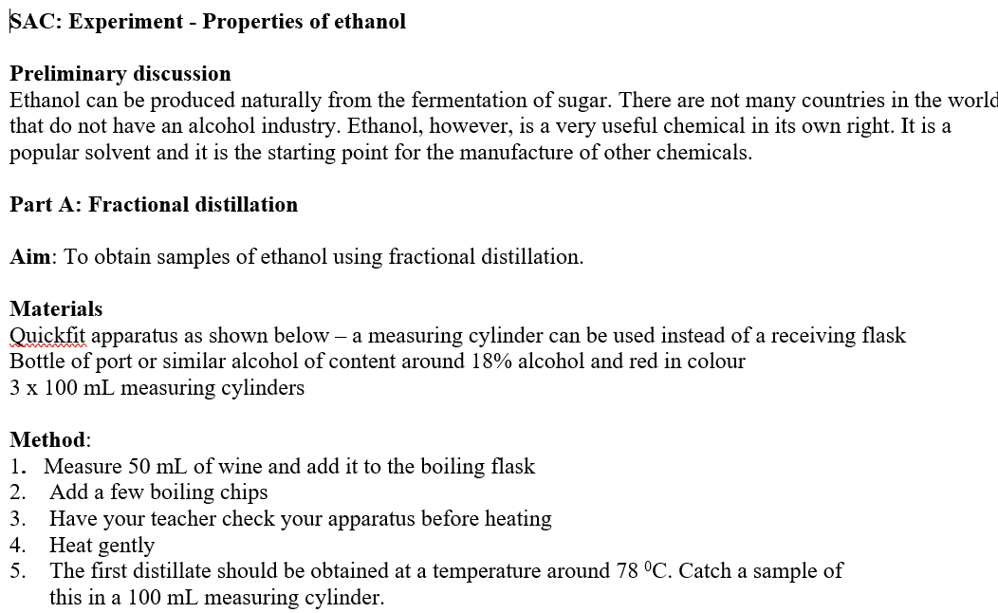

Slide 36
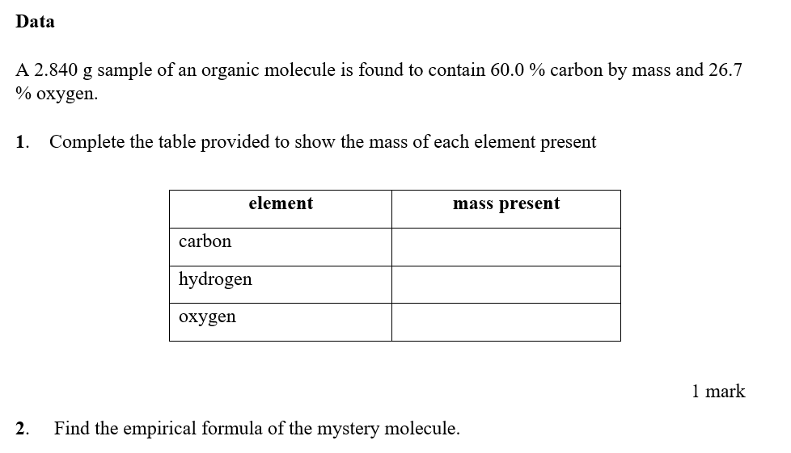

Slide 38
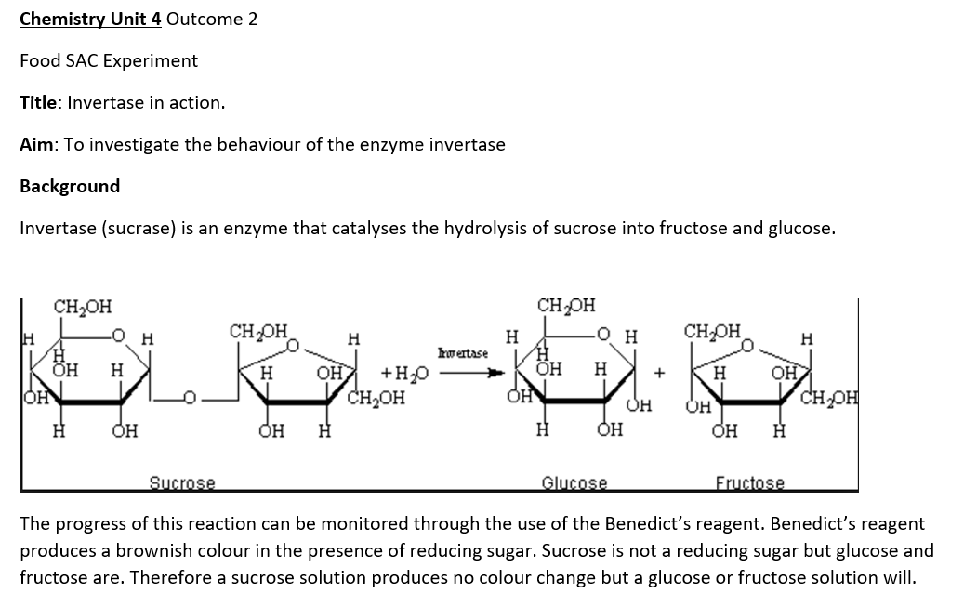

Slide 39
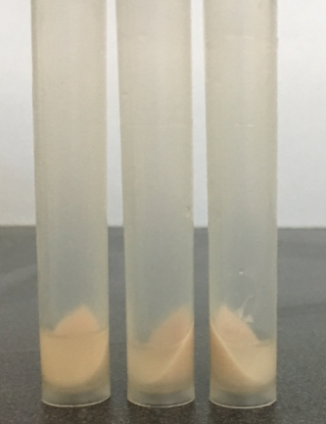
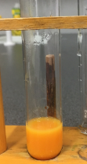
Quantitative Benedict’s reagent

Slide 40
