Slide 1
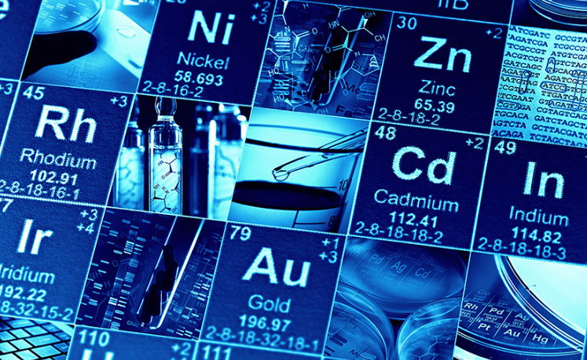
Critically endangered elements

Slide 2
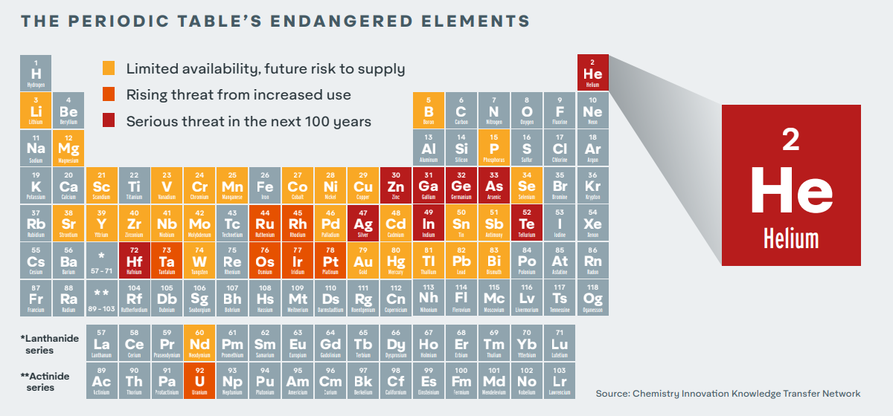
The elements in question

Slide 3
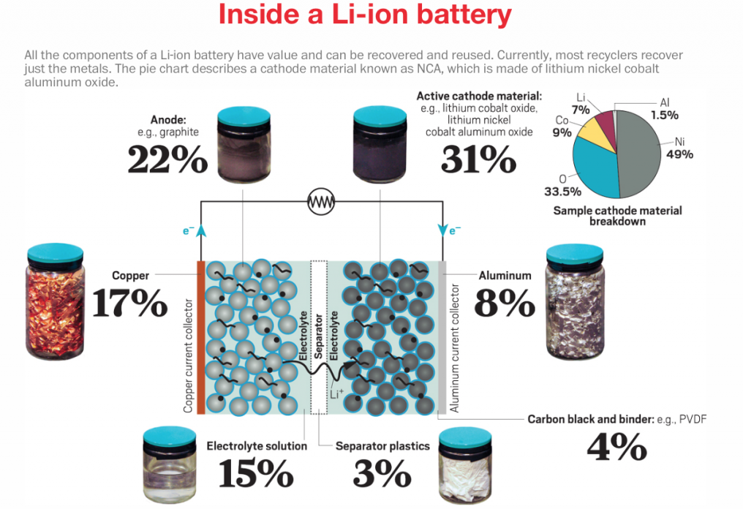
One of the main reasons for scarce elements – we are using high volumes of scarce metals in applications where it is difficult to get the metals back eg electric vehicle batteries and smartphones.

Slide 4
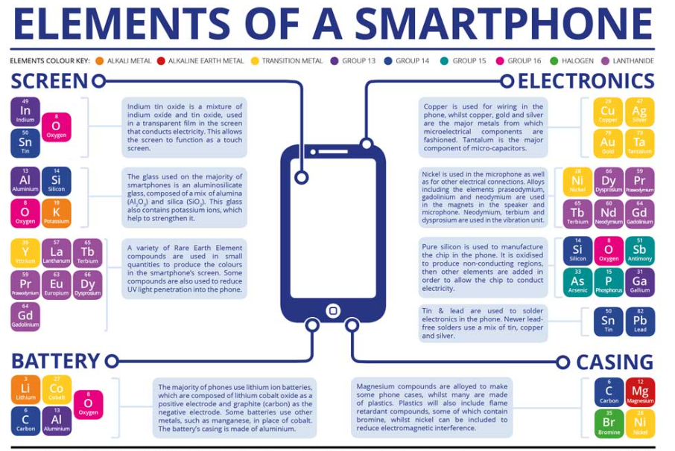

Slide 5
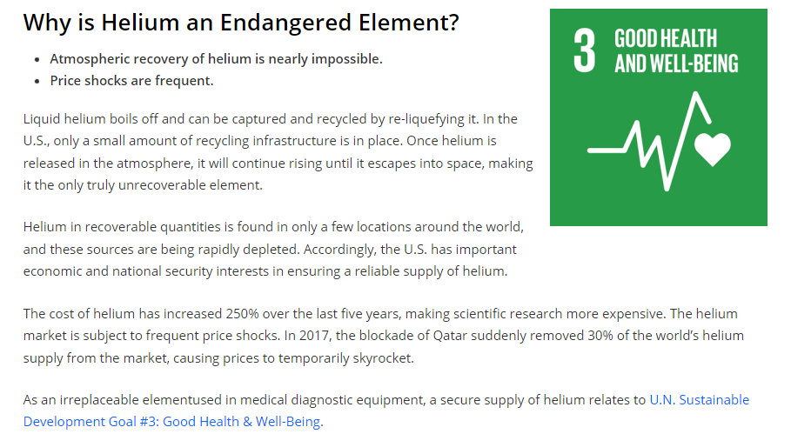
A unique example – helium: It is scarce anyway and it can leak from the Earth’s atmosphere into space.

Slide 8
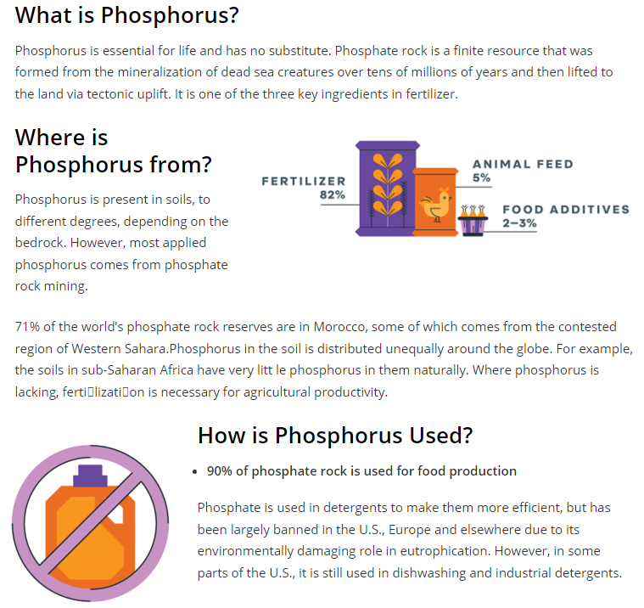
Phosphorus: deposits around the world are used, leading to phosphorus being dispersed through the water system in a way that it cannot be reclaimed.

Slide 9
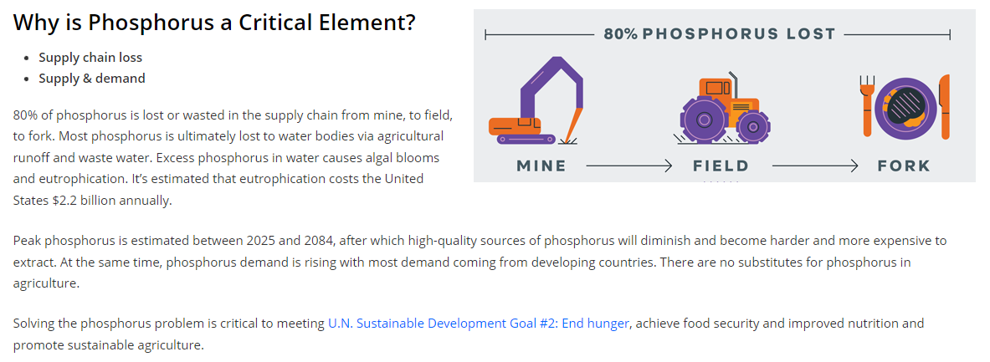

Slide 10
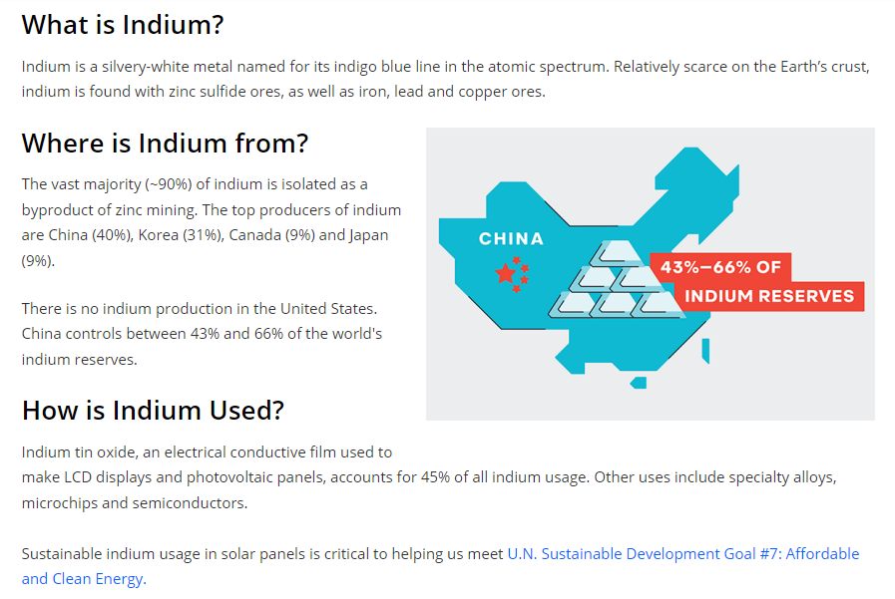

Slide 11
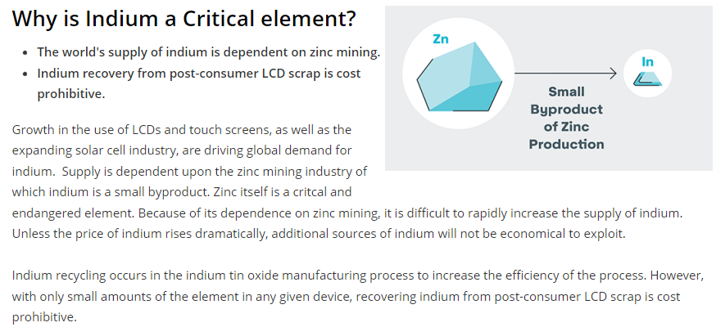

Slide 12
