Slide 1
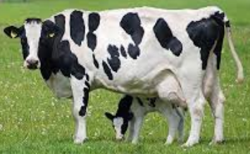
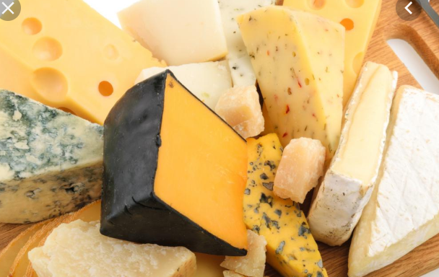
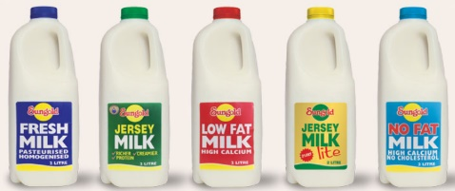
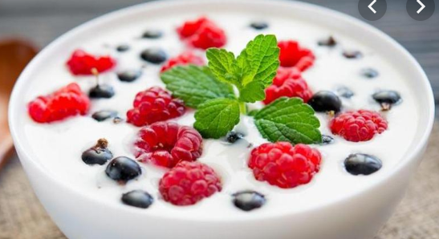
Dairy Industry
Sungold
Pura
Bega
Fonterra

Slide 2
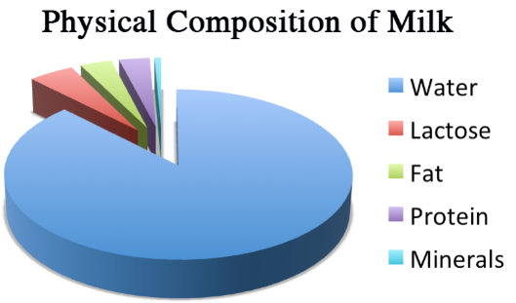
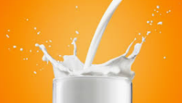

Slide 3
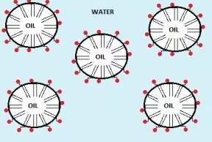
Milk is an oil in water emulsion. The small particles of butterfat are dispersed in water. Some proteins are water soluble while other, less soluble ones are contained with the oil droplets.
Natural emulsifiers enable the oil to be stable in water.
An emulsifier is a long molecule with a non-polar segment and a polar end. The polar end sits in water while the non-polar tail is in the oil drop.

Slide 4
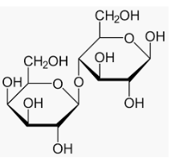
Lactose
Lactose is a disaccharide made from glucose and galactose. It is not as sweet as most disaccharides. A person is lactose intolerant if their body does not produce the enzyme lactase that breaks down the glycosidic bond
between the glucose and galactose

Slide 5
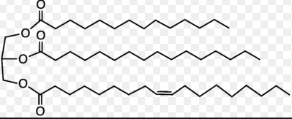
Butterfat
Butterfat is typically a triglyceride made from butyric acid, stearic acid and oleic acid. Oleic acid is monounsaturated, with one carbon-to-carbon double bond.

Slide 6
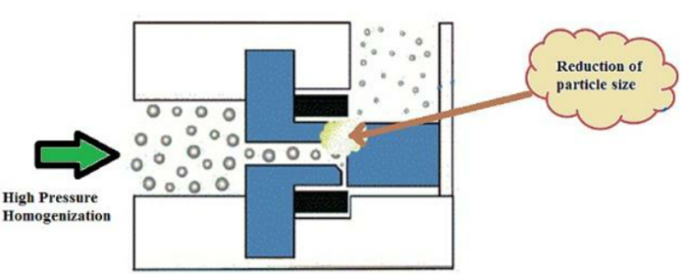
Homogenisation
The molecules are rushed through a small opening to reduce the oil drop size.
Australian milk must be pasteurised – this involves heating it to 71 0C briefly to ensure certain bacteria are killed.
Most milk is also homogenised. This involves breaking the butterfat blobs to a much smaller size so they will not separate as cream if the milk is left standing.

Slide 7
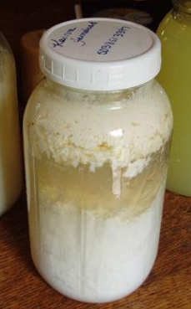
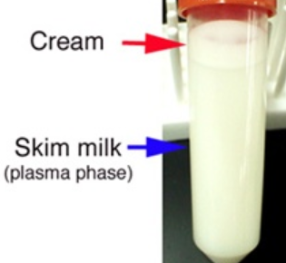
Centrifuging the milk will separate the cream from the skim milk, making two useful products.
The addition of an acid to milk causes the protein and fat to coagulate as curds, leaving a runny liquid or whey.

Slide 8
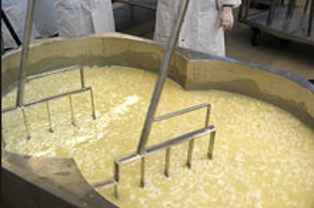
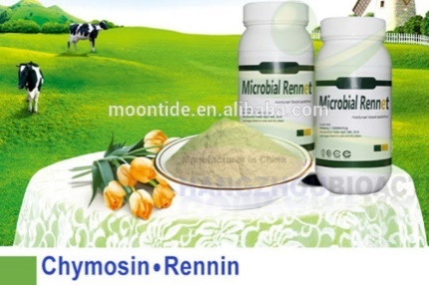
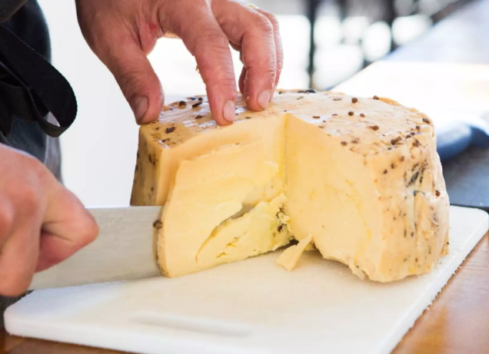
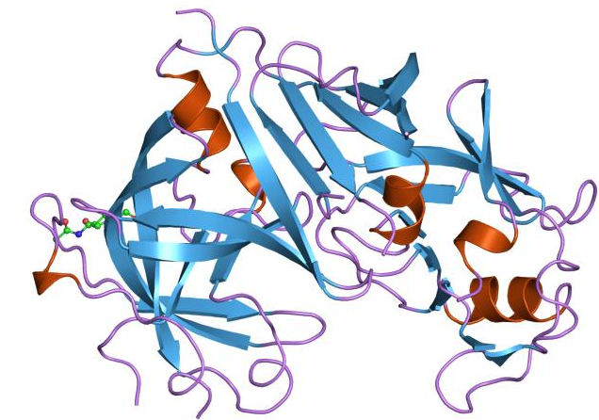
Cheese is formed by the addition of enzyme rennin from cow’s stomachs.

Slide 9
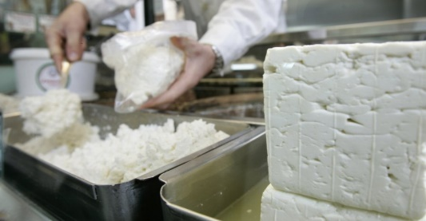
Fetta and ricotta cheeses are made from sheep and goat’s milk. Ricotta is from the whey component and is lower fat.

Slide 10
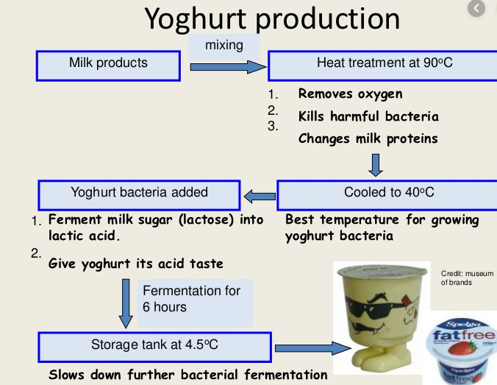
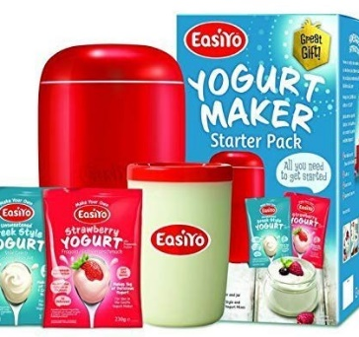
Live cultures (lactobacillus bulgaricus) added to milk lead to the formation of yoghurt.

Slide 11
Quality control testing of milk.

