Slide 1
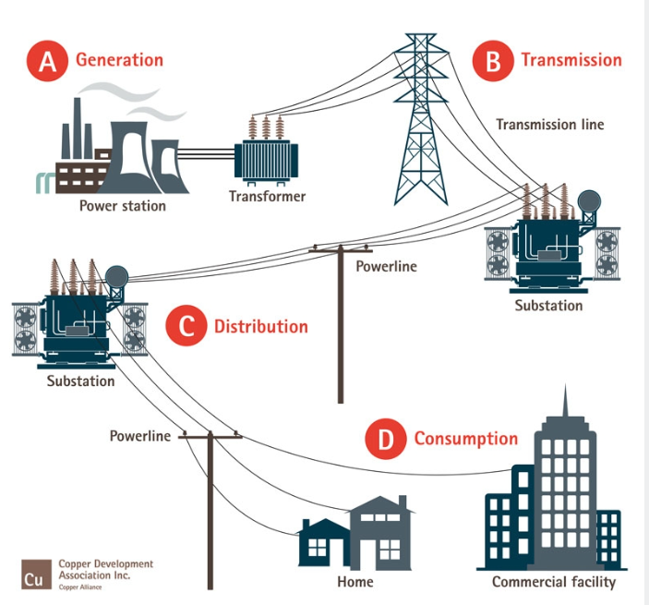
Australian energy overview

Slide 2
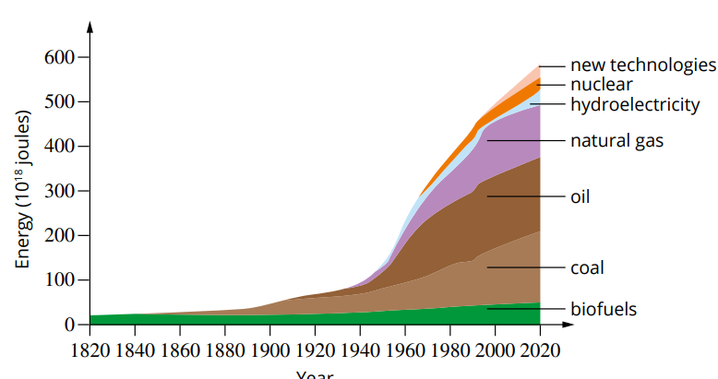
This was our energy forecast around 2010 – very obsolete
This graph is history – energy consumption is not growing at this rate and finally renewables are gaining a foothold.

Slide 3
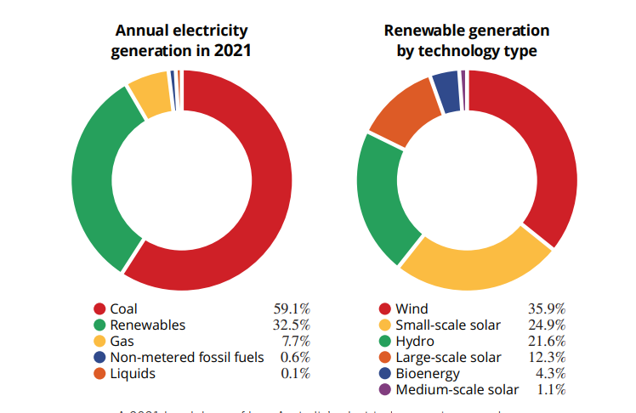
Renewables now account for over 30% of our electricity supply and this is rising fast.

Slide 4
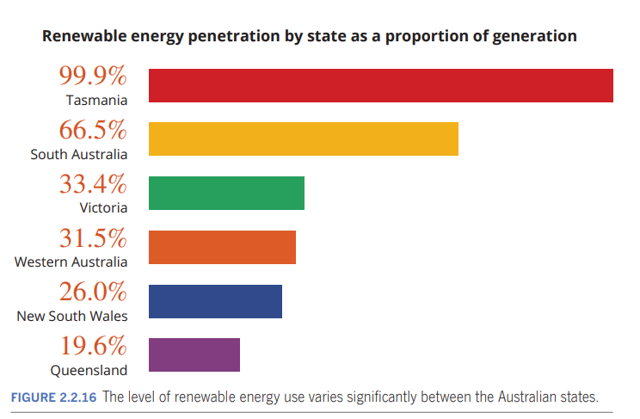
but not all states are equal!

Slide 5
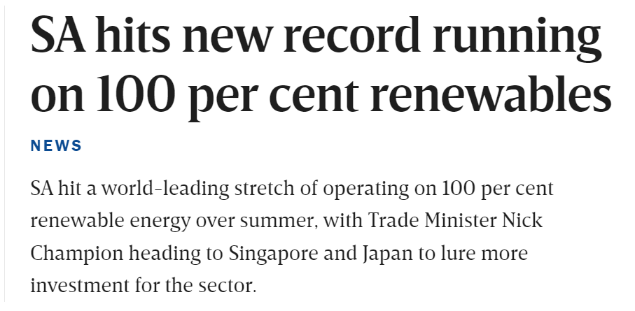
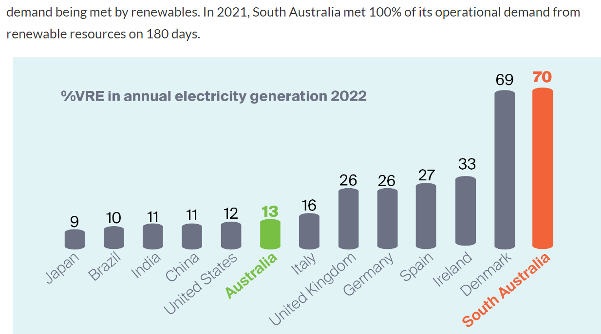

Slide 6
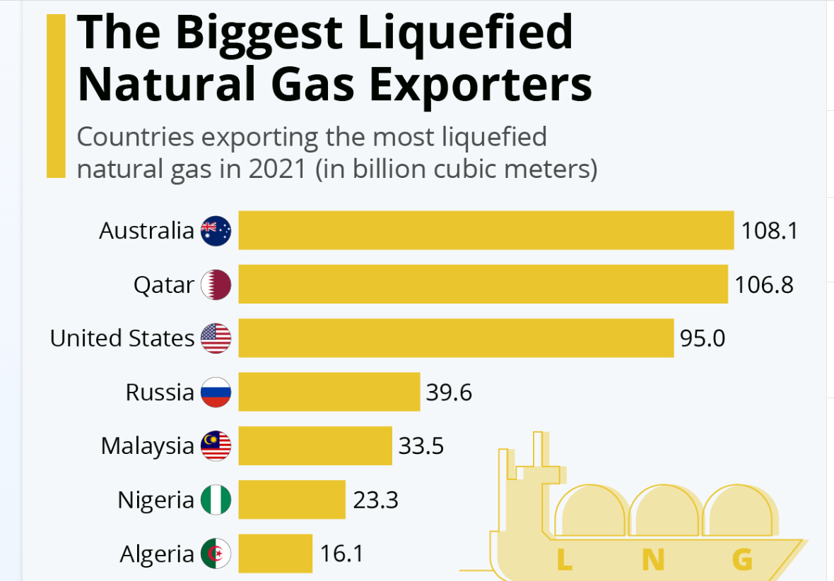
However, Australia gains financially from exporting massive volumes of LNG - perhaps not a graph to be proud of

Slide 7
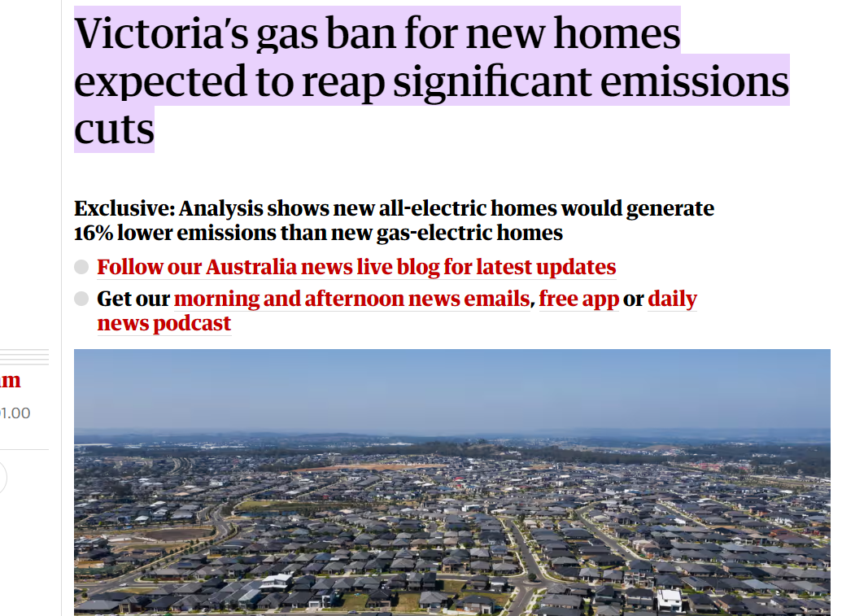
WA and Qld have gas reserves but Victoria does not.

Slide 8
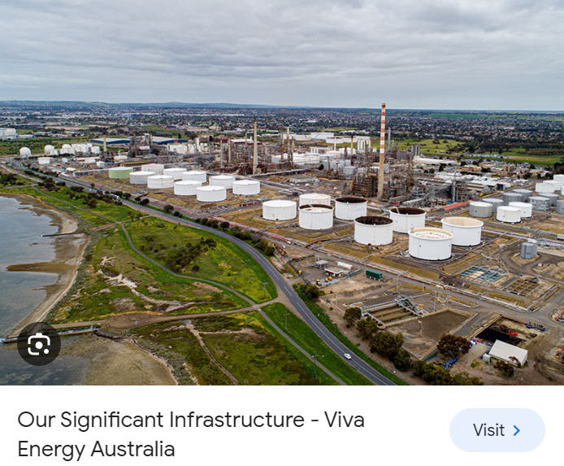
Our last petrol refinery – Corio Geelong

Slide 9
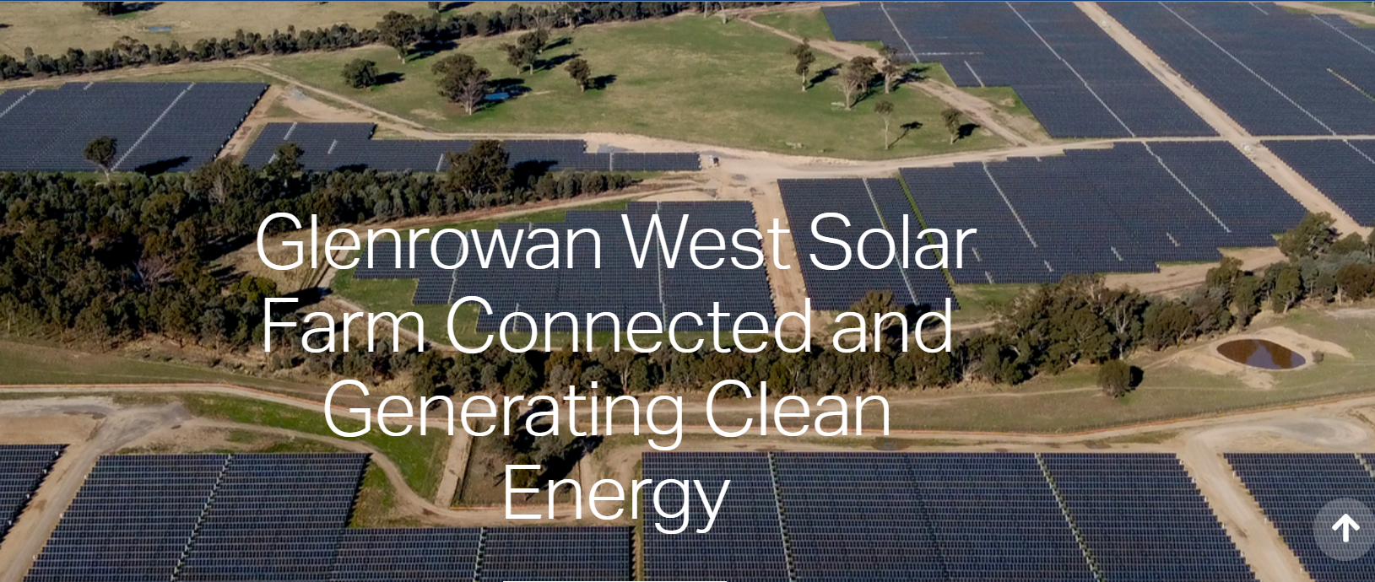
Change in Victoria – the Glenrowan Solar Farm

Slide 10
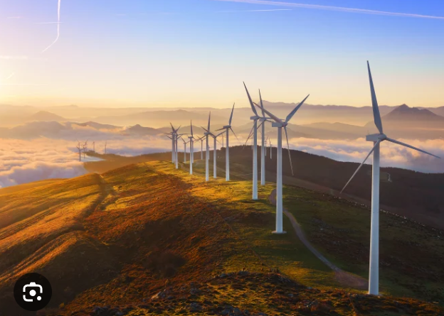
Wind Farms

Slide 11
and offshore wind in Gippsland

Slide 12
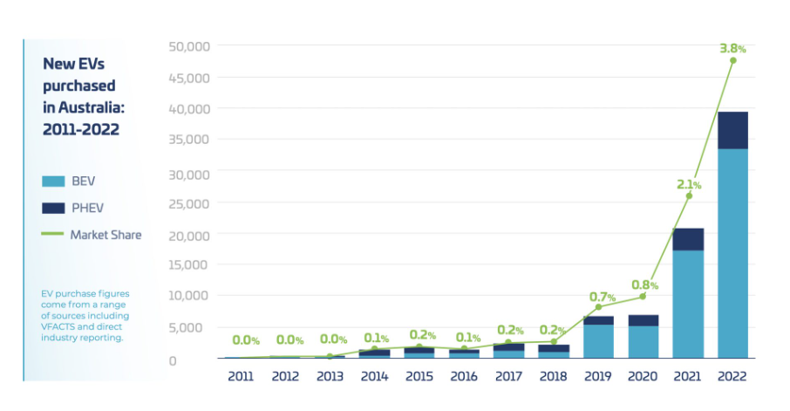
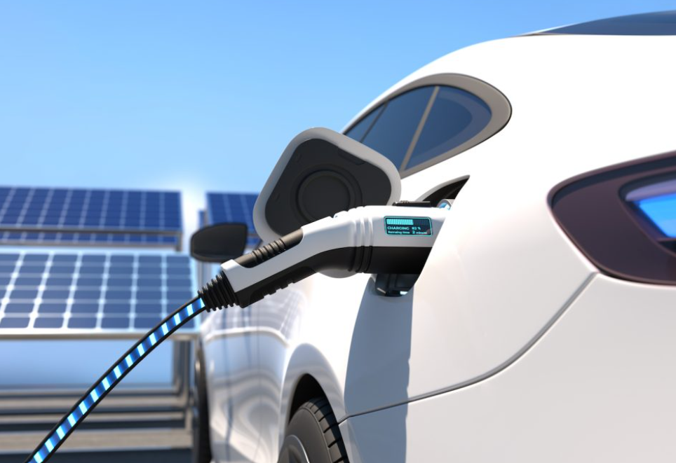
Not just electrical energy – also transport change

Slide 13
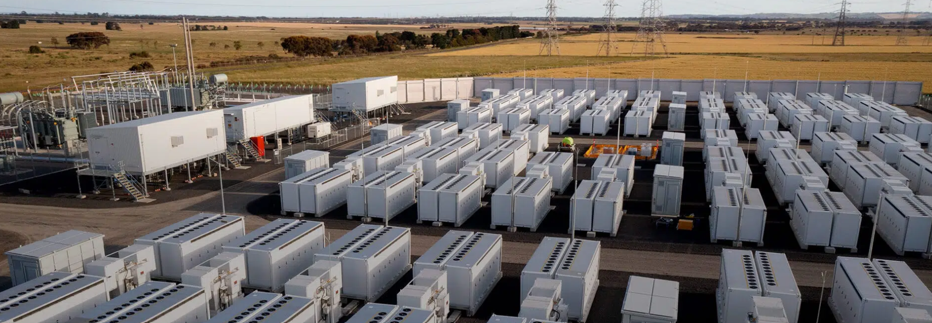
With renewables comes the question of storage (for when the sun don’t shine) – the Geelong lithium storage battery

Slide 14
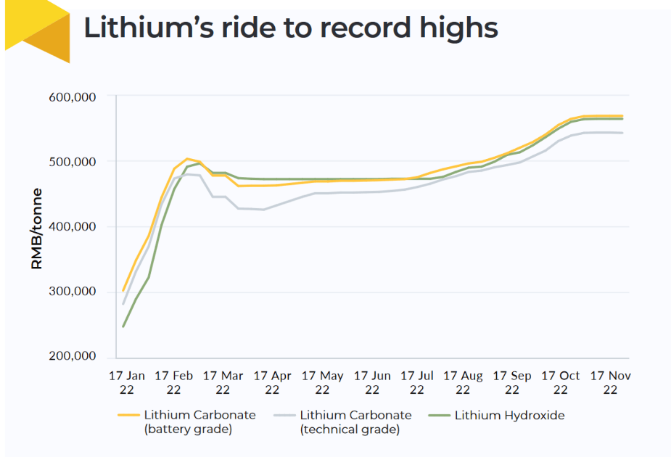
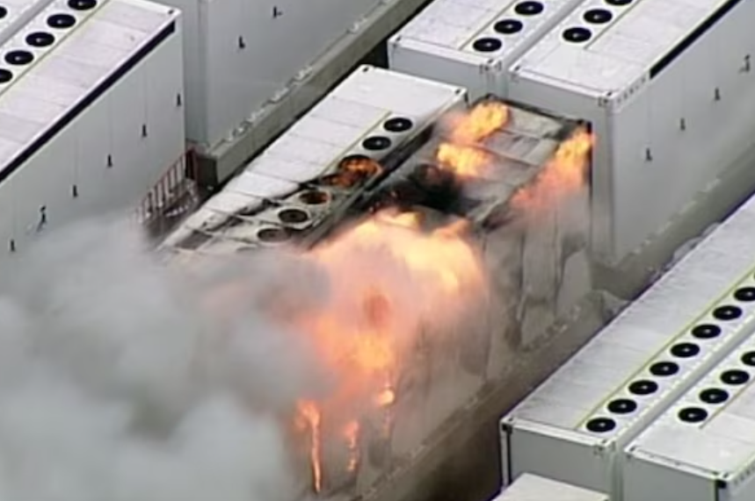
Three problems – care with fire and lithium abundance and

Slide 15
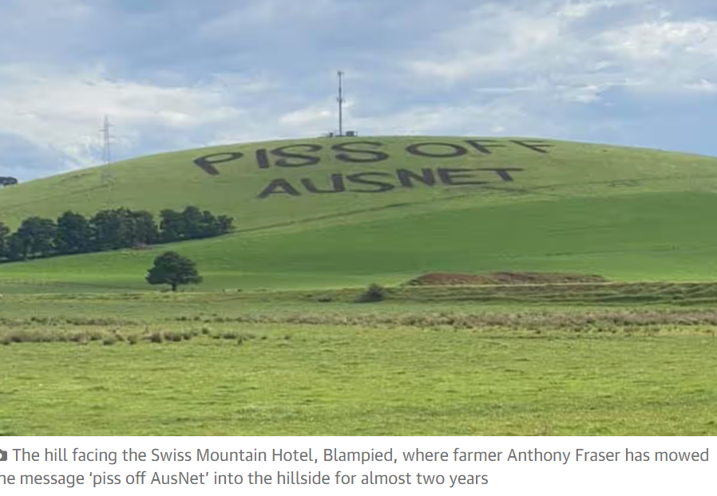
some farmers are not looking forward to new power lines running through their properties!

Slide 16
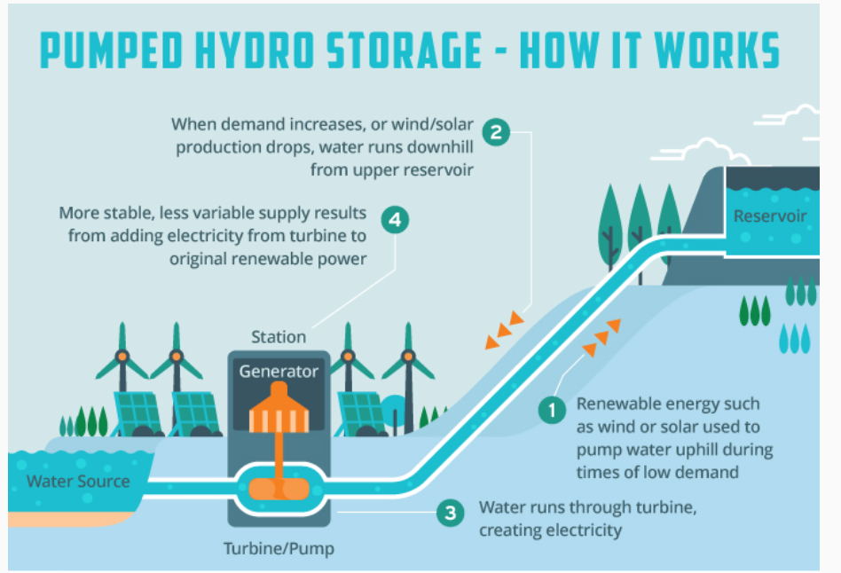
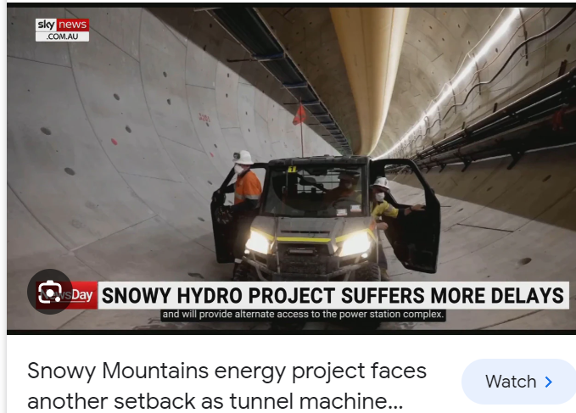
Pump water uphill as storage!

Slide 17
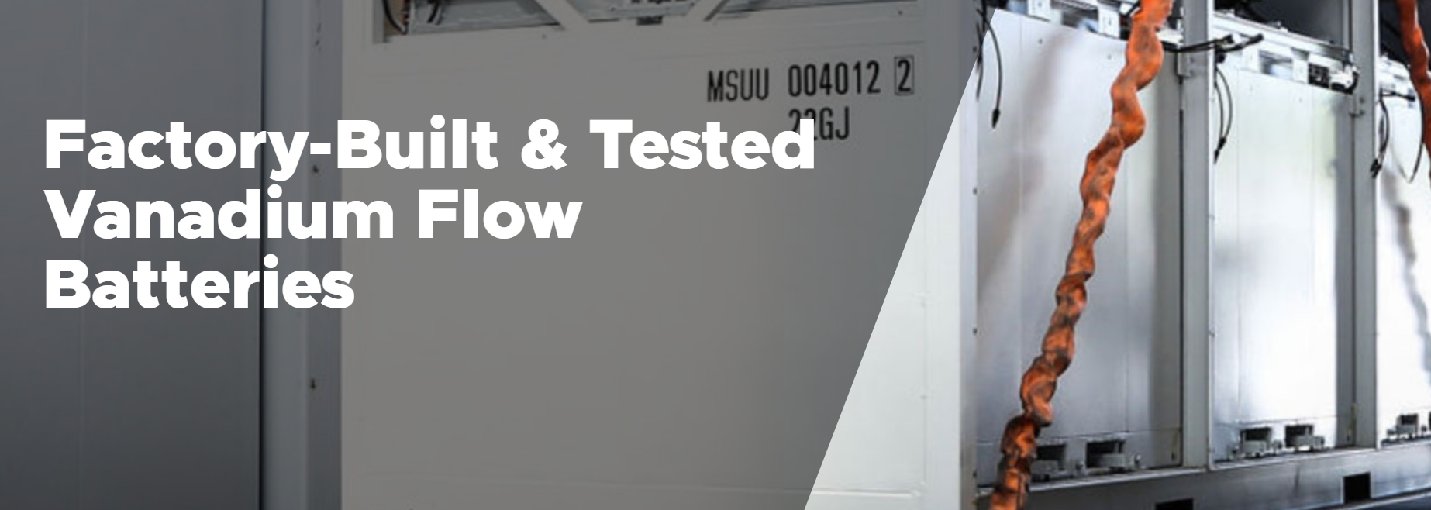
Maybe there are alternatives to lithium

Slide 18
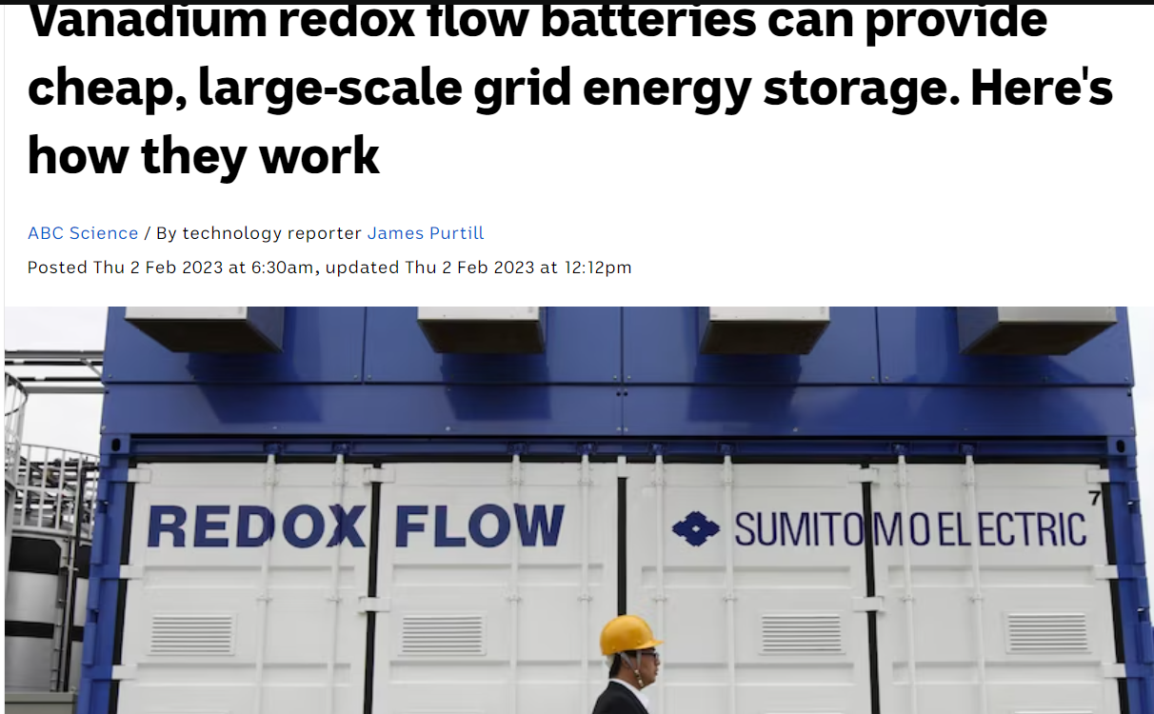

Slide 19
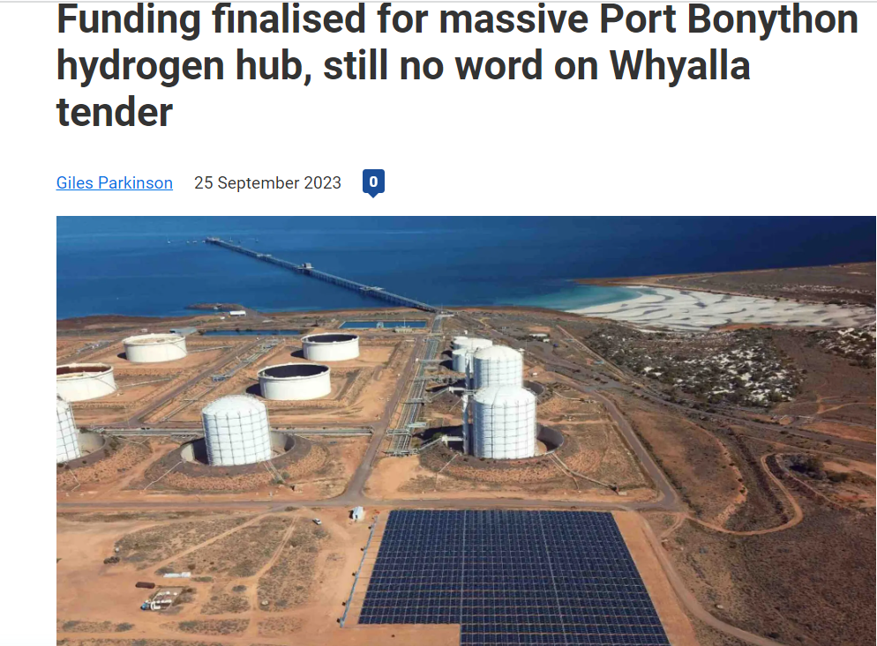
And hydrogen might be a form of storage

Slide 20
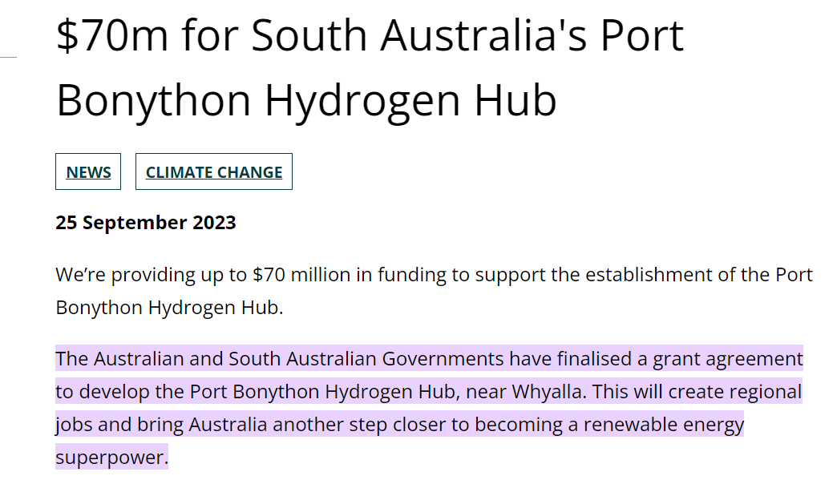

Slide 21
