Slide 1
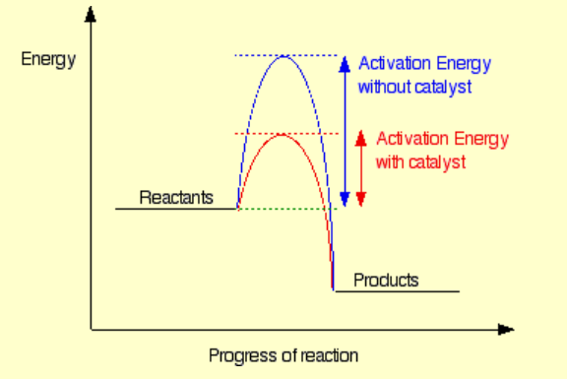
Thermochemical equations change.
(author’s interpretation!)
The change in the study design is that the mol⁻¹ has been removed.
This affects thermochemical equations only.

Slide 2
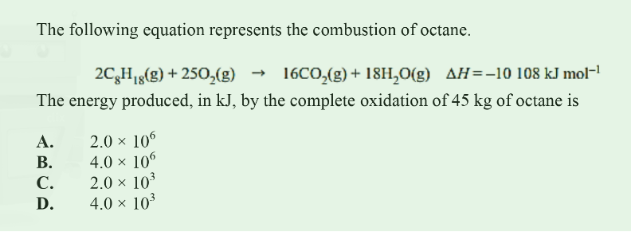
Was
Is
Why? Cos per mole makes no sense in this equation.
Equation now says 2 mole of octane will produce 10108 kJ

Slide 3
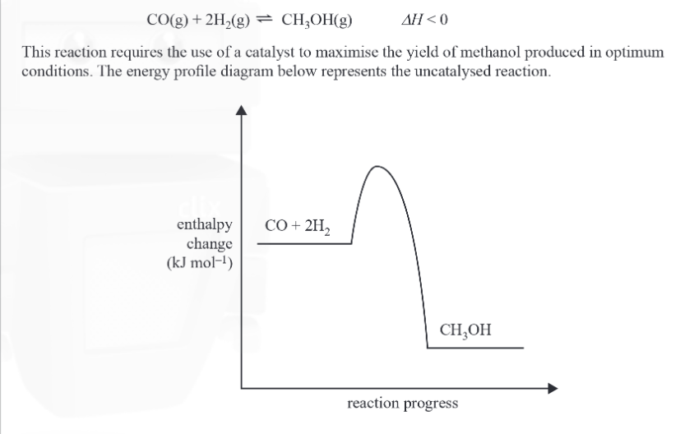
Cover up the mol⁻¹ . Equation will just be

Slide 4
The mol⁻¹ goes

Slide 5
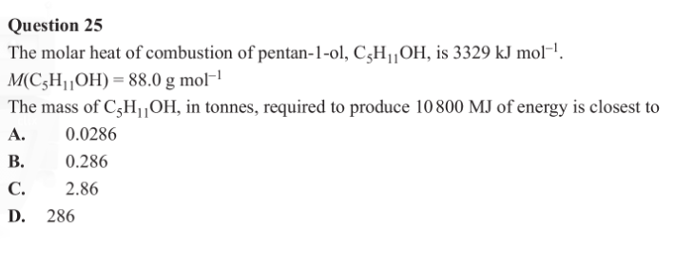
It is only thermochemical equations that change. Molar heat of combustion is unchanged as shown in the question below. This value needs the per mole to distinguish per mole from per gram.

Slide 6
Molar enthalpy: enthalpy of a substance, per mole.
Heat of combustion: energy released when a specified amount of a substance undergoes complete combustion
Enthalpy of combustion: enthalpy change when one mole of a substance undergoes complete combustion

