Slide 1
Free O2
This is about
having a supply of oxygen available to hospitals in poorer countries.
the system does not require electricity.
Melbourne Uni project

Slide 2
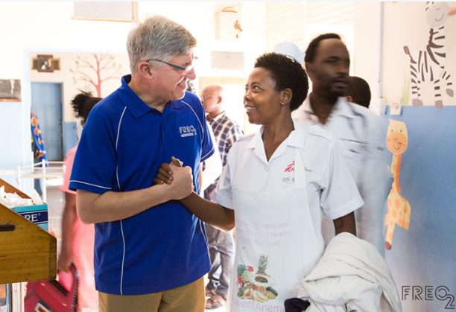
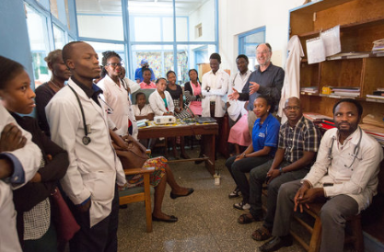
Trials of the units are being conducted in several countries

Slide 3
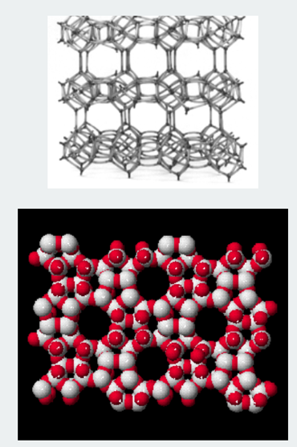
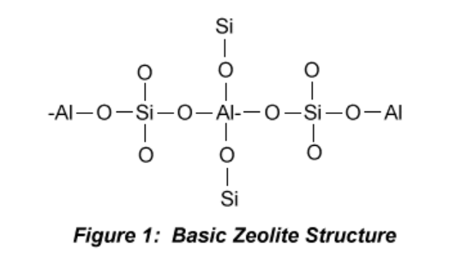
The principle is to pump air onto a zeolite or activated charcoal catalyst.
Under pressure the nitrogen is absorbed first.

Slide 4
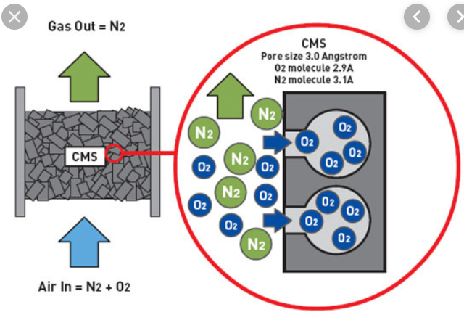
The oxygen rich air can be removed, then the pressure released and the nitrogen is then freed for the catalyst to be used again in the next cycle.

Slide 5
The Melbourne Uni challenge was to make this process work without electricity.
To do this they use running water and its ability to create a vacuum as the energy source.

Slide 6
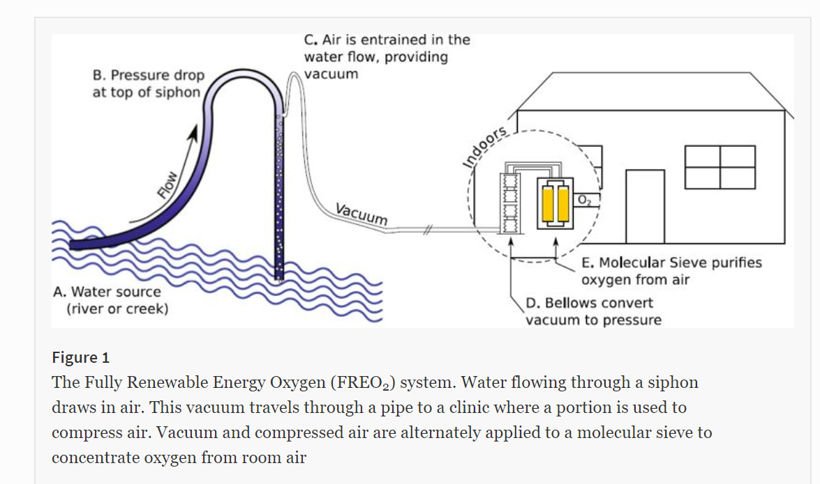

Slide 7
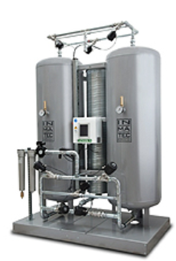
The volume of running water required is not high and typically oxygen production rates are around 3 L/min.
The units have been trialled successfully in Africa and have the potential to save many lives

