Slide 1
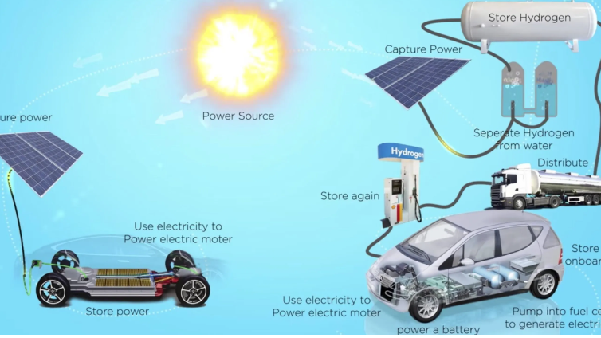
Hydrogen gas
Saviour or distraction?

Slide 2
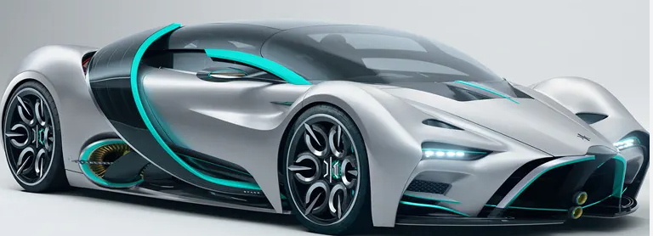
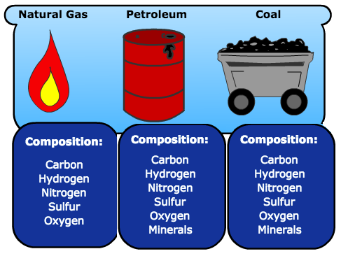
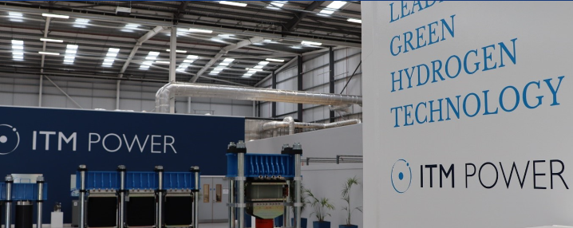
Supplies of fossil fuels are dwindling, and their combustion is fuelling climate change, therefore alternatives are needed.
One of the possible alternatives is hydrogen gas.

Slide 3

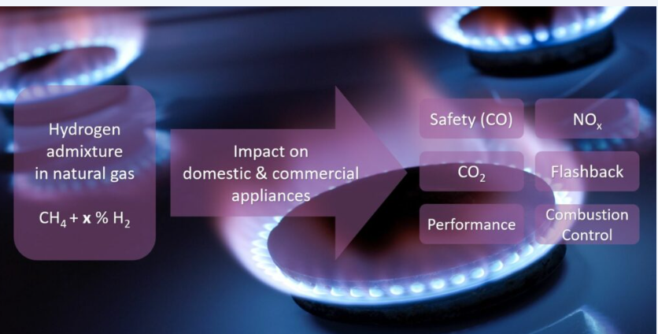
Hydrogen can
be blended with natural gas for use in homes. (Trials underway in Gladstone and Adelaide)
power vehicles (fuel cells)
power buildings (fuel cell stack)
be transported to other countries

Slide 4

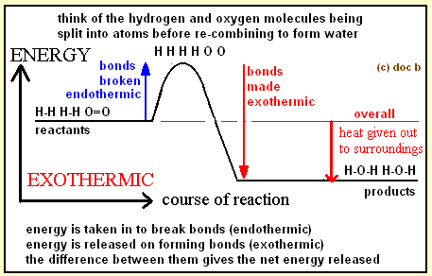
Why hydrogen?
hydrogen is a very energy dense fuel.
the only product of combustion of hydrogen is water.
hydrogen fuel cell technology is widely available

Slide 5
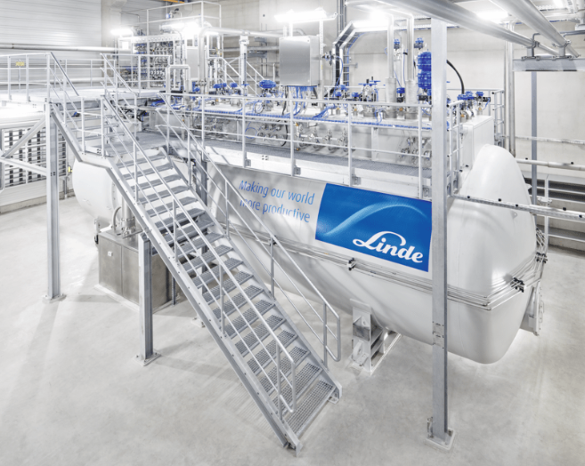

Is there a catch?
Yes!
Hydrogen is a gas. As a gas it is not a dense fuel.
Liquification requires significant energy input.
Hydrogen is highly flammable
Producing hydrogen from fossil fuels does not solve anything.
We will need to develop distribution networks.
-250 0C liquification

Slide 6
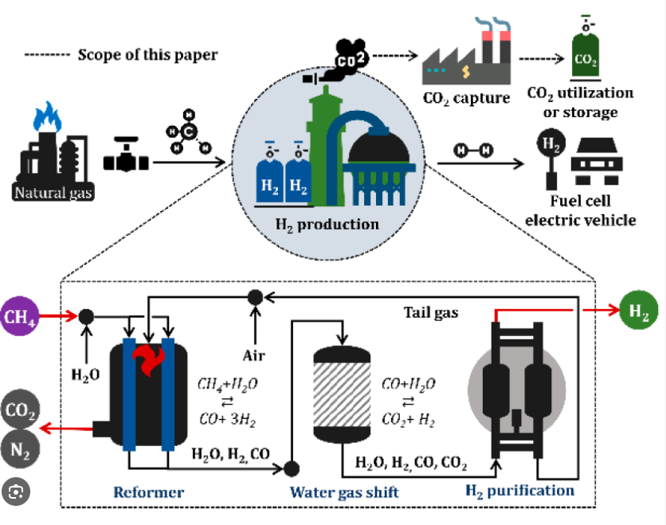
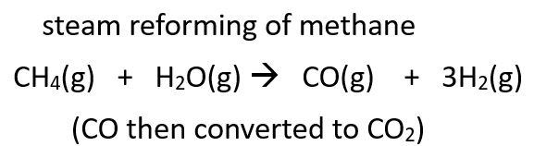
Brown, grey or blue hydrogen – hydrogen made from fossil fuels. (Not on your course)
Solves little as it uses a scarce resource and produces bulk CO2

Slide 7
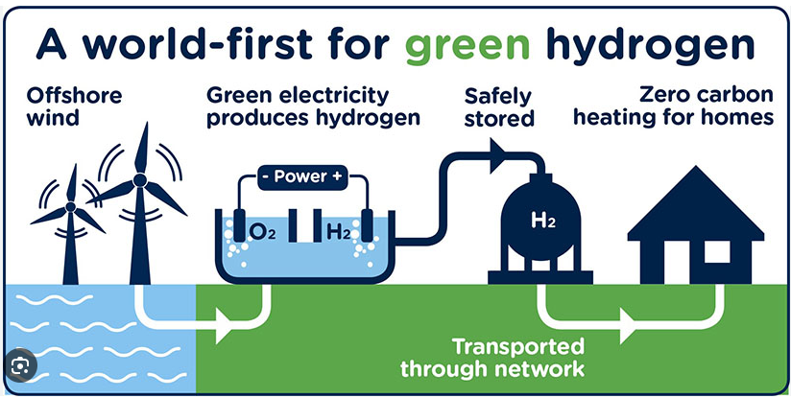
Green hydrogen – hydrogen produced using renewable energy (usually electrolysis of water)

Slide 8
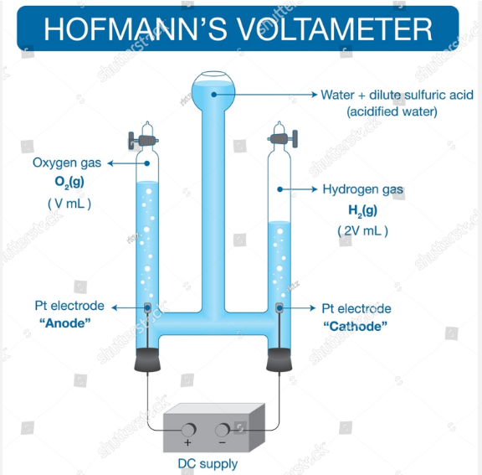
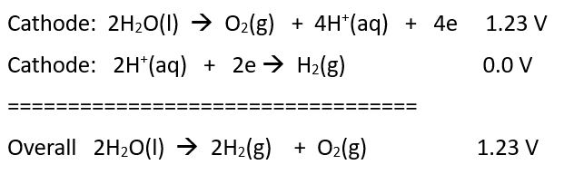
Laboratory preparation of hydrogen
Using dilute acid or voltage allows a lower voltage to be used than for a salt solution

Slide 9
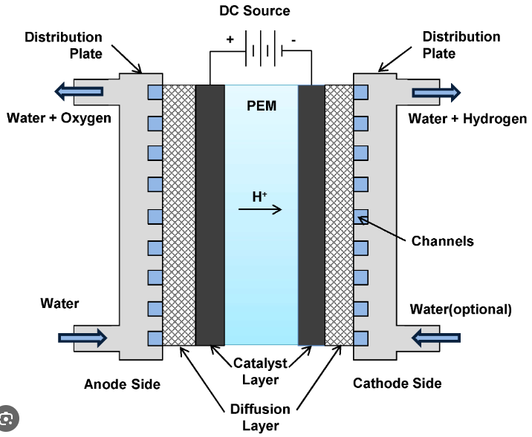


Commercial preparation of hydrogen – PEM cell
(polymer electrolyte membrane or proton exchange membrane)
Non-aqueous environment, handles the intermittent nature of renewable energy and produces hydrogen under pressure. Improved efficiency.
(Virtually a hydrogen fuel cell in reverse using similar high-tech electrodes.)

Slide 10
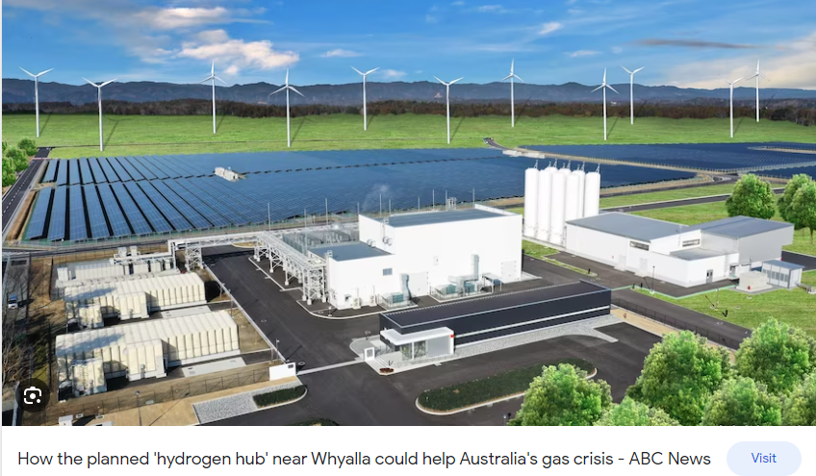
PEM - Only viable on a large scale

Slide 11
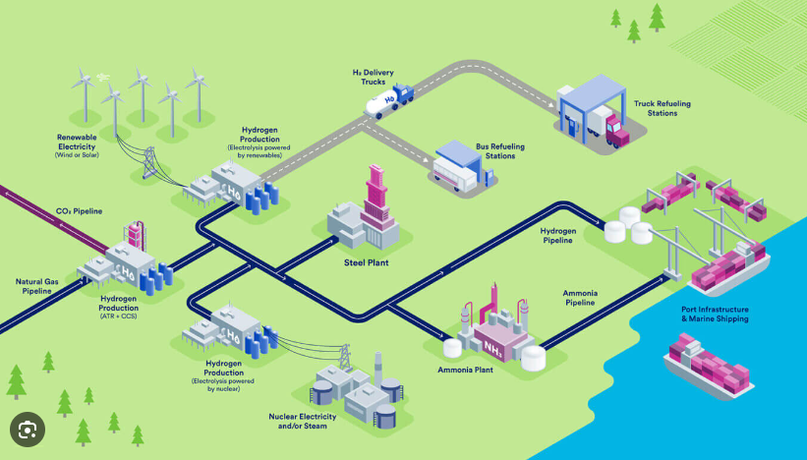
Put all the hydrogen related industries in the one zone – eg Gladstone Queensland

Slide 12
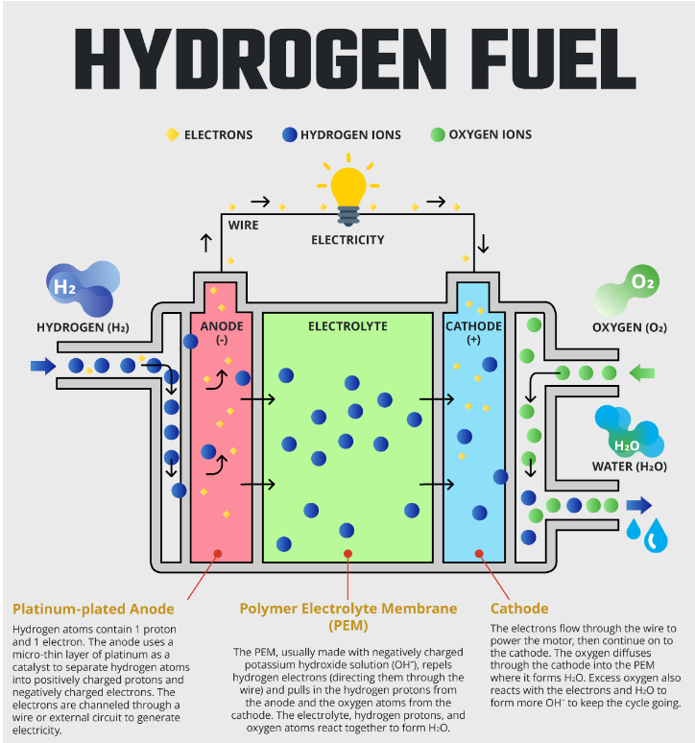
Use the transported hydrogen in a fuel cell

Slide 13
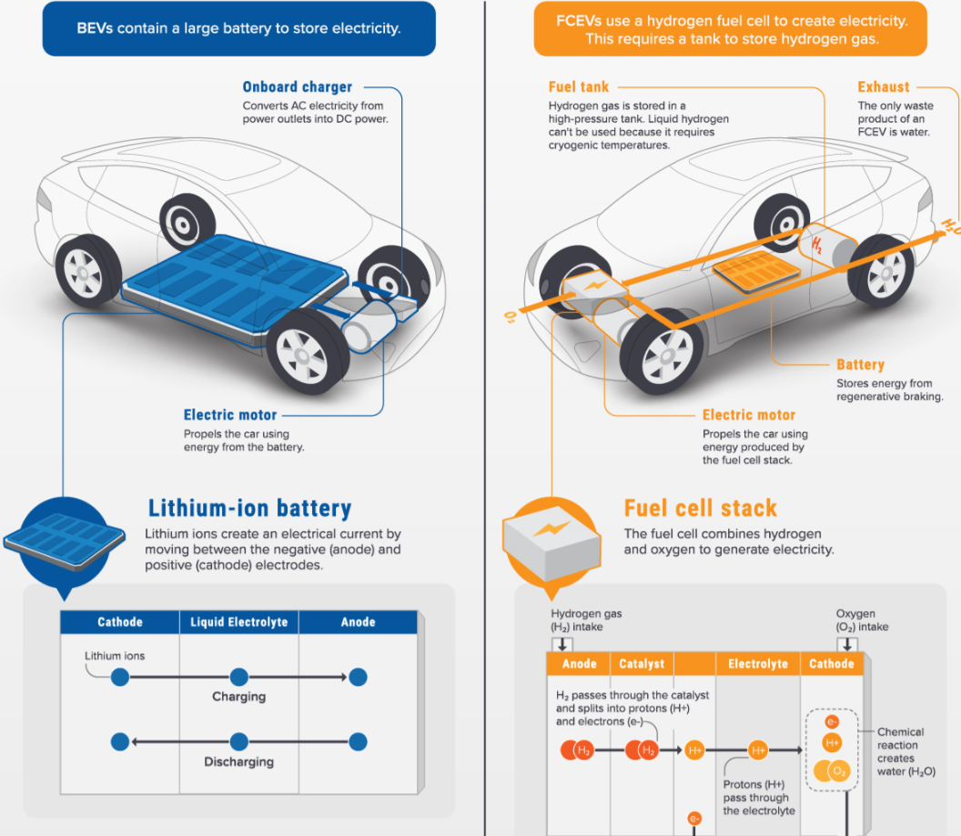
EV
Electric vehicle
Bank of Li-ion cells
Fuel-cell electric vehicle (hydrogen)

Slide 14
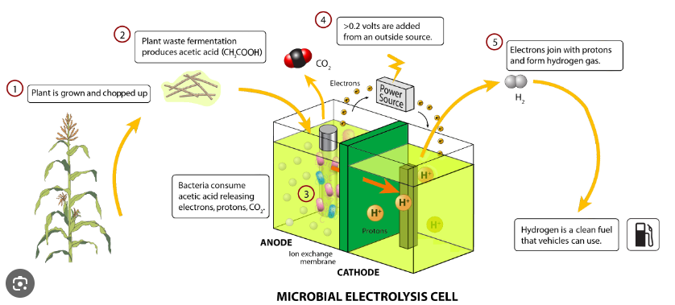
Left-field – get bacteria to produce hydrogen from biomass

Slide 15
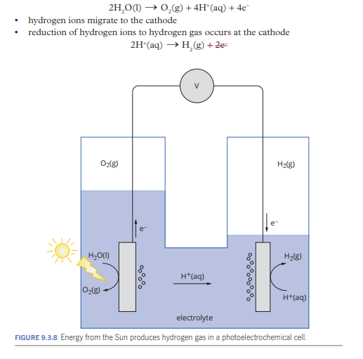
Left-field – get sunlight to power the electrolysis
Photoelectrochemical cell

Slide 16
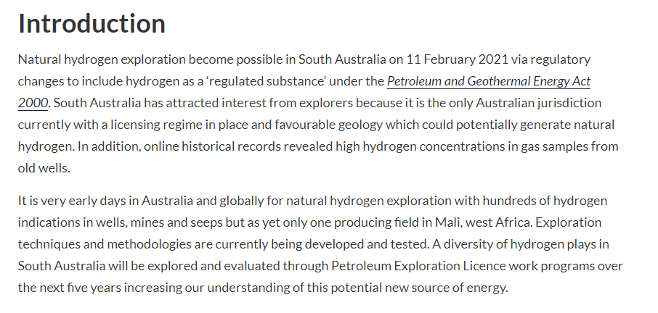
Left-field – go mining for hydrogen gas in the Earth’s crust!

