Slide 1
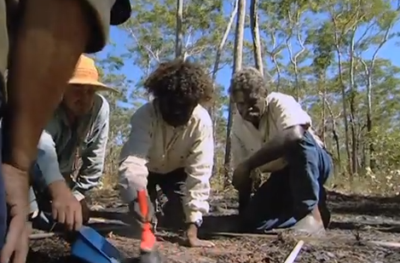
Indigenous Australian Chemistry
If you thought indigenous Australians knew very little about chemistry, think again!
Scientists are now starting to realise how chemical processes indigenous Australians have applied over the past centuries.
Indigenous rangers planning fire breaks in Northern Australia.
© POShea

Slide 2
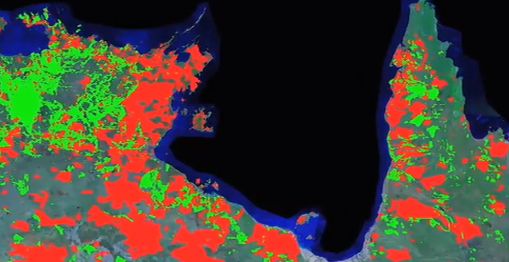
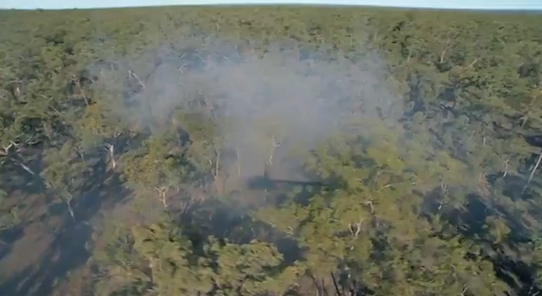
The red regions represent wildfires occurring regularly in Northern Australia creating very significant CO2 emissions.
Controlled burns in a different season can reduce the CO2 emissions by 50%

Slide 3
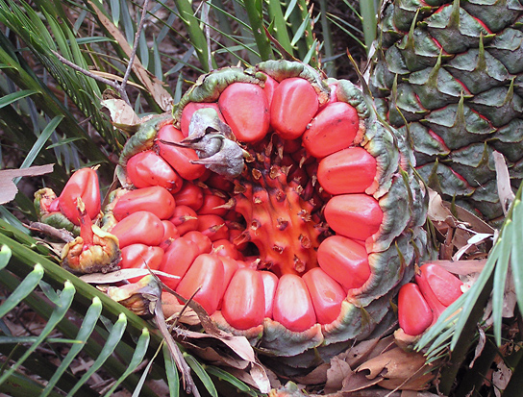
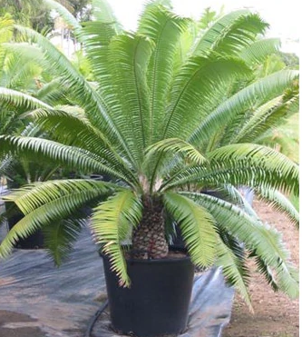
Cycads (sago palms)
Cycad fruit contains high starch levels but it also contains a range of oxalate toxins. Indigenous people from Northern Queensland knew to soak the fruit in water for several weeks. During this time toxins are leached from the fruit and it becomes edible.

Slide 4
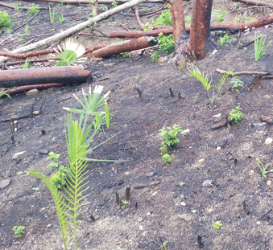
By burning cycad plants, indigenous Australians removed competing plants and increased germination levels of cycad seeds. The cycad plantation size was increased by this technique.

Slide 5
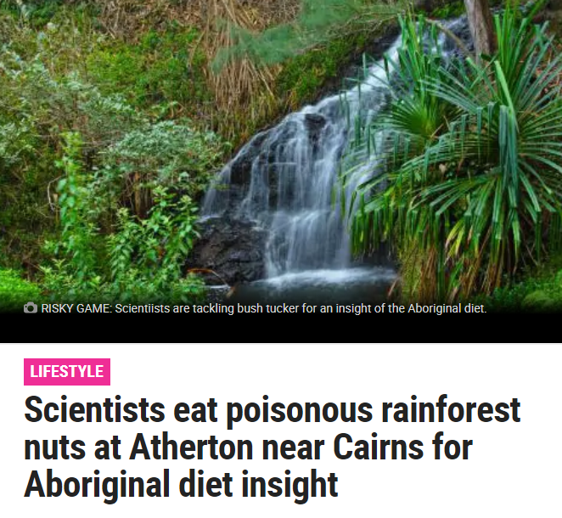
Latrobe University scientists copied indigenous techniques in a study near Cairns.

Slide 6
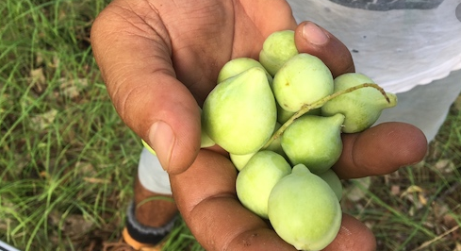
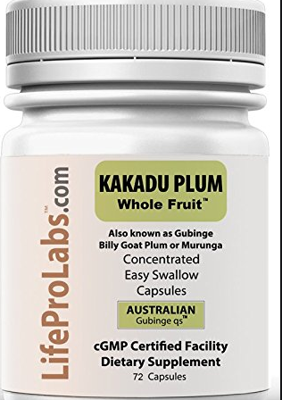
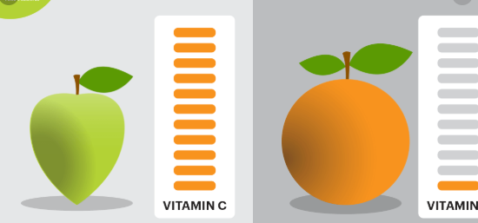
The vitamin C content of Kakadu plums is far higher than that of oranges, blueberries or any traditional fruits.

Slide 7
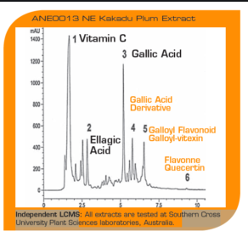
HPLC of the juice of Kakadu plums. The high peak for Vitamin C confirms the high concentration and the chromatogram also shows the presence of other useful nutrients such as gallic acid.

Slide 8
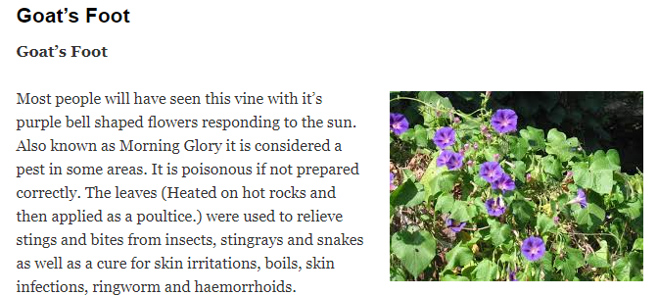
Morning Glory – a common nursery plant known to indigenous Australians as goat’s foot. If you are bitten by a stingray, the leaves will provide relief as long as they are treated appropriately!

Slide 9
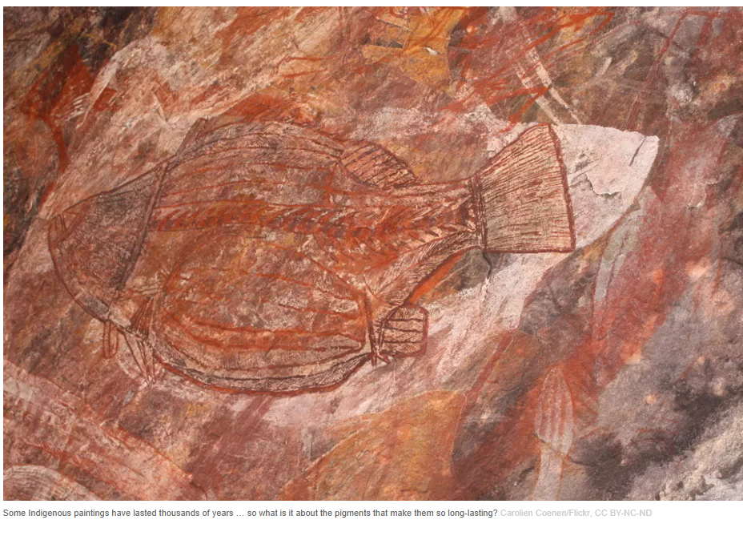
Indigenous artwork – made from paints prepared used ancient techniques.

Slide 10
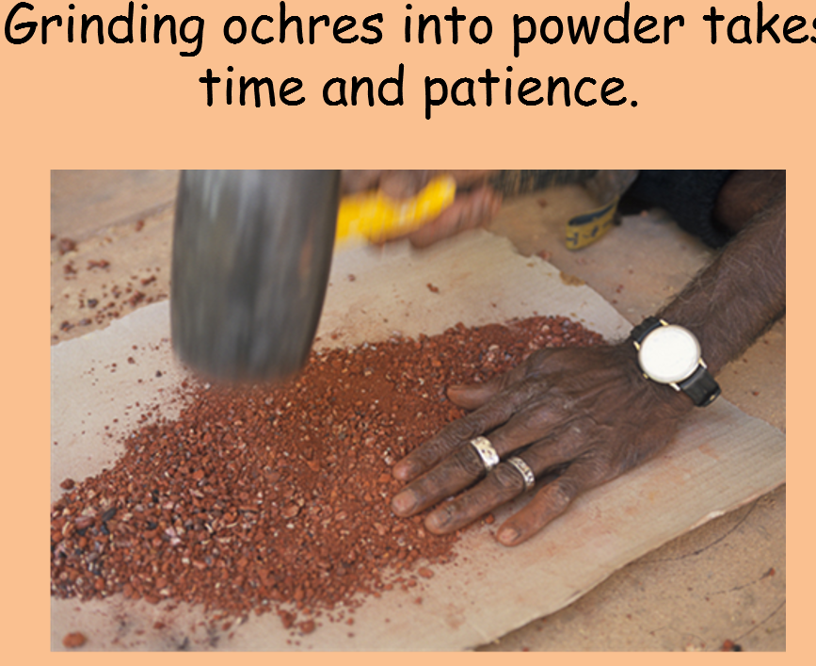

Slide 11
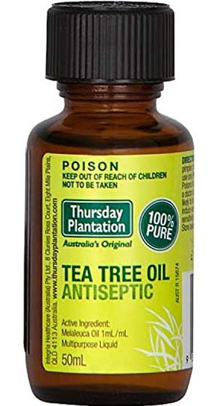
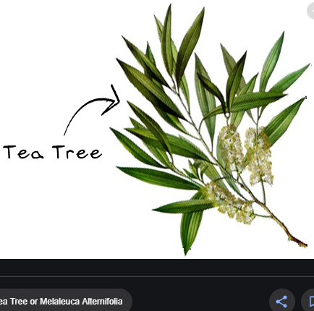
Captain Cook’s botanist, Joseph Banks noticed how many uses indigenous Australians had for tea-tree. It is the strongest natural antiseptic in the world.

Slide 12
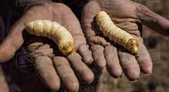

Slide 13
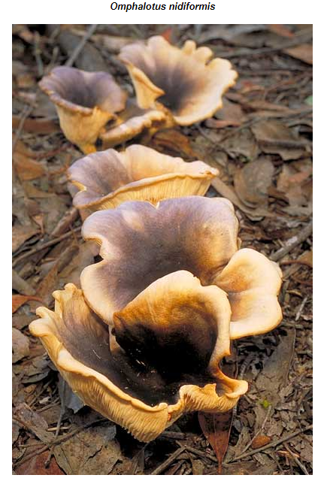

Slide 14
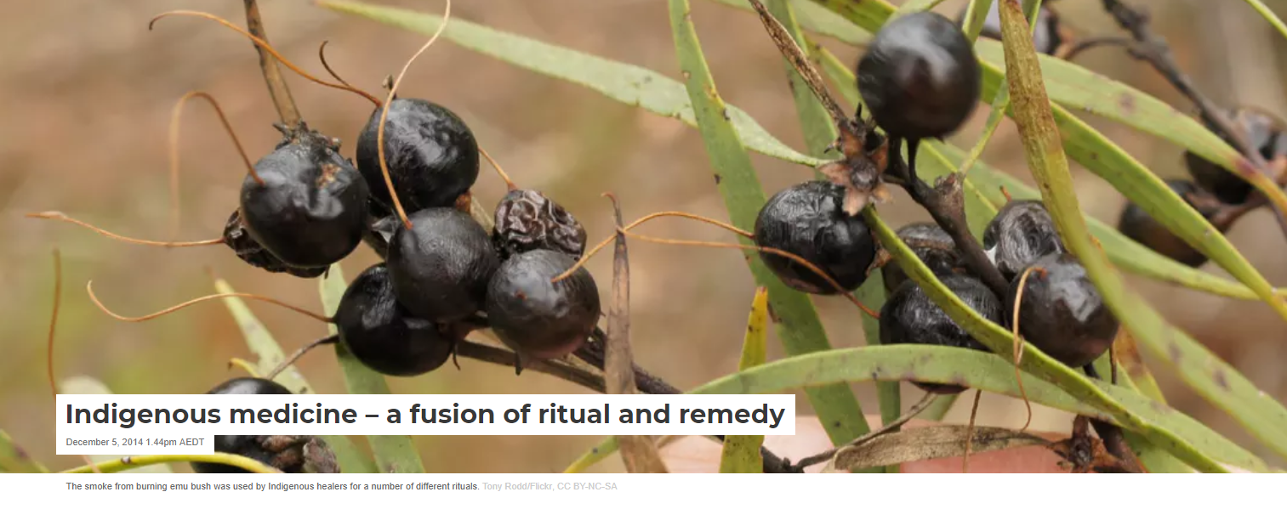
Eremophilia (Emu bush)
Often used in smoking ceremonies where the fragrant aromas helped with colds and other fevers.

Slide 15
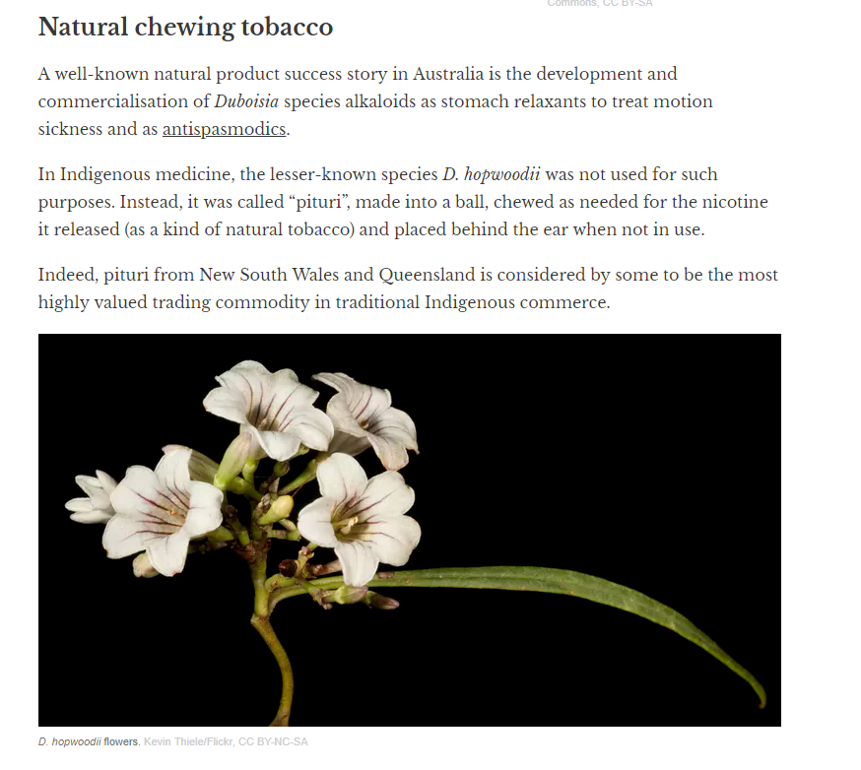

Slide 16
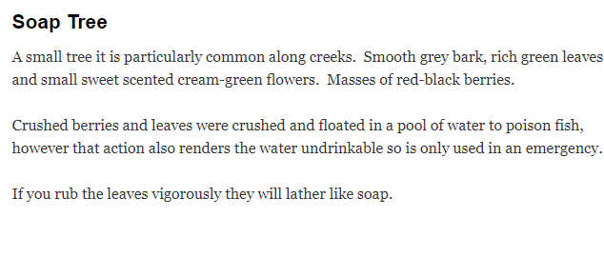
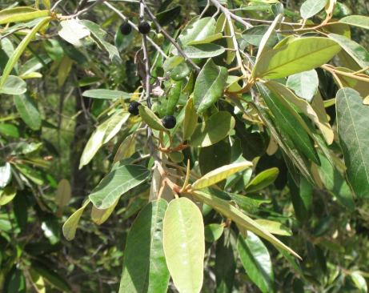

Slide 17
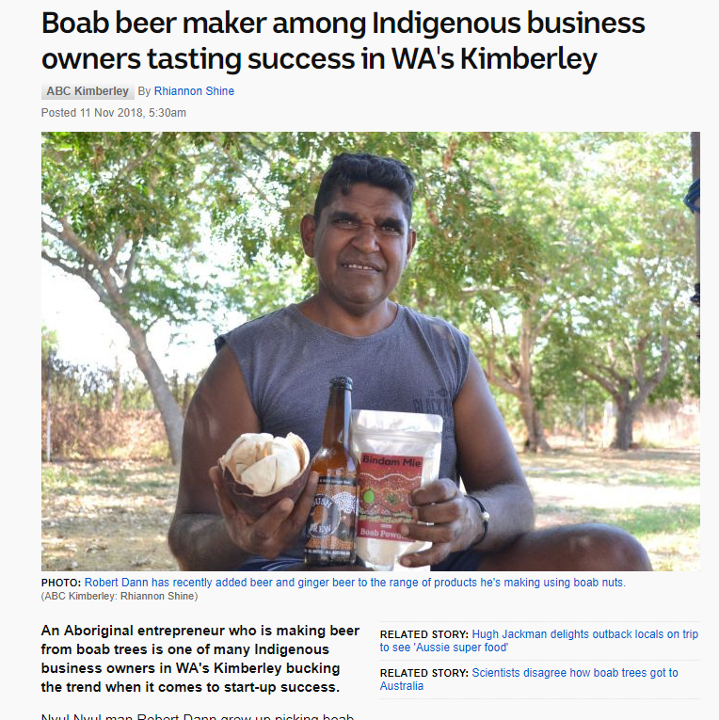
A drink from sap
The Eucalyptus gunnii trees originate from the Central Highlands of Tasmania at about 1,000 metres above sea level. Perhaps the easiest material to use from these trees is the sap.
One subspecies (divaricata) is listed as endangered, and is apparently suffering the effects of climate change and grazing.
In the past, Aboriginal people tapped the trees to allow the sap, resembling maple syrup, to collect in hollows in the bark or at the base of the tree. Ever-present yeast would ferment the liquid to an alcoholic, cider-like beverage that the local Aboriginal people referred to as Way-a-linah.

