Slide 1
Licella – approaching carbon chemicals differently

Slide 2
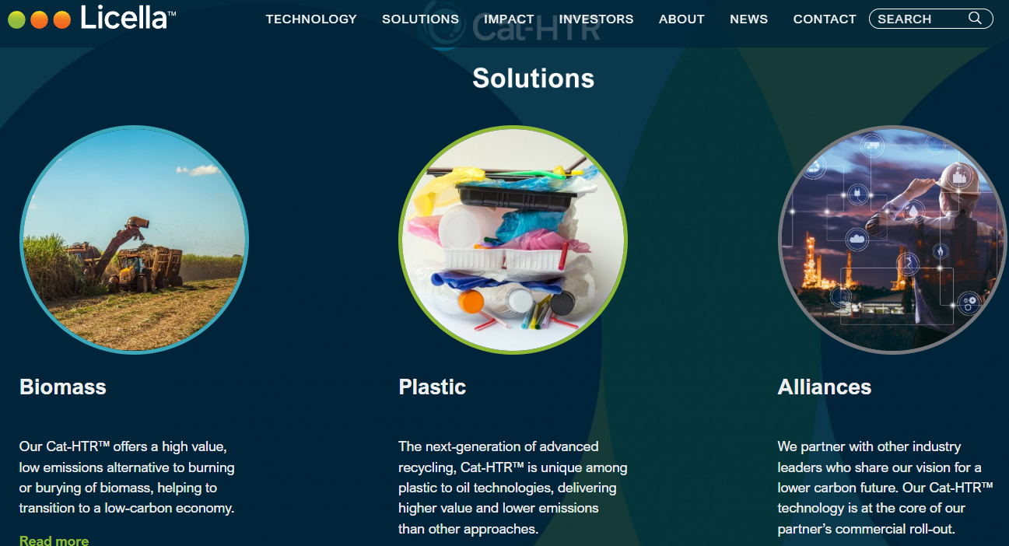
The key to Licella’s strategy is the use of high temperature steam, combined with catalysts, to break down any organic compound into a synthetic oil.

Slide 3
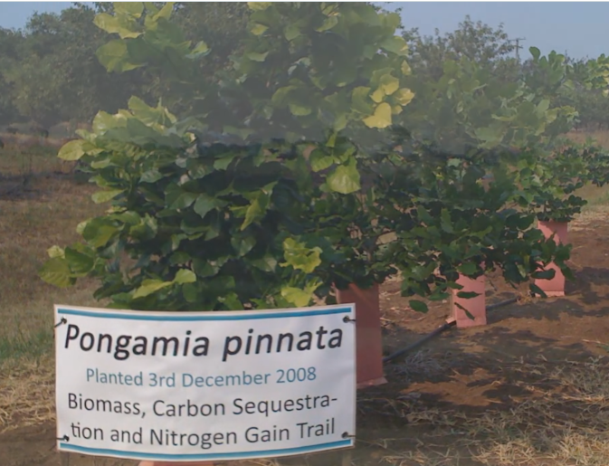
Advantages?
Rather than use crude oil, Licella can produce oil from biomass, therefore bypassing fossil fuels.
The biomass absorbs carbon while it is growing, reducing CO2 levels.
Licella can take organic waste such as plastics and convert them back to oil so they are not added to landfill.
https://www.youtube.com/watch?v=S1N3YqrlEPA

Slide 4
End result, we still use oil but the oil is a blend of crude oil, plastic waste and oil from biomass.

Slide 5
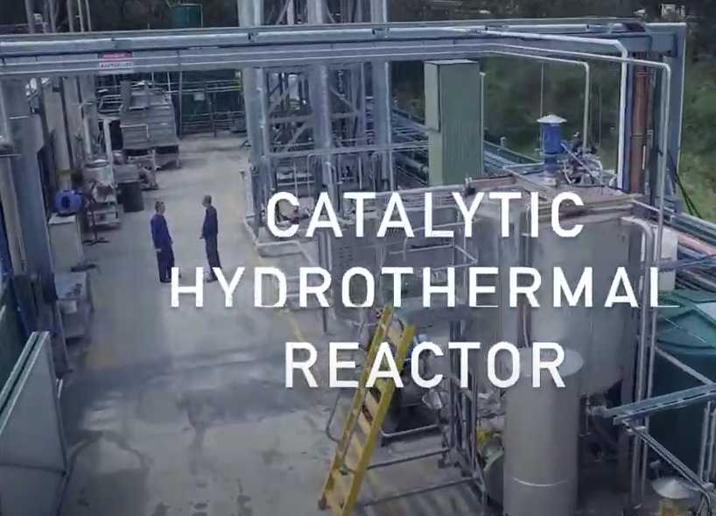
This is the NSW trial plant, a series of reactors with catalysts and steam

Slide 6
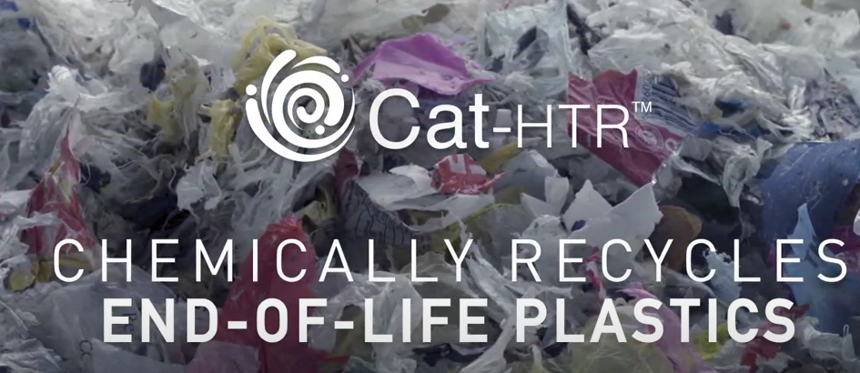
Waste plastic contains long polymer molecules.

Slide 7
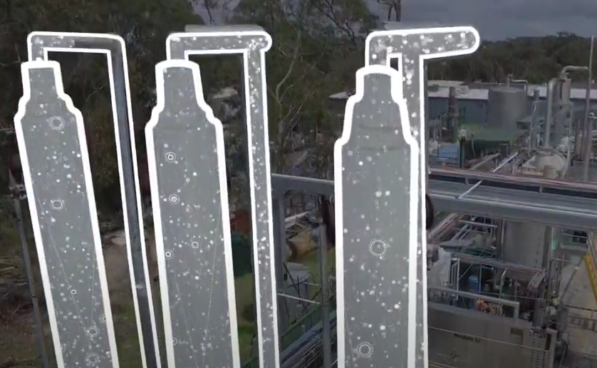
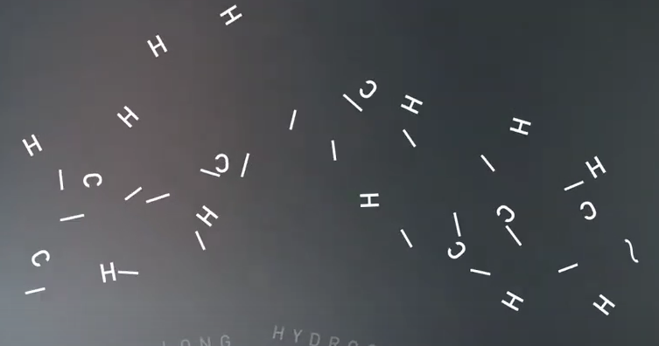
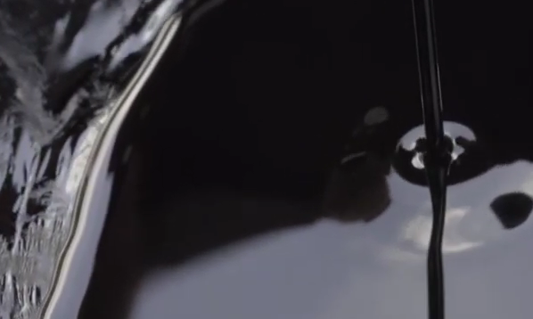
The polymer molecules are broken and reform into a synthetic oil, looking similar to normal crude oil

Slide 8
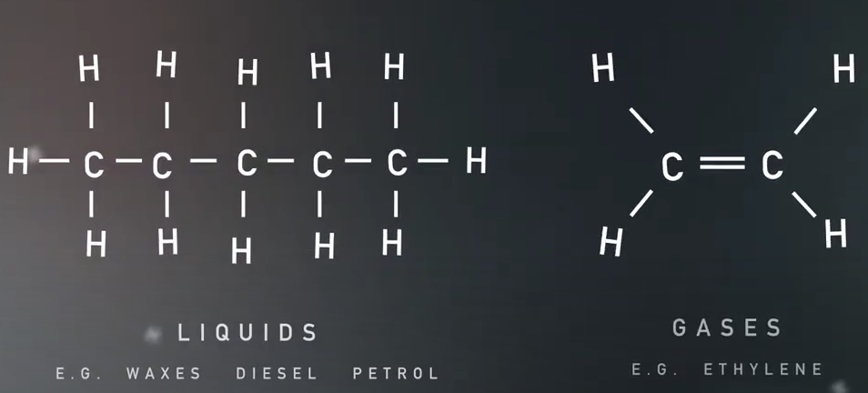
https://vimeo.com/64346837
The oil is made into monomers or fuels.

Slide 9
