Slide 1
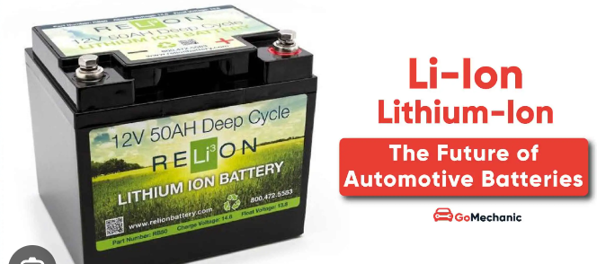
How Li-ion (lithium-ion) batteries work?
© POShea

Slide 2
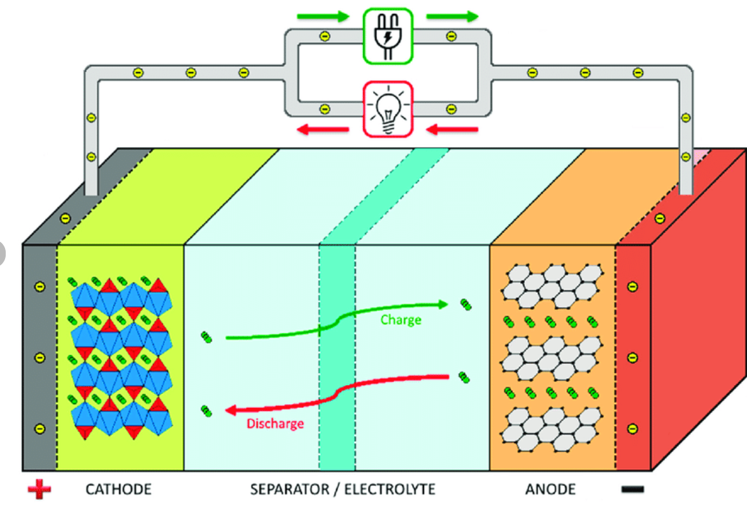
Firstly, they are serious high-technology
Composite electrodes, conducting polymer electrolytes, %s of many metals

Slide 3
Graphite structure to hold lithium ions, shown as LiC6
Lithium salt in organic solvent, ethene carbonate
Metal oxide, eg LiCoO2

Slide 4
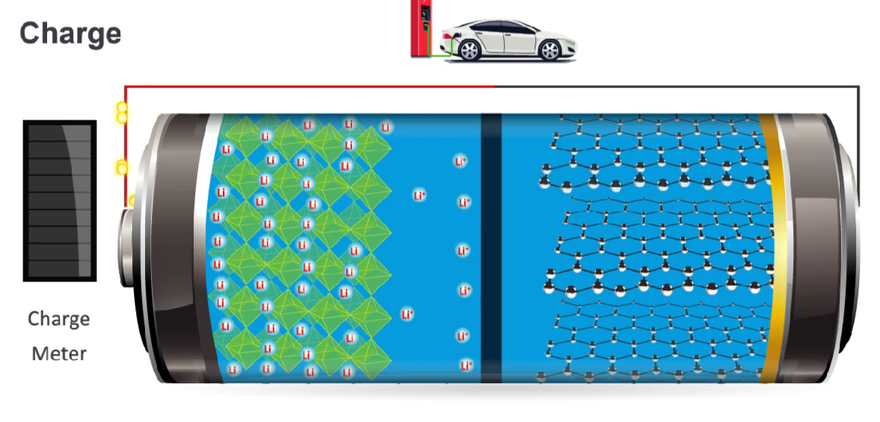
Car pulls into a charging station with a flat battery. Connects to charger => electrolytic cell
+
-
The charger forces electrons to the negative terminal and lithium ions stored at the positive electrode move to negative end – first ones can be seen near the separator.

Slide 5
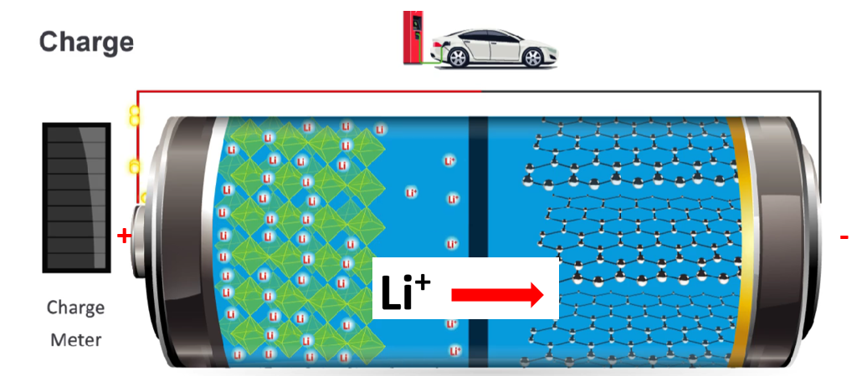
oxidation at the positive anode reduction at the negative cathode
cobalt changes from 3+ to 4+ LiC6 holds the arriving electrons

Slide 6
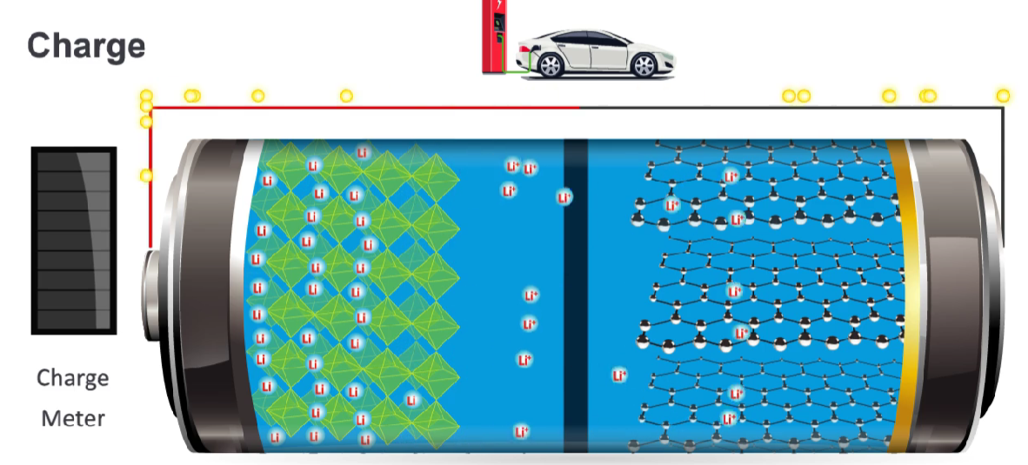
Power supply pushes more lithium ions to the anode

Slide 7
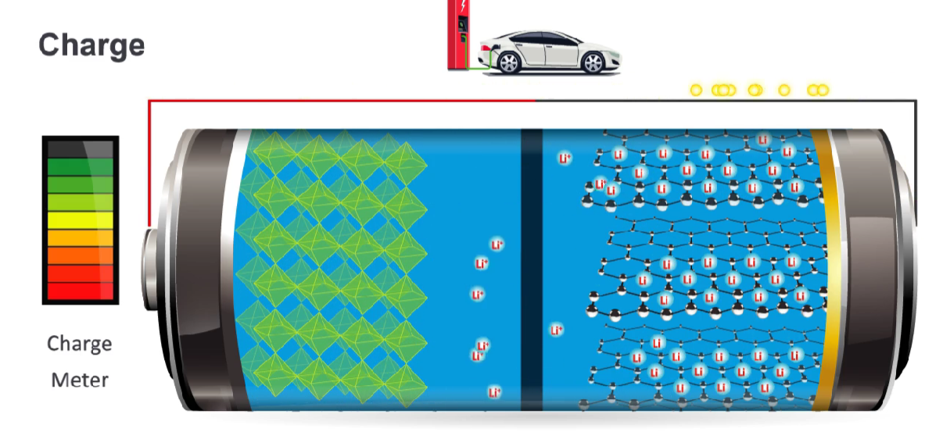
Almost fully charged

Slide 8
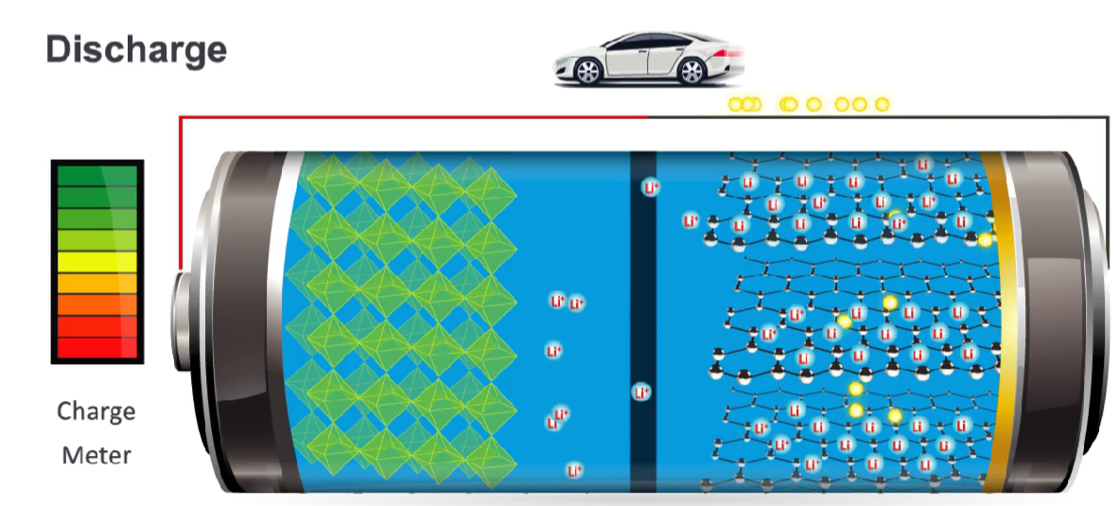
Power supply removed => galvanic cell
+
-
Cobalt ions drive the spontaneous reaction – they want to return to their preferred oxidation state of 3+.
This requires electrons – they are released by the LiC6

Slide 9
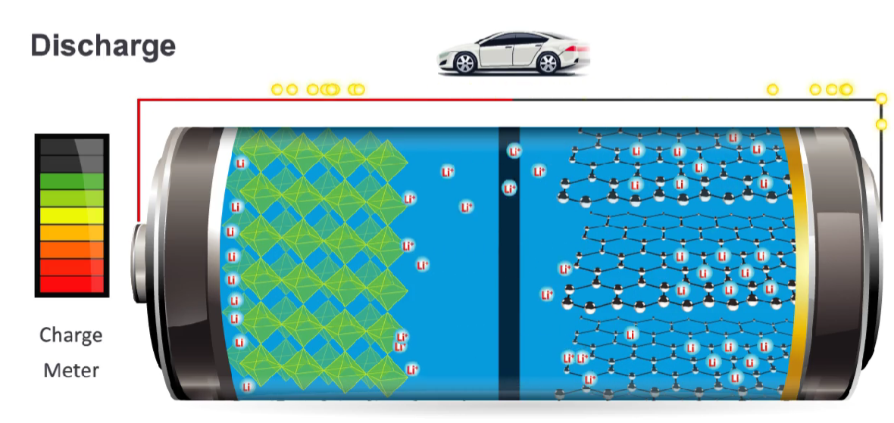
reduction at the cathode (+) oxidation at the anode (-)
cobalt reduced to 3+ LiC6 releases electrons
https://www.energy.gov/energysaver/articles/how-lithium-ion-batteries-work#:~:text=The%20Basics&text=The%20anode%20and%20cathode%20store,at%20the%20positive%20current%20collector.

Slide 10
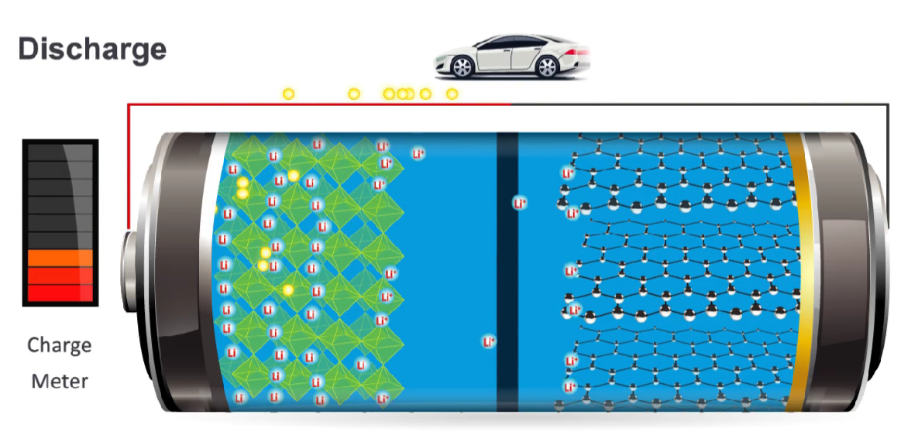
Lithium ion movement continues until all lithium ions have left the anode
Do not think about why Li+ ions are moving toward the positive electrode – it is the spontaneous reduction of cobalt that drives this reaction, the Li+ ions are just completing the circuit

Slide 11
Cobalt oxide is only one example of a lithium-ion cell – iron/phosphate combinations and other metal oxides have been trialled.
Aluminium and copper metals are used at the electrodes, increasing the demand on metals consumption of so many electric vehicles and storage systems.

