Slide 1
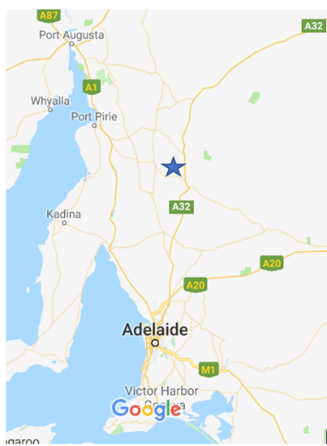
South Australian Tesla project
Where?
Hornsdale Power Complex
Jamestown South Australia
about 300 kms north of Adelaide

Slide 2
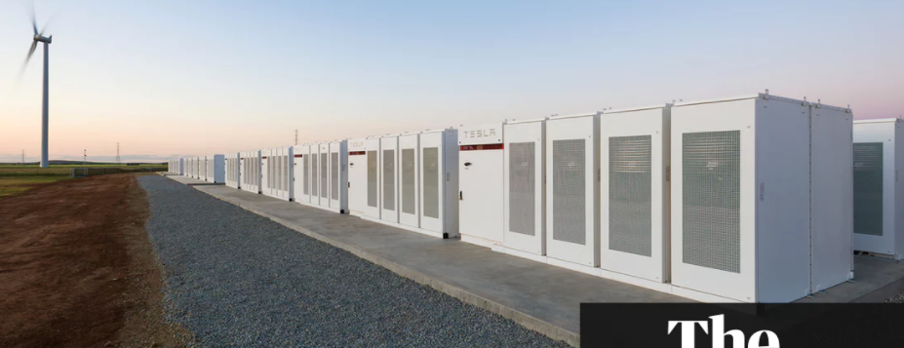
What is it?
A set of connected cells to be used to store electrical energy.

Slide 3
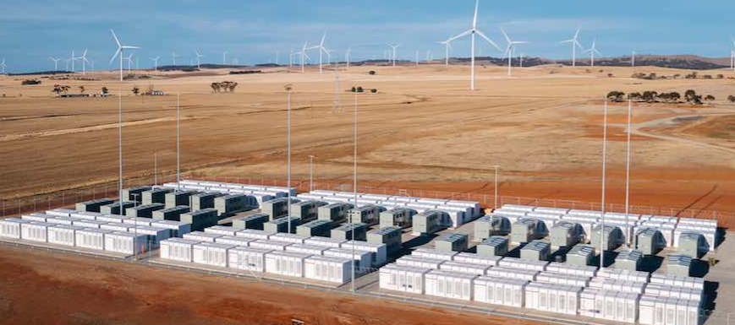
Located beside a windfarm – the role of the windfarm to supply the electricity.

Slide 4
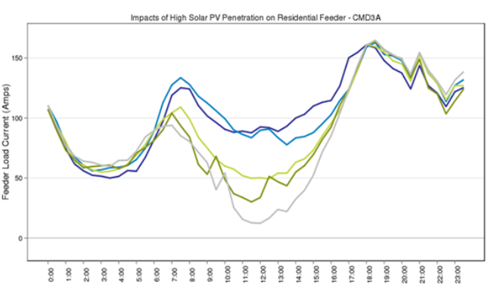
Size: 100 MW
Can power 50000 homes for 1 hour
Useful in balancing power demand every day, not just when there is a power outage- a typical day is shown below

Slide 5
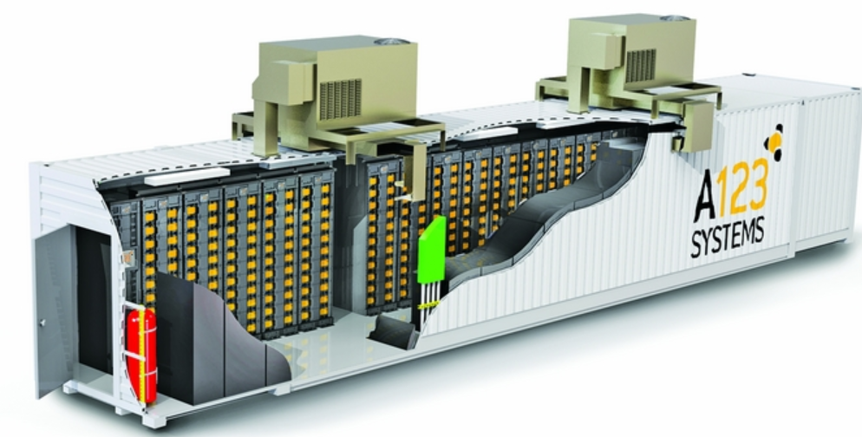
It is not a single battery, rather it is thousands of small cells like in any typical mobile device.

Slide 6
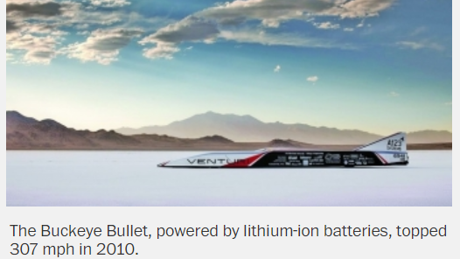
The last 20 years has seen rapid improvement in lithium technology.

Slide 7
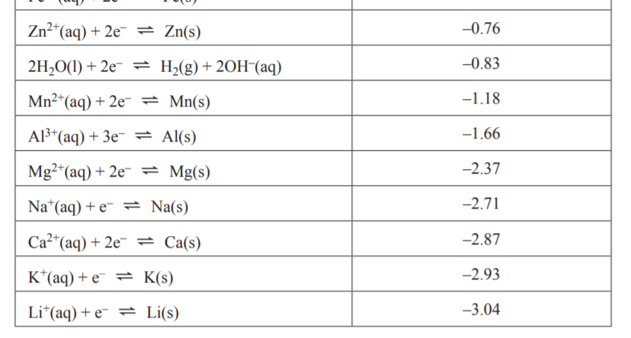
Why lithium? Simples!
It is the lightest metal
It offers the highest potential of any metal

Slide 8
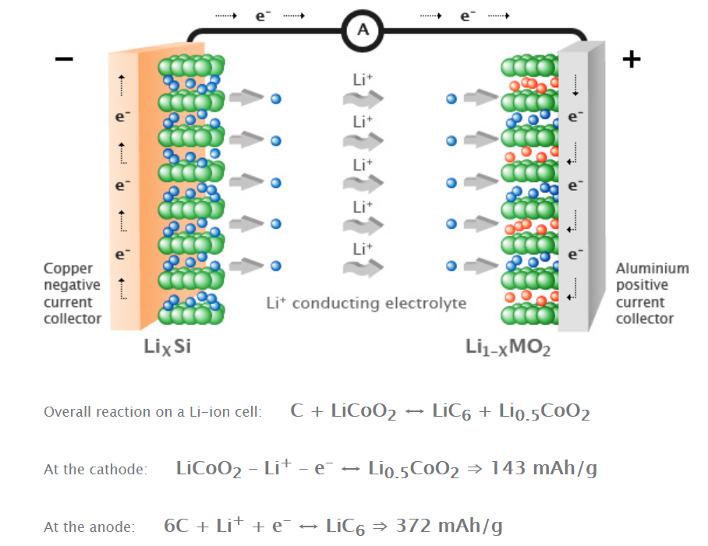
Technology – very complex!
No aqueous solutions
Flowing lithium ions

Slide 9
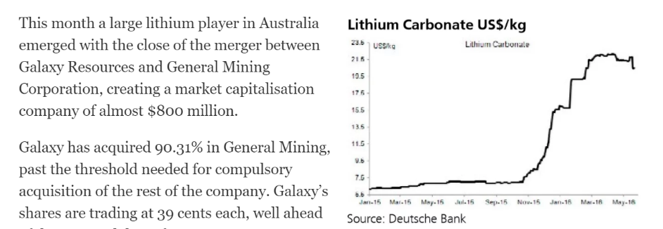
Lithium technology has a spin-off – a whole new industry based on lithium
Look at the world price of lithium

Slide 10
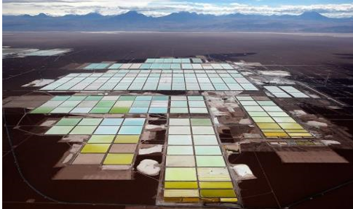
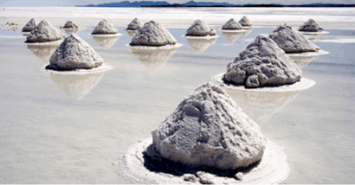
It is mined in the Attacama desert in Chile where it never rains! Hence the soluble lithium does not wash away.

