Slide 1
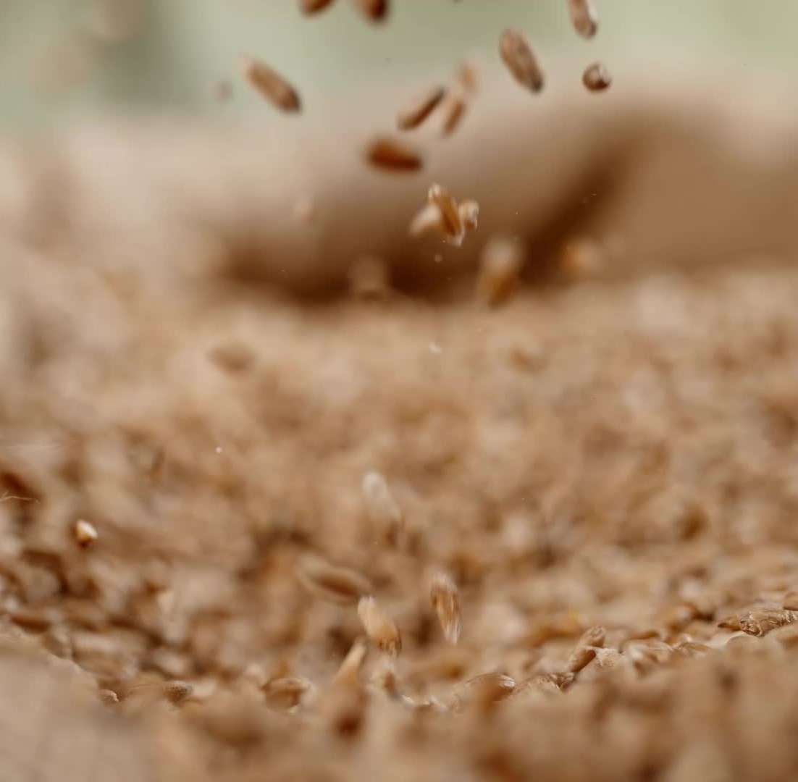
Nullarbor Fibre:
rayon made from biomass by Nullarbor Fibres

Slide 2
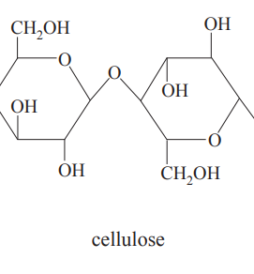
Rayon
Rayon is made from pulped cellulose. It is
a popular fibre, also referred to as viscose.
Cellulose is a natural polymer made from
glucose monomers as shown below.
The key to rayon production is sourcing the
cellulose required.
glucose
glucose

Slide 3
Traditional rayon production uses one of these 3 sources of cellulose –
bamboo
timber or
cotton.
The widespread use of these three raw materials leads to various stresses on water supplies and arable land.

Slide 4
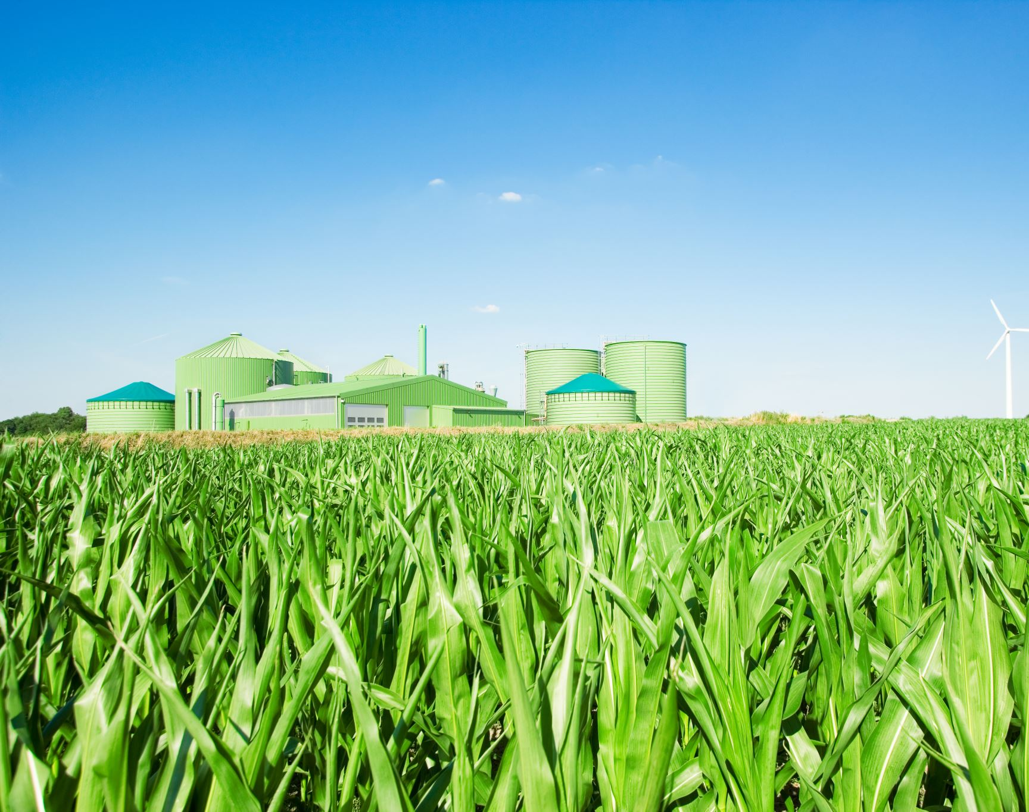
Nanollose has taken a new approach to rayon production by using biomass as a source of cellulose, a waste material in place of an important resource.

Slide 5
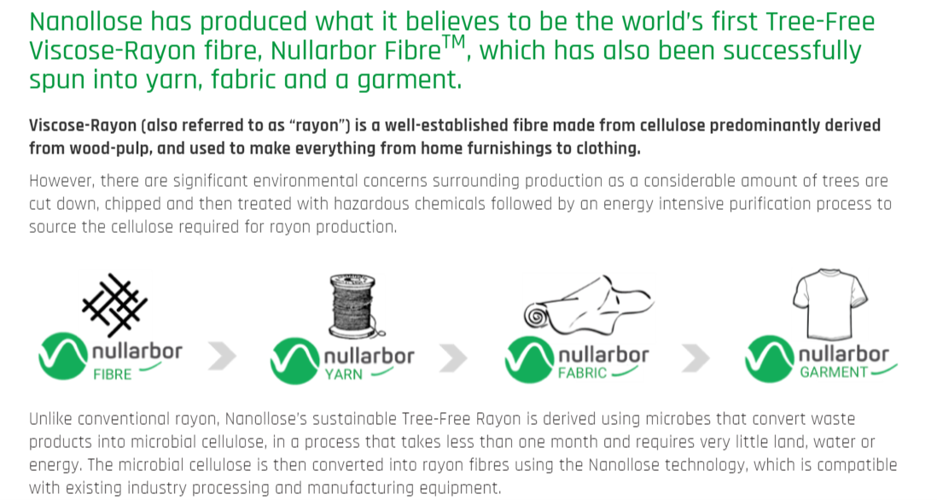

Slide 6
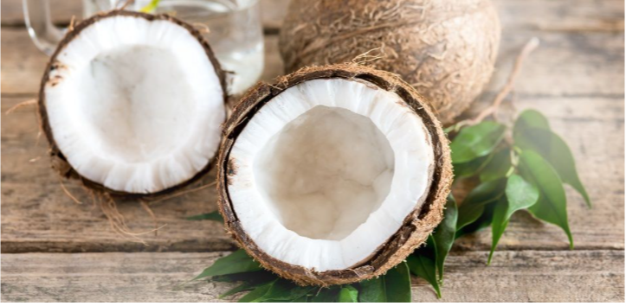
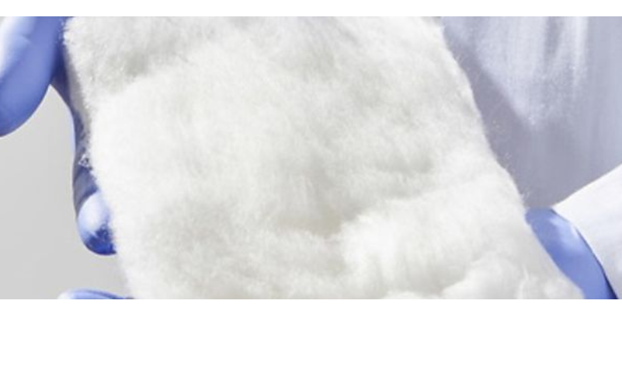
Coconut waste to cellulose to rayon
Nanollose is using waste from the coconut industry as the source of cellulose

Slide 7
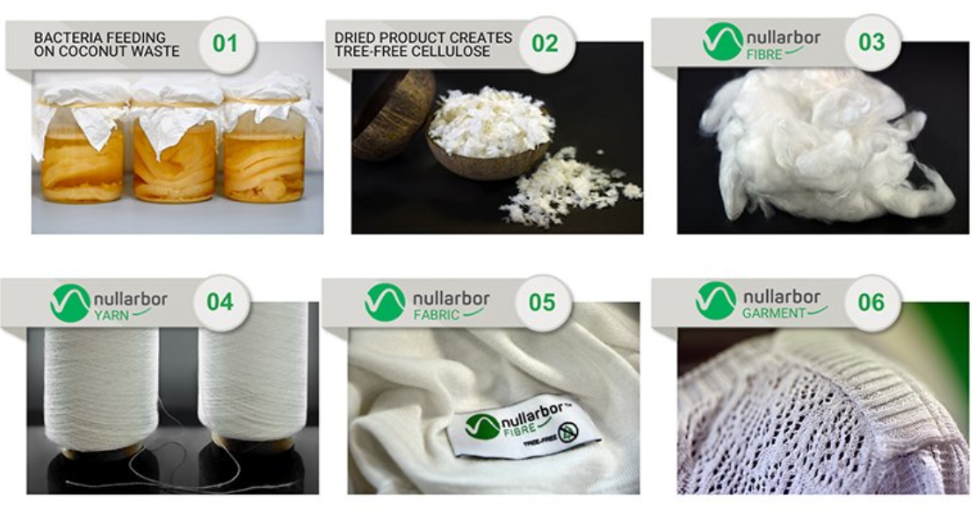
https://nanollose.com/media/videos/

