Slide 1
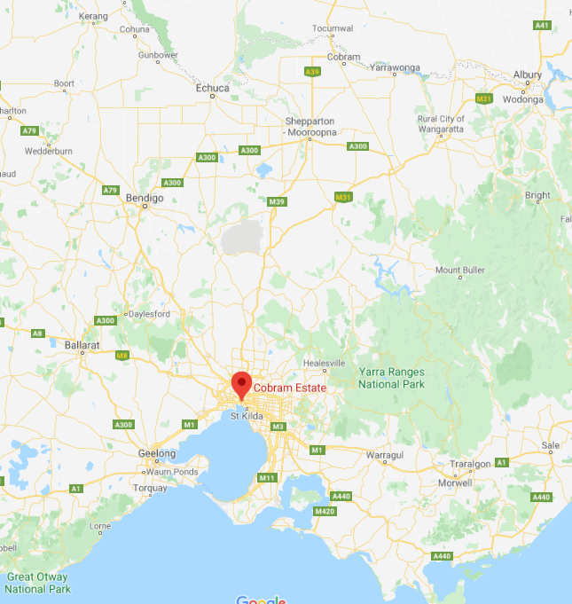
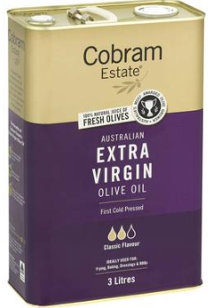
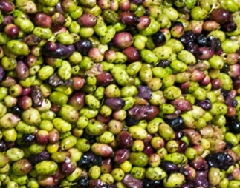
Olive oil: Cobram estate

Slide 2
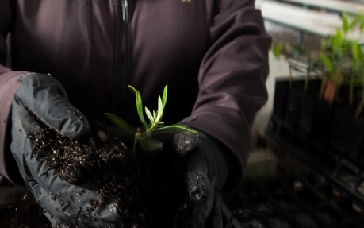
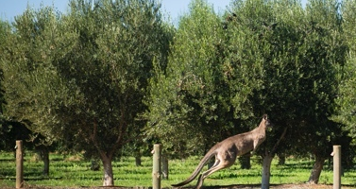
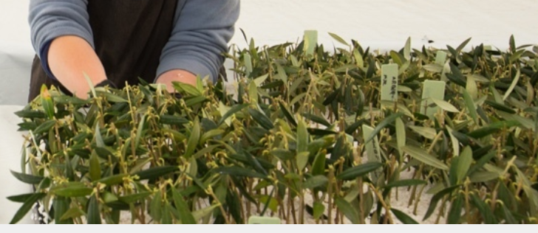
Cuttings to small plants to olive grove

Slide 3
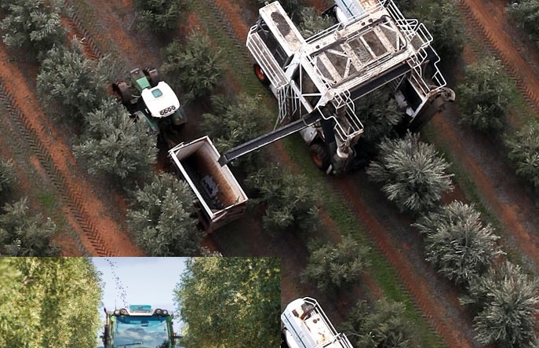
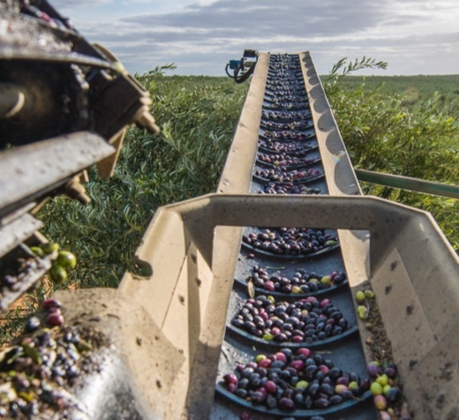
Harvest time:
Mechanical picker loads a hopper

Slide 4
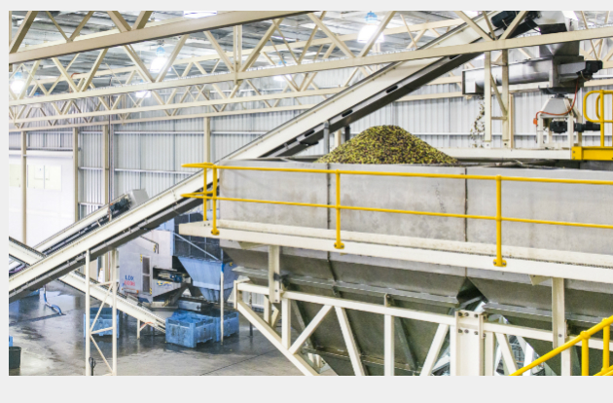
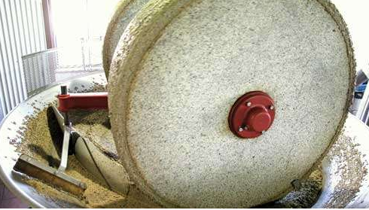
Old
Stone wheel pulled by
a horse to grind olives
New
Mechanised crushing device

Slide 5
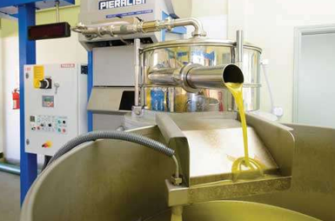
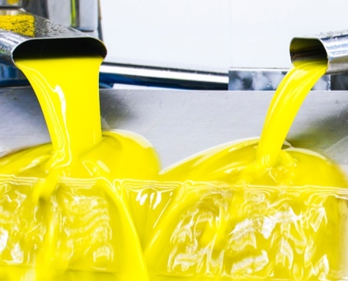
Oil emerging after pressing

Slide 6
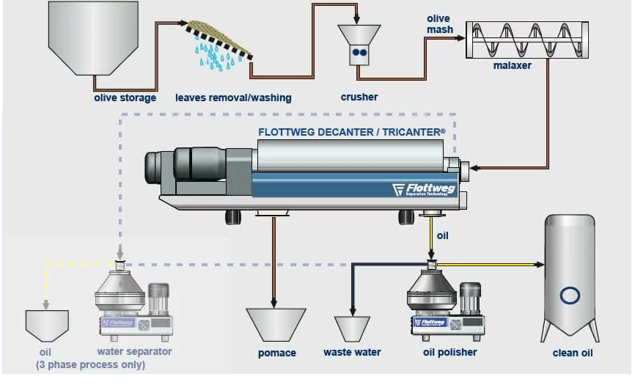
Process
Olives are washed and crushed. A malaxer chops the olives, freeing more oil.
Oil is decanted off from water. A solvent can be used to extract remaining oil

Slide 7
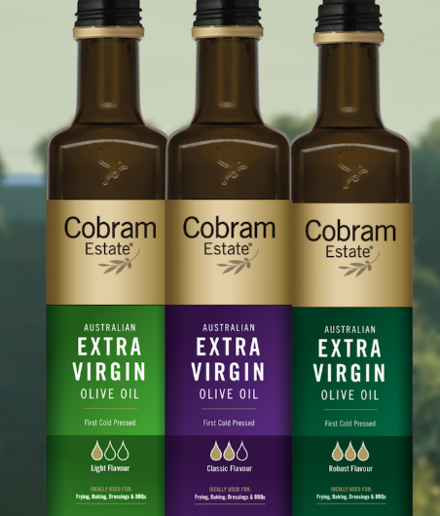
Virgin oil: The extraction is purely mechanical with no solvent used.
Cold-pressed: Extraction is at low temperature. This is more difficult but the oil is less likely to suffer any degradation.

Slide 8
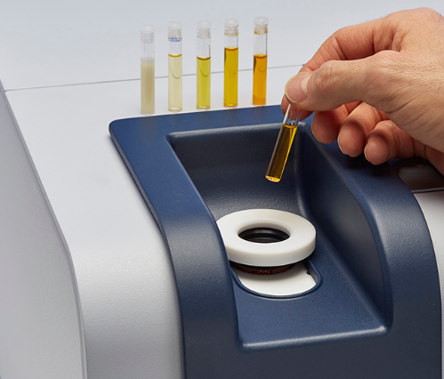
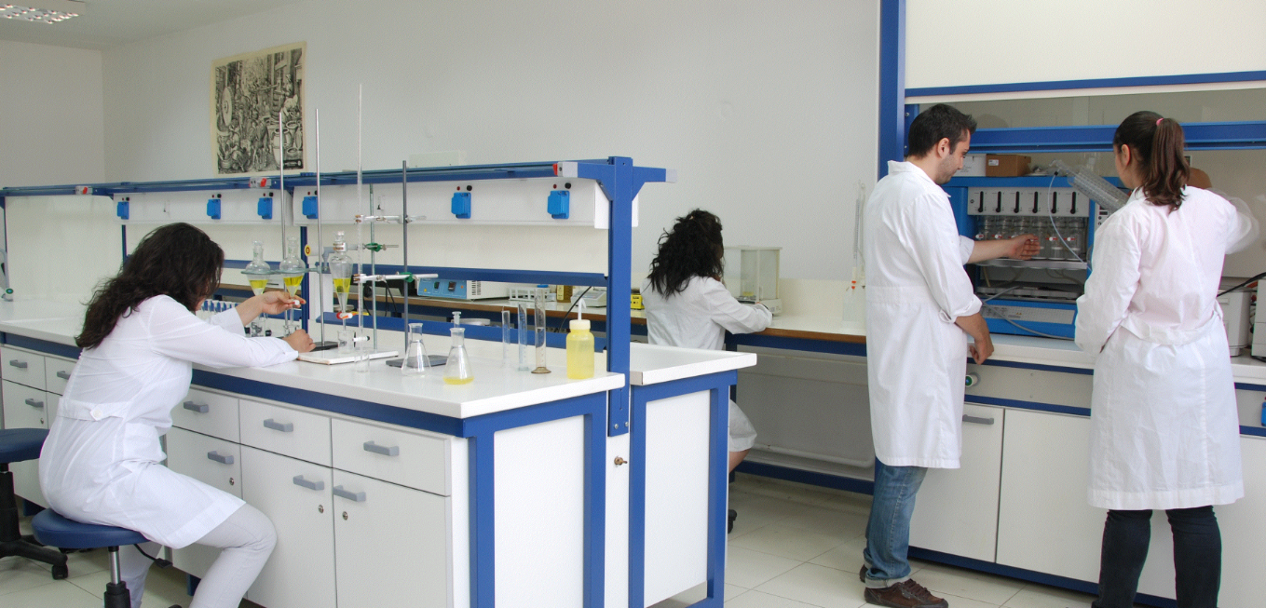
Quality control: Oil tested for
free oleic acid. The lower the value, the less degradation that has occurred.
peroxide content: This increases with rancidity
oil mix. Levels of oleic acid and other oils should match accepted levels if the oil is pure.
sterol levels

Slide 9
Oil mix: Oleic acid should be around 70% and a mix of other fatty acids are present.
Vitamin E (below) is also present
Single C=C bond

Slide 10
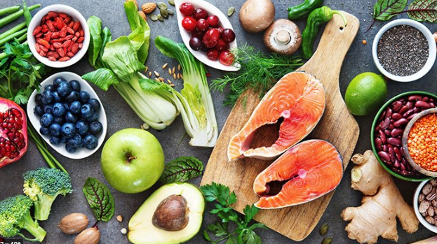
Health:
Olive oil is part of the Mediterranean diet which is good for the heart and blood.
Oleic acid is monounsaturated.
High level of antioxidants.

