Slide 1
Ballarat manufacturer of polyethene tanks, troughs and other products.

Slide 2
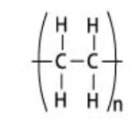
Polyethene polymer
ethene polyethene

Slide 3
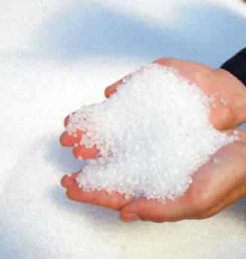
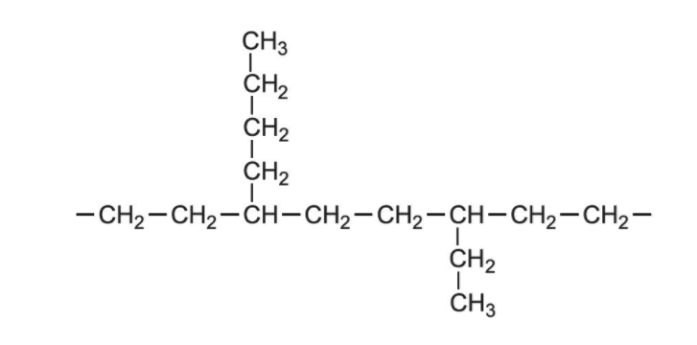
Pellets of polyethene ready to be moulded.
Plastek uses LDPE (low density polyethene). Its branched structure leads to the lower density and relative toughness

Slide 4
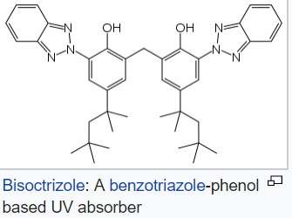
Polyethene beads used are not pure polyethene. They also contain
plasticizer (to add a degree of flexibility to the product)
UV stabilizers (so that light does not lead to cracking or crazing of the tank
antiozonants
colouring agents (for looks!)
UV absorbers dissipate the light energy of UV rays through proton transfer

Slide 5
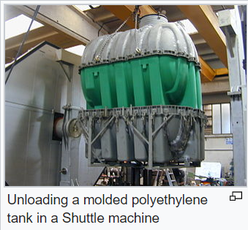
Tanks are made using a process known as rotational molding. As you can see the mold is the shape of the product. Liquid polymer is injected into the mold which is then spun to make an even layer.

Slide 6
Tanks are tested for even wall thickness, toughness and water impermability.

Slide 7
