Slide 1
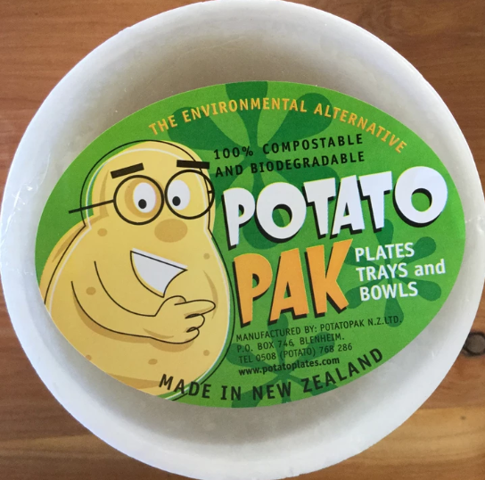
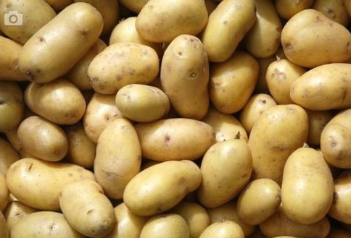
Biodegradable plastic from potatoes
A polymer can be made using the starch obtained from potatoes. This polymer will degrade to glucose very quickly.
© POShea

Slide 2
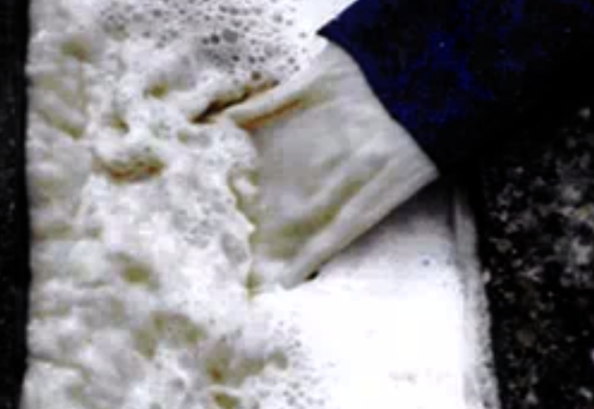
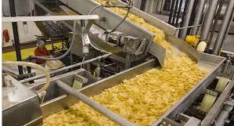
Plants like Mc Cains cut potatoes into chips. The whitish liquid produced can be collected and converted to plastic.

Slide 3
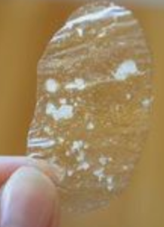
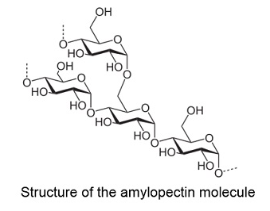
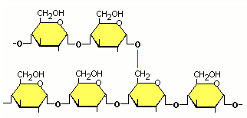
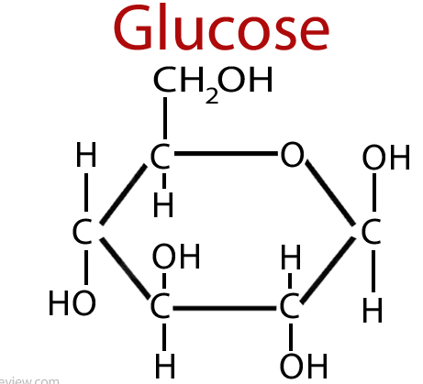
The whitish liquid dries to a clear plastic. The plastic is mainly starch. Starch is a polymer of glucose and has two forms amylopectin and amylose.
Two representations of amylopectin – a polymer of glucose with some branches.

Slide 4
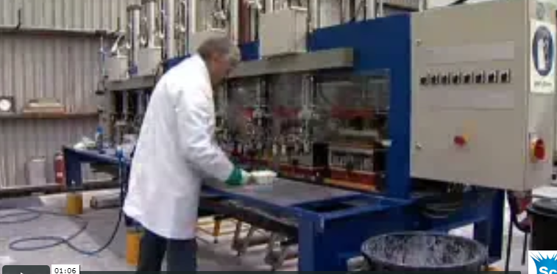
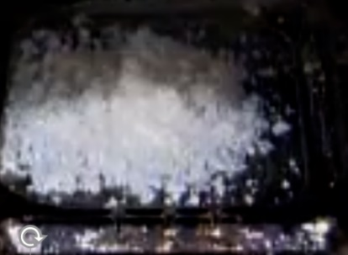
The starch powder is mixed with cellulose fibre to give the tray some strength and oil to ease its release from a mould.
Raw material and moulding press.

Slide 5
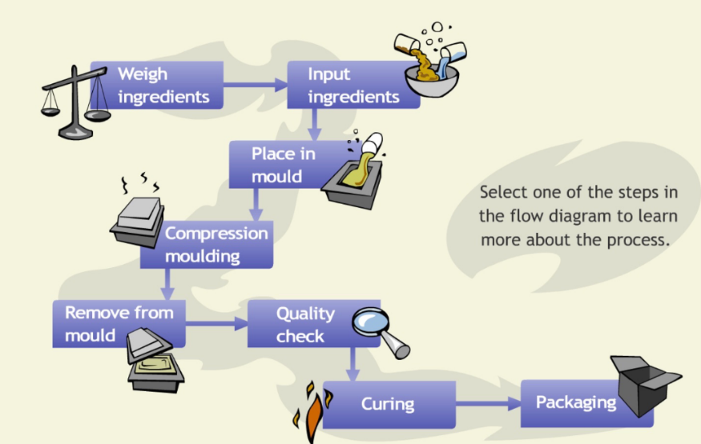
Production flowchart

Slide 6
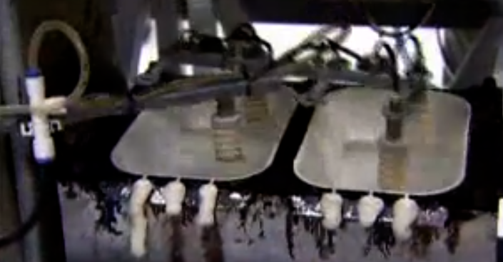
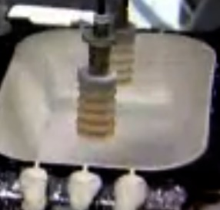
Trays coming out of a mould.

Slide 7
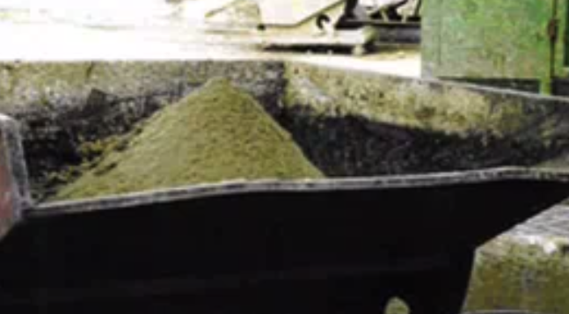
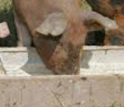
Waste: simple solution – feed it to the pigs!

Slide 8
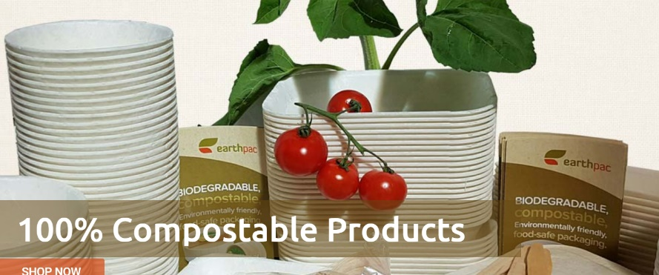
Samples of products formed.

