Slide 1
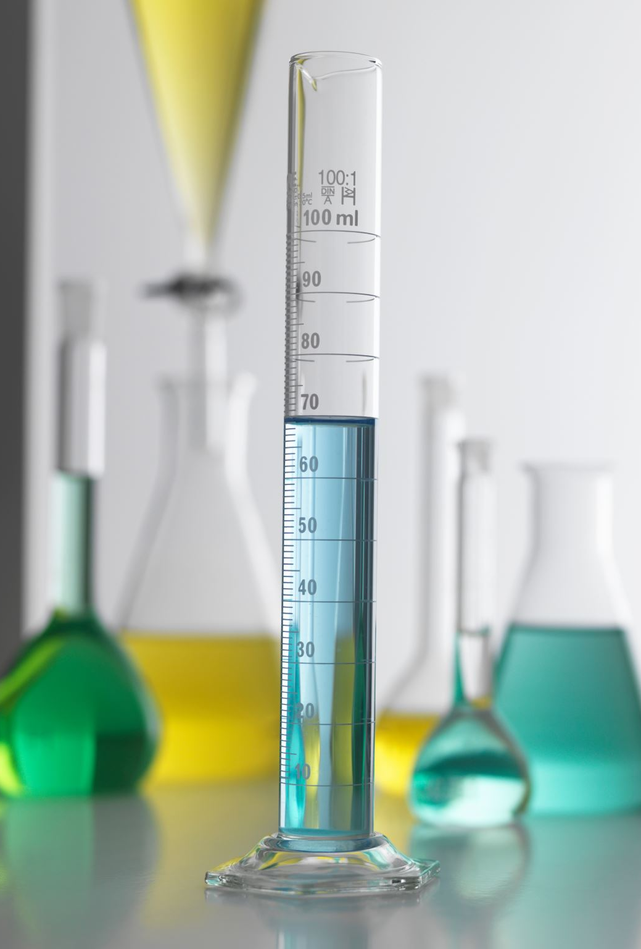
Unit 1_2 SAC starters
Should not be tests.
Don’t assess any content from other units eg. Revisit Unit 1 concepts in Unit 2
Don’t have to address all Key Skills
Should be varied.
It will be difficult to decide which category a task belongs to but that does not matter eg a set of experiments on acids and bases could lead to an annotated report, a reflective journal or an investigation
Don’t use commercial work without adaptation.
Give the students clear details beforehand.
Assessment must be transparent.
Do things that are useful and interesting.
Unit 1-2 SACs
Can be assessed as S/N => infographics are fine

Slide 2
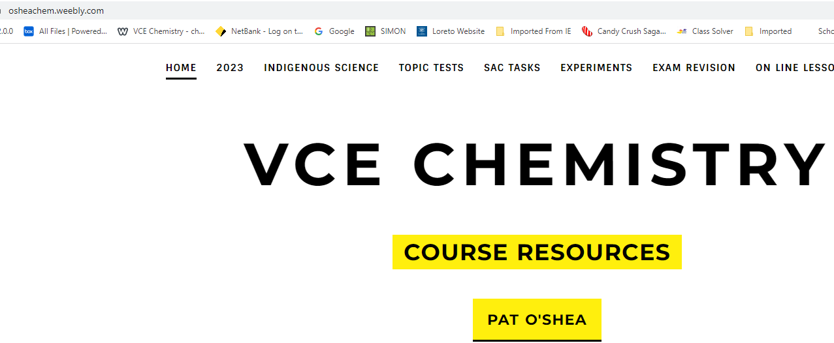
Licella polymers
Lithium production
Gold production/Rare Earths Mt Weld
Biodigesters
ULUU polymer
PHA/PLAs
Tea-tree oil
Phosphate
Replacing the Haber process for ammonia
Sironix
Ethtec
Commercial tasks on Kilbaha education

Slide 3
Planning your SAC tasks
Sit down for an hour
Unit 1 AOS 1 Reactivity of metals journal
AOS 2 Modelling of organics
AOS 3: Indigenous science
Unit 2 AOS 1 pH annotated experiments
AOS 2 Colorimetry primary data
AOS 3 Salinity by conductivity
No tests as SACs but run tests anyway

Slide 4
Production of Green Steel: Which category? Could be any of the categories below
Infographic, poster, media response, a report of an application, analysis of an innovation.
Australian iron ore production figures
Media file: need some articles to refer to, looking at how students interpret the information
Find some Andrew Forrest articles
Poster: Steps in the production of steel vs green steel.
Chemistry of reduction of iron ions

Slide 9
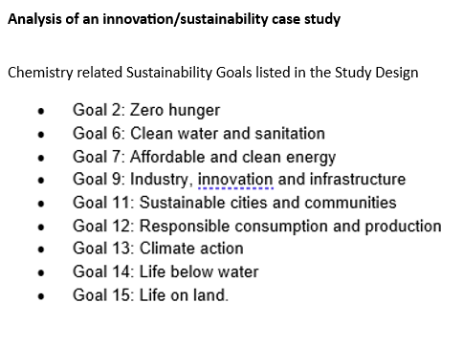
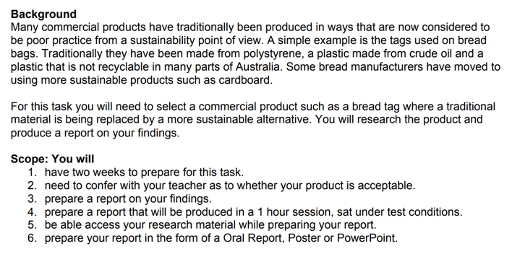

Slide 10
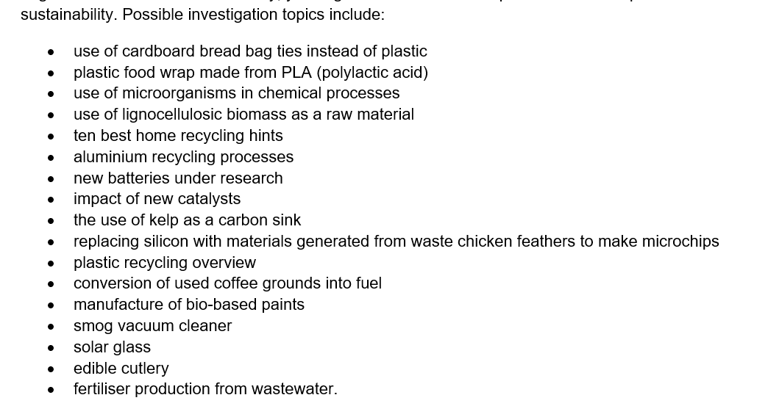

Slide 11
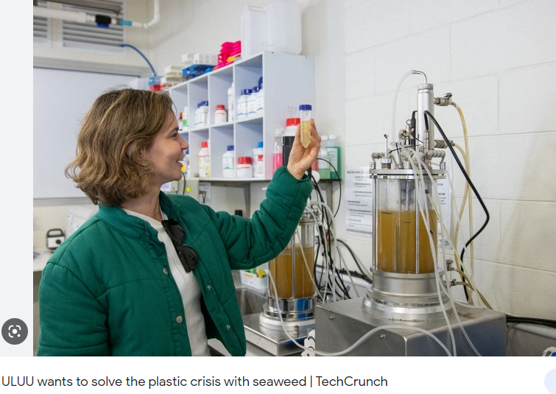

Slide 13
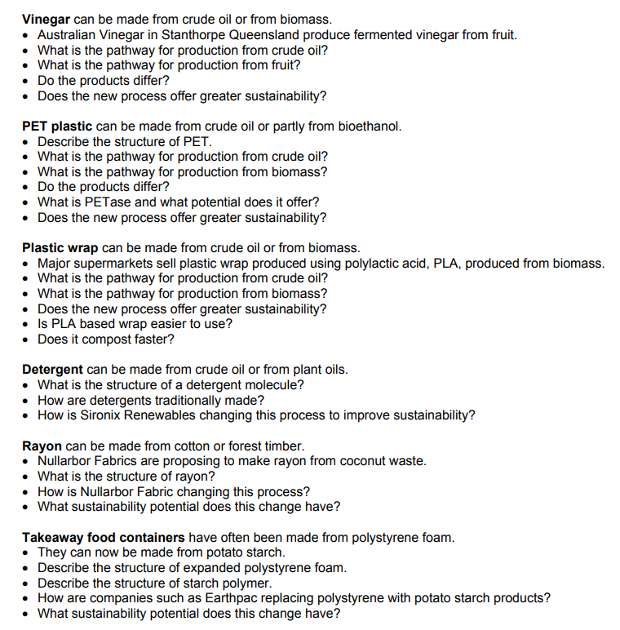
Investigation topic 4: The sustainability of a commercial product or material: AOS3

Slide 15
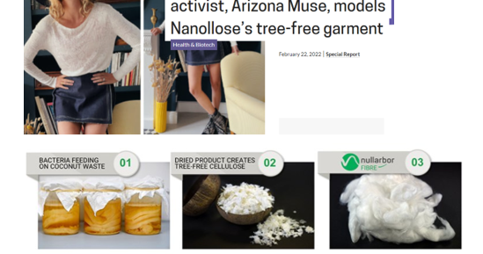

Slide 16
Kris Freebairn

Slide 18
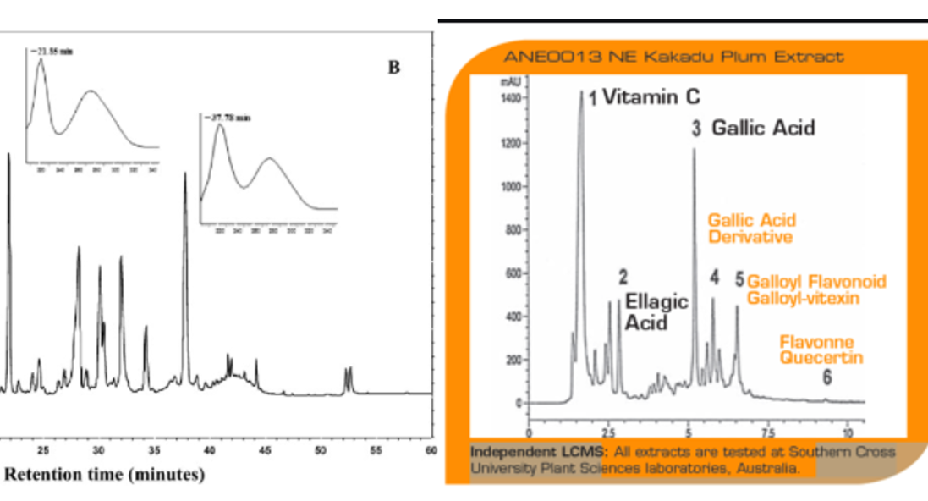

Slide 19
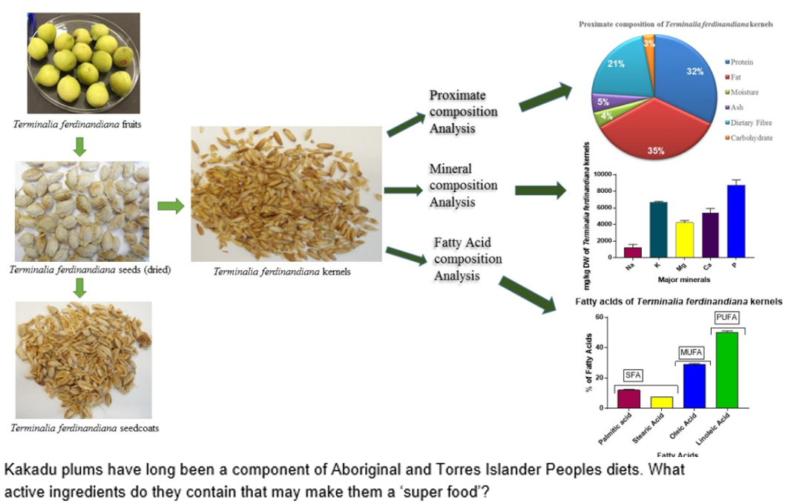

Slide 20
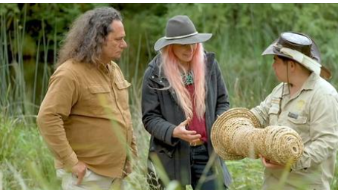

Slide 25
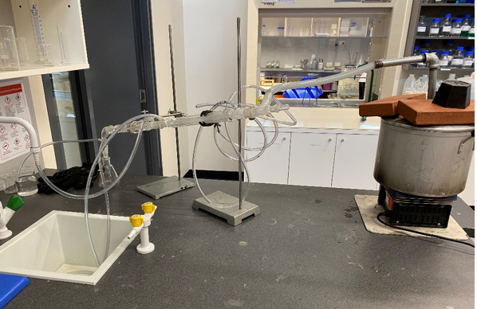
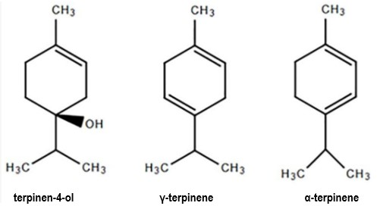

Slide 26
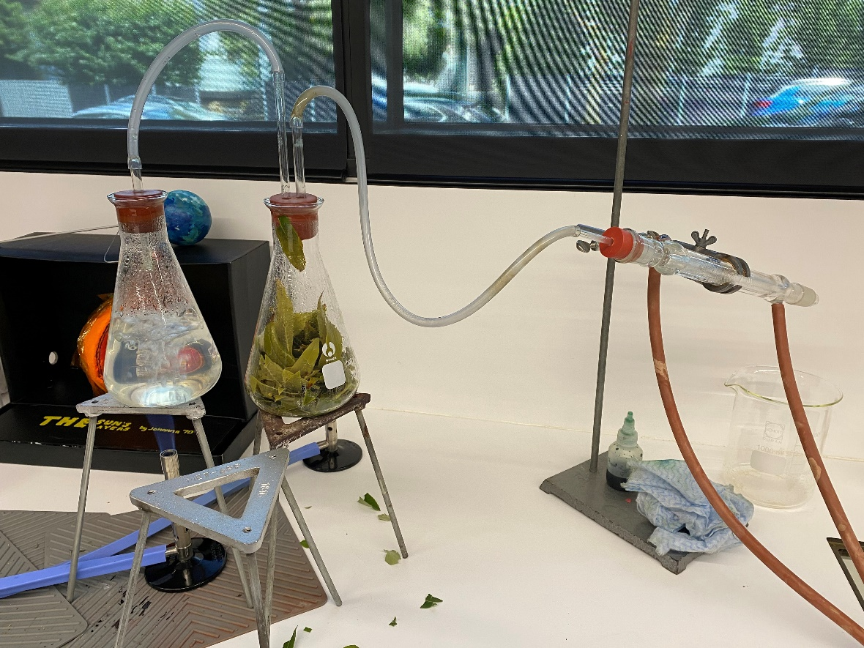

Slide 27
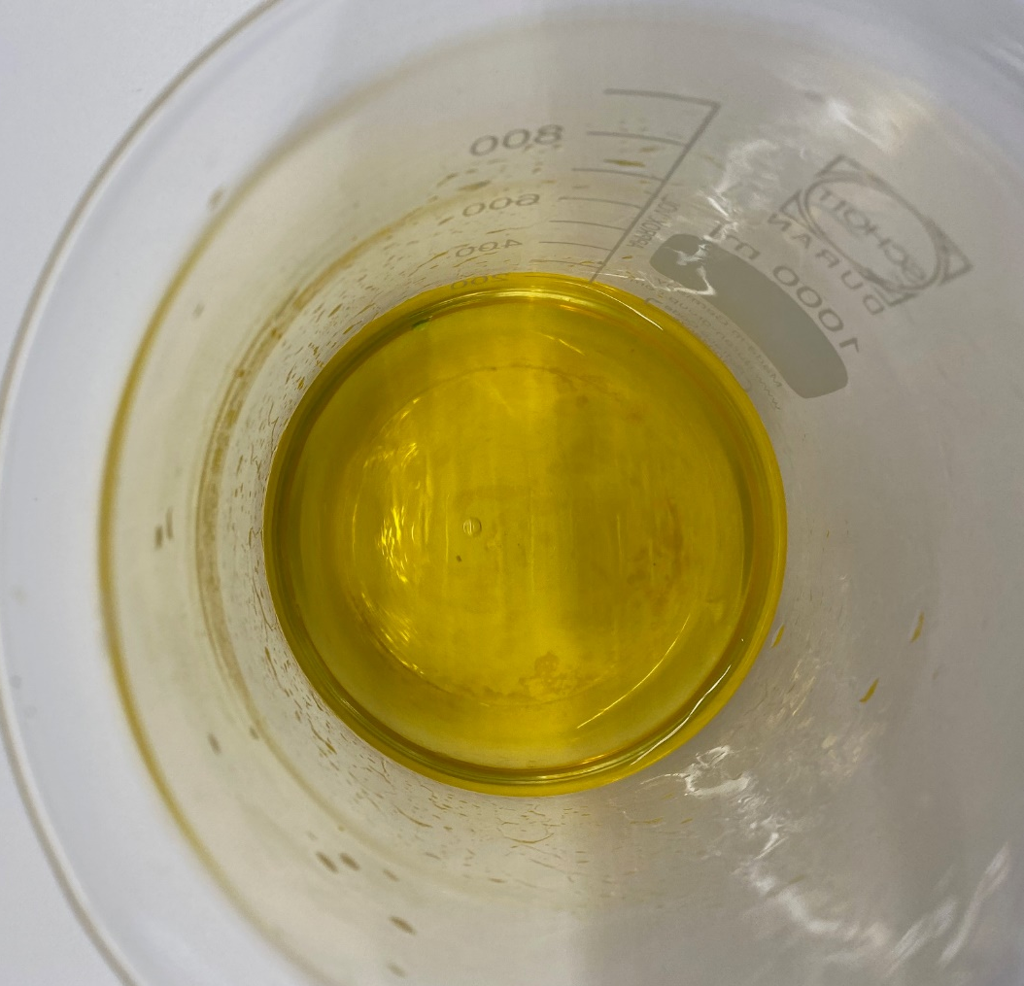
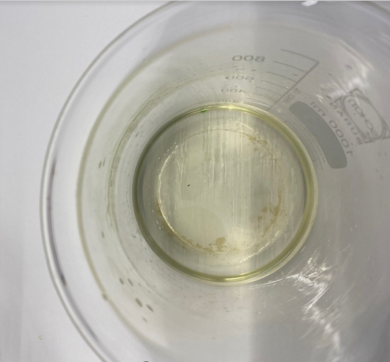

Slide 28
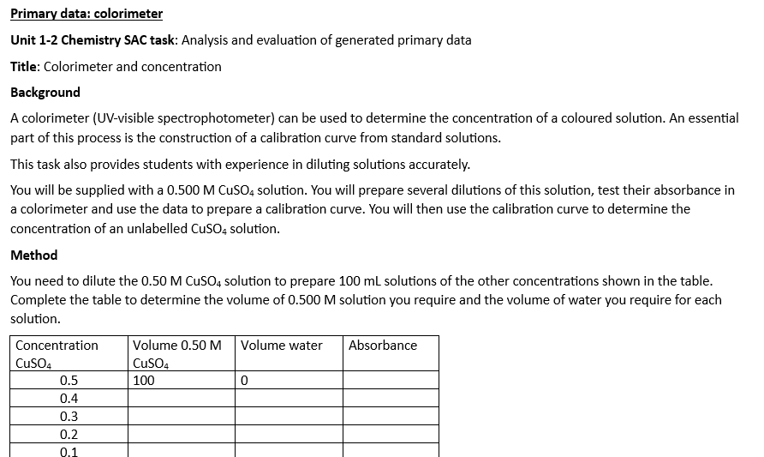
water quality, conductivity, melting points, pH curves, solubility,

Slide 32
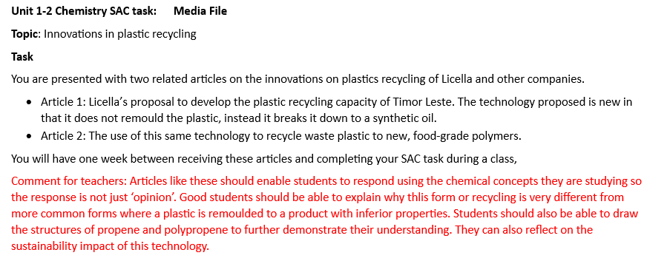

Slide 33
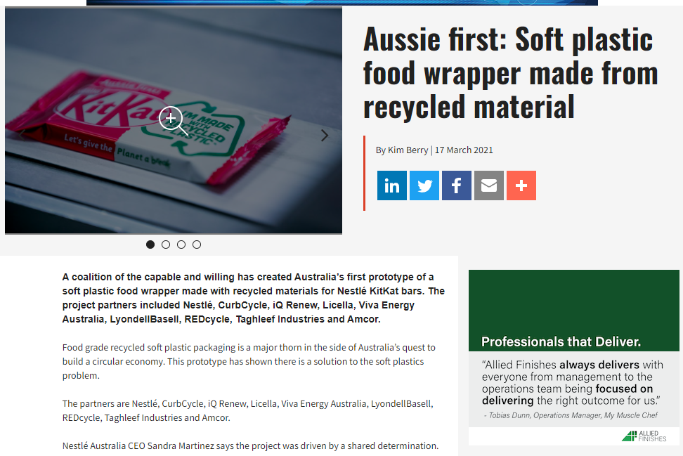

Slide 34
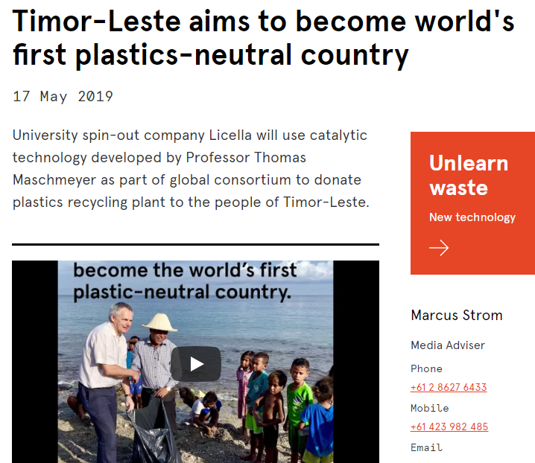

Slide 35
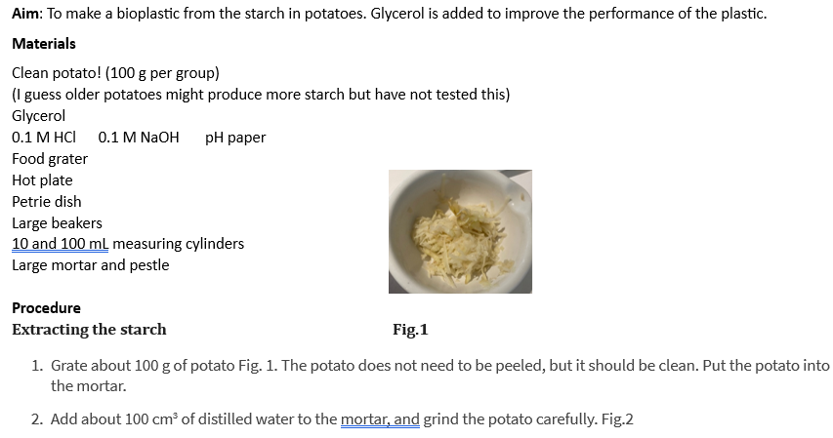
Learning journal: natural polymers
Latex
Potatoes
Milk
Cellulase

Slide 36
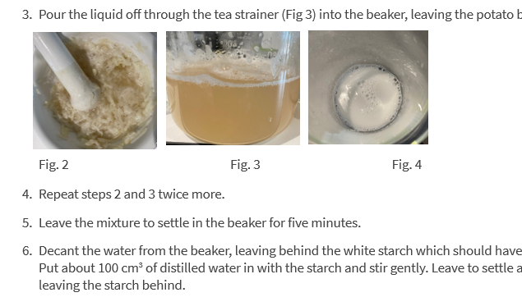

Slide 37
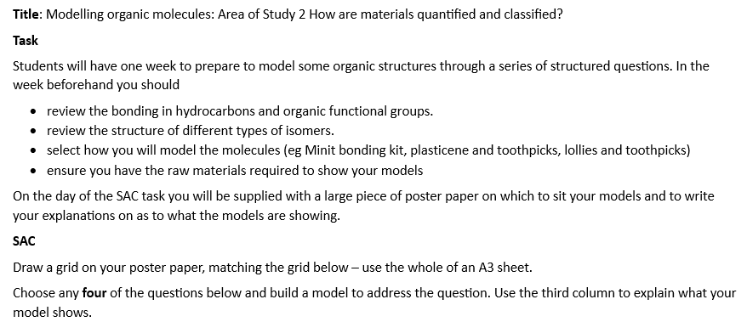

Slide 38
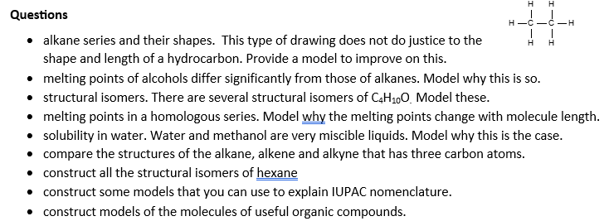

Slide 39
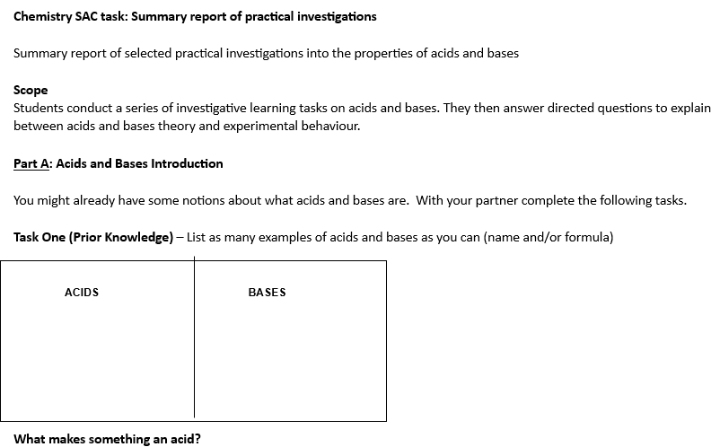

Slide 40
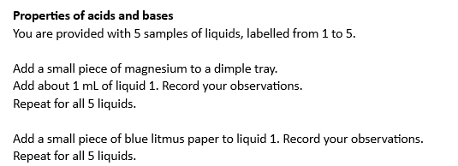

Slide 41
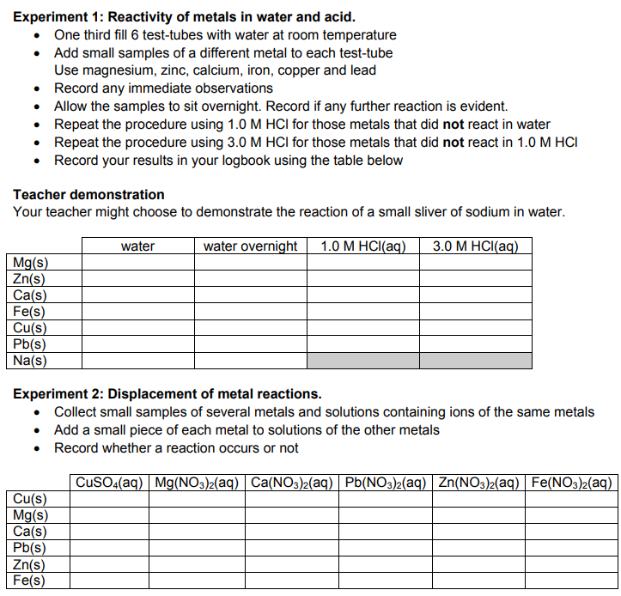

Slide 42
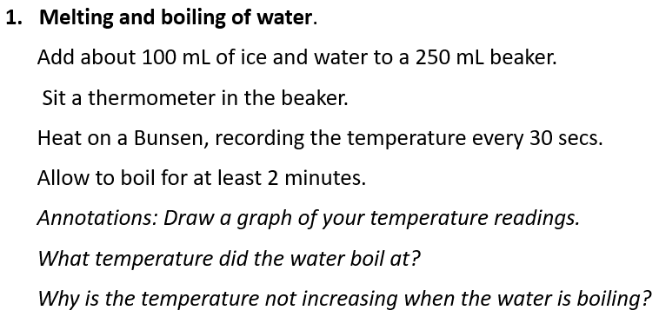
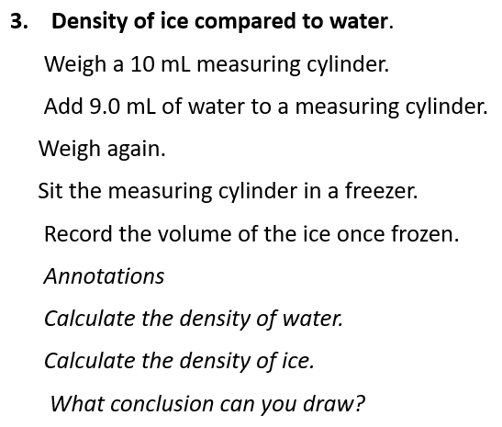
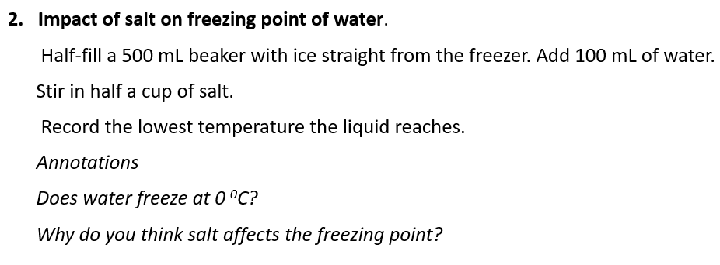
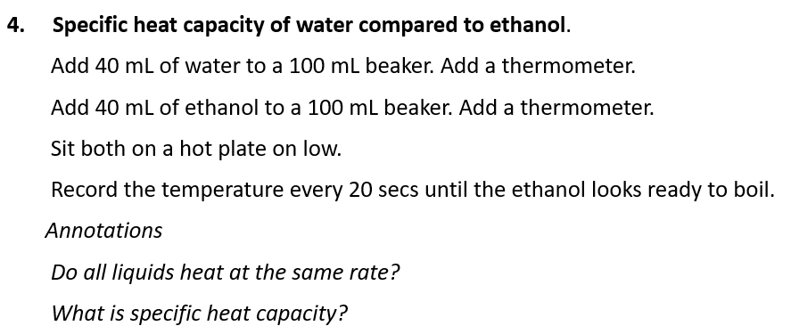
Learning Journal on water properties

