Slide 1
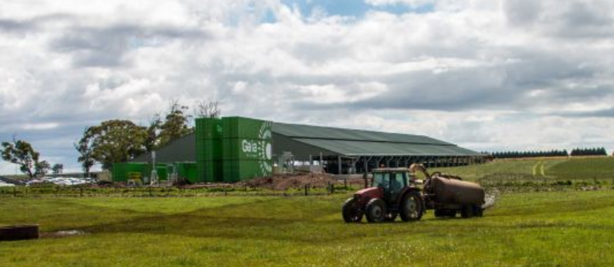
Sustainable farming – robotics and biogas.
Trigg’s dairy farm near Ballarat.

Slide 2
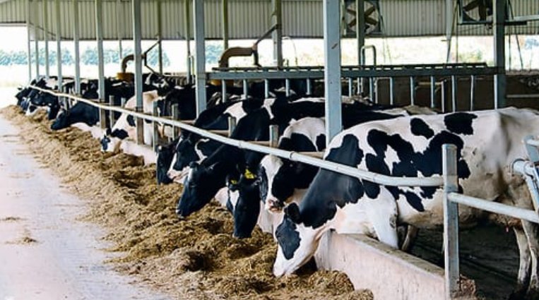
The herd of 300 cows never leave this barn. They sleep, eat and get milked here

Slide 3
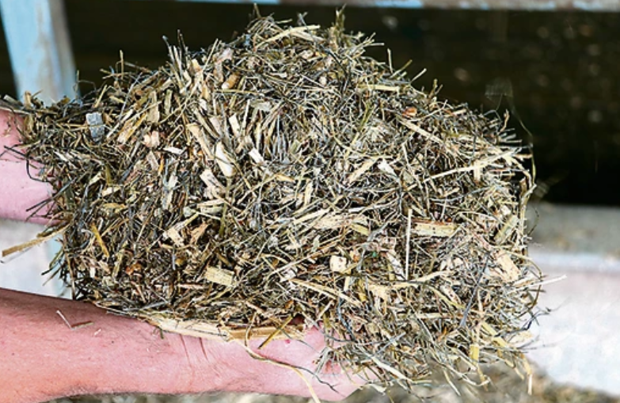
All feed is controlled – same diet and amount 365 days a year.

Slide 4
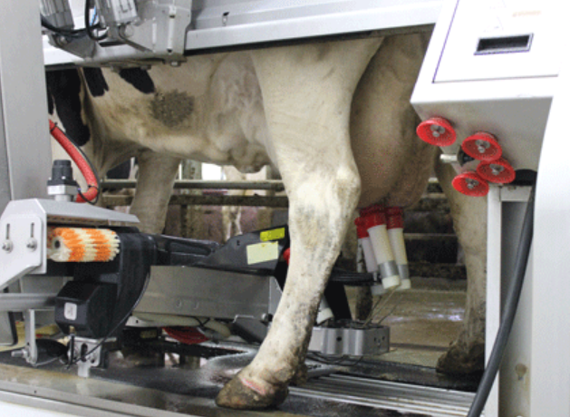
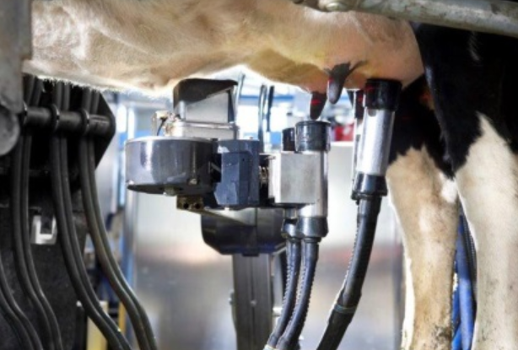
Sustainable farming – robotics and biogas.
Cows decide when they will walk into the milker. There is food there as an incentive

Slide 5
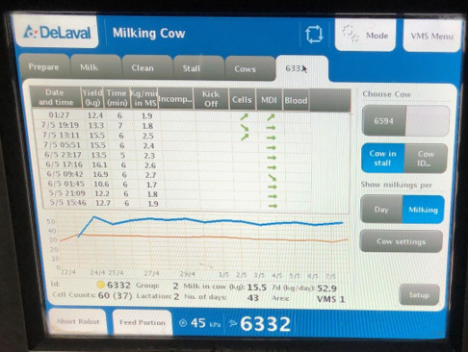
Computing programs monitor each cows frequency of milking, volume and quality. Non-performing cows are culled.

Slide 6
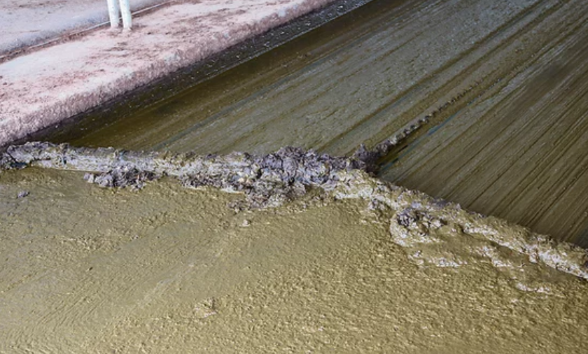
Sewage is automatically scraped to a holding tank. 25000 litres of effluent collected per day.

Slide 7
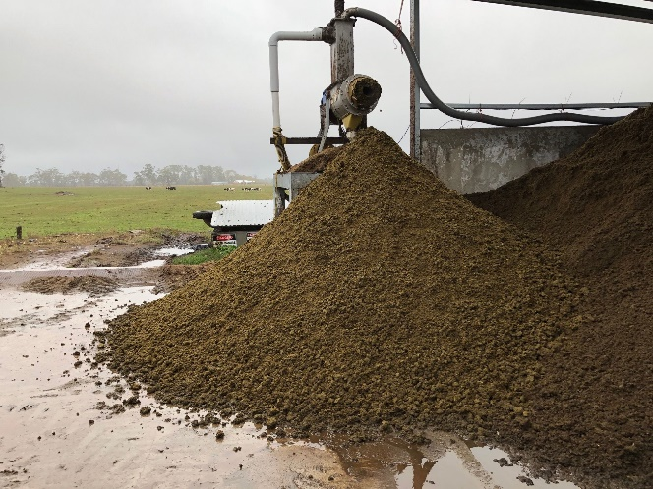
Solids are pressed from the waste and sold as fertilizer.

Slide 8
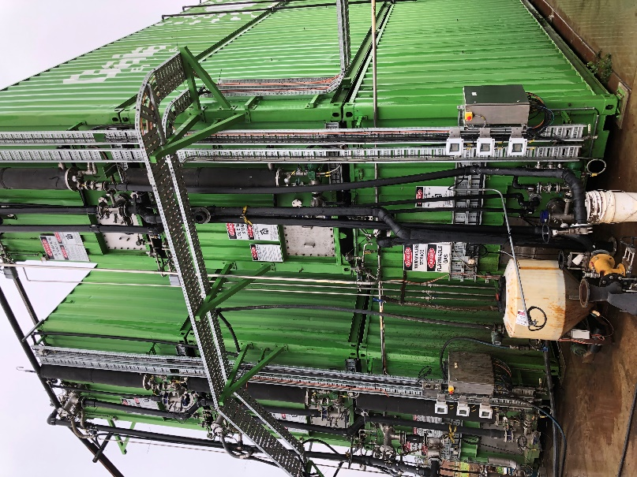
Liquids are pumped into sealed shipping containers. These act as digestors, producing biogas.
Biogas composition
Methane 60 %
CO2 25 %
Water
Hydrogen sulfide

Slide 9
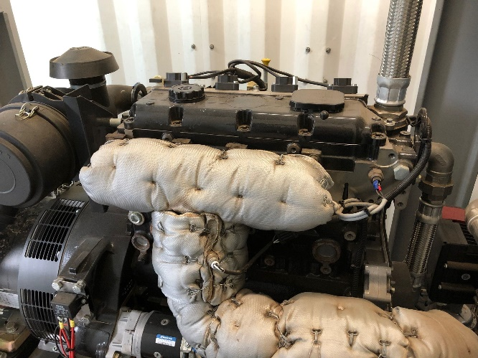
Two uses for the methane-
Burnt in a boiler to heat the content of the digestor at 37 0C.
Combusted in the generator below to produce electricity

