Slide 1
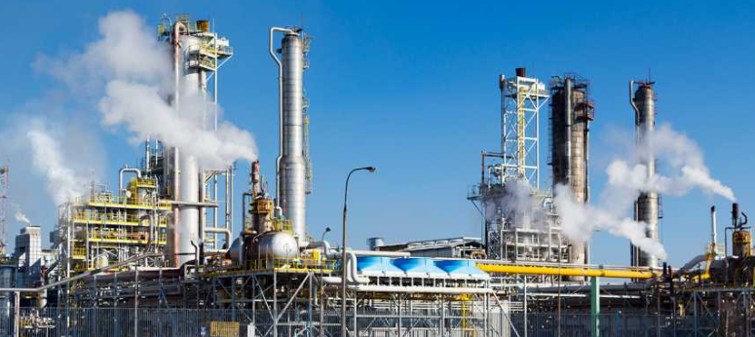
Unit 3 Chemistry
Using design and innovation to optimise chemical processes
Completely informal commentary on preparation for Unit 3

Slide 2
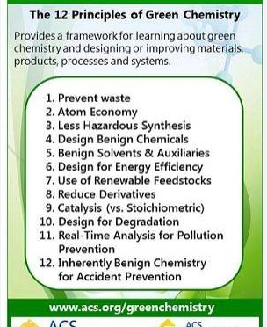
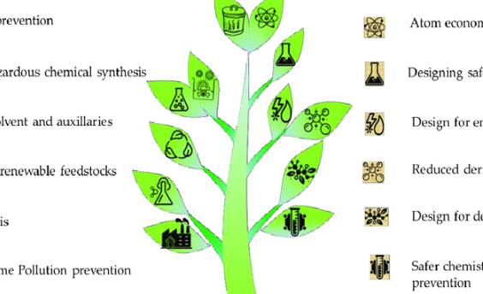
These themes guide the discussion of optimisation in Unit 3. Specifically referred to in the study design.

Slide 3
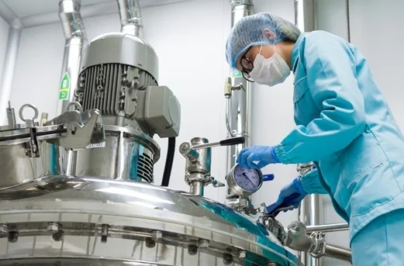
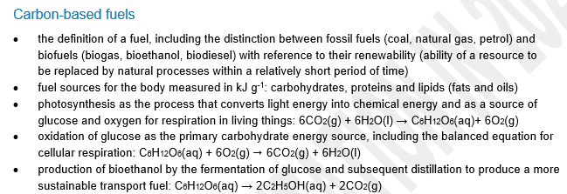
Introducing energy
New or relocated here | Changed or out
Low key intro on fossil fuels. Emphasis on bioethanol rather than biodiesel. Distillation of ethanol solutions. Discussion of photosynthesis required Energy from food relocated here with solution calorimetry. Thermochemical equations NOT per mole. | Gases in Unit 2 Gas volumes restricted to SLC.

Slide 4
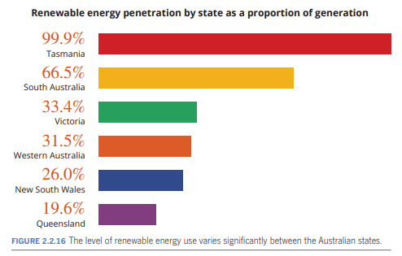
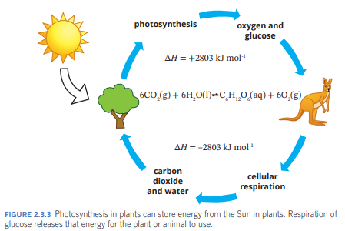
Our old graphs of Australia’s energy market are no longer accurate – fortunately!
Role of photosynthesis and respiration
NB: Several Heinemann diagrams included throughout the slides

Slide 5
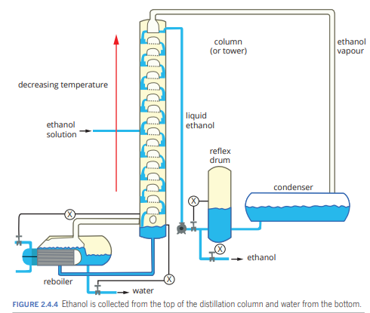
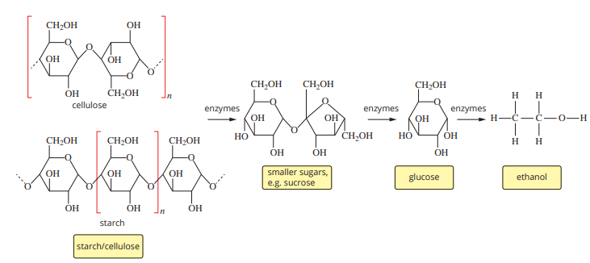
Ethanol produced by fermentation – the solution formed needs to be distilled to produce denatured ethanol.
Likely sources of biomass for fermentation – sugar, sorghum and timber.

Slide 6
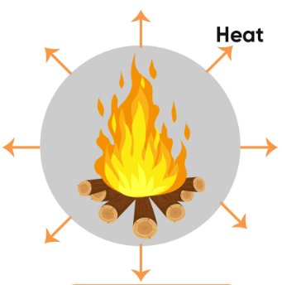
The above equation says – 6 mole of carbon dioxide and 6 mole of water requires 2803 kJ of energy.
Note: For thermochemical equations, the per mole is gone (as it should be – it does not make sense with the equation below)

Slide 7
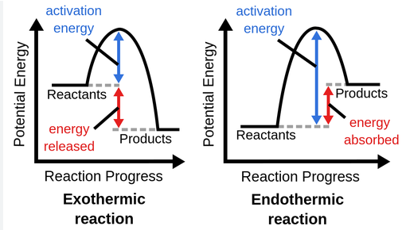
Representing energy change – no big change but limiting reagent in and PV=nRT out

Slide 8
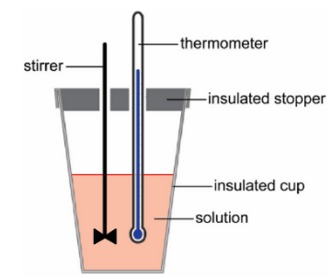
Measuring energy change.
The basics of food biomolecules covered but in-depth discussion of amino acids etc comes later in the course.
No bomb calorimeter.
Efficiency of energy transfer in.

Slide 9
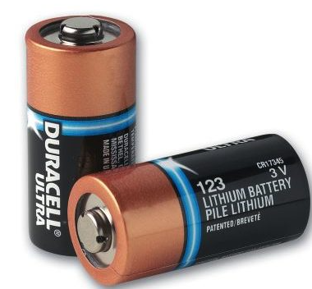
Primary galvanic cells and fuel cells – covered in the study design separately from secondary cells.
Faraday’s Laws applied to galvanic cells as well as electrolytic cells.
Alkaline half-equations specified, not just acidic.

Slide 10
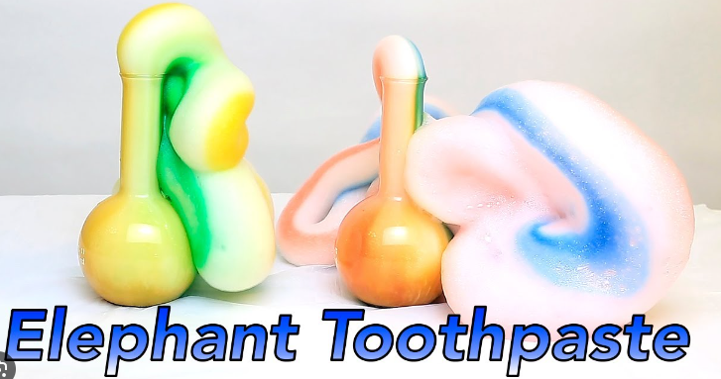
AOS2
Rate
Bottom – line: Maxwell- Boltzmann NOT specified but little other change to the rate section.

Slide 11
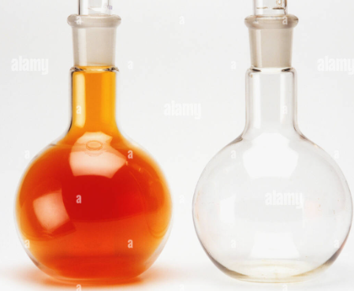
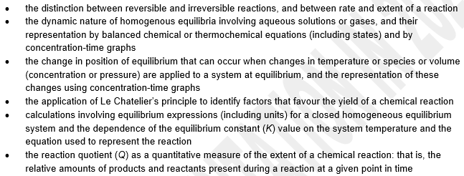
Equilibrium – little change
K replaces Kc
Reaction quotient, Q specified
Rate-time graphs not specified.

Slide 12
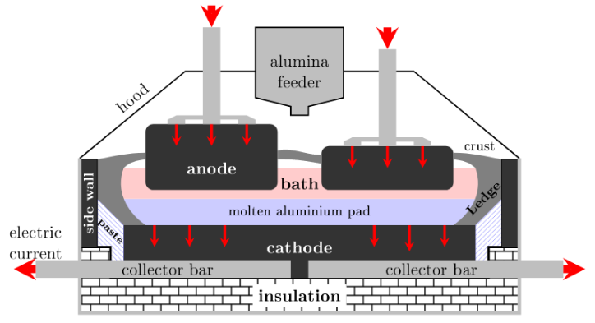
Electrolysis – little change
K replaces Kc
Reaction quotient, Q specified
Rate-time graphs not specified.

Slide 13
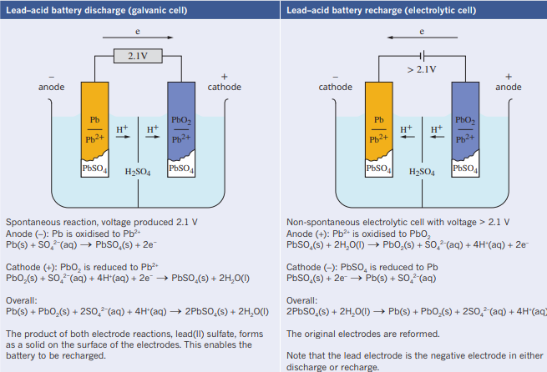
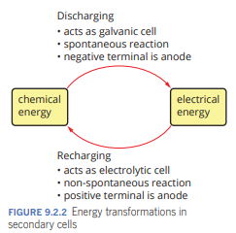
Secondary cells and optimisation in general
- very little change

Slide 14
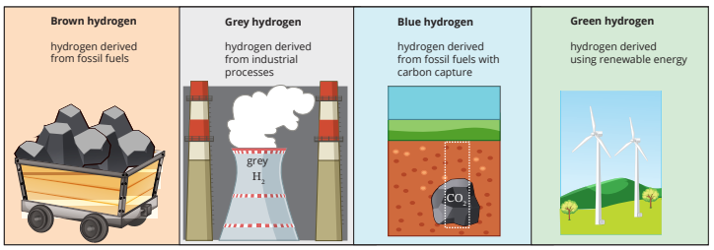
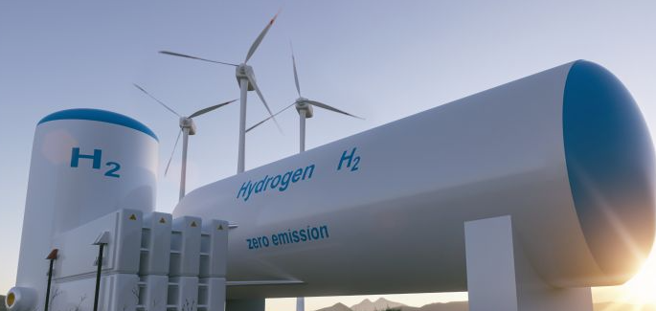
Green hydrogen - New
Electrolysis of water to produce hydrogen in a hydrogen hub.
Using renewable energy.

Slide 15
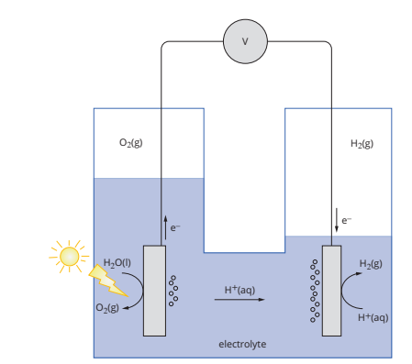
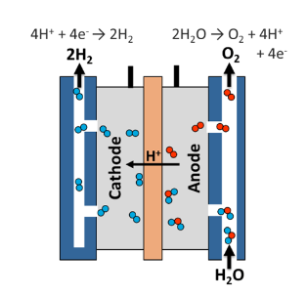
PEM hydrogen production
Polymer electrolyte membrane
Hydrogen fuel cell in reverse. A power supply breaks up water to hydrogen and oxygen gases in a non-aqueous electrolyte.
Artificial photosynthesis
(nothing to do with glucose)
Energy from the sun lands on complex metal electrodes causing their excitation. Hydrogen gas produced

